Slide 1





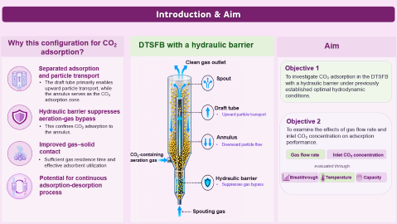
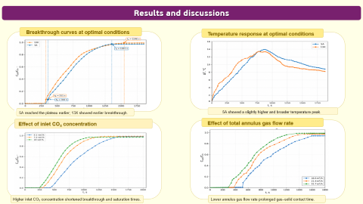
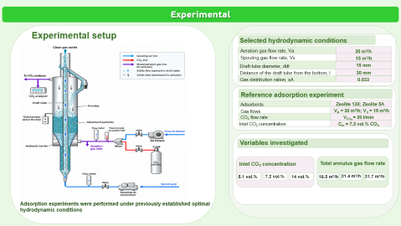
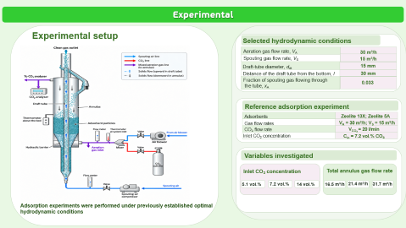

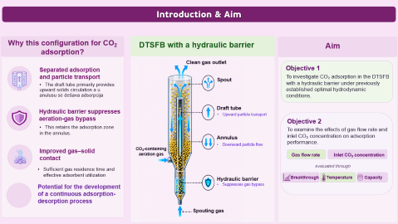
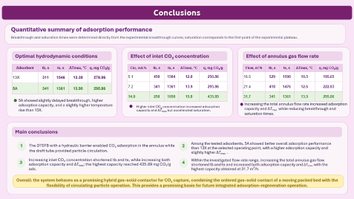
28th Congress of SCTM, 23-26 September, Ohrid, Macedonia
000
CO₂ adsorption in a draft-tube spout-fluid bed with a hydraulic barrier
Katarina Šućurović¹, Darko Jaćimovski¹, Danica Brzić², Mihal Đuriš¹, Zorana Arsenijević¹, Dunja Šijaković³, Tatjana Kaluđerović Radoičić², Nevenka Bošković Vragolović²
¹ Institute of Chemistry, Technology and Metallurgy - National Institute of the Republic of Serbia, University of Belgrade, Belgrade, Serbia , ² Faculty of Technology and Metallurgy, University of Belgrade, Belgrade, Serbia, ³ Innovation Center, Faculty of Technology and Metallurgy, University of Belgrade, Belgrade, Serbia

Slide 2
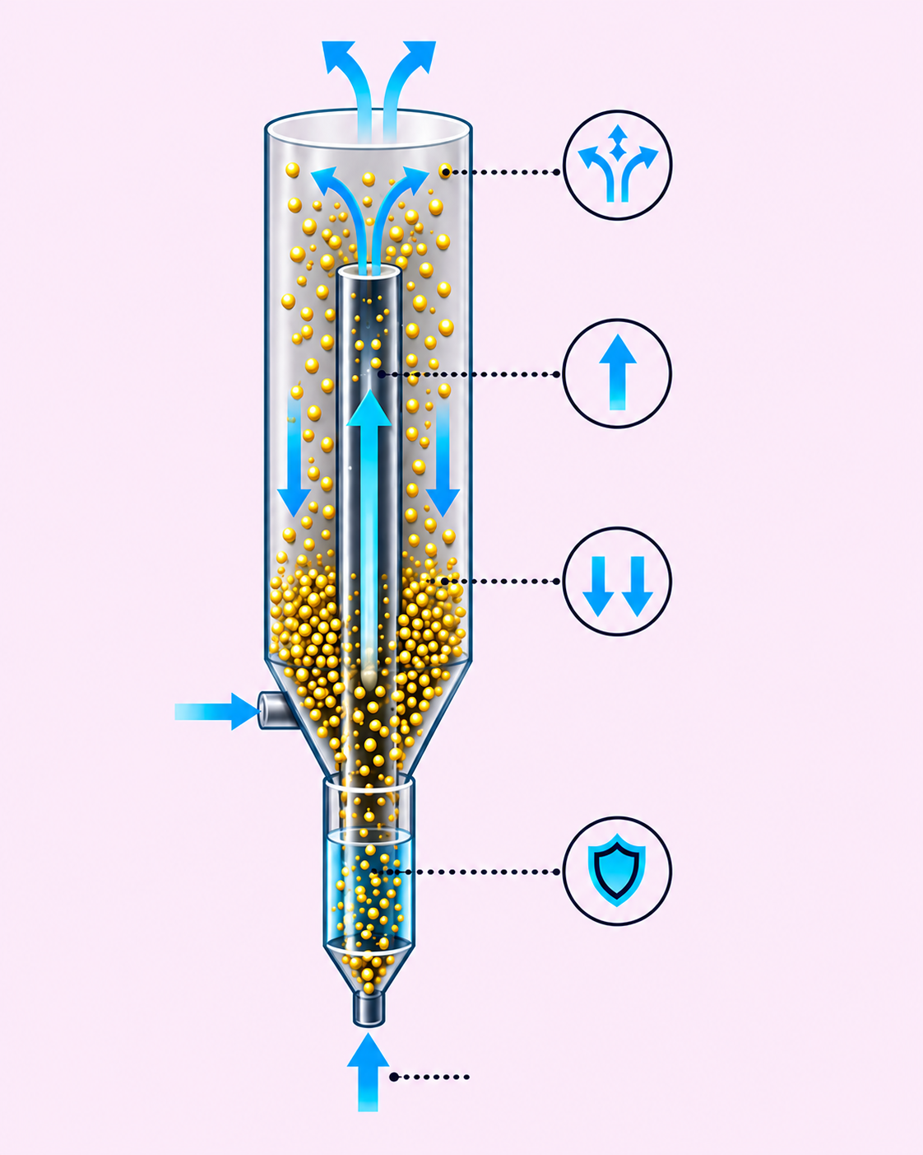
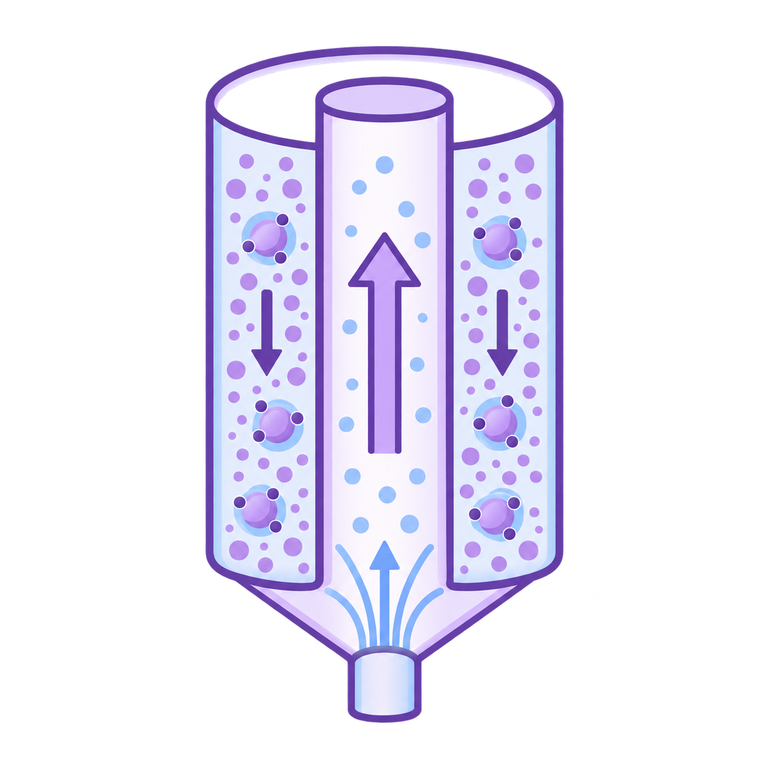


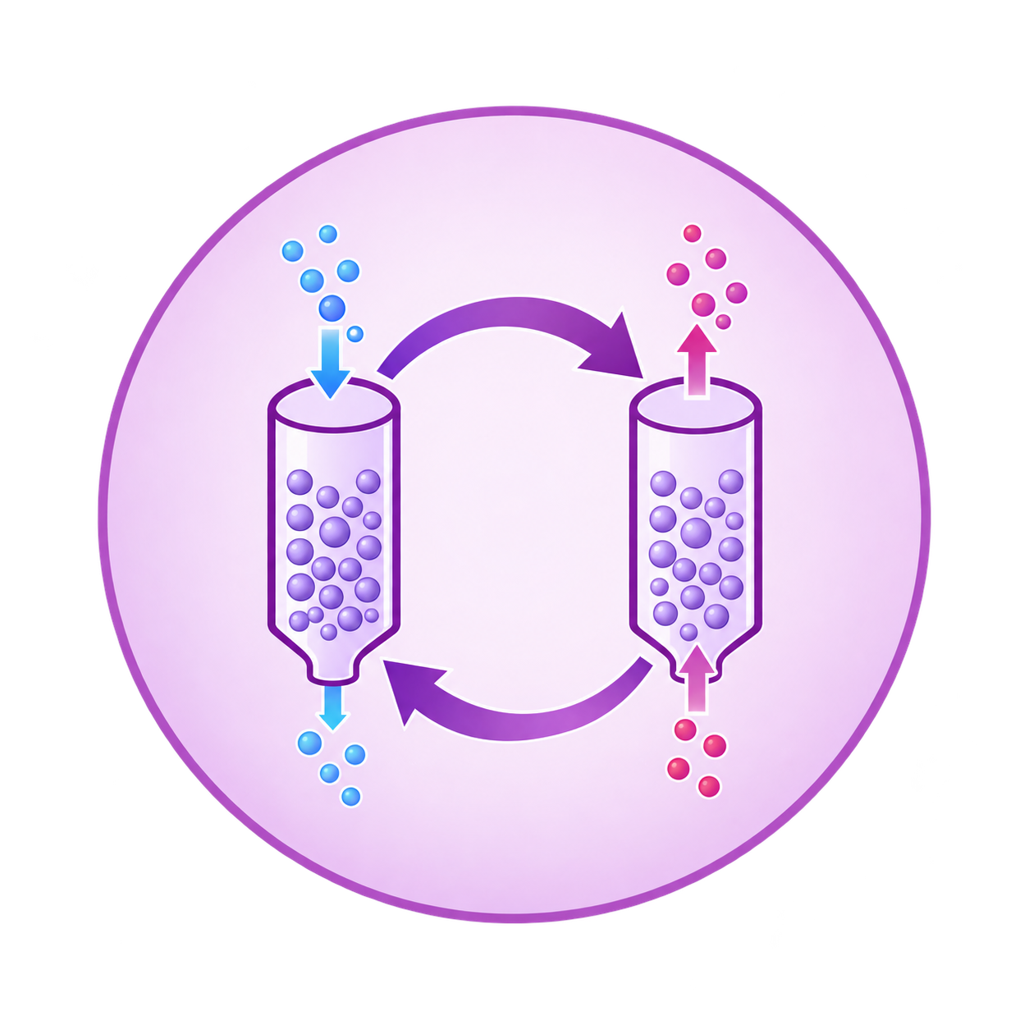



Introduction & Aim
Why this configuration for CO₂ adsorption?
DTSFB with a hydraulic barrier
Aim
Clean gas outlet
Objective 1
Separated adsorption
and particle transport
Spout
To investigate CO₂ adsorption in the DTSFB with a hydraulic barrier under previously established optimal hydrodynamic conditions.
Spout
The draft tube primarily enables upward particle transport, while the annulus serves as the CO₂ adsorption zone.
Draft tube
Hydraulic barrier suppresses
aeration-gas bypass
Draft tube
Upward particle transport
Objective 2
This confines CO₂ adsorption to the annulus.
To examine the effects of gas flow rate and inlet CO₂ concentration on adsorption performance.
Annulus
Annulus
Improved gas–solid contact
CO₂-containing
aeration gas
Downward particle flow
Sufficient gas residence time and effective adsorbent utilization
CO₂-containing
aeration gas
Gas flow rate
Inlet CO₂ concentration
evaluated through
Hydraulic barrier
Breakthrough
Temperature
Capacity
Potential for continuous adsorption-desorption process
Hydraulic barrier
Suppresses gas bypass
Spouting gas
Spouting gas

Slide 3
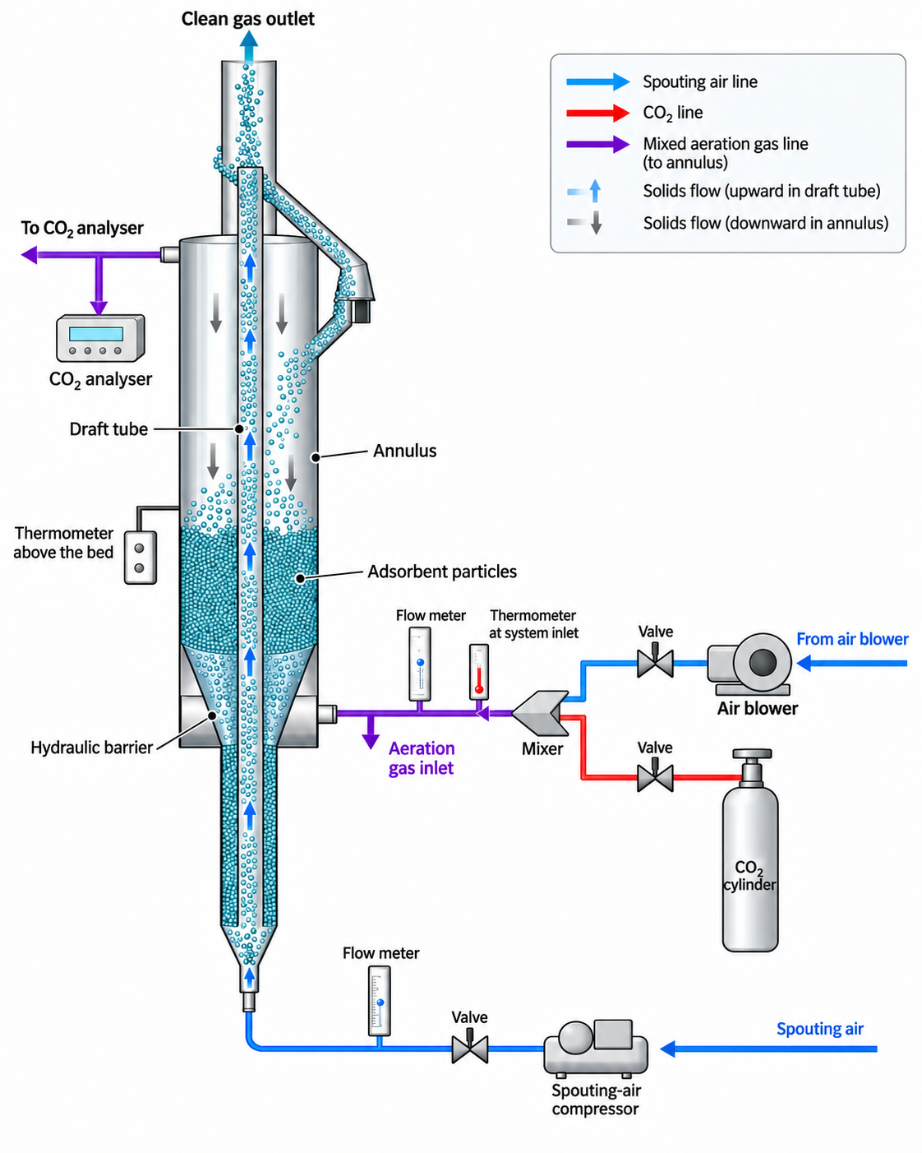
Experimental
Experimental setup
Selected hydrodynamic conditions
Aeration gas flow rate, V_{A}
30 m³/h
Spouting gas flow rate, V_{S}
15 m³/h
Draft-tube diameter, d_{dt}
15 mm
Distance of the draft tube from the bottom, l
30 mm
Fraction of spouting gas flowing through
the tube, x_{A}
0.033
Reference adsorption experiment
Adsorbents
Zeolite 13X; Zeolite 5A
Gas flow rates
V_{A} = 30 m³/h; V_{S} = 15 m³/h
CO₂ flow rate
V_{CO₂} = 20 l/min
Inlet CO₂ concentration
C_{in} = 7.2 vol.% CO₂
Variables investigated
Inlet CO₂ concentration
Total annulus gas flow rate
5.1 vol.%
7.2 vol.%
14 vol.%
16.5 m³/h
21.4 m³/h
31.7 m³/h
Adsorption experiments were performed under previously established optimal hydrodynamic conditions

Slide 4
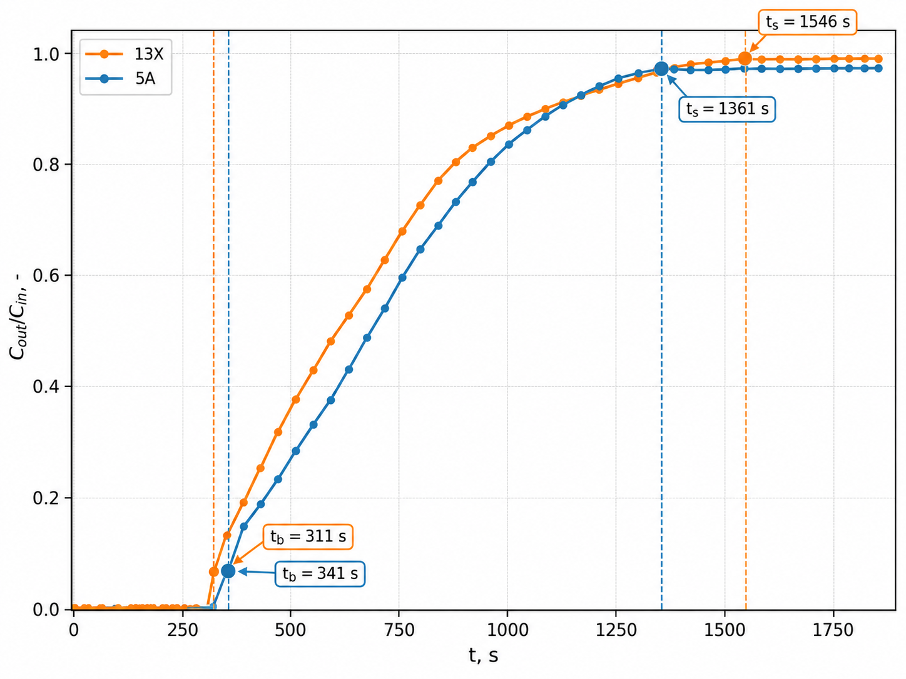
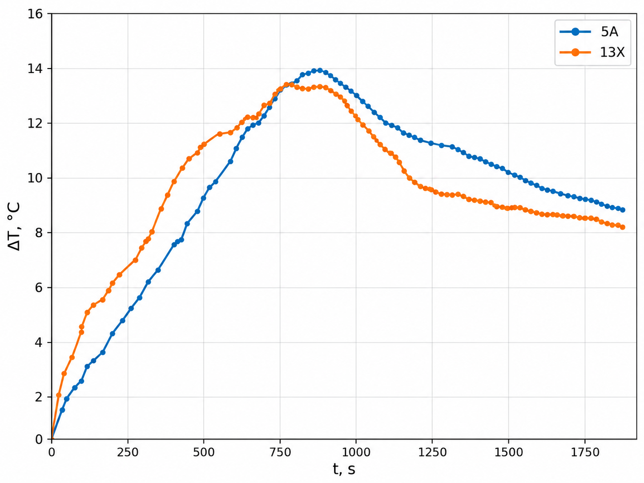
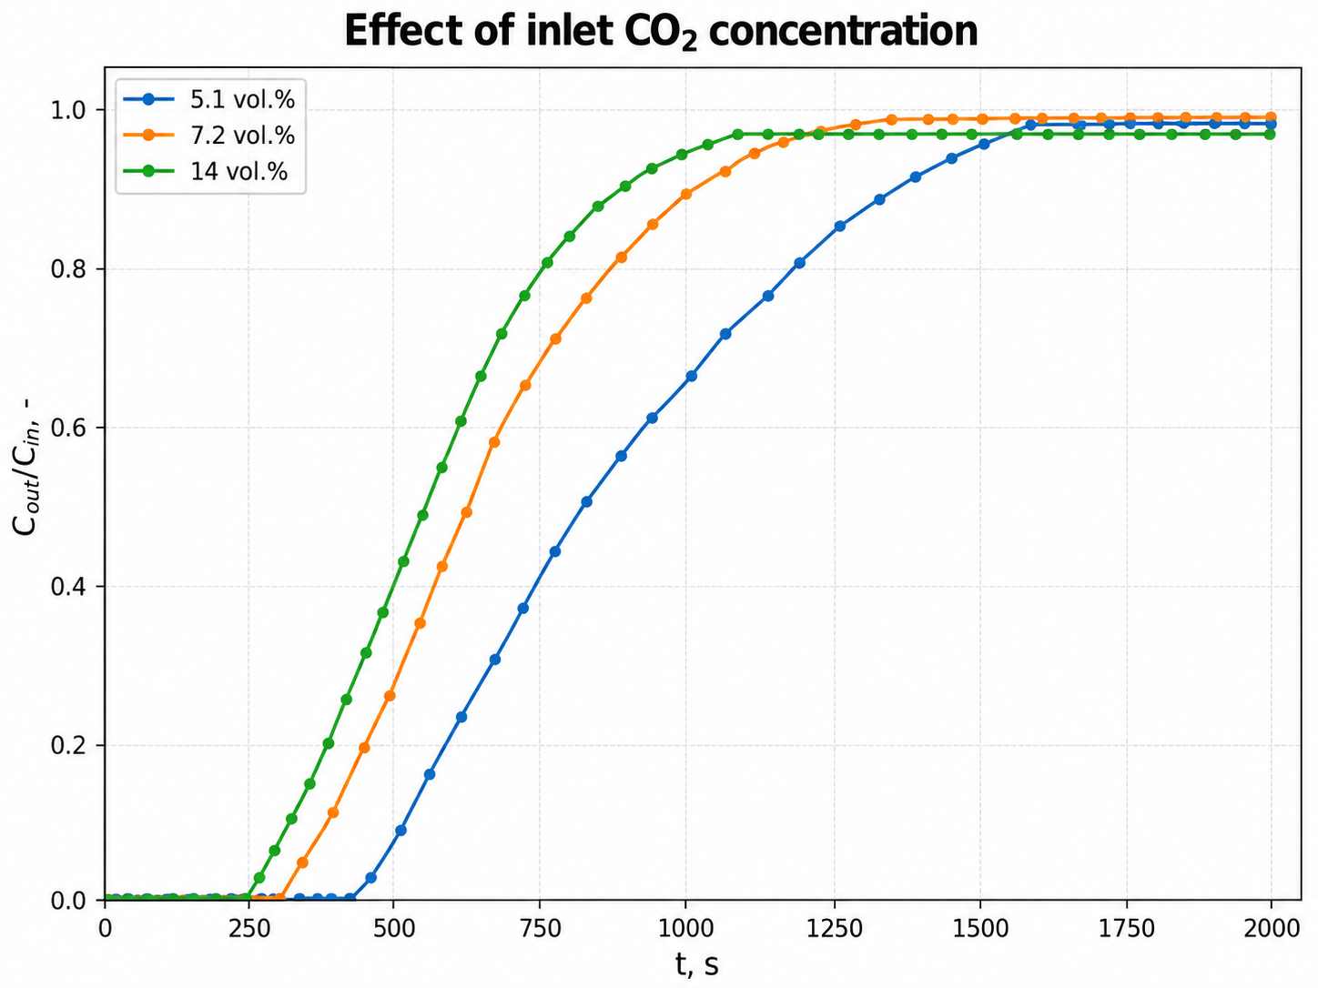
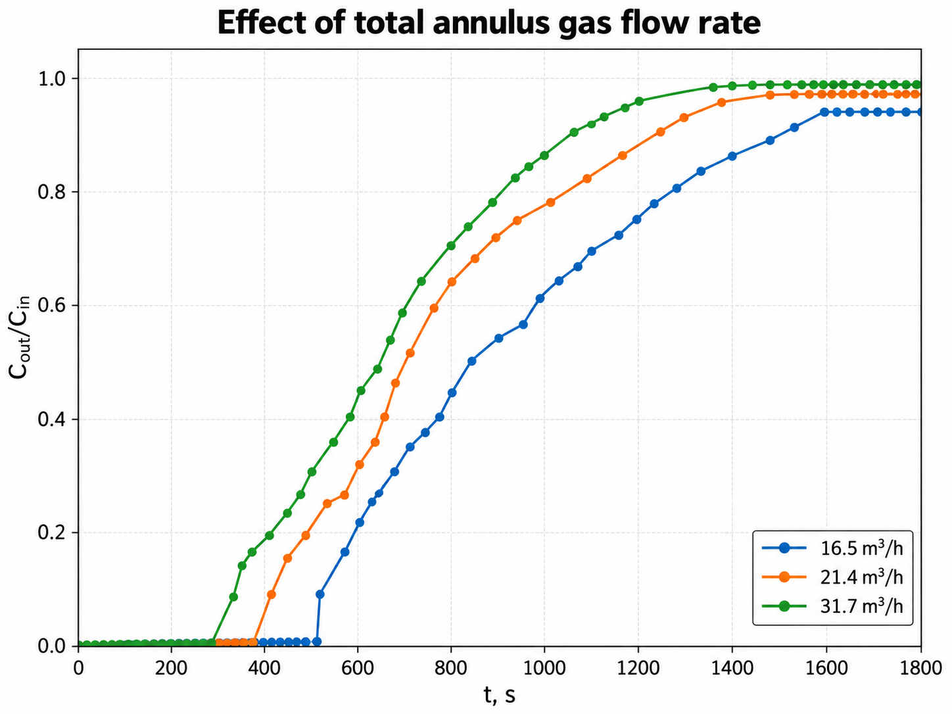
Results and discussions
Breakthrough curves at optimal conditions
Temperature response at optimal conditions
ccv
ccv
5A reached the plateau earlier; 13X showed earlier breakthrough.
5A showed a slightly higher and broader temperature peak.
Effect of inlet CO₂ concentration
Effect of total annulus gas flow rate
ccv
ccv
Higher inlet CO₂ concentration shortened breakthrough and saturation times.
Lower annulus gas flow rate prolonged gas–solid contact time.

Slide 5
Conclusions
Quantitative summary of adsorption performance
Breakthrough and saturation times were determined directly from the experimental breakthrough curves; saturation corresponds to the first point of the experimental plateau.
Optimal hydrodynamic conditions
Effect of inlet CO₂ concentration
Effect of annulus gas flow rate
Adsorbent
tb, s
ts, s
ΔTmax, °C
q, mg CO₂/g
Cin, vol.%
tb, s
ts, s
ΔTmax, °C
q, mg CO₂/g
Flow, m³/h
tb, s
ts, s
ΔTmax, °C
q, mg CO₂/g
13X
311
1546
13.39
278.06
5.1
450
1584
12.0
250.86
16.5
529
1590
10.5
195.65
5A
341
1361
13.90
295.86
7.2
341
1361
13.9
295.86
21.4
418
1476
12.6
222.83
14.0
250
1090
15.8
435.89
31.7
341
1361
13.9
295.86
5A showed slightly delayed breakthrough, higher adsorption capacity, and a slightly higher temperature rise than 13X.
Higher inlet CO₂ concentration increased adsorption capacity and ∆T_{max} but accelerated saturation.
Increasing the total annulus flow rate increased adsorption capacity and ∆T_{max} while reducing breakthrough and saturation times.
Main conclusions
1
The DTSFB with a hydraulic barrier enabled CO₂ adsorption in the annulus while the draft tube provided particle circulation.
2
Among the tested adsorbents, 5A showed better overall adsorption performance than 13X at the selected operating point, with a higher adsorption capacity and slightly higher ∆T_{max} .
3
Increasing inlet CO₂ concentration shortened tb and ts, while increasing both adsorption capacity and ∆T_{max}; the highest capacity reached 435.89 mg CO₂/g ads.
4
Within the investigated flow-rate range, increasing the total annulus gas flow shortened tb and ts and increased both adsorption capacity and ∆T_{max}, with the highest capacity obtained at 31.7 m³/h.
Overall: the system behaves as a promising hybrid gas–solid contactor for CO₂ capture, combining the ordered gas–solid contact of a moving packed bed with the flexibility of circulating-particle operation. This provides a promising basis for future integrated adsorption–regeneration operation.

