Slide 1

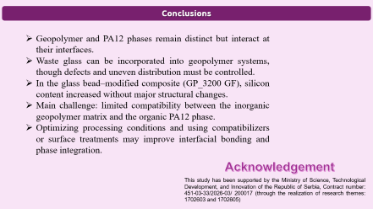
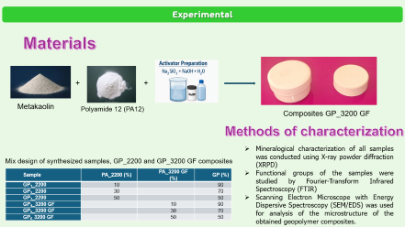

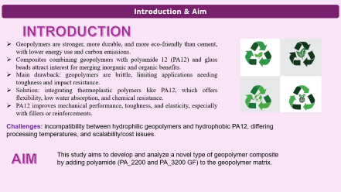
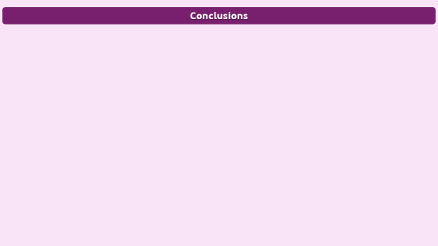
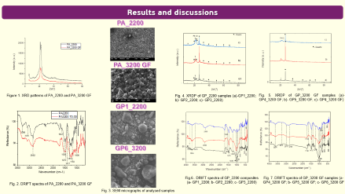

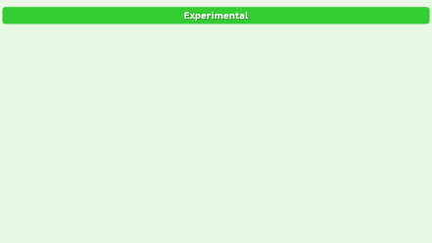
Structural and Morphological Evaluation of Geopolymer–PA12
Hybrid Composites
28th Congress of SCTM, 23-26 September, Ohrid, Macedonia
ICTM-P5
Ljiljana M. Kljajević¹, Olivera A. Erić Cekić², Miloš T. Nenadović¹, Nataša N. Mladenović Nikolić¹, Snežana S. Nenadović¹, Jelena J. Gulicovski^{1*}
¹ Vinča Institute of Nuclear Sciences, National Institute of the Republic of Serbia, University of Belgrade, Mike Petrović Alasa 12-14, Vinča, Belgrade, Serbia rocenj@vin.bg.ac.rs
²Innovation Center of Mechanical Engineering Faculty, University of Belgrade, 11000 Belgrade, Serbia

Slide 2

Introduction & Aim
INTRODUCTION
Geopolymers are stronger, more durable, and more eco-friendly than cement, with lower energy use and carbon emissions.
Composites combining geopolymers with polyamide 12 (PA12) and glass beads attract interest for merging inorganic and organic benefits.
Main drawback: geopolymers are brittle, limiting applications needing toughness and impact resistance.
Solution: integrating thermoplastic polymers like PA12, which offers flexibility, low water absorption, and chemical resistance.
PA12 improves mechanical performance, toughness, and elasticity, especially with fillers or reinforcements.
Challenges: incompatibility between hydrophilic geopolymers and hydrophobic PA12, differing processing temperatures, and scalability/cost issues.
This study aims to develop and analyze a novel type of geopolymer composite
by adding polyamide (PA_2200 and PA_3200 GF) to the geopolymer matrix.
AIM

Slide 3
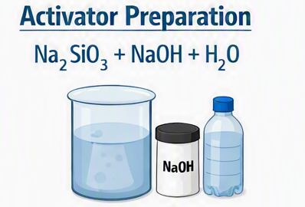
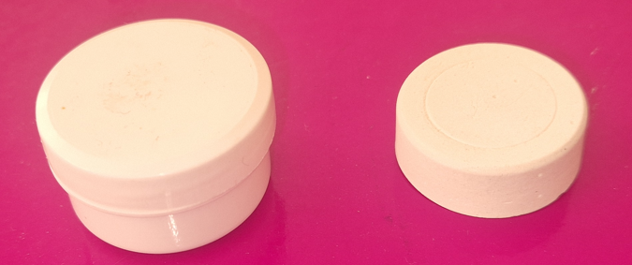
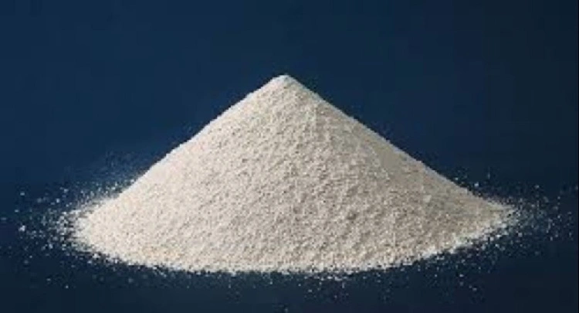
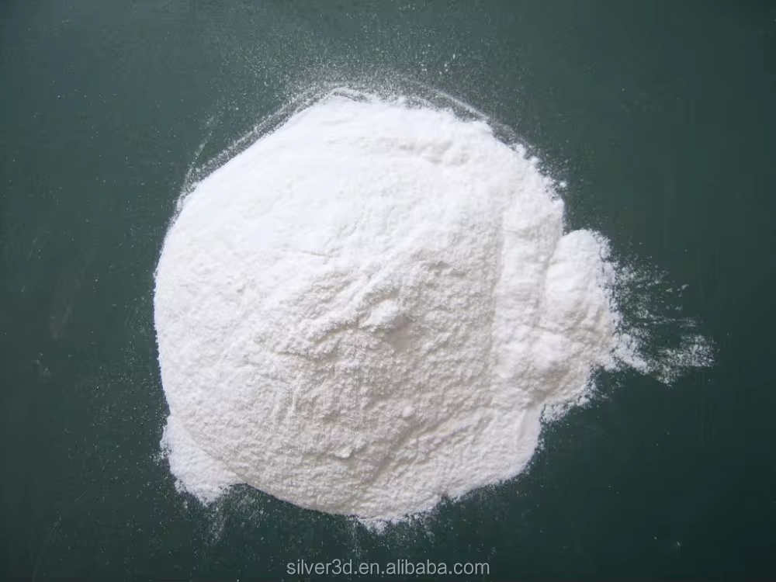
Experimental
Materials
+
+
Metakaolin
Polyamide 12 (PA12)
Composites GP_3200 GF
Methods of characterization
Mineralogical characterization of all samples was conducted using X-ray powder diffraction (XRPD)
Functional groups of the samples were studied by Fourier-Transform Infrared Spectroscopy (FTIR)
Scanning Electron Microscope with Energy Dispersive Spectroscopy (SEM/EDS) was used for analysis of the microstructure of the obtained geopolymer composites.
Mix design of synthesized samples, GP_2200 and GP_3200 GF composites
Sample | PA_2200 (%) | PA_3200 GF (%) | GP (%)
GP₁_2200 | 10 |  | 90
GP₂_2200 | 30 |  | 70
GP₃_2200 | 50 |  | 50
GP₄_3200 GF |  | 10 | 90
GP₅_3200 GF |  | 30 | 70
GP_{6_}3200 GF |  | 50 | 50

Slide 4
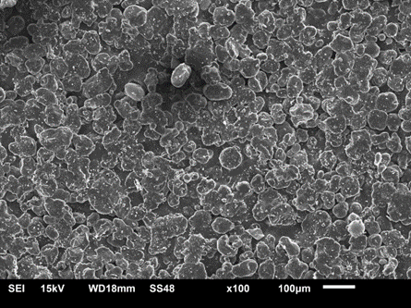
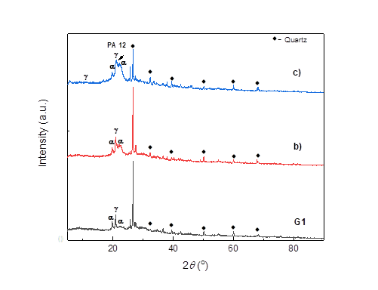
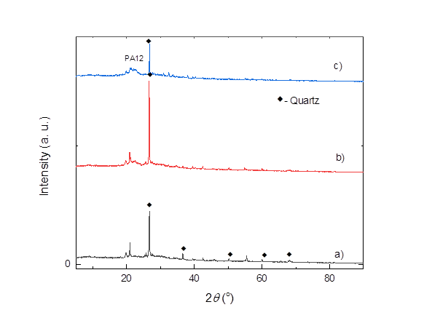
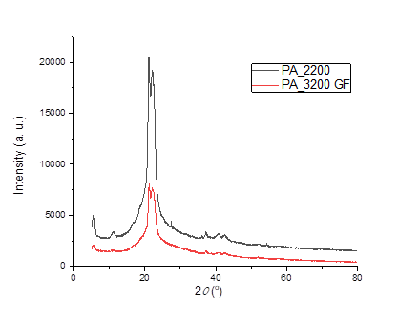
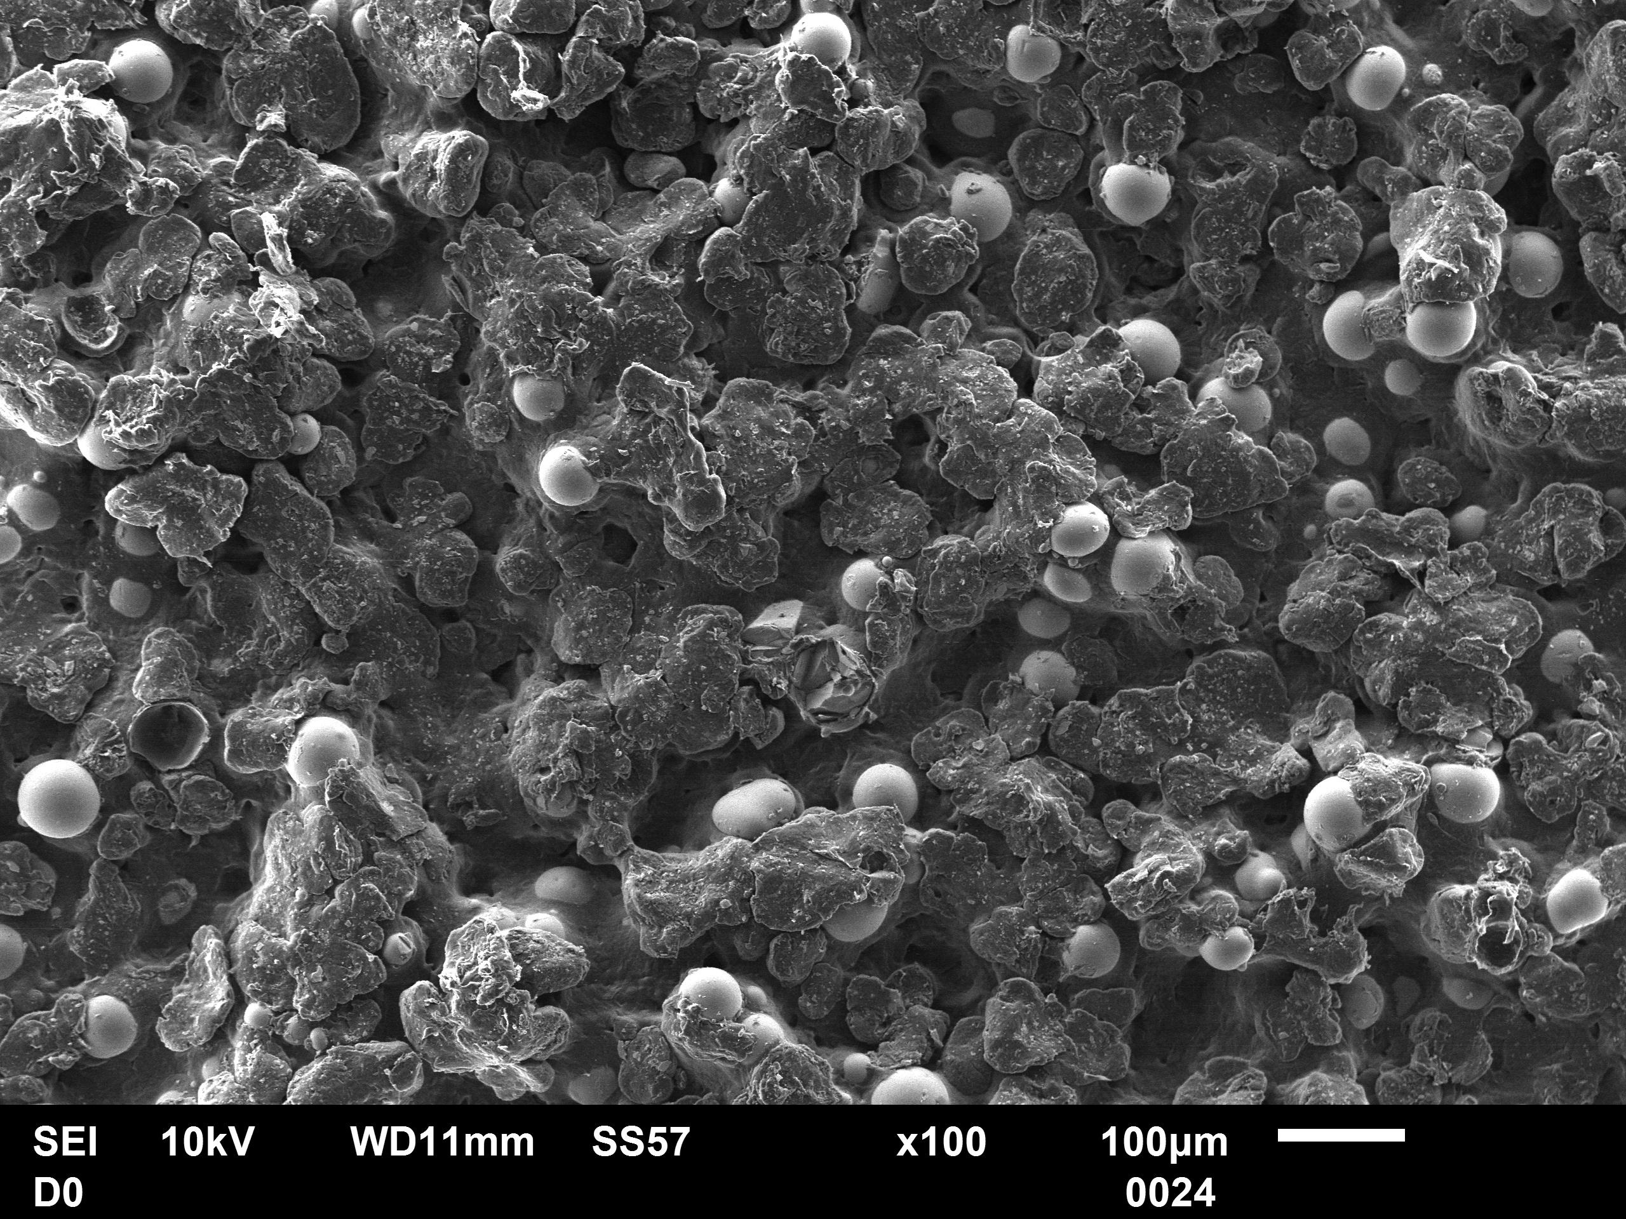
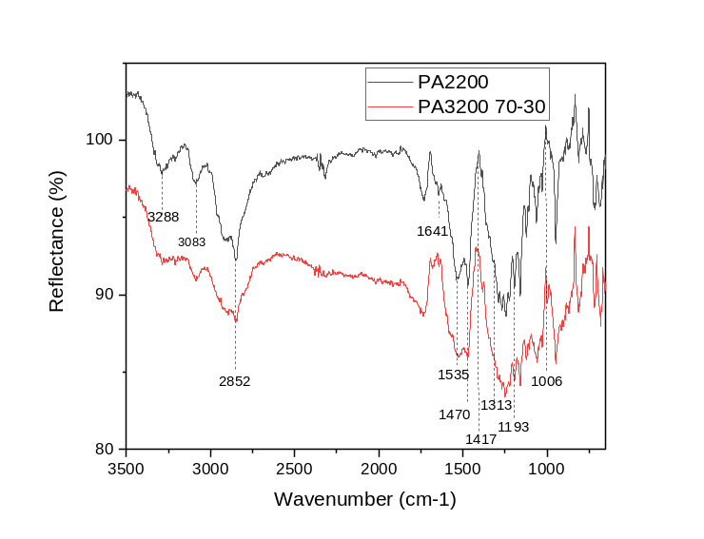
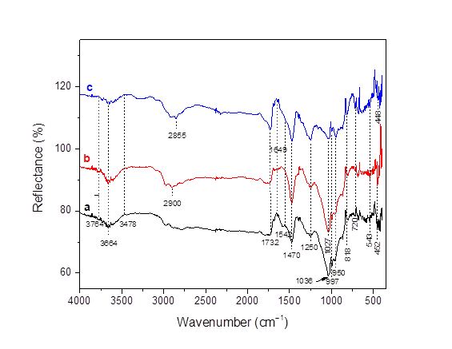
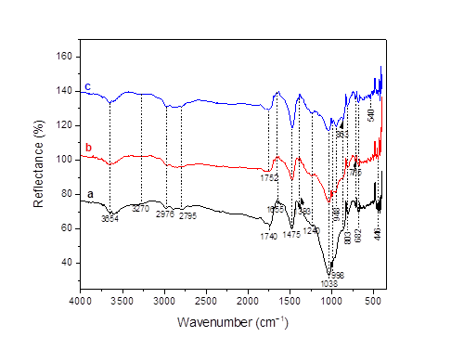
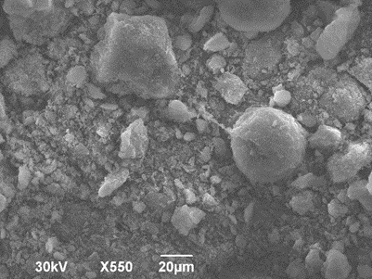
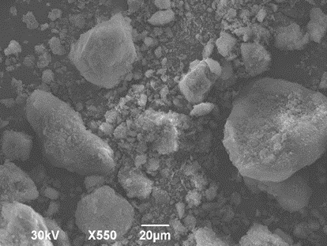
Results and discussions
PA_2200
PA_3200 GF
Figure 1. XRD patterns of PA_2200 and PA_3200 GF
Fig. 4. XRDP of GP_2200 samples (a)-GP1_2200; b)- GP2_2200; c)- GP3_2200)
Fig. 5. XRDP of GP_3200 GF samples (a)- GP4_3200 GF; b)- GP5_3200 GF; c)- GP4_3200 GF)
GP1_2200
GP6_3200
Fig.6.. DRIFT spectra of GP_2200 composites (a- GP1_2200; b- GP2_2200; c- GP3_2200)
Fig. 7. DRIFT spectra of GP_3200 GF samples (a- GP4_3200 GF; b- GP5_3200 GF; c- GP6_3200 GF
Fig. 2. DRIFT spectra of PA_2200 and PA_3200 GF
Fig. 3. SEM micrographs of analysed samples

Slide 5
Conclusions
Geopolymer and PA12 phases remain distinct but interact at their interfaces.
Waste glass can be incorporated into geopolymer systems, though defects and uneven distribution must be controlled.
In the glass bead–modified composite (GP_3200 GF), silicon content increased without major structural changes.
Main challenge: limited compatibility between the inorganic geopolymer matrix and the organic PA12 phase.
Optimizing processing conditions and using compatibilizers or surface treatments may improve interfacial bonding and phase integration.
Acknowledgement
This study has been supported by the Ministry of Science, Technological Development, and Innovation of the Republic of Serbia, Contract number: 451-03-33/2026-03/ 200017 (through the realization of research themes: 1702603 and 1702605)

