Slide 1

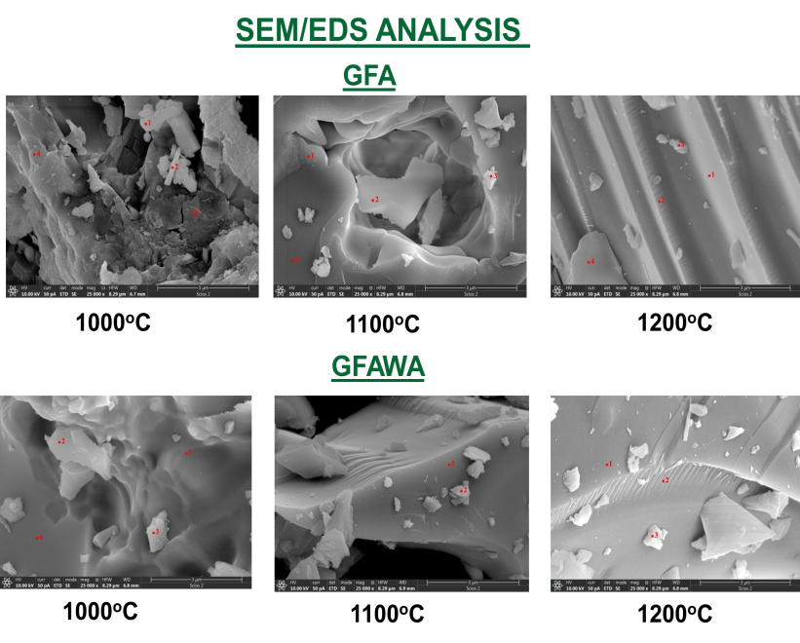

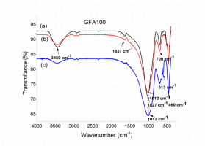
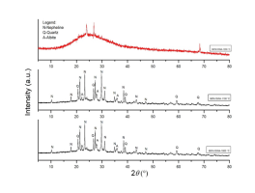
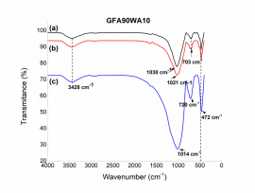
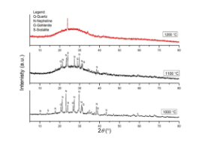
28th Congress of SCTM, 23-26 September, Ohrid, Macedonia
000
Effect of Wood Ash Addition on the High-Temperature Performance of Alkali-Activated Fly Ash Materials
Ljiljana Kljajević^{1,*}, Dušan Bučevac¹, Marija Ivanović¹, Nataša Mladenović Nikolić¹, Sanja Knežević¹, Miloš Nenadović¹, Miško Milanović², Snežana Nenadović¹
¹ Vinča Institute of Nuclear Sciences, National Institute of the Republic of Serbia, University of Belgrade, Belgrade, Serbia
² University of Belgrade, Faculty of Geography, Belgrade, Serbia
Introduction & Aim
Alkali activated nmeterials (AAMs) were synthesized from fly ash obtained from the Obrenovac Thermal Power Plant and from a 90:10 wt.% fly ash/oak wood ash mixture. NaOH and sodium silicate solutions, at a volumetric ratio of 1.6, were used as activators. After 28 days of curing, the samples were thermally treated at 1000–1200 °C for 1 h at a heating rate of 5 °C/min in air and then allowed to cool naturally. The samples were characterized using XRD, FTIR, and SEM/EDS analyses.
Experimental
Results and discussion
AAMs were synthesized by alkaline activation of fly ash obtained from the Obrenovac Thermal Power Plant (Serbia) (GFA) and a 90:10 wt.% mixture of fly ash and oak wood ash obtained from Barajevo (Serbia) (GFAWA). The alkaline activator was a mixture of a 6 M NaOH solution (99%, Analar Normapur) and sodium silicate (1.5 S.G., Fisher Chemical) at a volumetric ratio of 1.6.
After 28 days of curing, the AAMs were thermally treated at 1000, 1100, and 1200 °C at a heating rate of 5 °C/min in air, with a soaking time of 1 h at each target temperature, followed by spontaneous cooling to room temperature. The structure and properties of the samples were characterized using XRD, SEM/EDS, and FTIR.
Conclusions
Thermal treatment influences the structure and properties of the investigated AAMs, with relatively some changes depending on temperature and precursor composition.
Acknowledgement
This work was financially supported by the Ministry of Science, Technological Development and Innovation of the Republic of Serbia, through Contract No. 451-03-33/2026-03/200017, within the scope of the research topic No. 1702402 and No. 1002402.

Slide 2
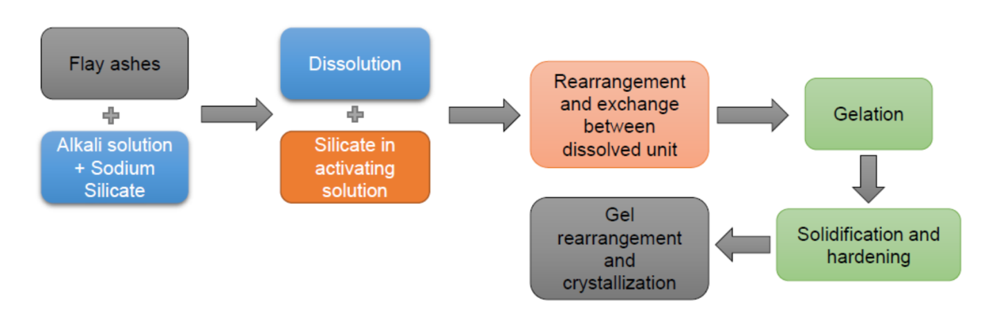
Introduction & Aim
Investigation of alkali-activated materials at temperatures exceeding 1000 °C is essential for assessing their thermal stability, phase evolution, and microstructural transformations, thereby providing valuable insights into their potential applications as high-performance binders and refractory materials under extreme thermal conditions.
The technology of process is gaining increasing commercial interest because, in certain cases, the properties of geopolymeric materials have been demonstrated to be superior to those of existing cementitious systems.
Figure 1. Schematic representation of the process
The aim of this research is to investigate the structural properties of thermally treated AAMs based on lignite fly ash (LFA) from the Kolubara Thermal Power Plant and wood fly ash (WFA), both obtained as combustion products.

Slide 3
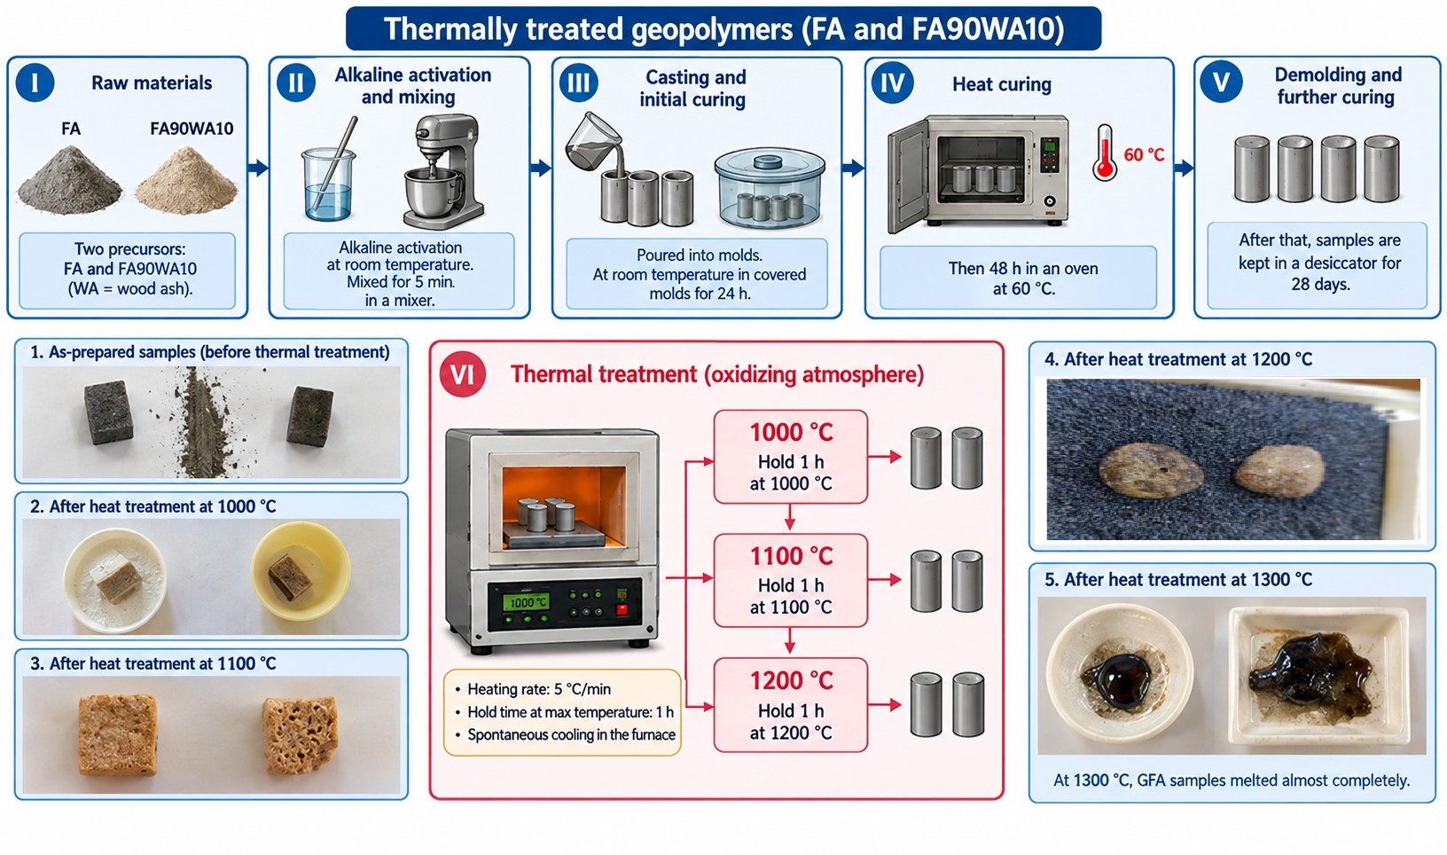
Experimental
AAMs were synthesized from fly ash obtained from the Obrenovac Thermal Power Plant and from a 90:10 wt.% fly ash/oak wood ash mixture. NaOH and sodium silicate solutions at a volumetric ratio of 1.6, were used as activators. After 28 days of curing, the samples were thermally treated at 1000–1200 °C for 1 h at a heating rate of 5 °C/min in air and then allowed to cool naturally. The samples were characterized using XRD, FTIR, and SEM/EDS analyses.

Slide 4


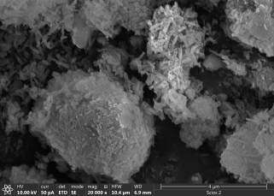
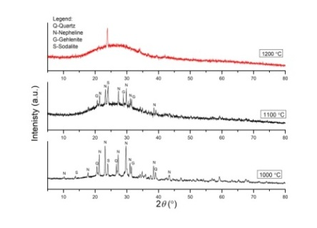
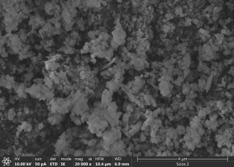

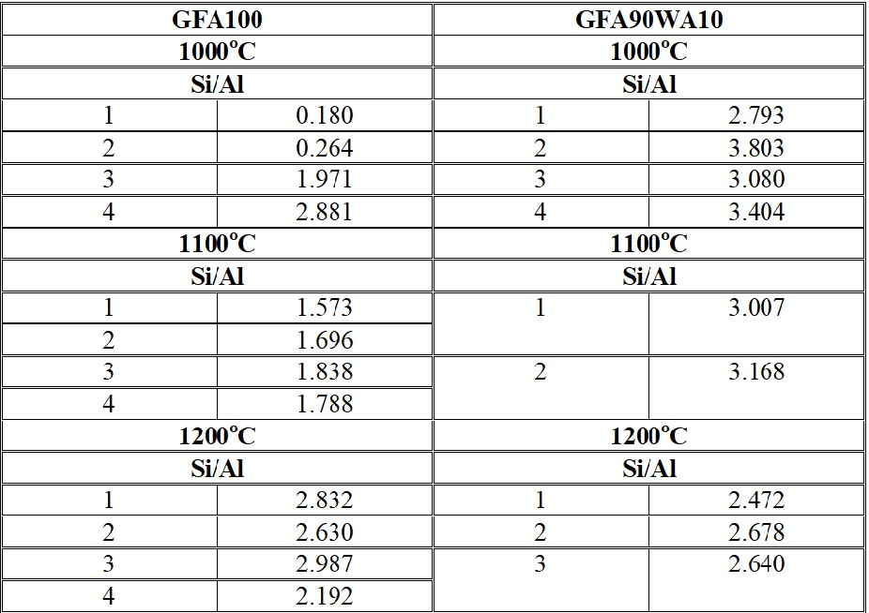
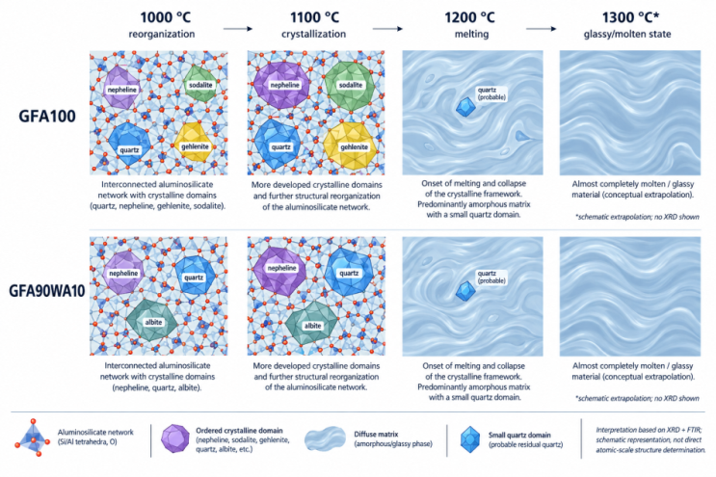
Results and discussions
Table 1. Si/Al ratios at the marked points in the SEM micrographs
FTIR and XRD analyses of GFA and GFAWA thermally treated at (a) 1000 °C, (b) 1100 °C, and (c) 1200 °C

Slide 5
Conclusions
Thermal treatment to high temperature (1200 °C) influences the structure and properties of the investigated AAMs, with relatively some changes depending on temperature and precursor composition.
XRD analysis confirmed the presence of nepheline and quartz in both AAMs compositions. At 1100 °C, the GFA sample exhibited a pronounced increase in the amorphous phase fraction. At 1200 °C, both AAMs were predominantly amorphous, indicating significant structural transformation during thermal treatment.
The FTIR spectra did not reveal significant differences between the two AAMs compositions with respect to the main vibrational band observed in the 1000–1040 cm⁻¹ region, which is attributed to asymmetric stretching vibrations of Si–O–T bonds (T = Si or Al). With increasing temperature, a gradual shift of this band toward lower wavenumbers was observed. This shift can be associated with progressive structural reorganization of the aluminosilicate network during thermal treatment.
Visual examination revealed that both AAMs maintained their dimensional stability after treatment at 1000 °C.
Acknowledgement
This work was financially supported by the Ministry of Science, Technological Development and Innovation of the Republic of Serbia, through Contract No. 451-03-33/2026-03/200017, within the scope of the research topic No. 1702602 and No. 1002602.
Thank you for your attention!
Corresponding author: Ljiljana Kljajević
ljiljana@vin.bg.ac.rs

