Slide 1

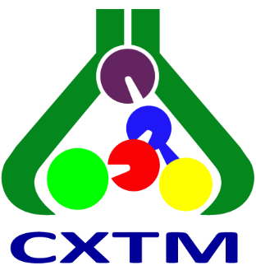


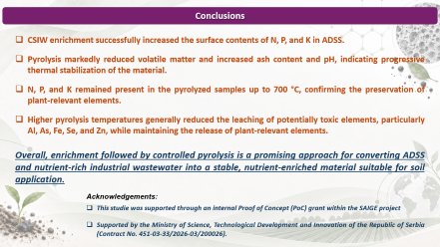
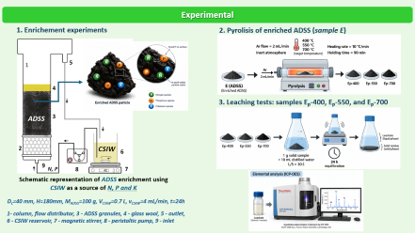
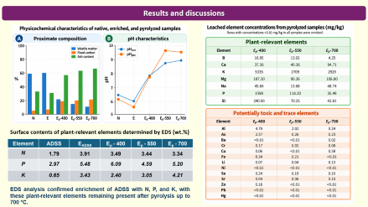
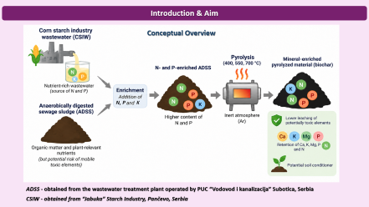
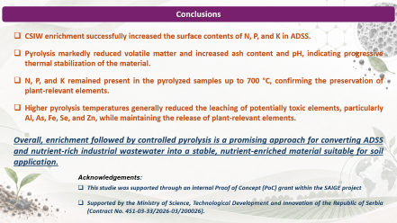



28th Congress of SCTM, 23-26 September, Ohrid, Macedonia
000
EFFECT OF PYROLYSIS TEMPERATURE ON THE LEACHING BEHAVIOR
OF ENRICHED DIGESTATE BIOCHAR
Mihal Đuriš¹, Katarina Šućurović¹, Darko Jaćimovski¹, Jovana Perendija¹, Dragana Milošević¹, Dunja Šijaković², Anja Antanasković³
¹ Institute of Chemistry, Technology and Metallurgy, Belgrade, Serbia; mihal.djuris@ihtm.bg.ac.rs, ² Innovation Centre, Faculty of Technology and Metallurgy, Belgrade, Serbia,
³ Institute for Technology of Nuclear and Other Mineral Raw Materials, Belgrade, Serbia

Slide 2
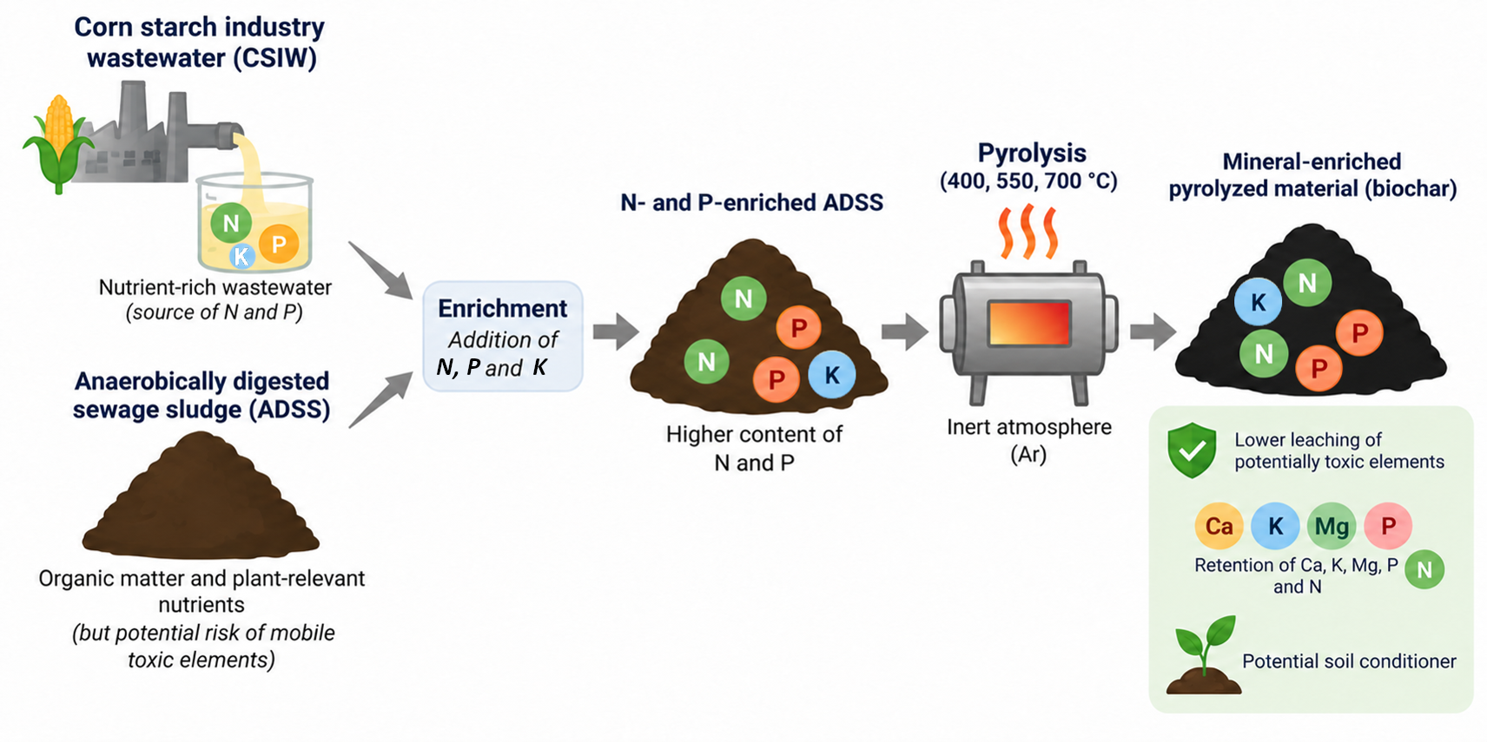
Introduction & Aim
Conceptual Overview
ADSS - obtained from the wastewater treatment plant operated by PUC “Vodovod i kanalizacija” Subotica, Serbia
CSIW - obtained from “Jabuka” Starch Industry, Pančevo, Serbia

Slide 3
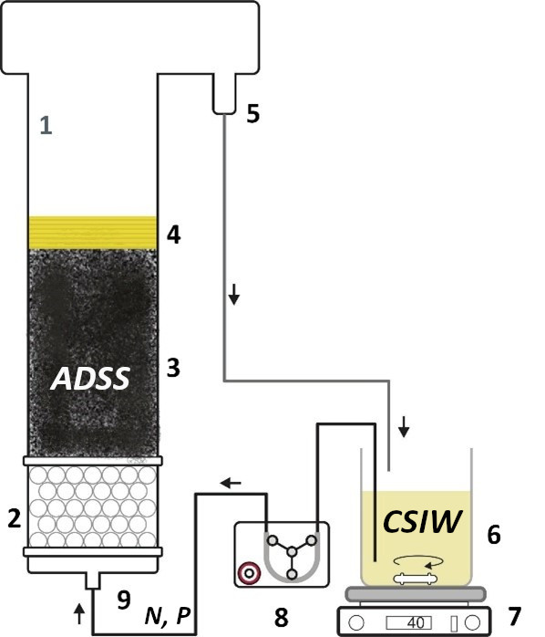
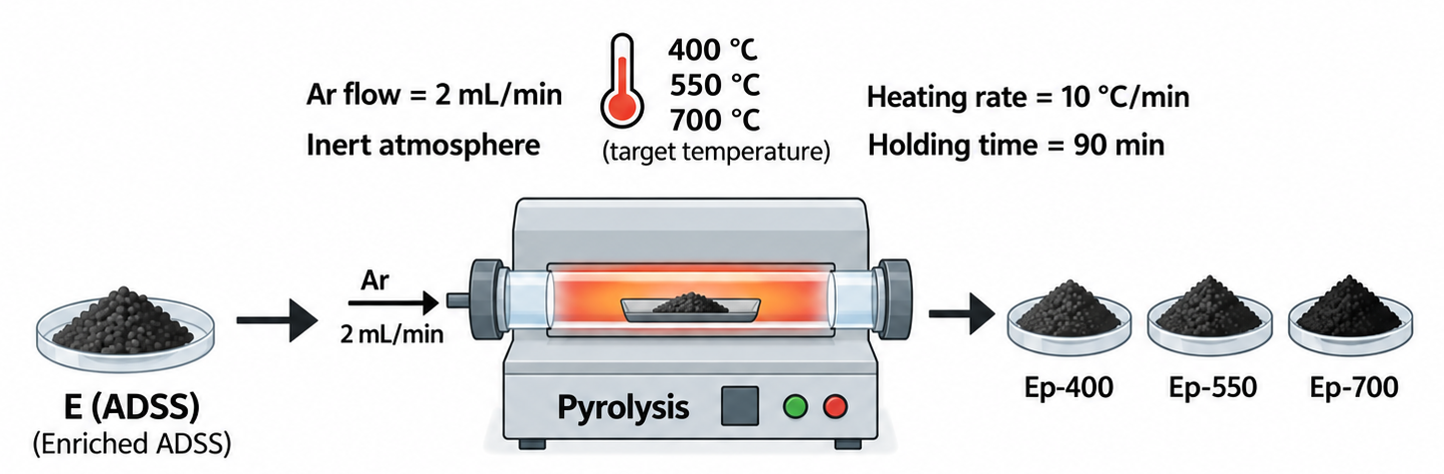
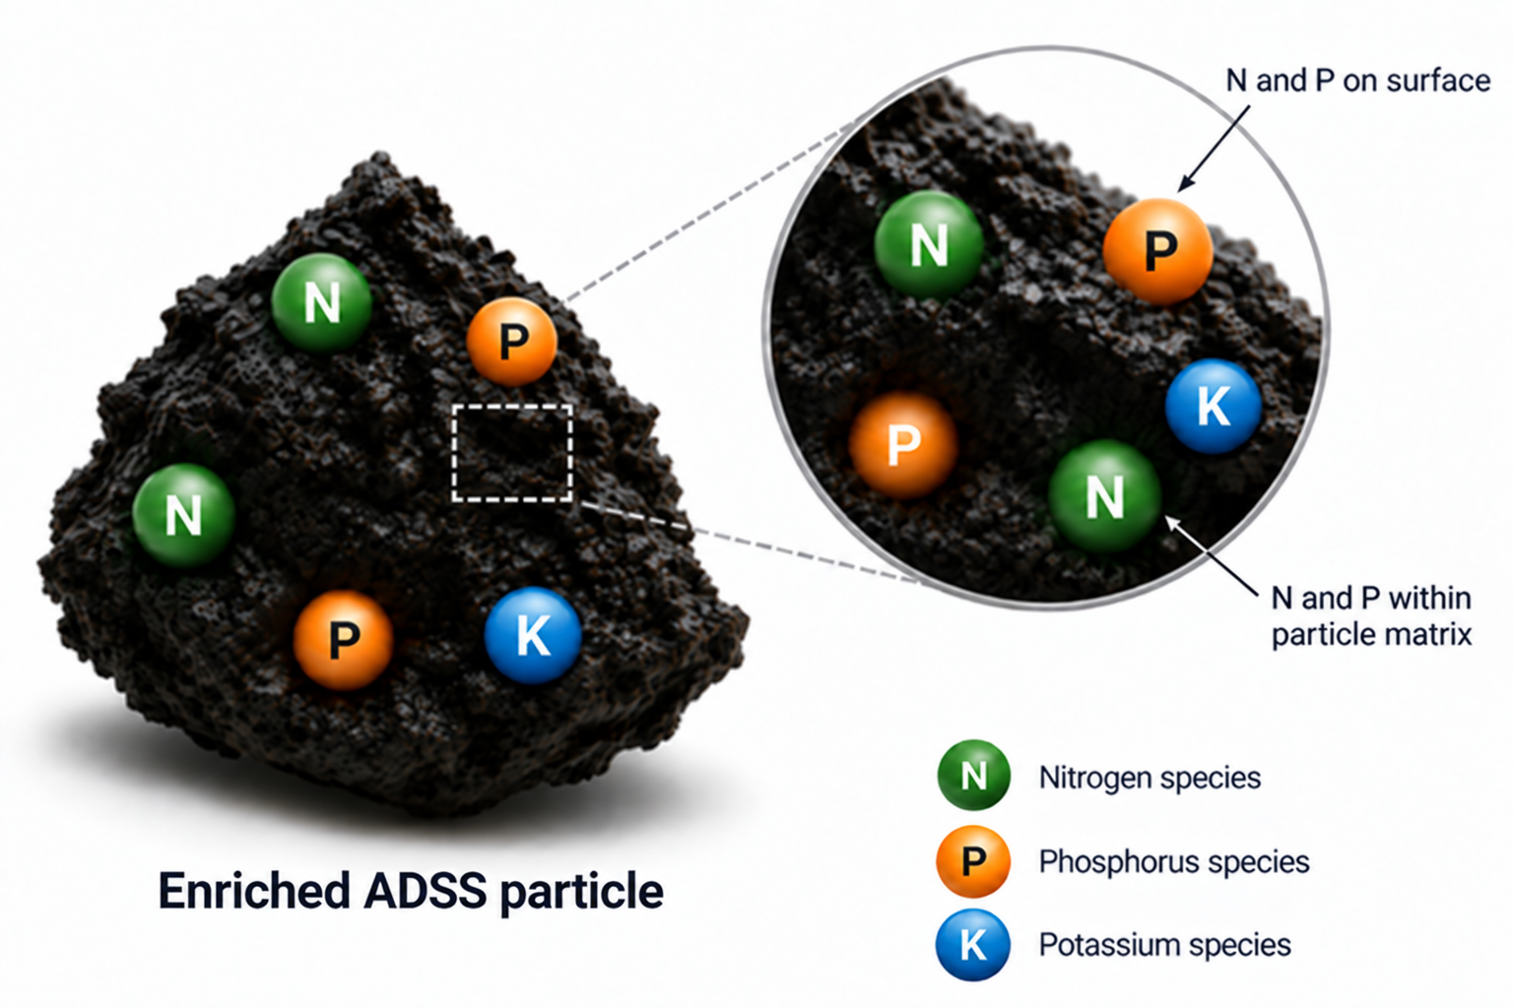
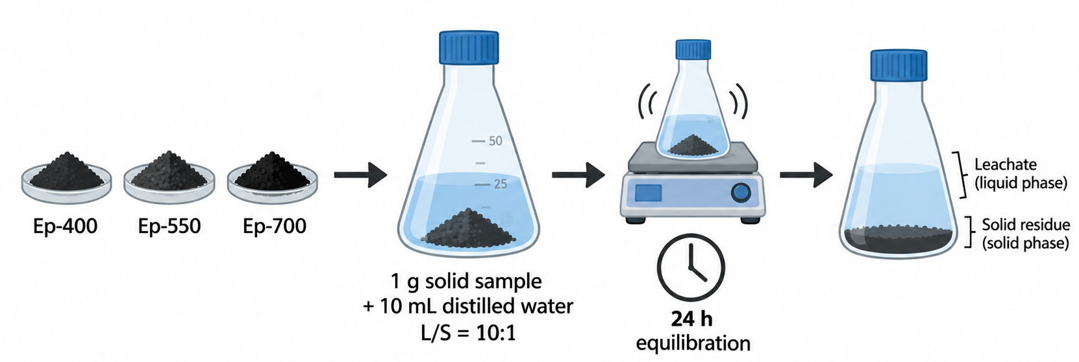
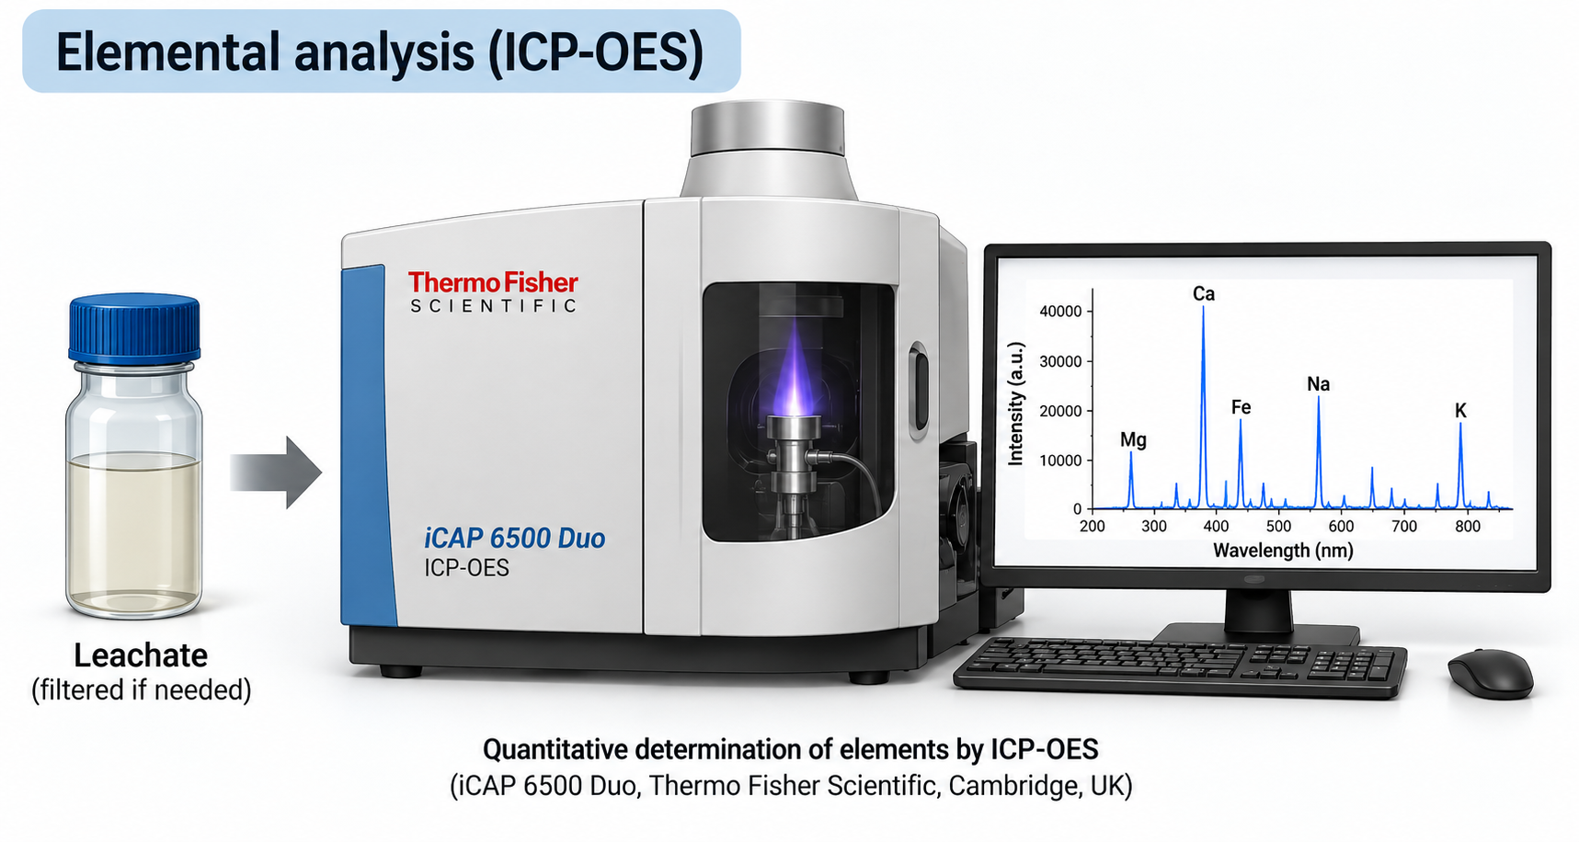
Experimental
1. Enrichement experiments
2. Pyrolisis of enriched ADSS (sample E)
3. Leaching tests: samples Eₚ-400, Eₚ-550, and Eₚ-700
Schematic representation of ADSS enrichment using CSIW as a source of N, P and K
D_{c}=40 mm, H=180mm, M_{ADSS}=100 g, V_{CSIW}=0.7 L, v_{CSIW}=4 mL/min, t=24h
1- column, flow distributor, 3 - ADSS granules, 4 - glass wool, 5 - outlet, 6 - CSIW reservoir, 7 - magnetic stirrer, 8 - peristaltic pump, 9 - inlet

Slide 4
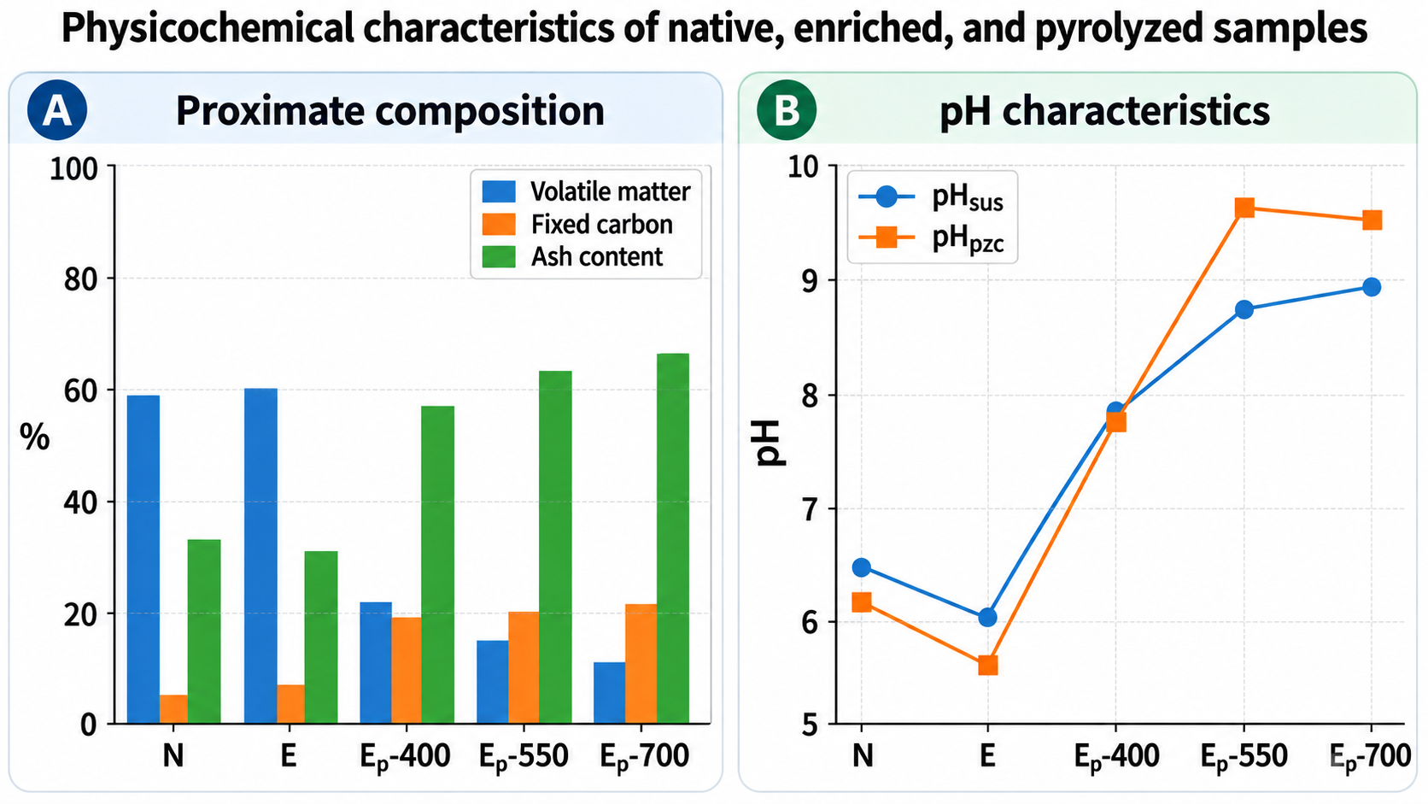
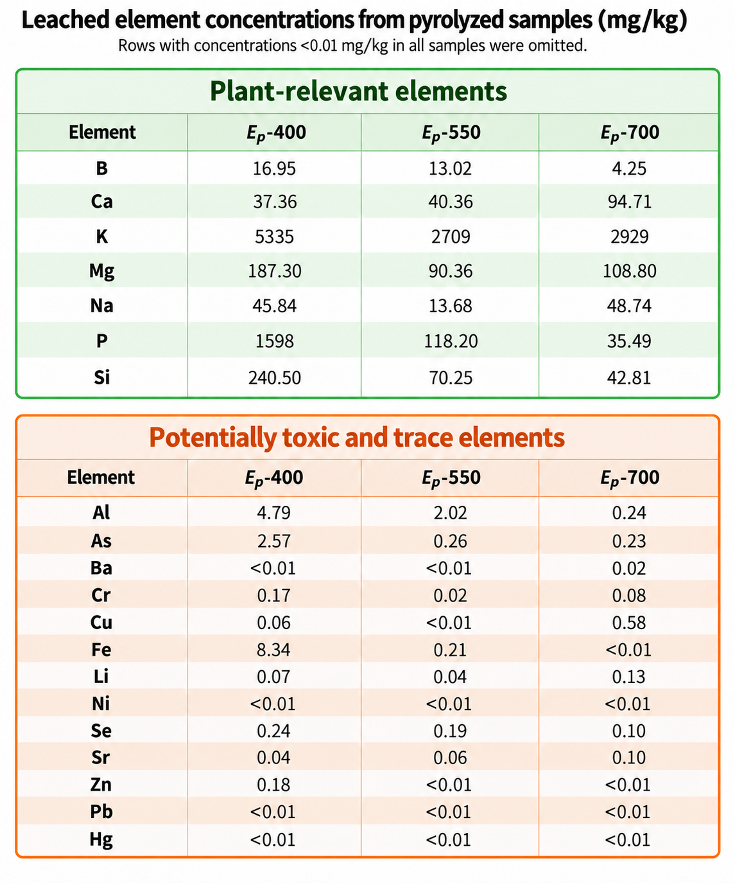
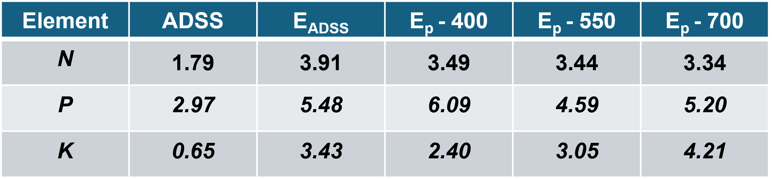
Results and discussions
Surface contents of plant-relevant elements determined by EDS (wt.%)
EDS analysis confirmed enrichment of ADSS with N, P, and K, with these plant-relevant elements remaining present after pyrolysis up to 700 °C.

Slide 5
Conclusions
CSIW enrichment successfully increased the surface contents of N, P, and K in ADSS.
Pyrolysis markedly reduced volatile matter and increased ash content and pH, indicating progressive thermal stabilization of the material.
N, P, and K remained present in the pyrolyzed samples up to 700 °C, confirming the preservation of plant-relevant elements.
Higher pyrolysis temperatures generally reduced the leaching of potentially toxic elements, particularly Al, As, Fe, Se, and Zn, while maintaining the release of plant-relevant elements.
Overall, enrichment followed by controlled pyrolysis is a promising approach for converting ADSS and nutrient-rich industrial wastewater into a stable, nutrient-enriched material suitable for soil application.
Acknowledgements:
This studie was supported through an internal Proof of Concept (PoC) grant within the SAIGE project
Supported by the Ministry of Science, Technological Development and Innovation of the Republic of Serbia (Contract No. 451-03-33/2026-03/200026).

