Slide 1

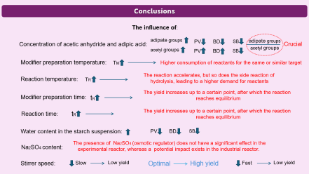
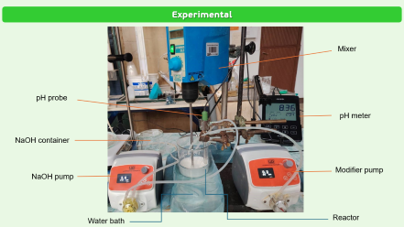


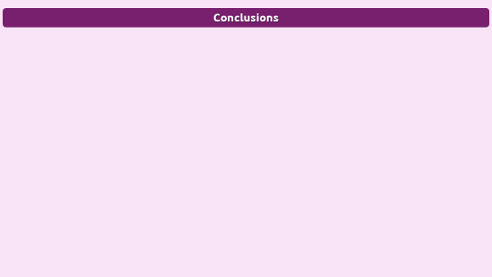
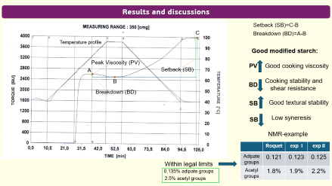
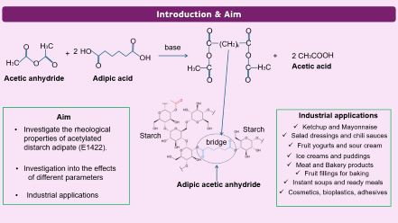
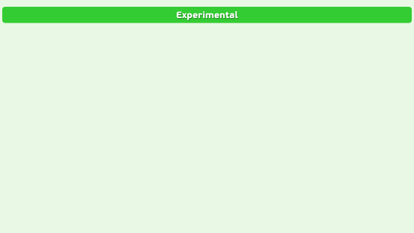
28th Congress of SCTM, 23-26 September, Ohrid, Macedonia
000
Influence of physical and chemical parameters on the rheological properties of modified acetylated distarch adipate
Darko Jaćimovski¹, Dunja Šijaković², Katarina Šućurović ¹ , Mihal Đuriš¹, Nevenka Bošković-Vragolović², Zorana Arsenijević¹
¹ Institute of Chemistry, Technology and Metallurgy - National Institute of the Republic of Serbia, University of Belgrade, Belgrade, Serbia
² Faculty of Technology and Metallurgy, University of Belgrade, Belgrade, Serbia

Slide 2
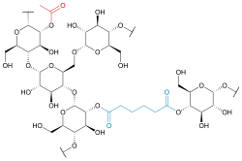
Introduction & Aim
O
O
O
C
(CH2)
C
O
H3C
base
4
+
2
HO
O
+
2 CH3COOH
OH
O
H3C
O
O
O
H3C
Acetic acid
H3C
C
C
Acetic anhydride
Adipic acid
O
O
Aim
Industrial applications
Investigate the rheological properties of acetylated distarch adipate (E1422).
Starch
Ketchup and Mayonnaise
Starch
Salad dressings and chili sauces
bridge
Fruit yogurts and sour cream
Ice creams and puddings
Investigation into the effects
of different parameters
Meat and Bakery products
Fruit fillings for baking
Adipic acetic anhydride
Instant soups and ready meals
Industrial applications
Cosmetics, bioplastics, adhesives

Slide 3
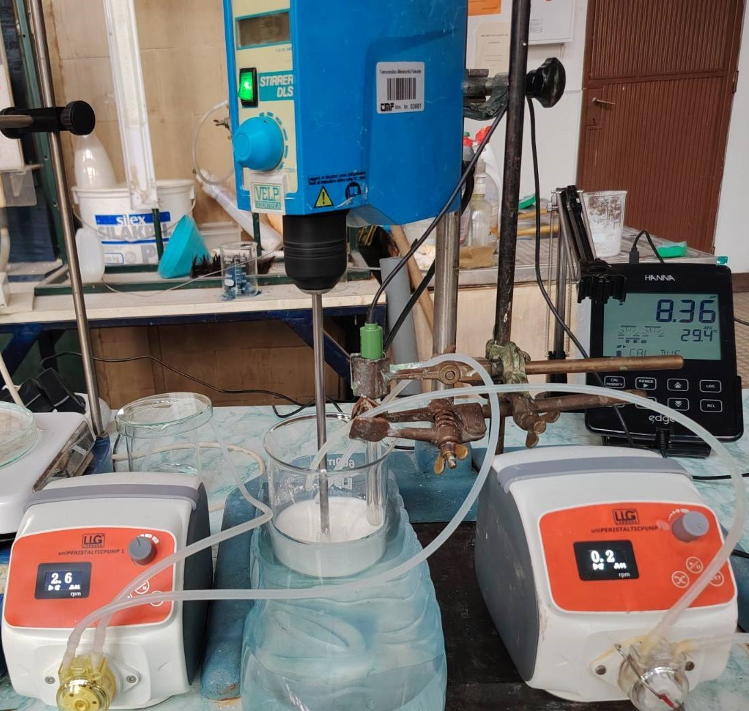
Experimental
Mixer
pH probe
pH meter
NaOH container
Modifier pump
NaOH pump
Water bath
Reactor

Slide 4
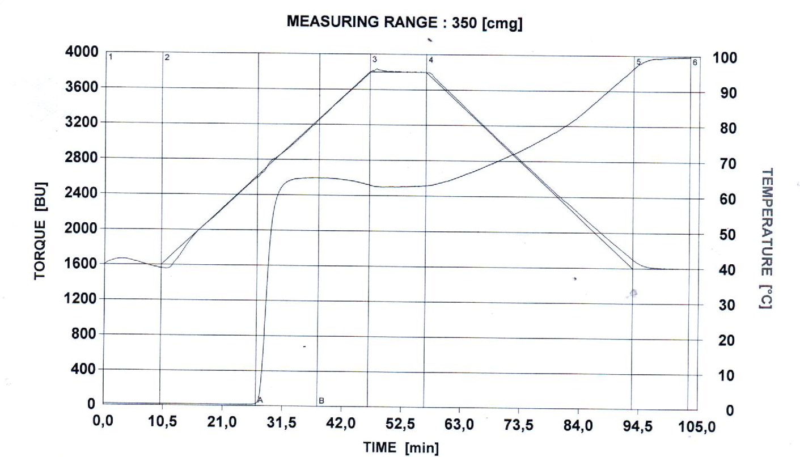
Results and discussions
Setback (SB)=C-B
C
Breakdown (BD)=A-B
Temperature profile
Good modified starch:
Peak Viscosity (PV)
PV
Good cooking viscosity
A
Setback (SB)
B
Cooking stability and
shear resistance
BD
Breakdown (BD)
SB
Good textural stability
SB
Low syneresis
NMR-example
 | Roquet | exp I | exp II
Adipate groups | 0.121 | 0.123 | 0.125
Acetyl groups | 1.8% | 1.9% | 2.2%
Within legal limits
0.135% adipate groups
2.5% acetyl groups

Slide 5
Conclusions
The influence of:
adipate groups
PV
BD
SB
adipate groups
Concentration of acetic anhydride and adipic acid:
Crucial
acetyl groups
PV
BD
acetyl groups
SB
Modifier preparation temperature:
TM
Higher consumption of reactants for the same or similar target
The reaction accelerates, but so does the side reaction of hydrolysis, leading to a higher demand for reactants
Reaction temperature:
TR
The yield increases up to a certain point, after which the reaction reaches equilibrium
Modifier preparation time:
tR
Reaction time:
tR
The yield increases up to a certain point, after which the reaction reaches equilibrium
Water content in the starch suspension:
PV
BD
SB
The presence of Na2SO4 (osmotic regulator) does not have a significant effect in the experimental reactor, whereas a potential impact exists in the industrial reactor.
Na2SO4 content:
Stirrer speed:
Slow
Low yield
Optimal
High yield
Fast
Low yield

