Slide 1



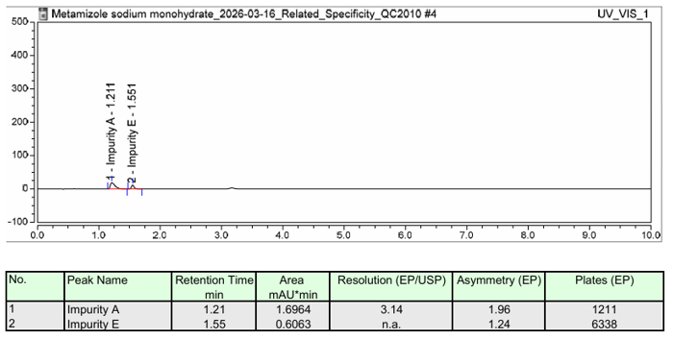
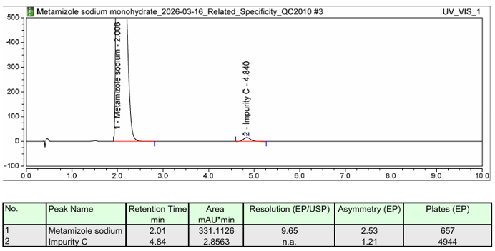
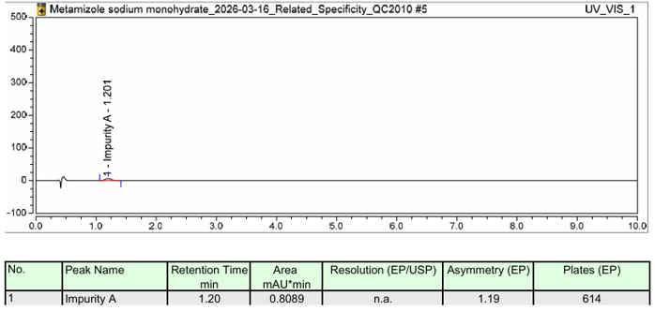
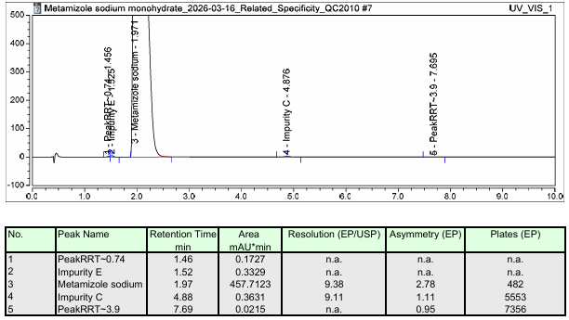
28th Congress of SCTM, 23-26 September, Ohrid, Macedonia
ANALYTICAL VERIFICATION OF A PHARMACOPOEIAL HPLC METHOD FOR RELATED SUBSTANCES IN METAMIZOLE SODIUM MONOHYDRATE
000
Sara Petreska¹, Anastasija Georgieva², Bisera Janeska Trajkovska², Hristina Tomovska², Mena Ivanoska Zdravkovska² and Gjorgji Petrusevski²
e-mail: spetreska@alkaloid.com.mk
^{1,2} Quality Control Pharmaceuticals, Alkaloid AD Skopje, Blvd. Aleksandar Makedonski 12, 1000 Skopje, Republic of Macedonia.
Introduction & Aim
Specificity
Metamizole sodium monohydrate is a widely used non-opioid analgesic and antipyretic. The control of related substances is a critical component of its quality assessment, ensuring the safety, efficacy, and consistency of the pharmaceutical product. High-performance liquid chromatography (HPLC) methods described in the European Pharmacopoeia (Ph.Eur) are routinely applied for impurity testing; however, their suitability must be verified before implementation in individual quality control laboratories. This study presents the verification of a pharmacopoeial HPLC method for determination of related substances in metamizole sodium monohydrate, focusing on key performance characteristics required for routine analytical use.
Peak Name | RT Theoretical (min) | RRT | RT Observed (min) | RRT
Impurity E | 1.6 | 0.8 | 1.52 | 0.77
Impurity C | 5.0 | 2.5 | 4.88 | 2.47
Metamizole sodium | 2.0 | 1.0 | 1.97 | 1.0
Procedure
No interference of the diluent peaks with the peak of Metamizole sodium monohydrate and its known impurities was observed, indicating the specificity of the method.
.
Method precision was evaluated by preparing and analyzing six independent sample solutions of metamizole sodium monohydrate according to the procedure described in the pharmacopoeial monograph. The precision of the method was assessed by calculating the relative standard deviation (RSD) of the obtained results. The acceptance criterion for method precision was an RSD not greater than 10%. The obtained results demonstrated satisfactory repeatability of the analytical procedure, with the calculated RSD remaining within the predefined acceptance limit.
System precision was verified by six consecutive injections of the reference solution. The system was considered suitable if the RSD of the peak areas did not exceed 5%, indicating adequate performance and stability of the chromatographic system throughout the analysis.
Specificity was assessed to confirm the ability of the method to unequivocally determine metamizole sodium in the presence of its known and potential related substances. Blank solution, reference solution, and sample solution chromatograms were examined and compared. Chromatograms were evaluated for potential interference at the retention time of the main analyte peak. Additionally, the chromatographic resolution between metamizole sodium and neighboring impurity peaks was reviewed to ensure adequate separation. The results demonstrated that the principal peak was well resolved from all detected impurities and that no interfering peaks were observed at the retention time of the active substance.
The limit of quantification was verified according to the reporting threshold specified in the Ph. Eur monograph. A solution containing impurities at the reporting threshold concentration was prepared and analyzed under the established chromatographic conditions. The LOQ was considered acceptable when the signal-to-noise ratio was approximately 10:1 and the precision at this concentration level met the acceptance criterion of RSD not greater than 10%. The obtained results fulfilled both requirements, demonstrating that the method was capable of reliably detecting and quantifying impurities at concentrations relevant to the pharmacopoeial specification.
Limit of quantification
Instrument: Thermo Ultimate Dionex
Signal/Noise Ratio | Set limits | Observed value
Impurity A | ~10 | 10.1
Impurity A
Injection Number | Area
1 | 0.0673
2 | 0.0696
3 | 0.0670
4 | 0.0728
5 | 0.0718
6 | 0.0720
Concentration (mg/mL) | 0.0045
Signal/Noise Ratio | 10.1
RSD (%) | 3.6
Figure 1 Chromatogram of Reference solution b
Figure 2 Chromatogram of Reference solution c
Results & discussion
Precision
 | Metamizole sodium monohydrate (Area)
1 | 0.7982
2 | 0.8283
3 | 0.8016
4 | 0.7909
5 | 0.8009
6 | 0.8049
RSD (%) | 1.6 %
 | Impurity E (Amount)
1 | 0.057
2 | 0.056
3 | 0.057
4 | 0.057
5 | 0.064
6 | 0.065
Average | 0.059
RSD (%) | 7.0 %
From the above data, it can be concluded that the impurities can be qualified to an acceptable degree of precision at the above-mentioned levels. Also, the limit of quantification is lower than the value for BDL.
Resolution | Set limits | Observed value
Between Metamizole Impurity A and Metamizole | NLT 1 | 3.32
RSD (%) | Set limits | Observed value
Impurity A | NMT 5 % | 1.58 %
Figure 3 Chromatogram of Reference solution d
Figure 4 Chromatogram of Sample
Conclusion
Table 1 System suitability – Resolution
Table 2 System suitability – RSD
The verification study confirm that the Ph. Eur. HPLC method for determination of related substances in Metamizole sodium monohydrate meets the predefined criteria for precision, specificity, and limit of quantification. The method was confirmed as suitable for routine quality control, supporting reliable impurity profiling and compliance with pharmacopoeial and regulatory requirements.
The amount of Impurity C is below threshold therefore the results are not reported.
The amount of Impurity E is above threshold and the results indicate that the method is precise.
Table 4 Method precision
Table 3 System precision

