Slide 1



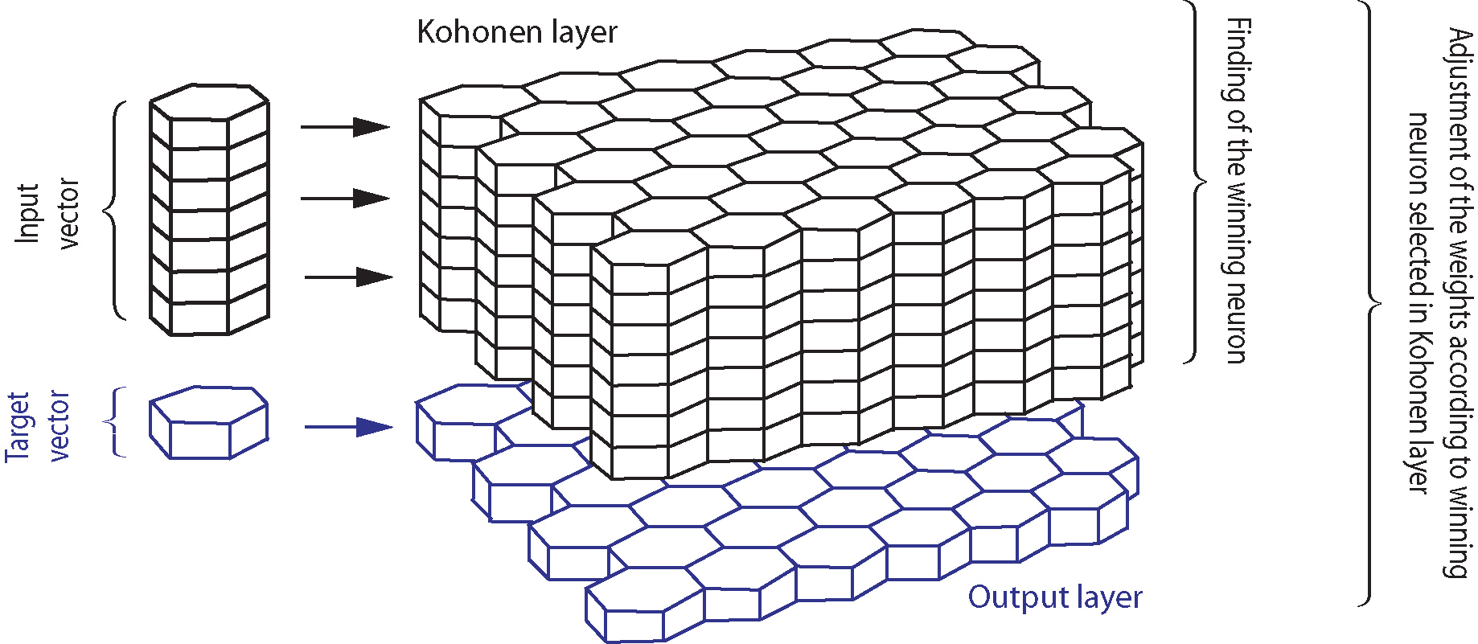
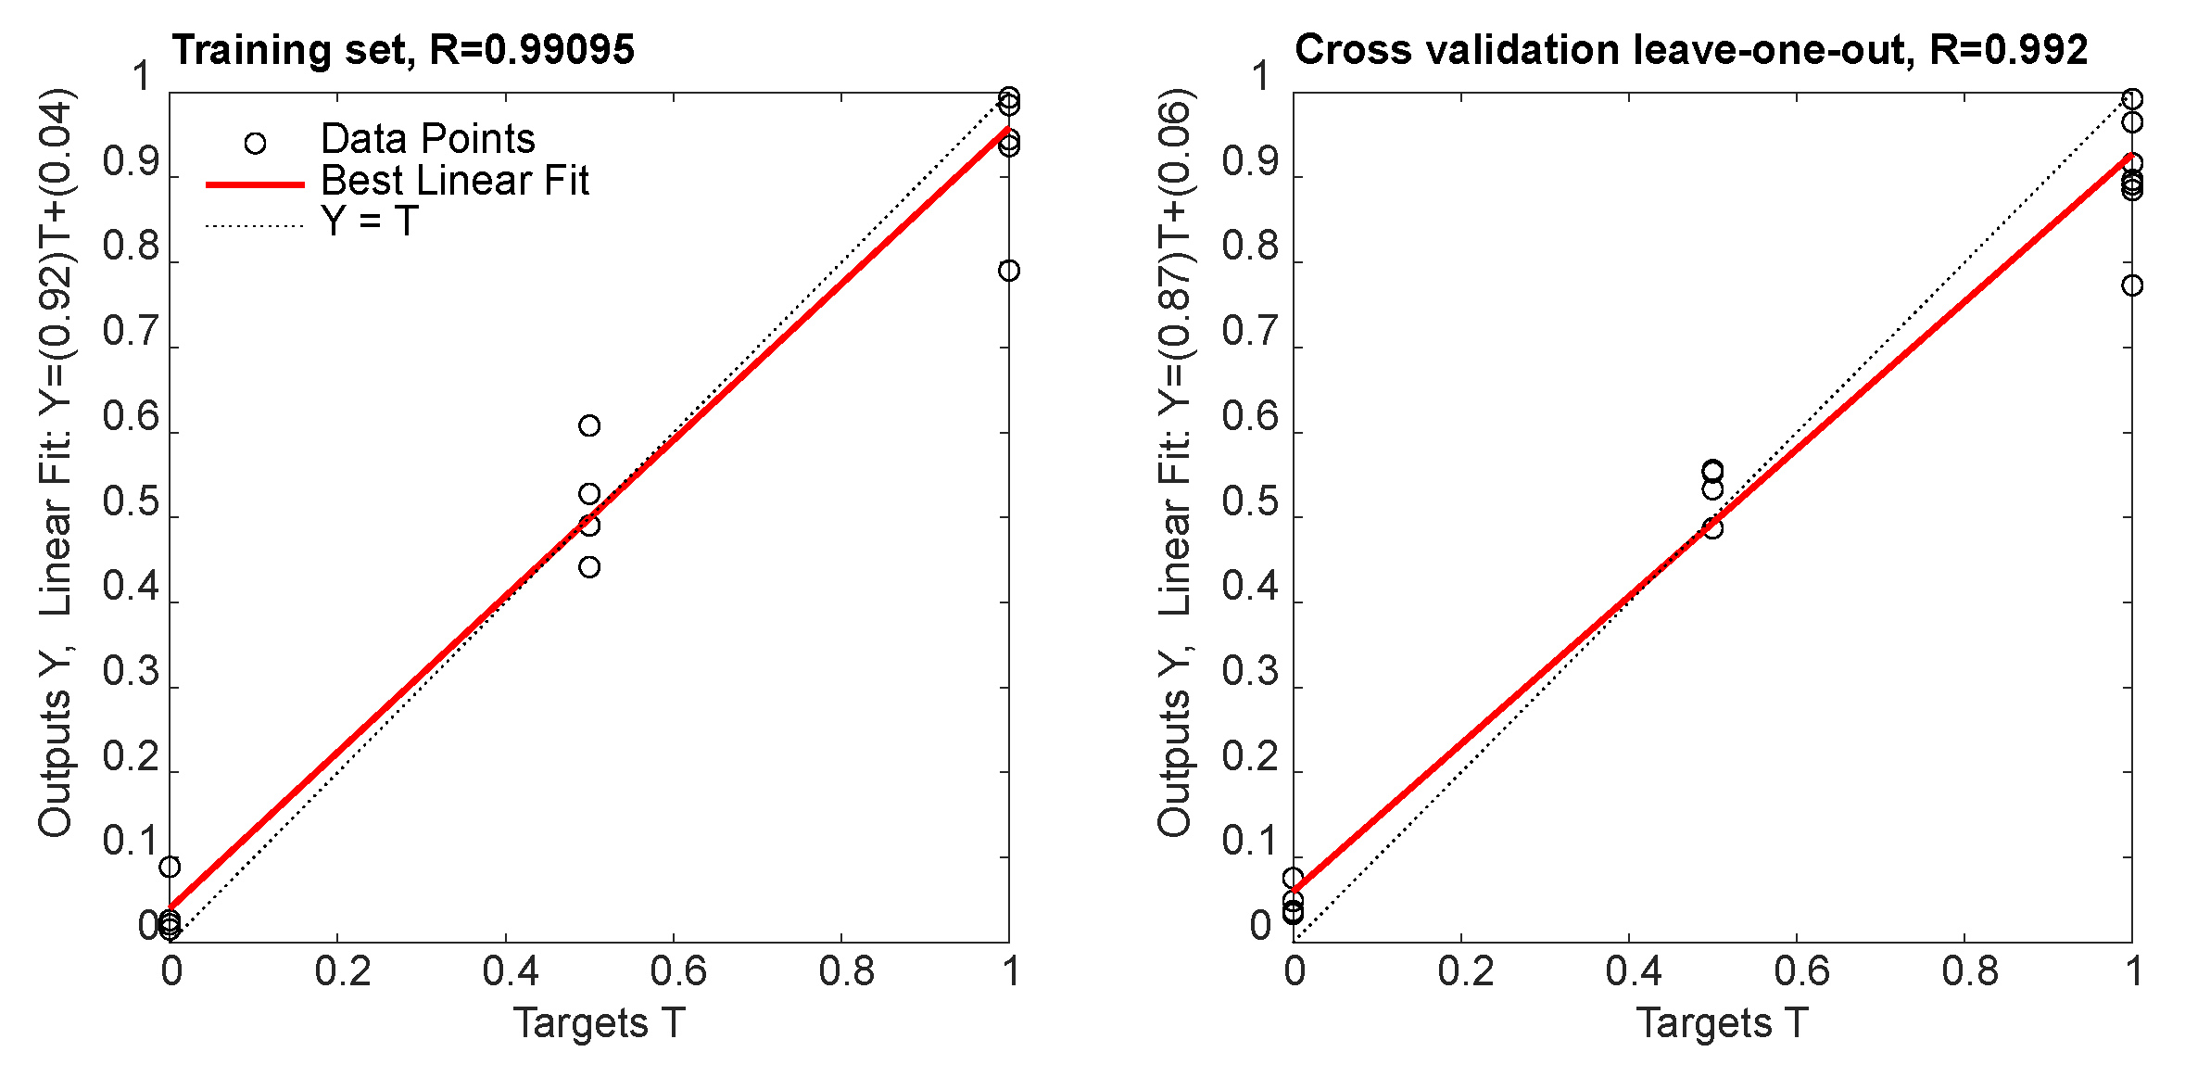
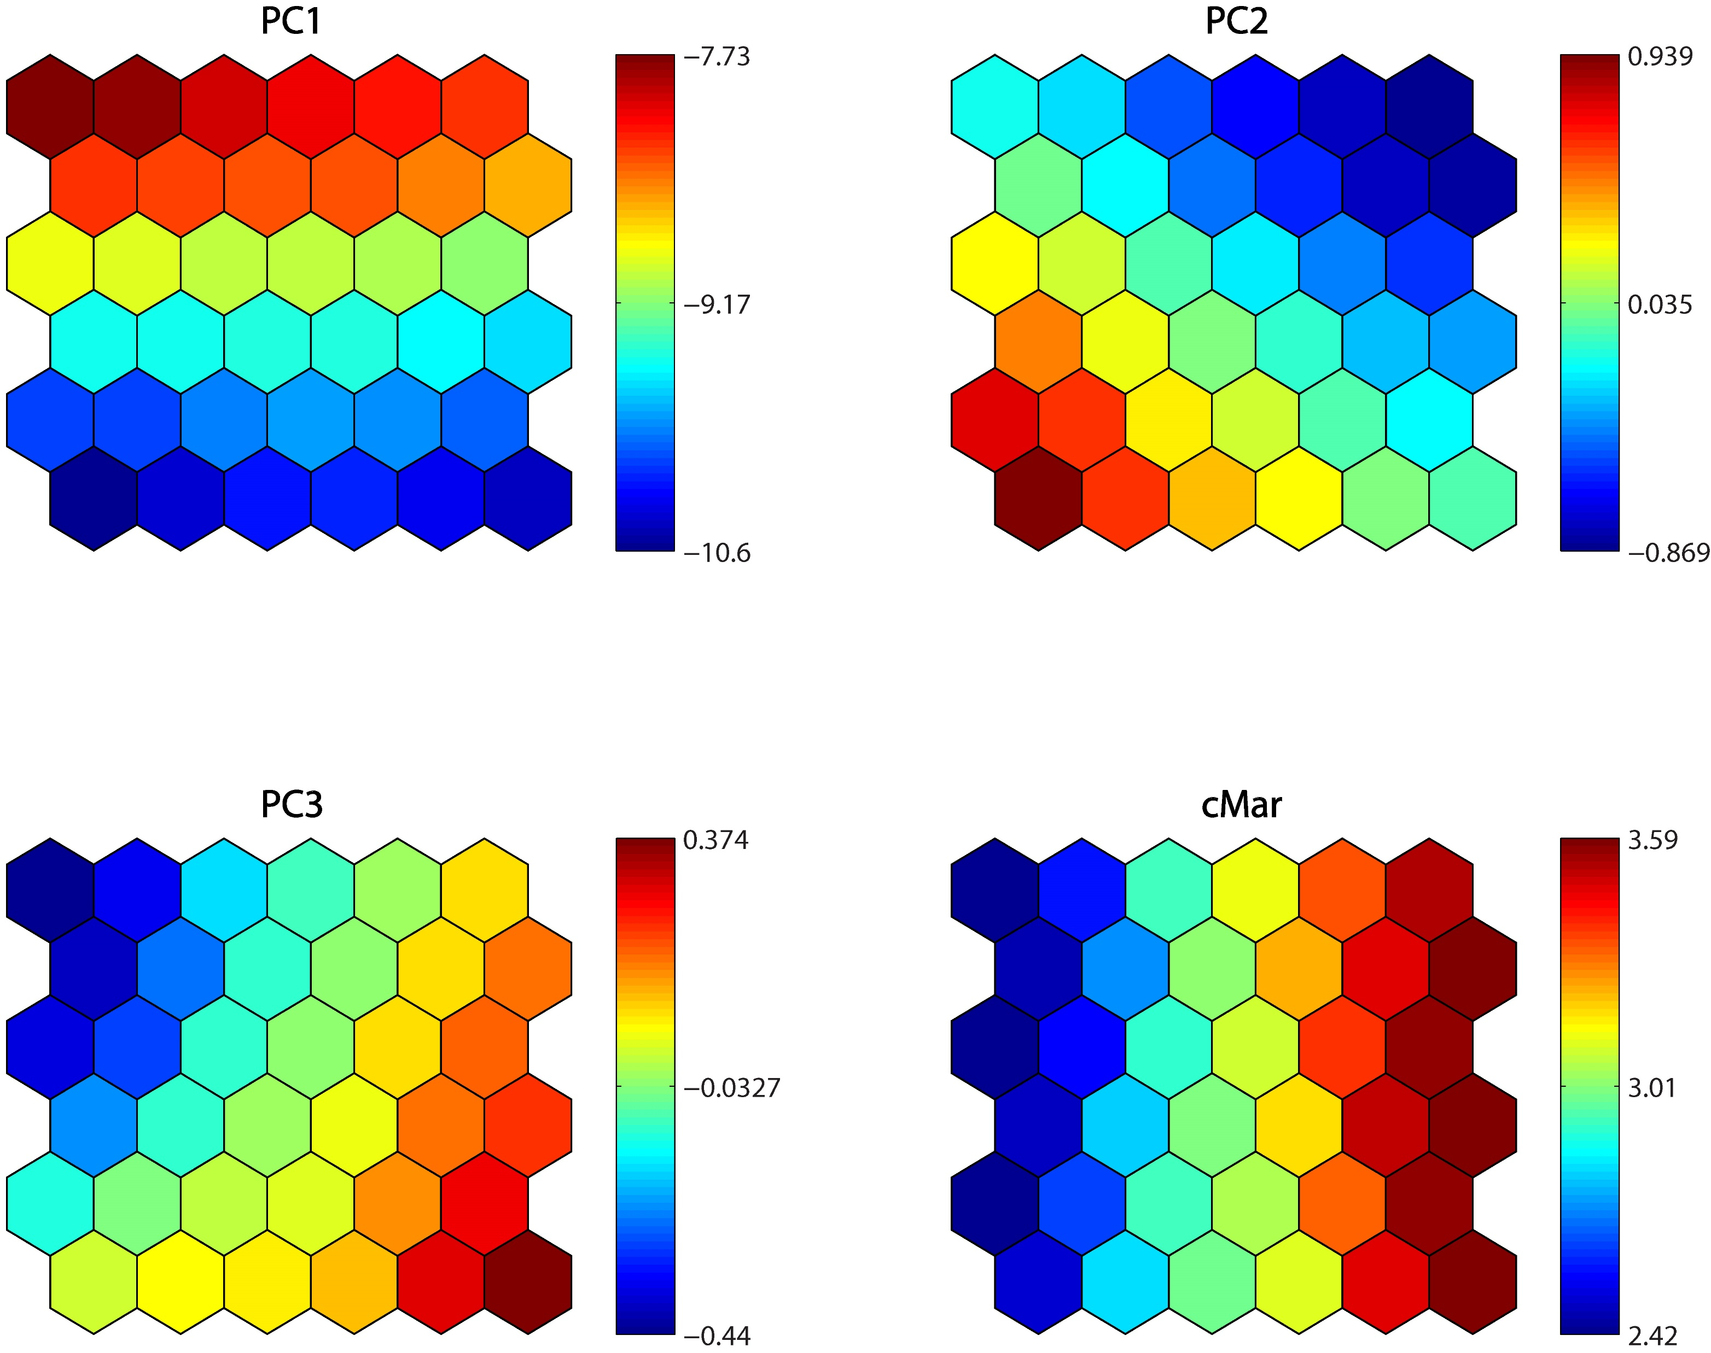
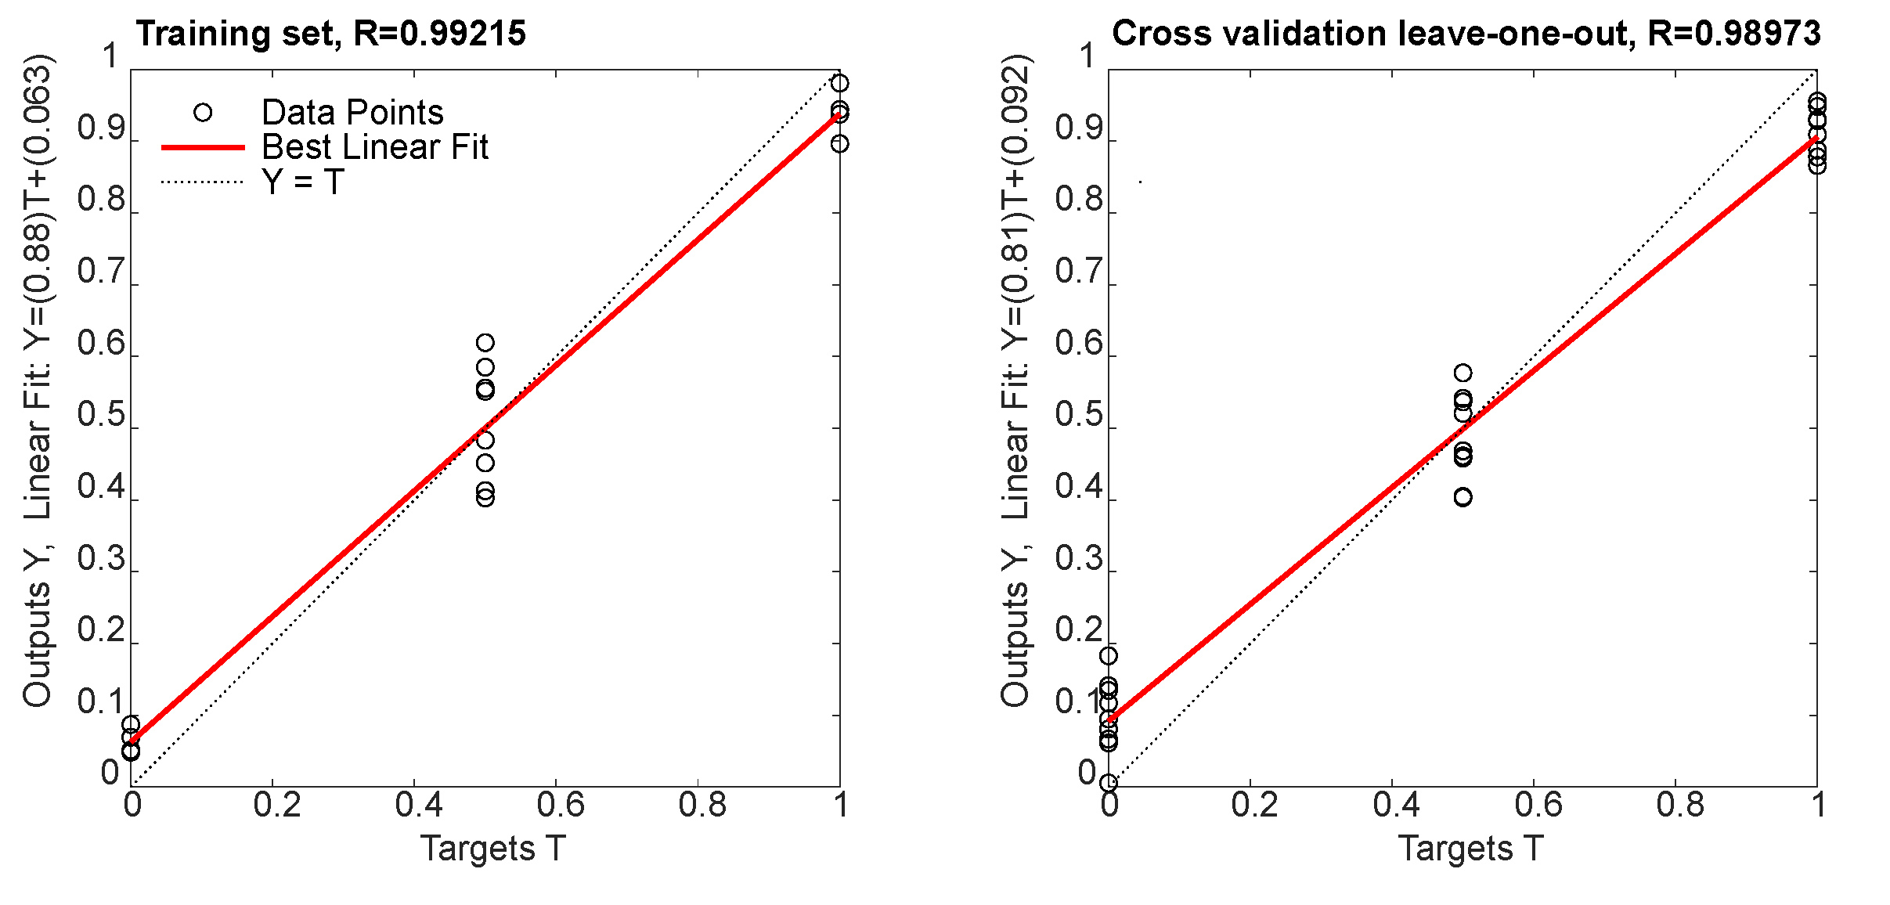
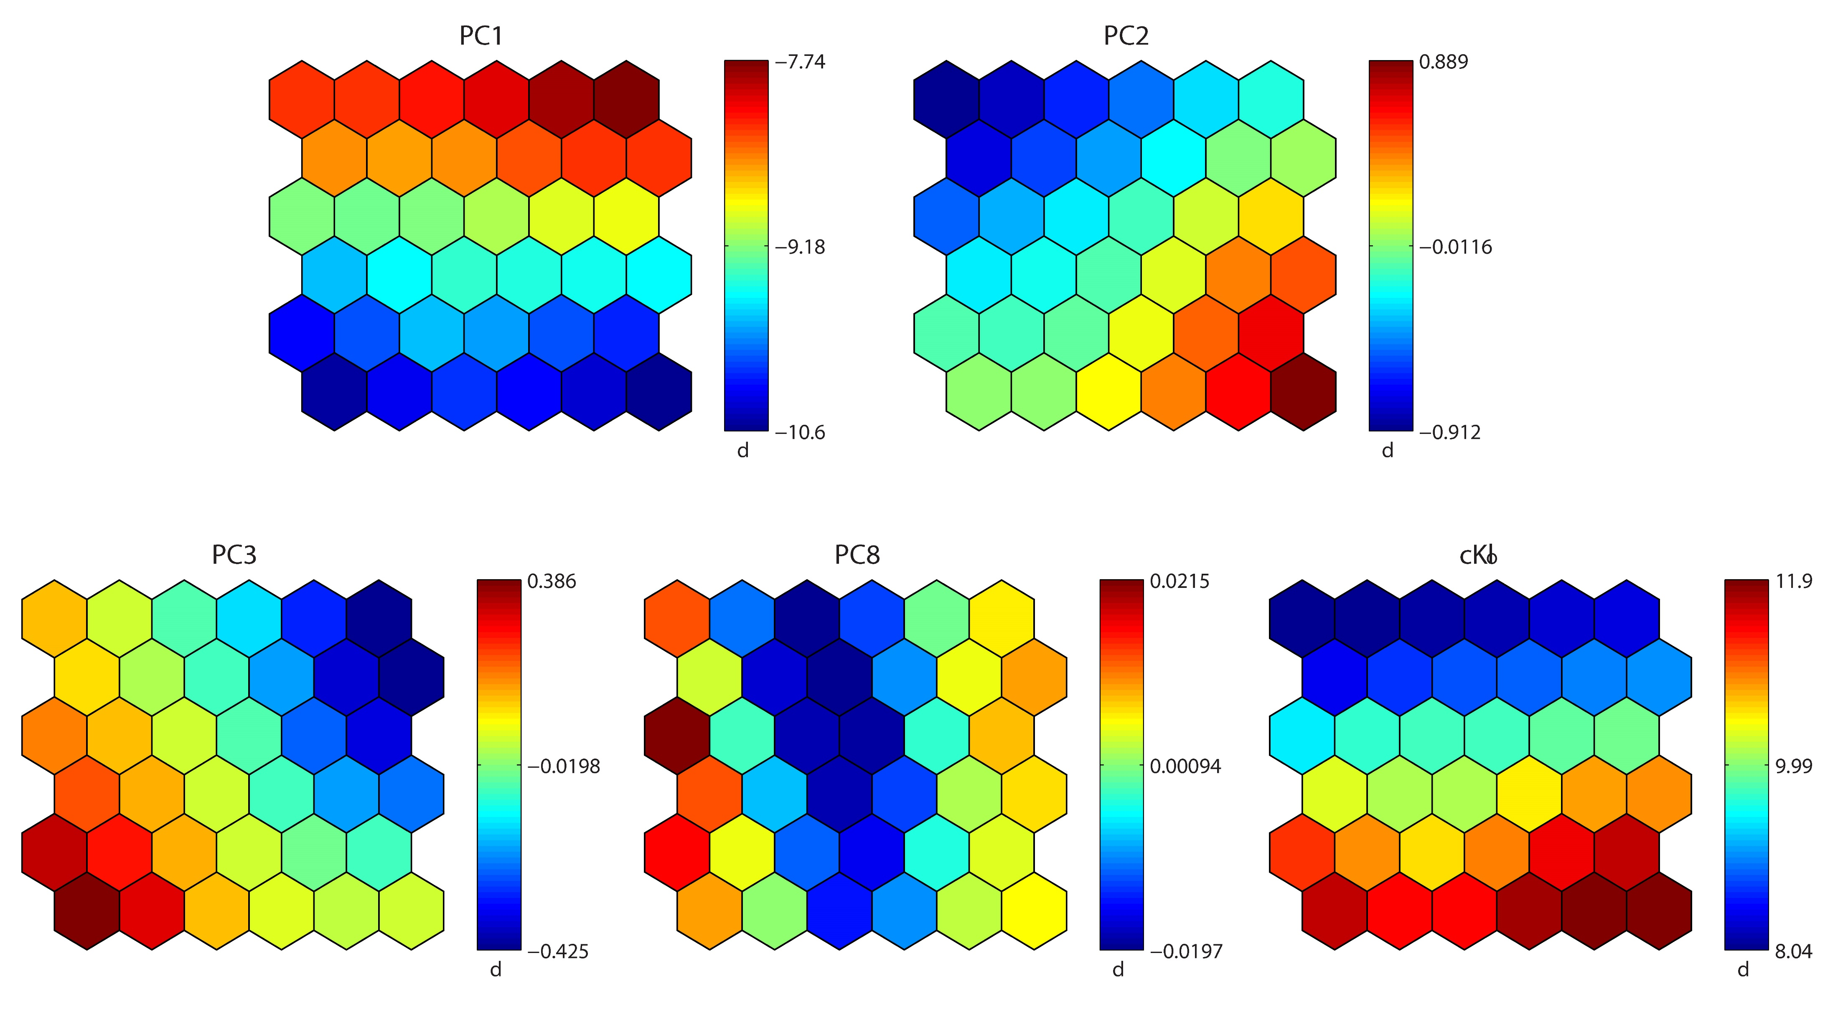
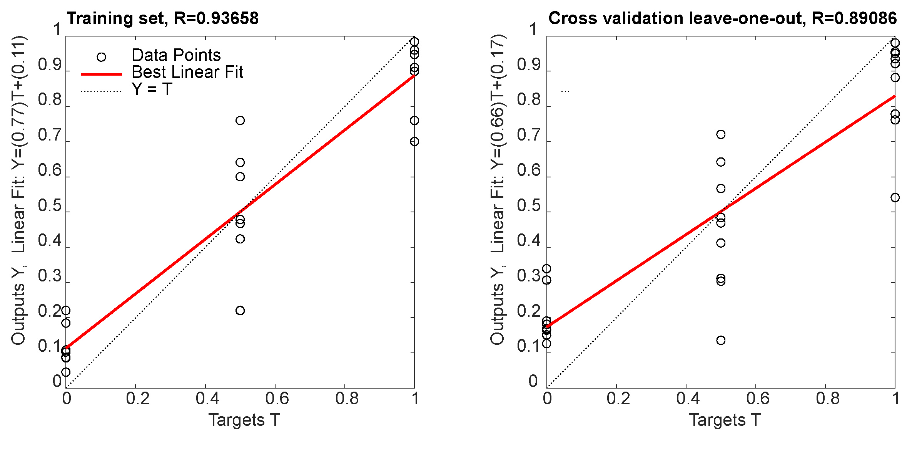
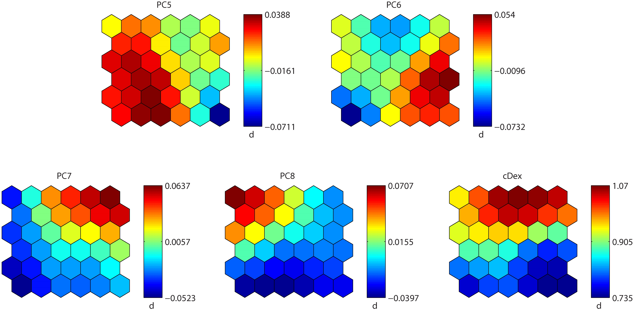
Application of Counter-propagation Artificial Neural Networks in prediction of marbofloxacin, clotrimazole and dexamethasone concentrations in Otoxolan ear drops, suspension for dogs
000
Lina Bozhinovska^{1,2}, Igor Kuzmanovski¹, Goran Stojkovic¹
¹ Institute of Chemistry, Faculty of Natural Sciences and Mathematics, Ss. Cyril and Methodius University in Skopje, Skopje, North Macedonia, linabozh@gmail.com,
²Bionika Pharmaceuticals, Skopje, North Macedonia
Introduction & Aim
Otoxolan ear drops, suspension is a veterinary pharmaceutical formulation containing three active ingredients such as marbofloxacin, clotrimazole and dexamethasone. However, simultaneous determination of these three compounds without prior separation can be challenging due to extensive overlapping spectra. This study aims to develop and evaluate a CPANN model for the simultaneous prediction of active components’ concentrations in Otoxolan ear drops using UV/Vis spectrophotometric data.
Experimental
Results and discussion
Table 1. Comparison between the declared and predicted concentrations of marbofloxacin
Both standard and sample solutions were prepared at the working range of 2.4-12 μg/mL, used for the preparation of calibration and validation mixtures. The absorption spectra of the prepared solutions were recorded using a Varian Cary 500 UV/Vis spectrophotometer over the range 200-400 nm, with a resolution of 0.5 nm. The obtained spectral data were used as input variables for the development of the chemometric model, while the output variables were the predicted concentrations of marbofloxacin, clotrimazole and dexamethasone. Cross-validation was used for control of the generalization performances of the CPANN models.
Declared conc. (μg/mL) | Predicted conc. (μg/mL)
5.40 | 5.26
6.00 | 6.01
6.60 | 6.28
8.40 | 8.28
9.00 | 9.04
9.60 | 9.34
11.40 | 11.55
12.00 | 11.92
Figure 2. The calibration graph and the weight levels of CPANN for marbofloxacin
The cross validation leave-one-out results demonstrate the predictive capability of the developed model with correlations of 0.992, 0.990 and 0.891 for marbofloxacin, clotrimazole and dexamethasone, respectively. The predicted concentrations of marbofloxacin correspond with the declared concentrations, indicating successful prediction.
Figure 1. Counter-propagation neural network
Conclusions - The developed model based on the CPANN approach was successfully applied to the simultaneous prediction of the three active components, demonstrating that analysis of complex mixtures is achievable using inexpensive instrumentation.
Acknowledgement – L.Bozhinovska sincerely acknowledges Bionika Pharmaceuticals for providing financial support for participation in this event.
Figure 3. The calibration graph and the weight levels of CPANN for a) clotrimazole and b) dexamethasone

