Slide 1


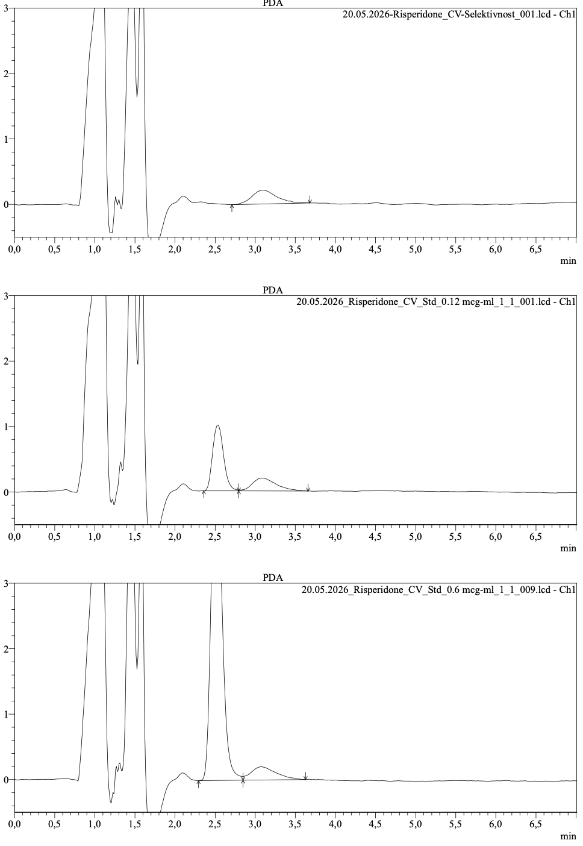
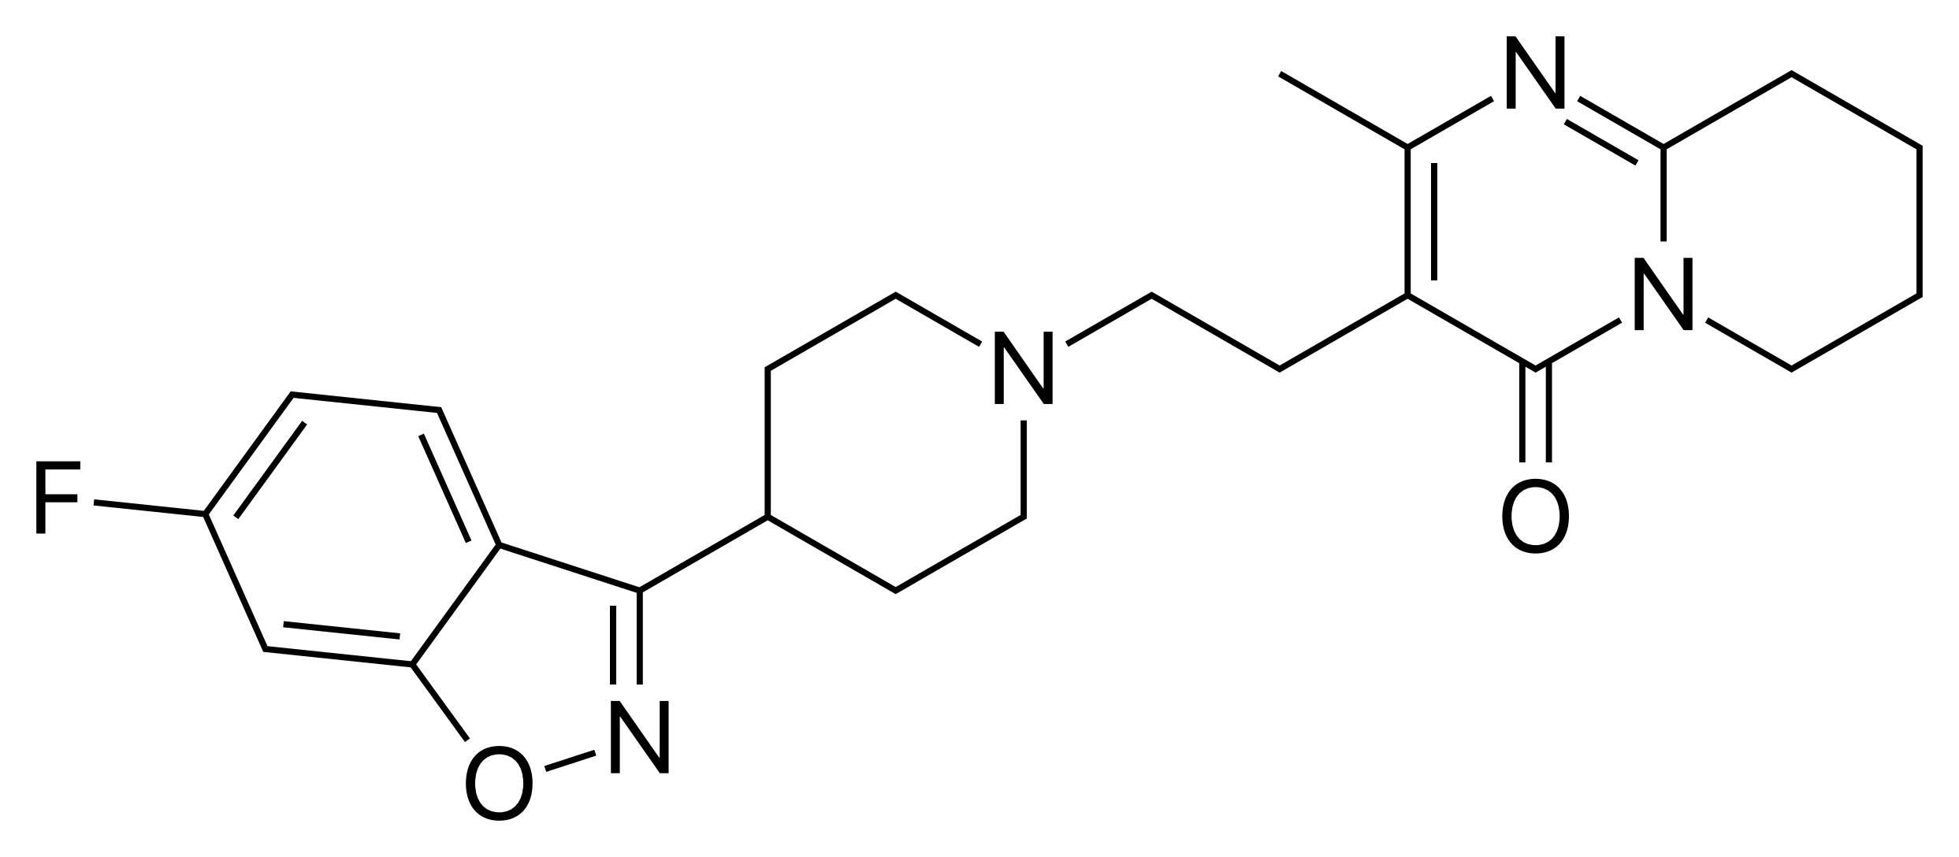
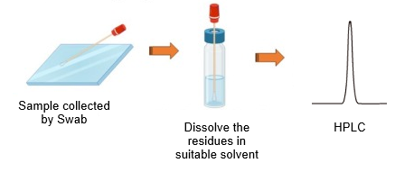
28th Congress of SCTM, 23-26 September, Ohrid, Macedonia
000
OPTIMIZATION OF AN HPLC METHOD FOR RISPERIDONE
QUANTIFICATION FOR CLEANING VALIDATION PURPOSES
Marijana Nikoloska¹, Silvana Janevikj², Katerina Kochova³, Irena Slaveska Spirevska⁴, Tanja Bakovska Stoimenova⁵, Elena Petrovska Kostadinoska⁶, Kristina Grncharoska⁷
¹ Replek Farm Ltd, Skopje, North Macedonia, marijana.nikolovska@replek.mk, ^{2,3,4,5,6,7} Replek Farm Ltd, Skopje, North Macedonia
Introduction & Aim
Risperidone (a), chemically known as 3-[2-[4-(6-fluoro-1,2-benzoxazol-3-yl)piperidin-1-yl]ethyl]-2-methyl-6,7,8,9-tetrahydropyridol[1,2-a]pyrimidin-4-one, is indicated for the treatment of schizophrenia, bipolar disorder and related psychiatric conditions.
The aim of this study was to optimize the swabbing procedure and high performance liquid chromatography (HPLC) method conditions for risperidone cleaning validation.
Risperidone (a)
Used solvent:
Methanol and 0.08% H3PO4
in a 7 : 3 (v/v) ratio
Results and discussion
Experimental
Reference substance:
Risperidone CRM
HPLC system and conditions:
analytical column: LiChrospher RP Select B 125 mm x 4.0 mm, 5 µm
mobile phase: 0.25% KH₂PO₄ buffer (pH 3.0) and Acetonitrile in a 66 : 34 (v/v) ratio
isocratic conditions;
flow rate: 1.0 mL/min.;
detection wavelength: 235 nm;
column temperature: 35° C;
injection volume: 50 µL
Swab recovery: acidified methanol achieved recovery >80% (acceptance criterion), while plain methanol gave lower recovery — confirming the acidified medium as the optimal swab solvent for risperidone cleaning validation.
The HPLC method was validated with respect to selectivity, linearity, precision, and sensitivity, with the limit of detection (LOD) and limit of quantification (LOQ) being determined.
Conclusions
The use of an acidified extraction medium ensures robust and reproducible recovery, while the optimized HPLC method provides accurate and reliable quantification suitable for routine cleaning validation in risperidone manufacturing.

