Slide 1

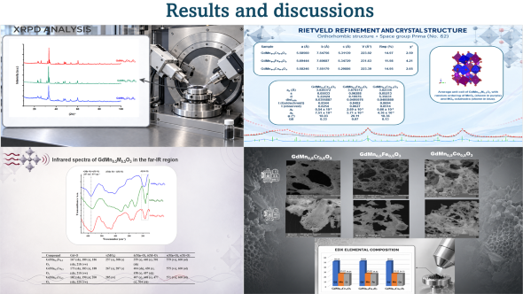
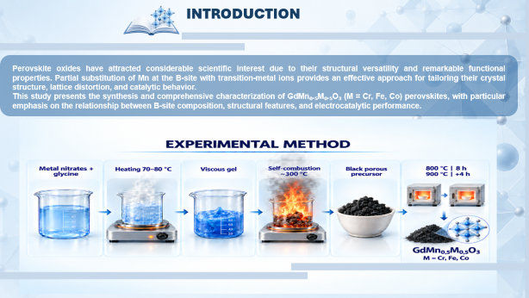
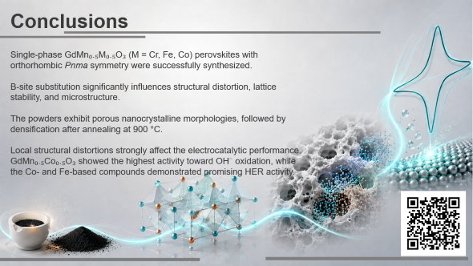
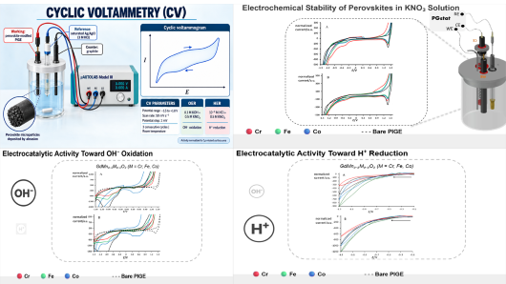
PSSE-P10
28th Congress of SCTM, 23-26 September, Ohrid, Macedonia
Rietveld Structural Analysis and Electrocatalytic Activity of GdMn_{0.5}M_{0.5}O₃ (M = Cr, Fe, Co) Double Perovskites toward Hydroxide Oxidation and Hydrogen Evolution Reactions
ª Besarta Cheliku Ramadani ª Jeta Sela,^{b} Leon Stojanov,^{c} David Jovanov, ^{c} Miha Bukleski,^{c} Arianit A. Reka,^{b} Valentin Mirceski^{c} and Slobotka Aleksovska^{c*}
¹ Mother Teresa University, Skopje, North Macedonia²University of Tetovo, Tetovo, North Macedonia, ³ Ss. Cyril and Methodius University, Skopje, North Macedonia

Slide 2


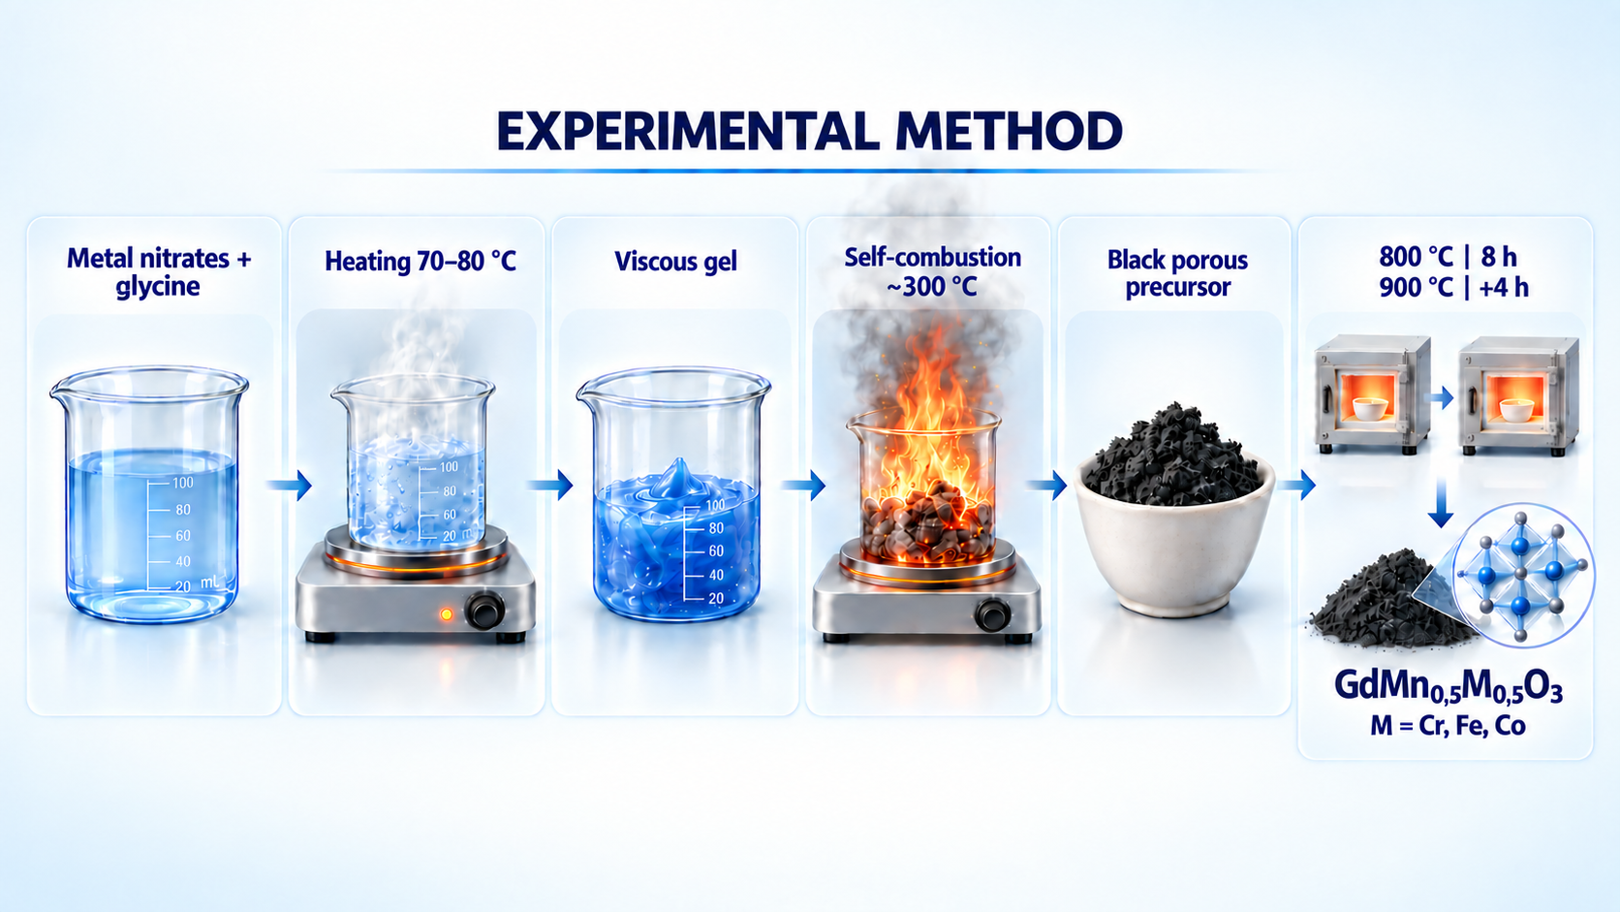
INTRODUCTION
Perovskite oxides have attracted considerable scientific interest due to their structural versatility and remarkable functional properties. Partial substitution of Mn at the B-site with transition-metal ions provides an effective approach for tailoring their crystal structure, lattice distortion, and catalytic behavior.
This study presents the synthesis and comprehensive characterization of GdMn₀.₅M₀.₅O₃ (M = Cr, Fe, Co) perovskites, with particular emphasis on the relationship between B-site composition, structural features, and electrocatalytic performance.

Slide 3


Slide 4
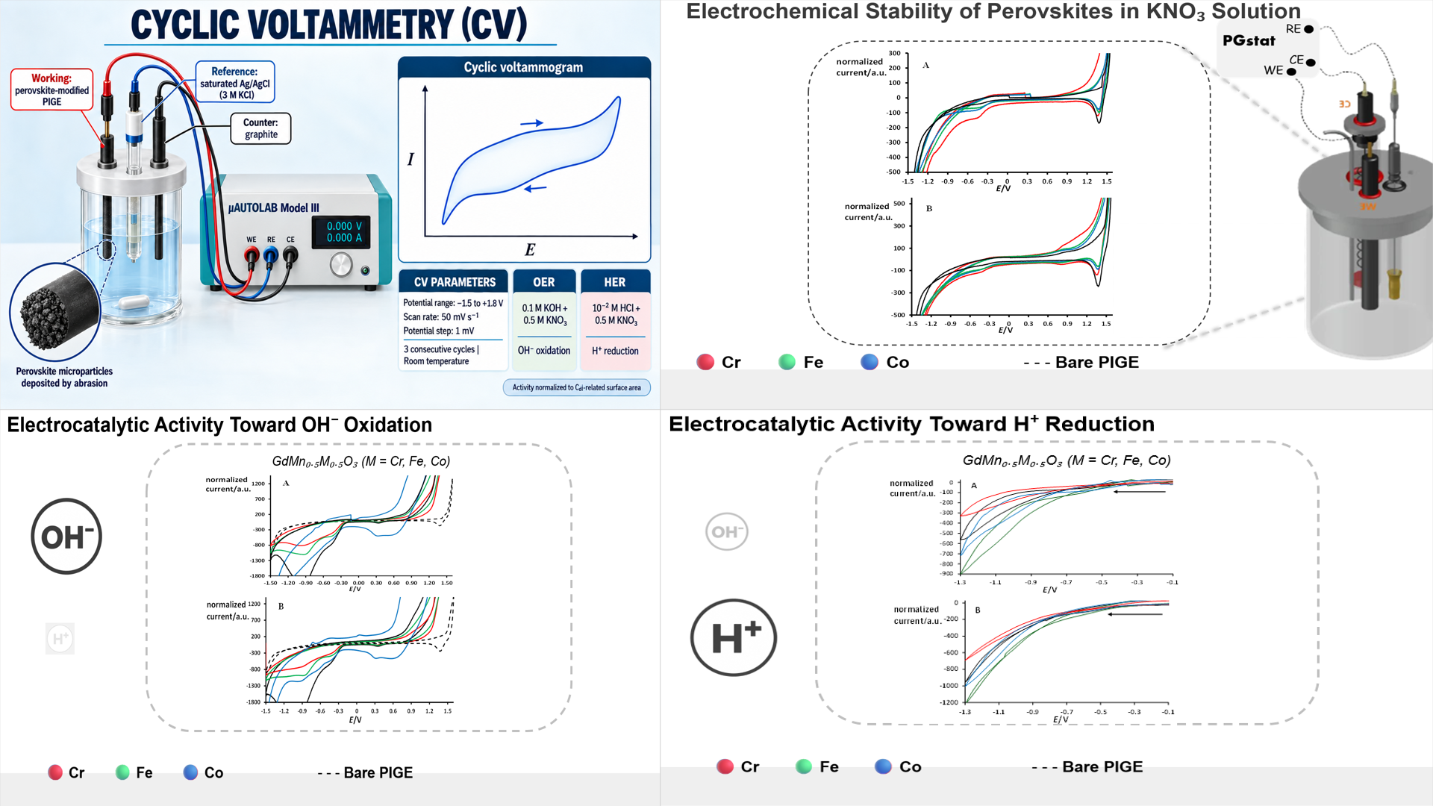

Slide 5


Conclusions
Single-phase GdMn₀.₅M₀.₅O₃ (M = Cr, Fe, Co) perovskites with orthorhombic Pnma symmetry were successfully synthesized.
B-site substitution significantly influences structural distortion, lattice stability, and microstructure.
The powders exhibit porous nanocrystalline morphologies, followed by densification after annealing at 900 °C.
Local structural distortions strongly affect the electrocatalytic performance.
GdMn₀.₅Co₀.₅O₃ showed the highest activity toward OH⁻ oxidation, while the Co- and Fe-based compounds demonstrated promising HER activity.

