Slide 1
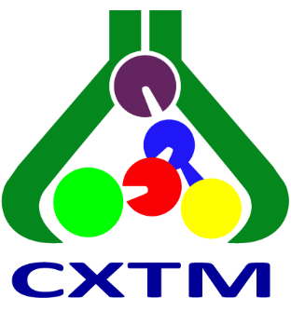
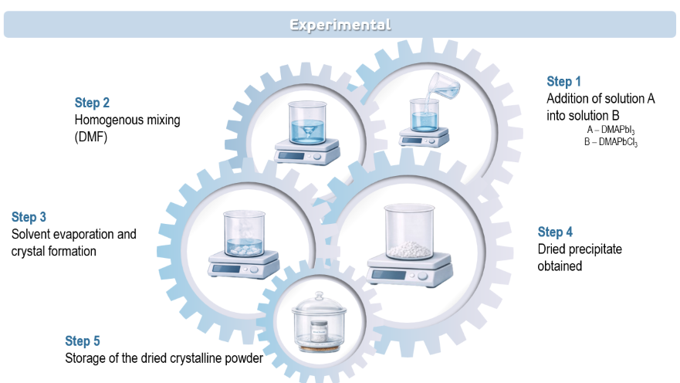
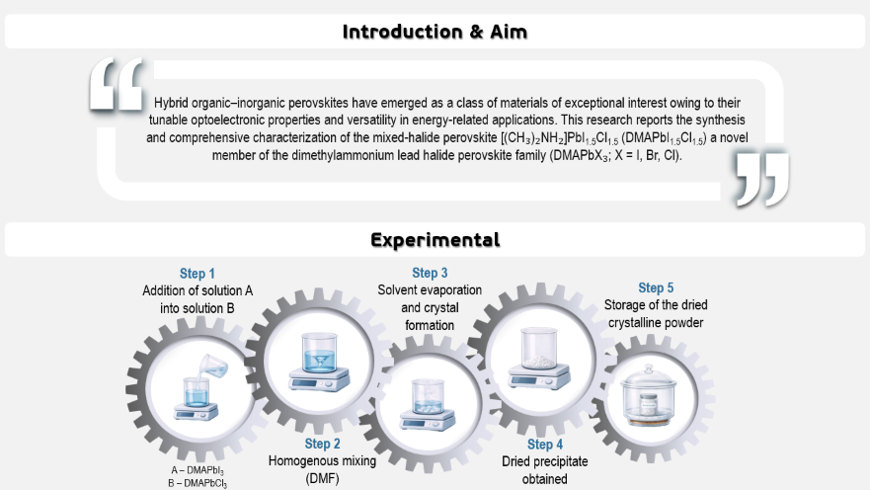
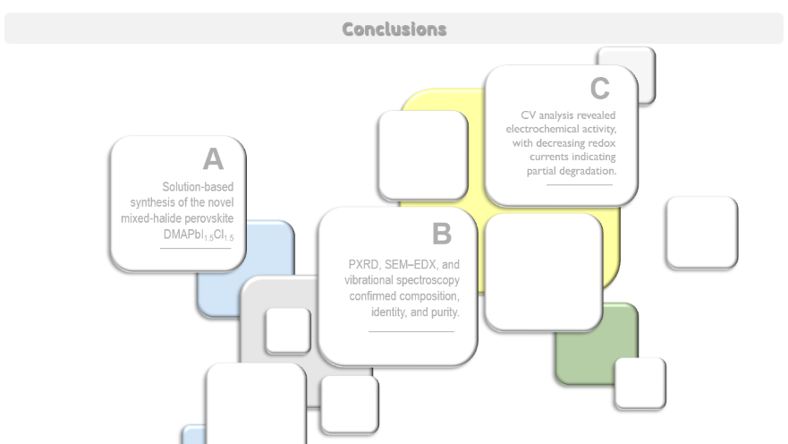
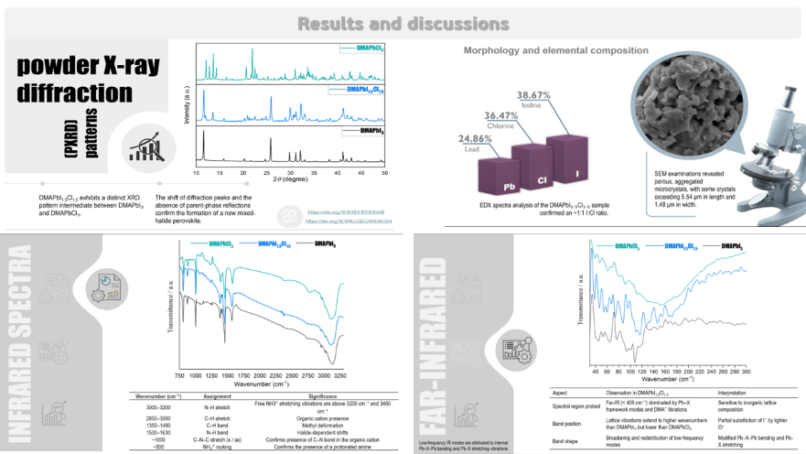

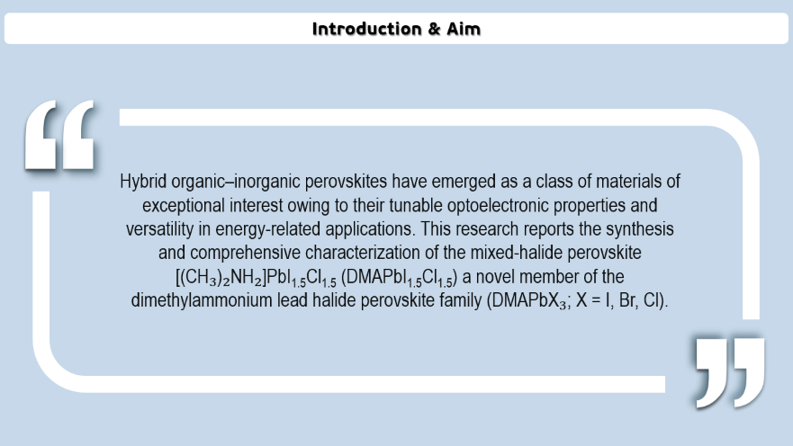
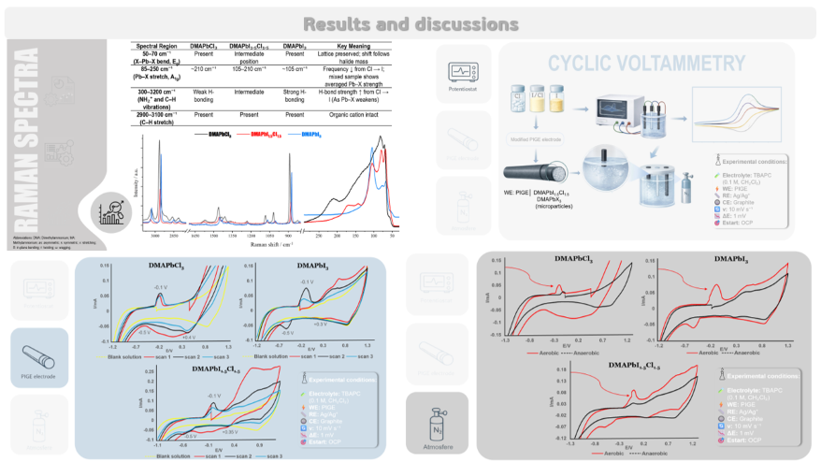
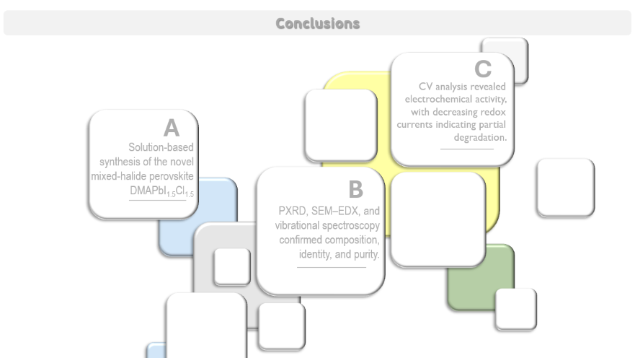
28th Congress of SCTM, 23-26 September, Ohrid, Macedonia
000
SYNTHESIS AND CHARACTERIZATION OF THE NOVEL MIXED-HALIDE PEROVSKITE DMAPbI_{1.5}Cl_{1.5}
Jeta Sela¹, Besarta Cheliku Ramadani², Leon Srojanov³, Miha Bukleski³, Arianit A. Reka¹, Valentin Mirceski³, Slobotka Aleksovska^{3*}
¹ University of Tetovo, Tetovo, North Macedonia, jeta.sela@unite.edu.mk, ² Mother Teresa University, Skopje, North Macedonia, ³ Ss. Cyril and Methodius University, Skopje, North Macedonia

Slide 2
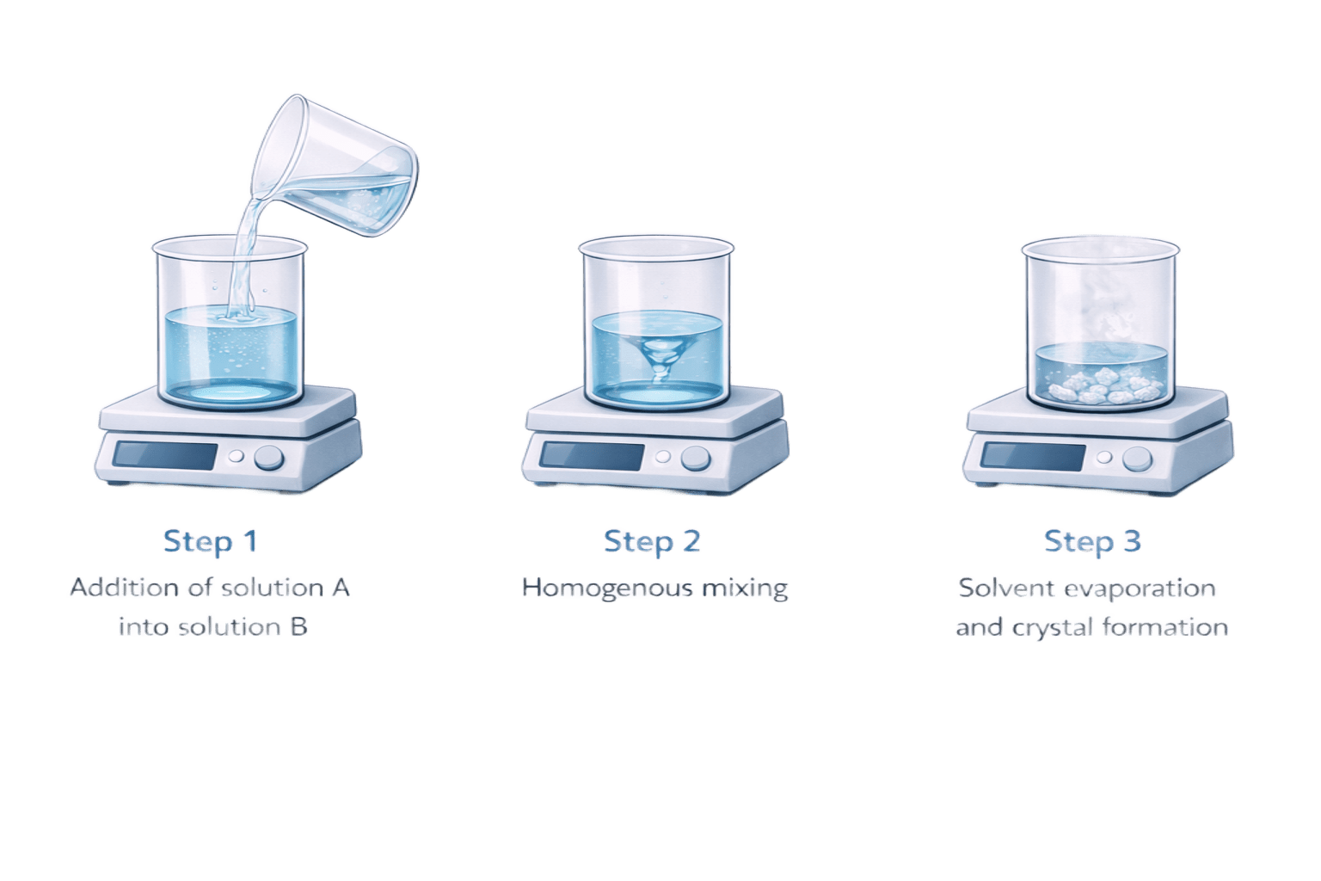
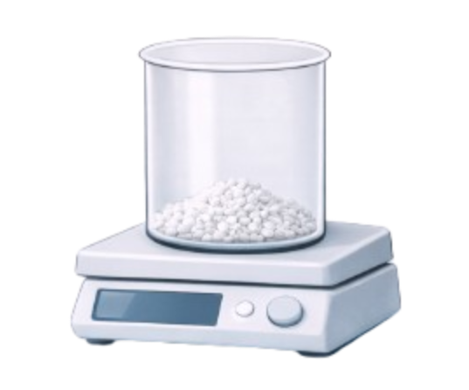
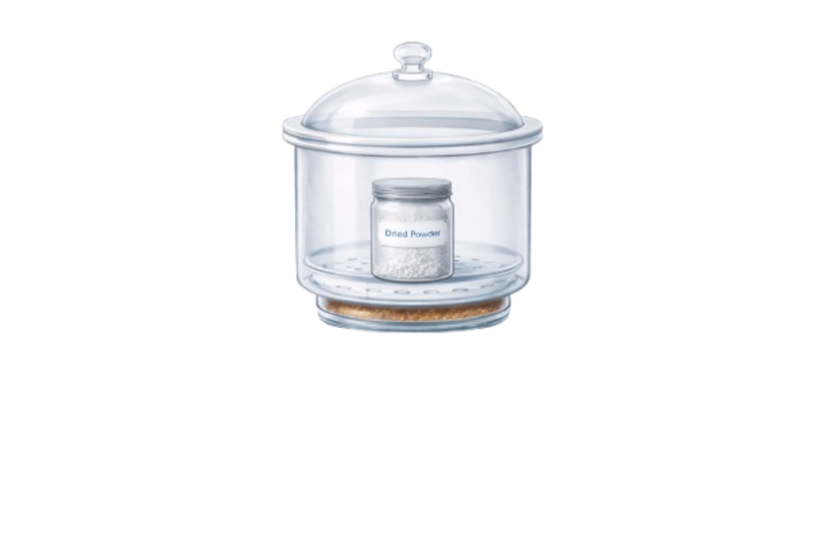
‘
‘
Introduction & Aim
‘
‘
Hybrid organic–inorganic perovskites have emerged as a class of materials of exceptional interest owing to their tunable optoelectronic properties and versatility in energy-related applications. This research reports the synthesis and comprehensive characterization of the mixed-halide perovskite [(CH₃)₂NH₂]PbI_{1.5}Cl_{1.5} (DMAPbI_{1.5}Cl_{1.5}) a novel member of the dimethylammonium lead halide perovskite family (DMAPbX₃; X = I, Br, Cl).
Experimental
Step 1
Addition of solution A into solution B
Step 3
Solvent evaporation and crystal formation
Step 5
Storage of the dried crystalline powder
Step 2
Homogenous mixing
(DMF)
Step 4
Dried precipitate obtained
A – DMAPbI₃
B – DMAPbCl₃

Slide 3
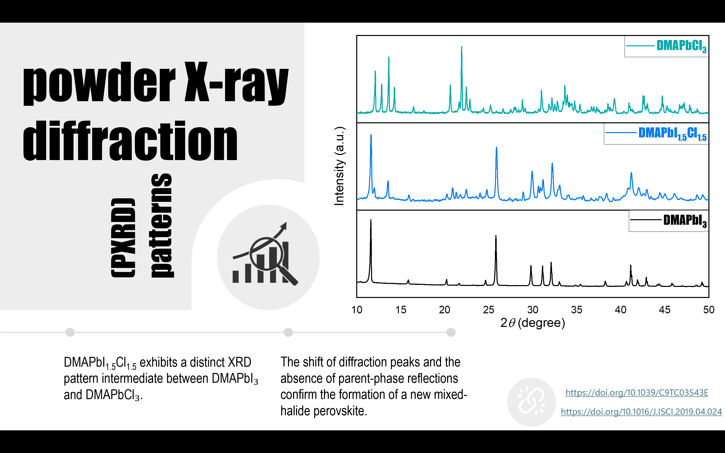
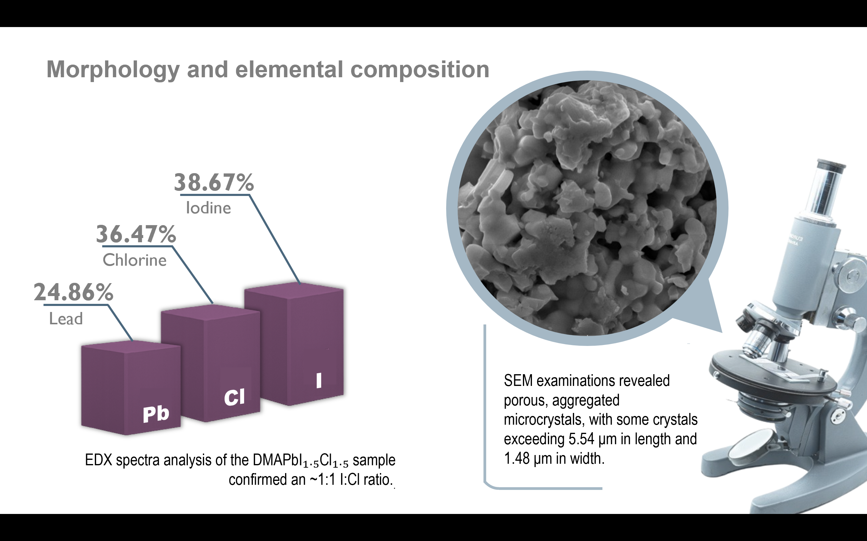
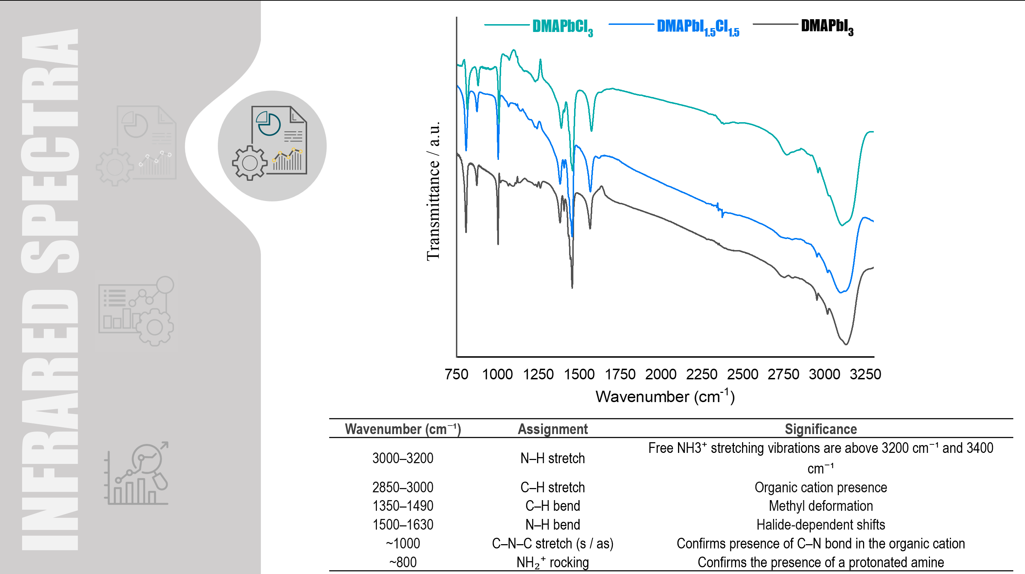
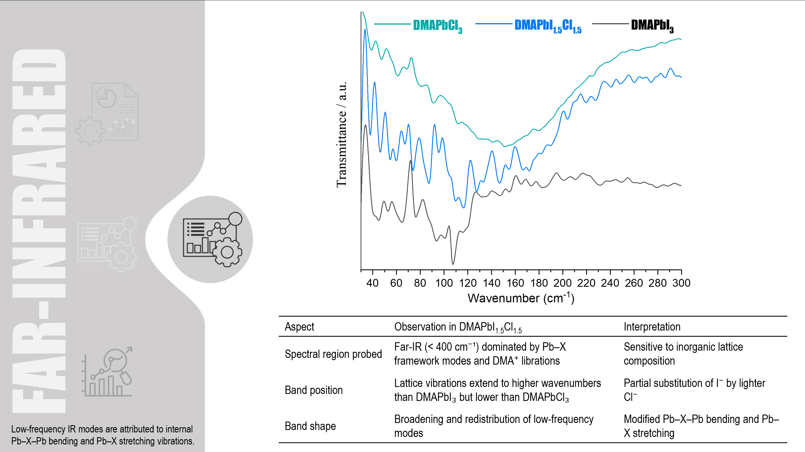
Results and discussions

Slide 4
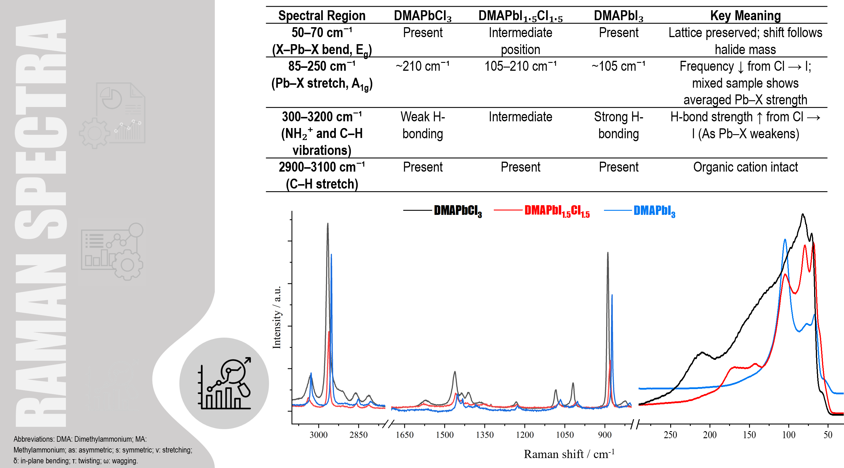
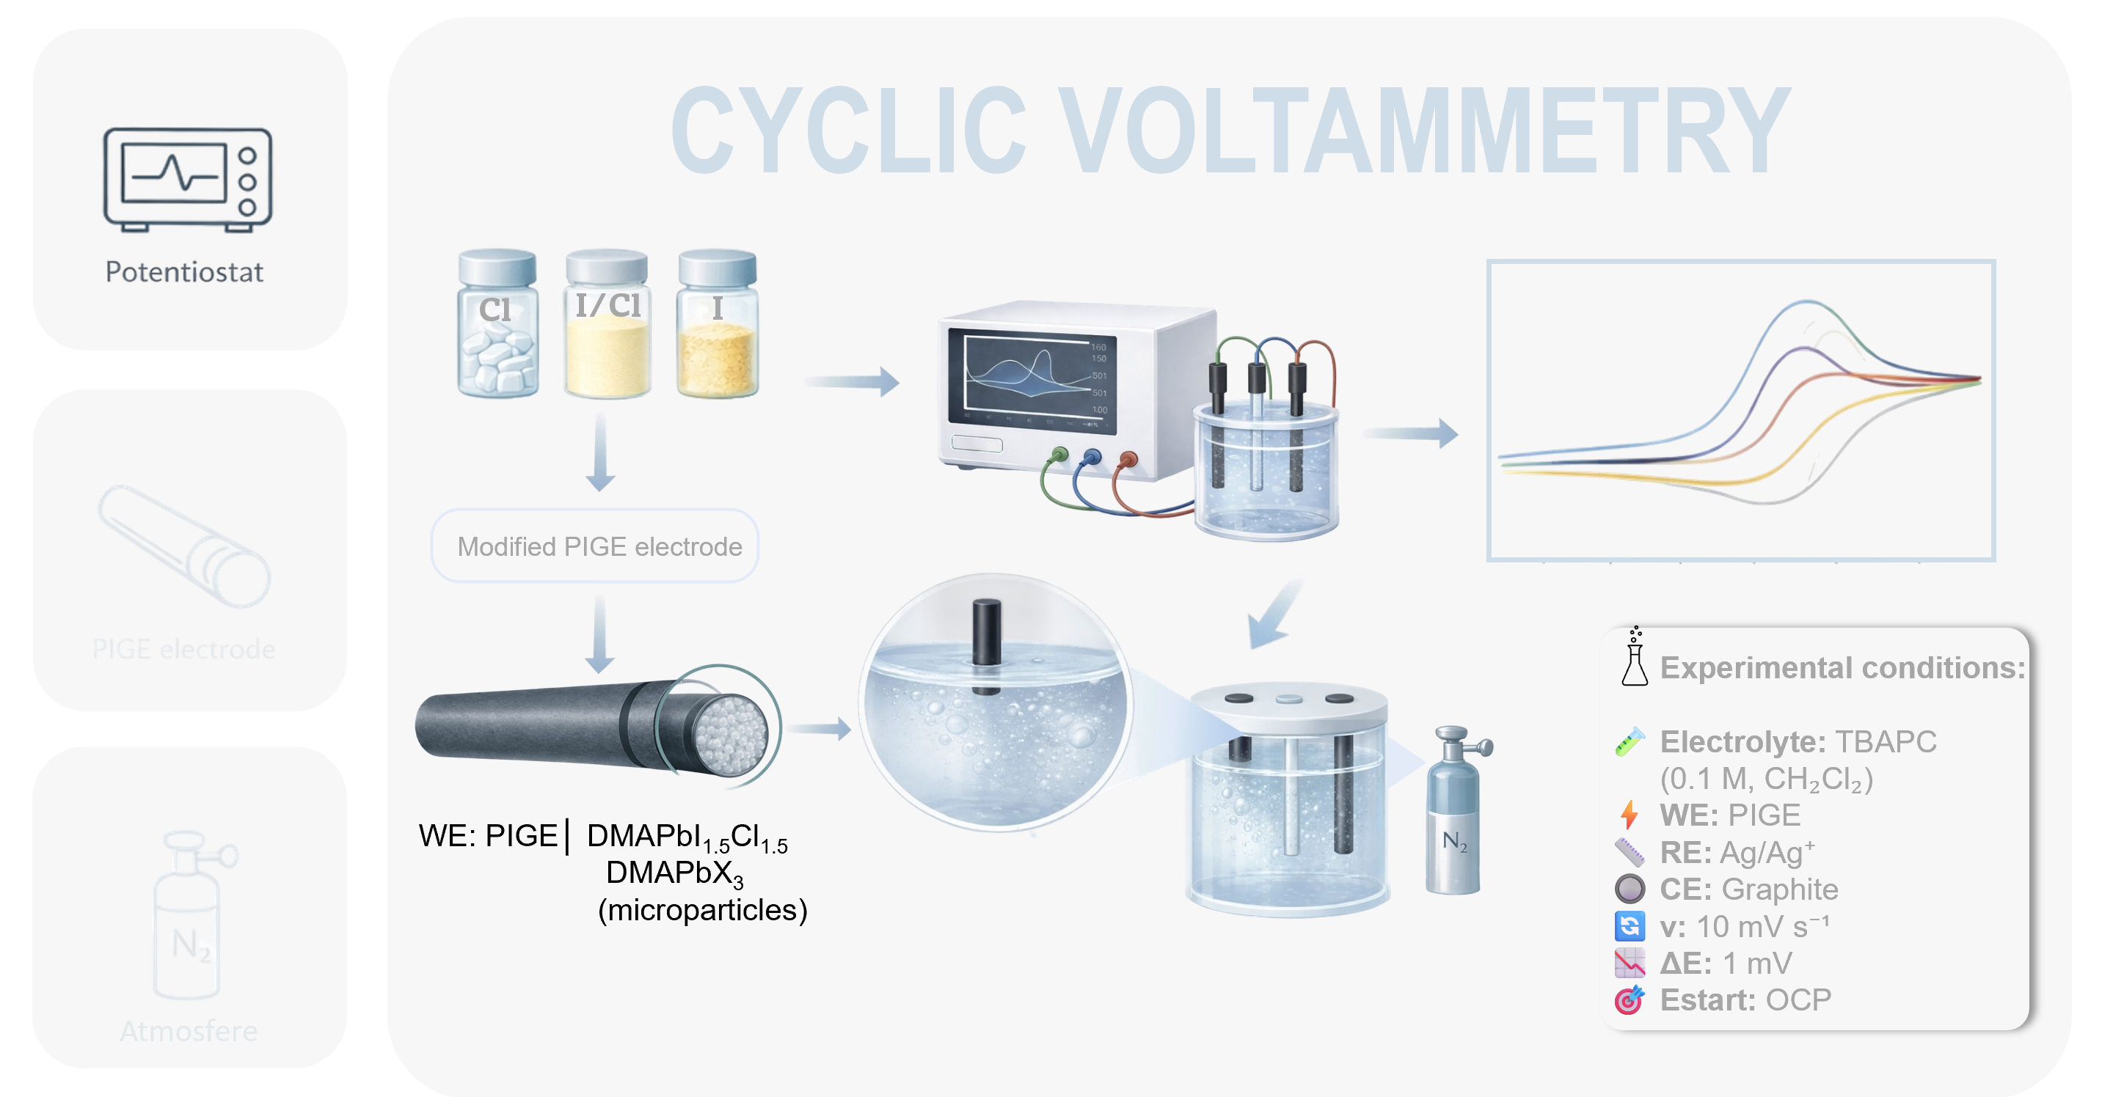
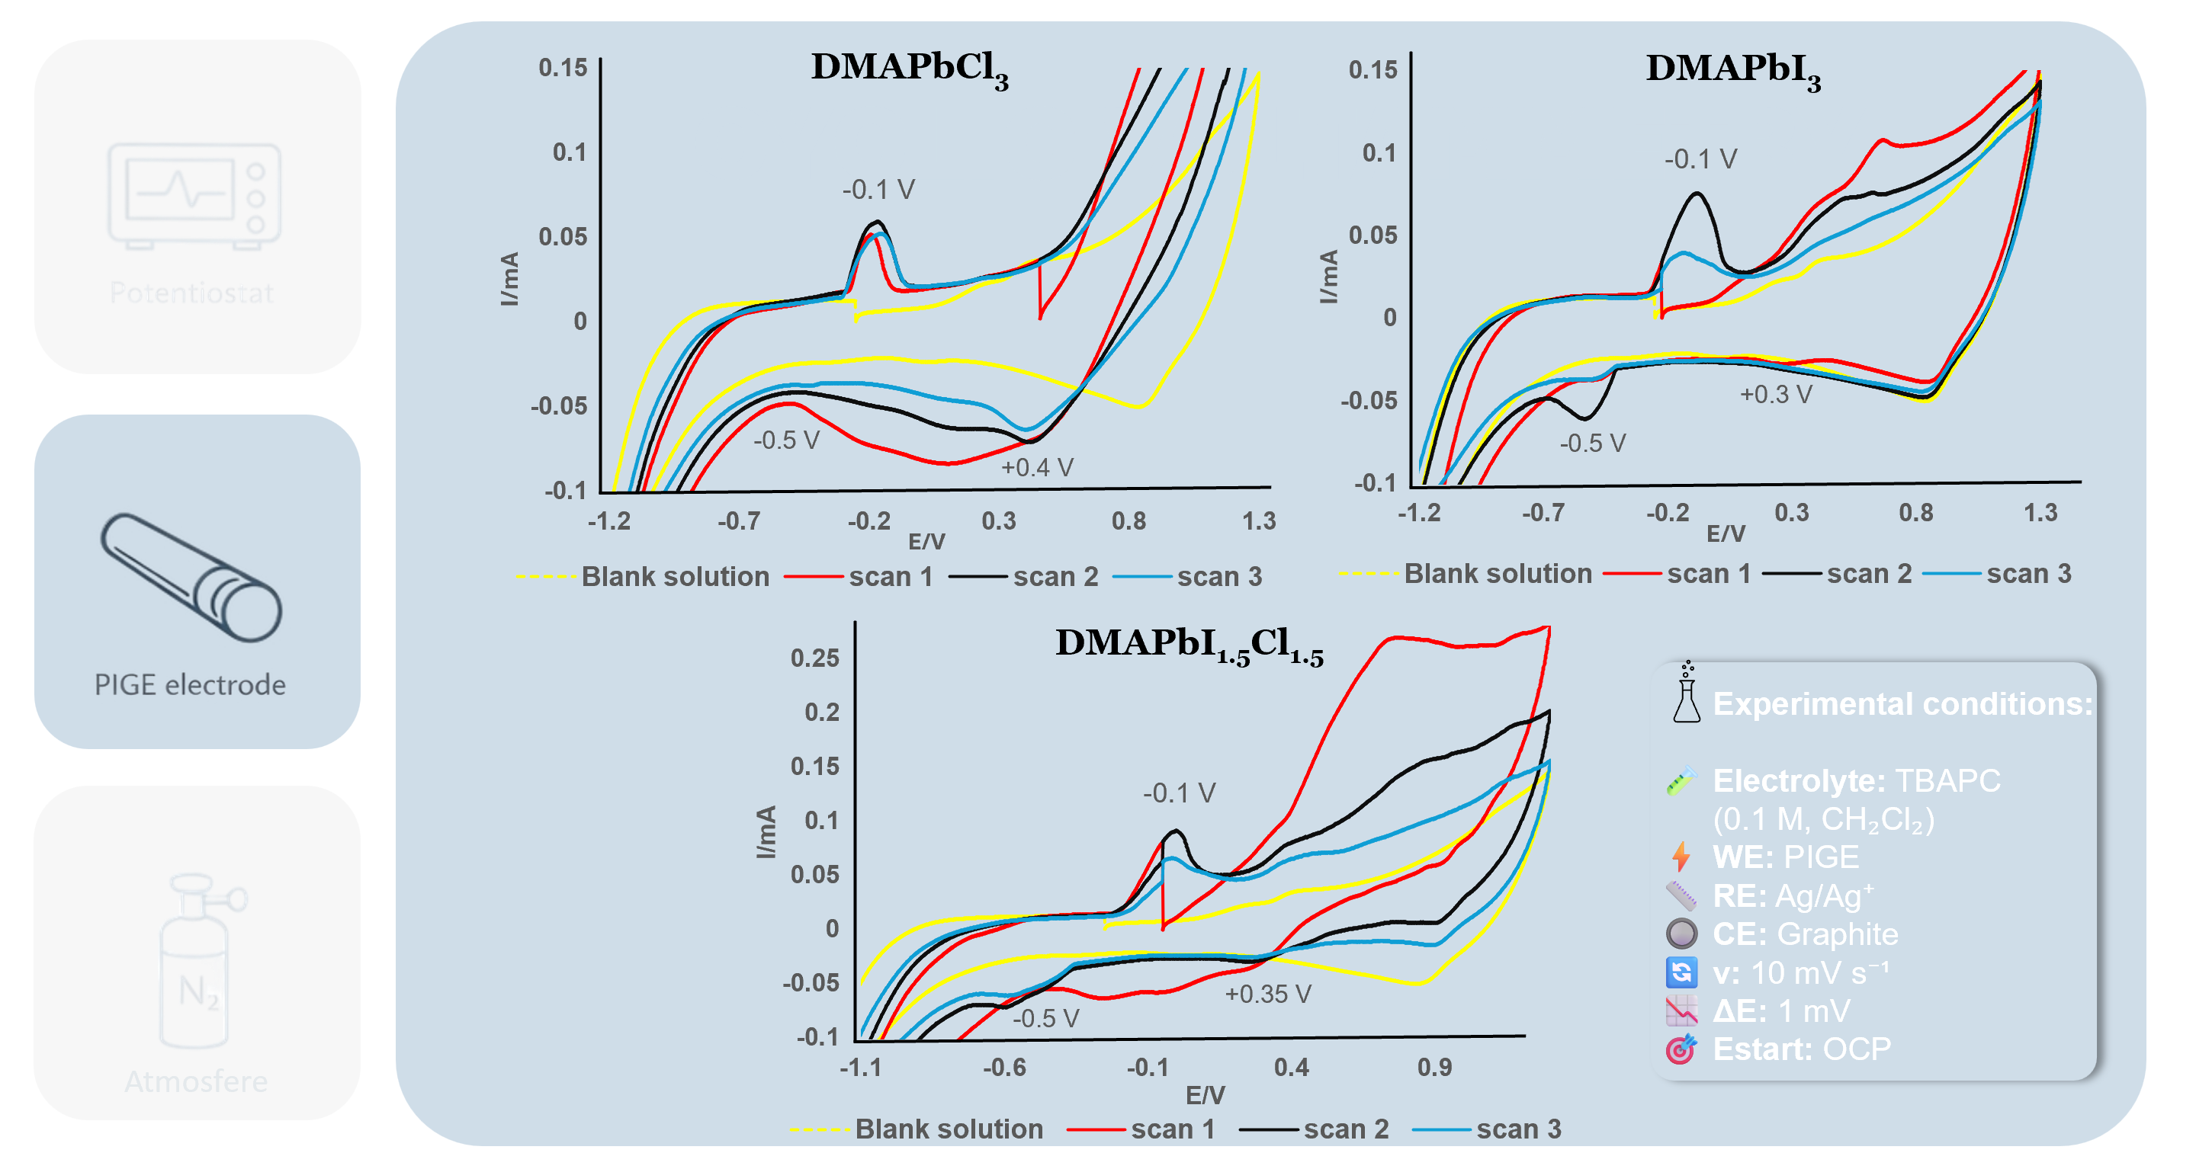
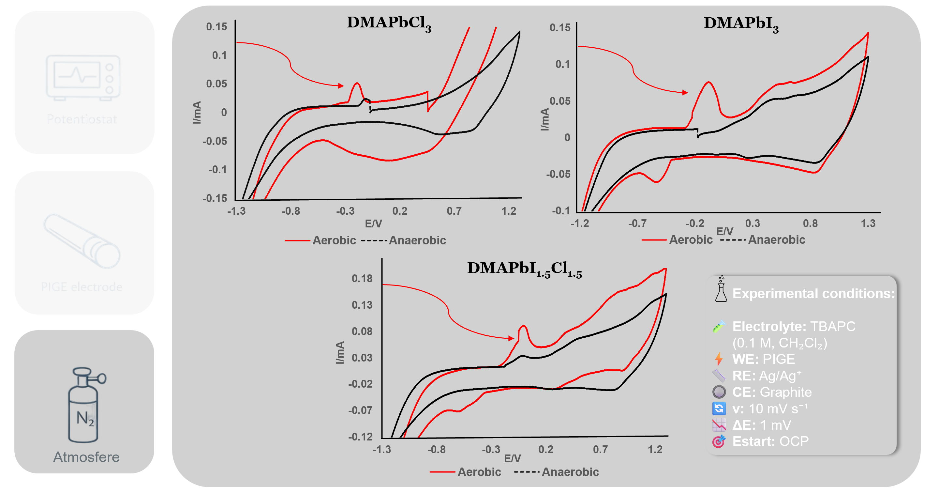
Results and discussions

Slide 5
Conclusions
C
CV analysis revealed electrochemical activity, with decreasing redox currents indicating partial degradation.
A
Solution-based synthesis of the novel mixed-halide perovskite DMAPbI_{1.5}Cl_{1.5}
B
PXRD, SEM–EDX, and vibrational spectroscopy confirmed composition, identity, and purity.

