Slide 1


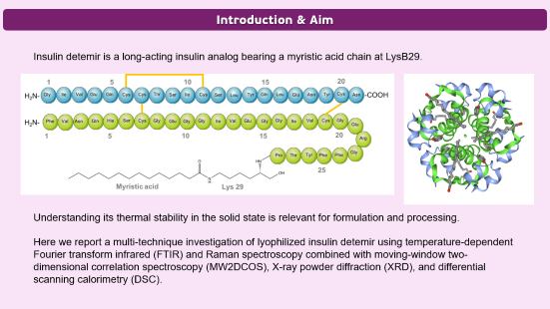
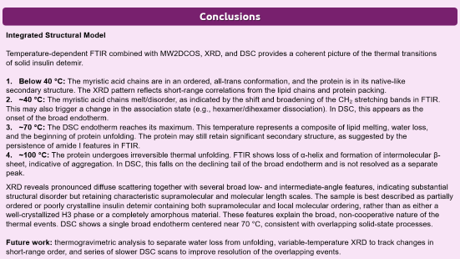
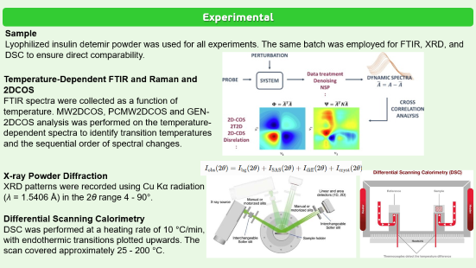


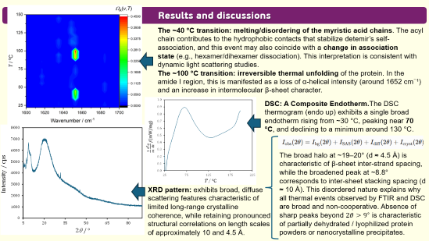

28th Congress of SCTM, 23-26 September, Ohrid, Macedonia
TEMPERATURE-DEPENDENT STRUCTURAL DYNAMICS OF MOLECULARLY ENGINEERED INSULIN DETEMIR REVEALED BY X-RAY DIFFRACTION AND TWO-DIMENSIONAL CORRELATION ANALYSIS OF INFRARED AND RAMAN SPECTRA
000
Hrisanta Godzo¹, Blagoj Achevski¹, Biljana Pejova², Katerina Brezovska¹, Ljupcho Pejov²
¹Faculty of Pharmacy, SS Cyril and Methodius University, Skopje, Macedonia
²Institute of Chemistry, Faculty of Natural Sciences and Mathematics, SS Cyril and Methodius University, Skopje, Macedonia

Slide 2
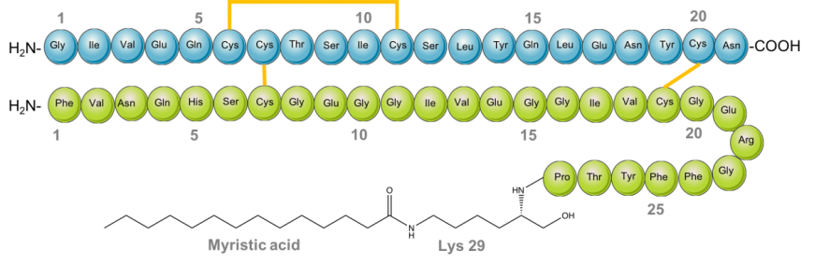
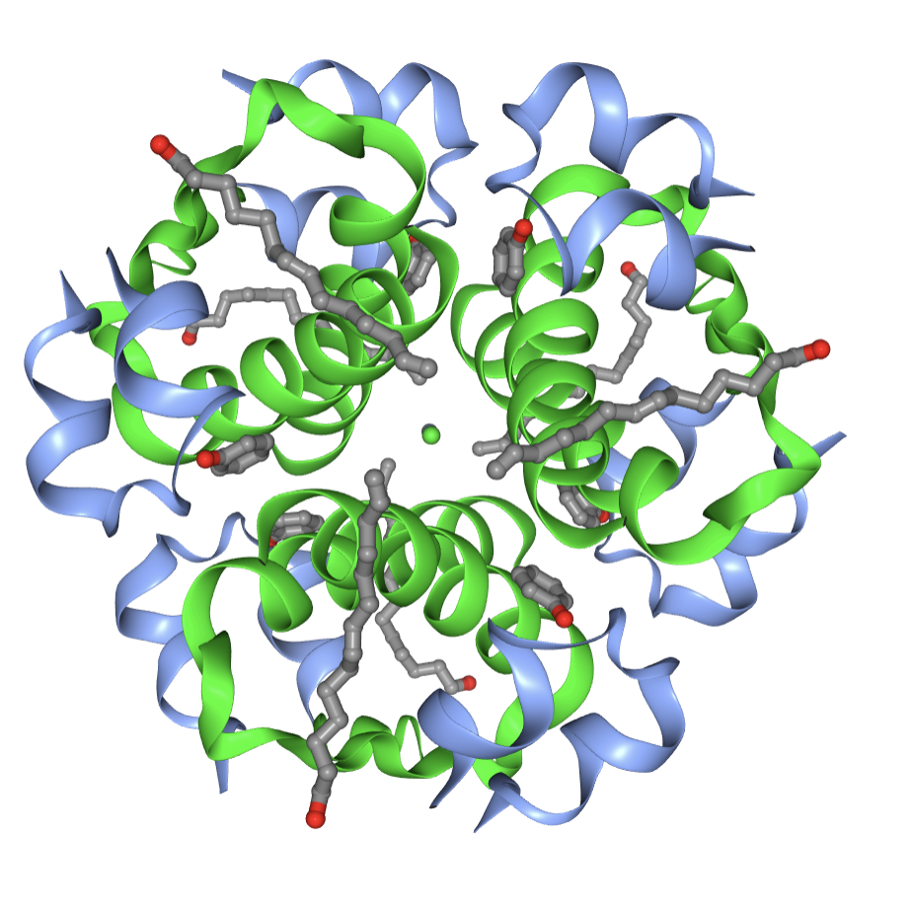
Introduction & Aim
Insulin detemir is a long-acting insulin analog bearing a myristic acid chain at LysB29.
Understanding its thermal stability in the solid state is relevant for formulation and processing.
Here we report a multi-technique investigation of lyophilized insulin detemir using temperature-dependent Fourier transform infrared (FTIR) and Raman spectroscopy combined with moving-window two-dimensional correlation spectroscopy (MW2DCOS), X-ray powder diffraction (XRD), and differential scanning calorimetry (DSC).

Slide 3
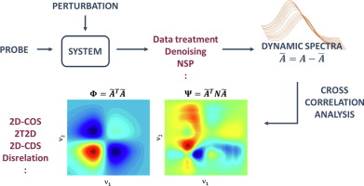
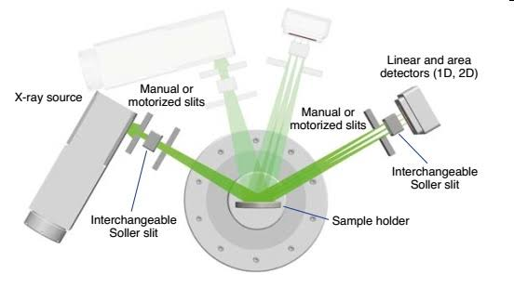
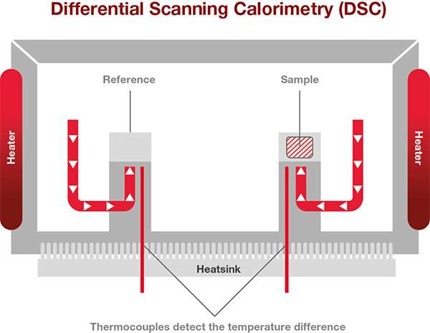
Experimental
Sample
Lyophilized insulin detemir powder was used for all experiments. The same batch was employed for FTIR, XRD, and DSC to ensure direct comparability.
Temperature-Dependent FTIR and Raman and 2DCOS
FTIR spectra were collected as a function of temperature. MW2DCOS, PCMW2DCOS and GEN-2DCOS analysis was performed on the temperature-dependent spectra to identify transition temperatures and the sequential order of spectral changes.
X-ray Powder Diffraction
XRD patterns were recorded using Cu Kα radiation (λ = 1.5406 Å) in the 2θ range 4 - 90°.
Differential Scanning Calorimetry
DSC was performed at a heating rate of 10 °C/min, with endothermic transitions plotted upwards. The scan covered approximately 25 - 200 °C.

Slide 4
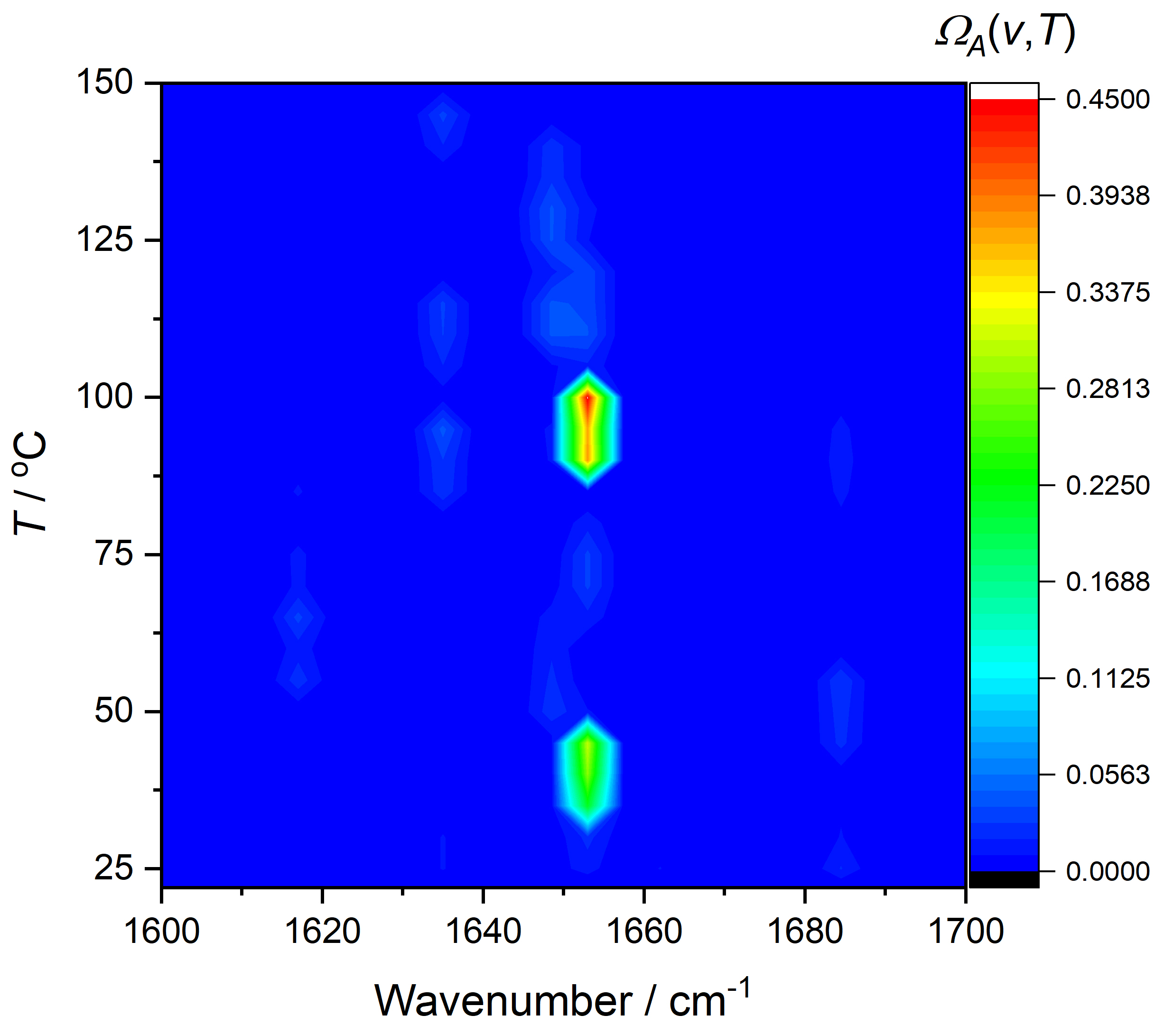
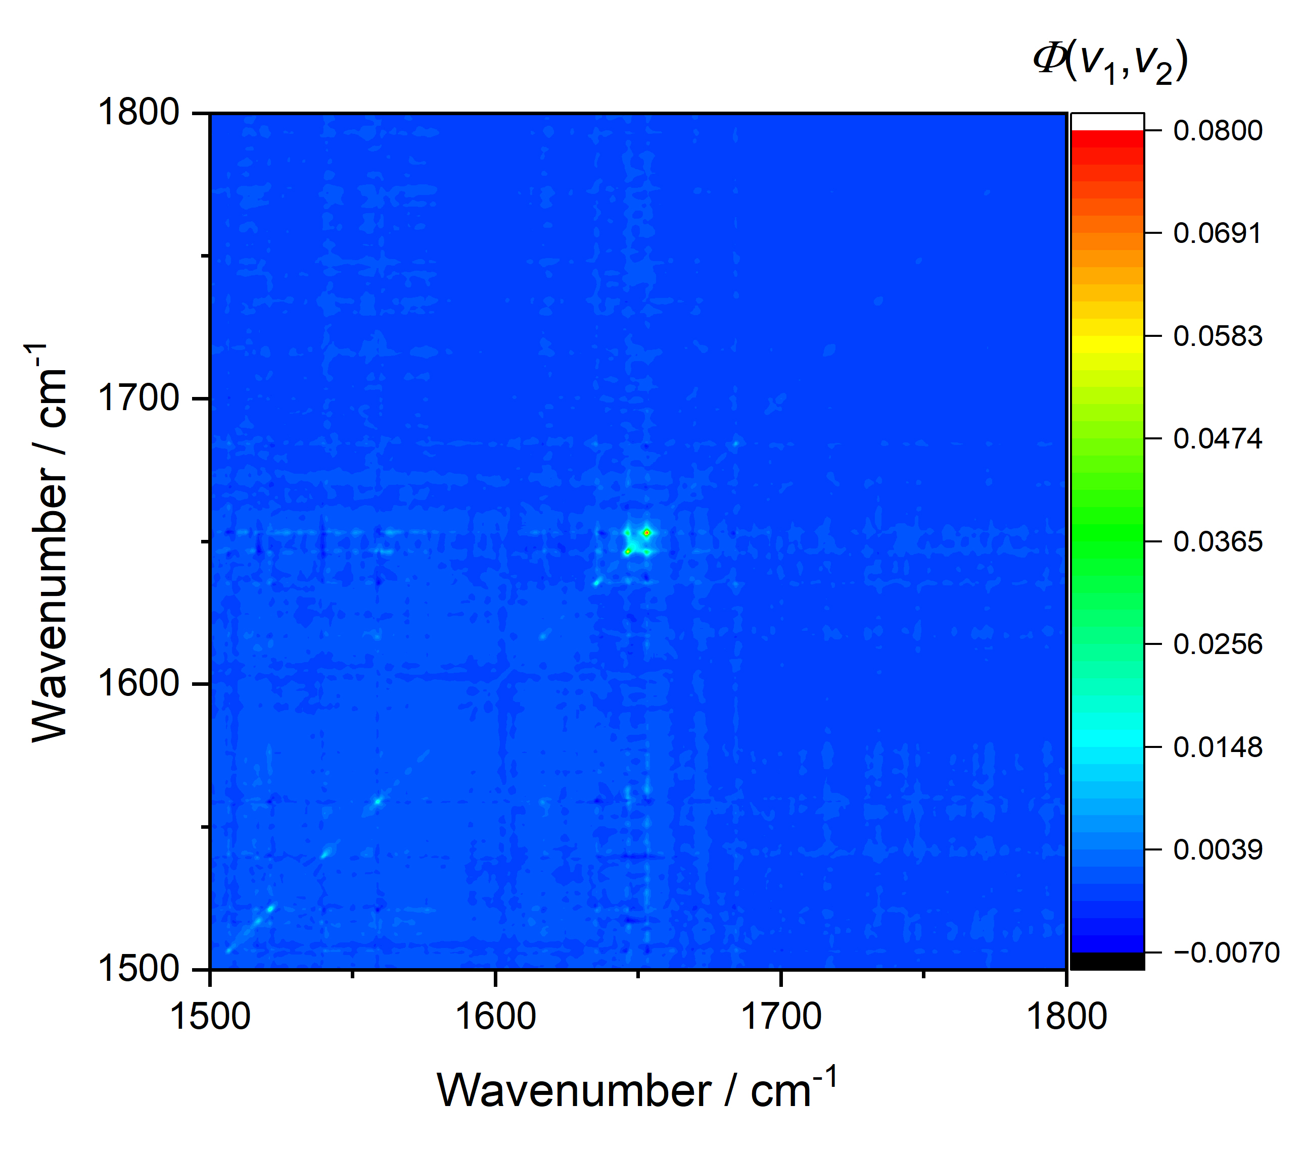
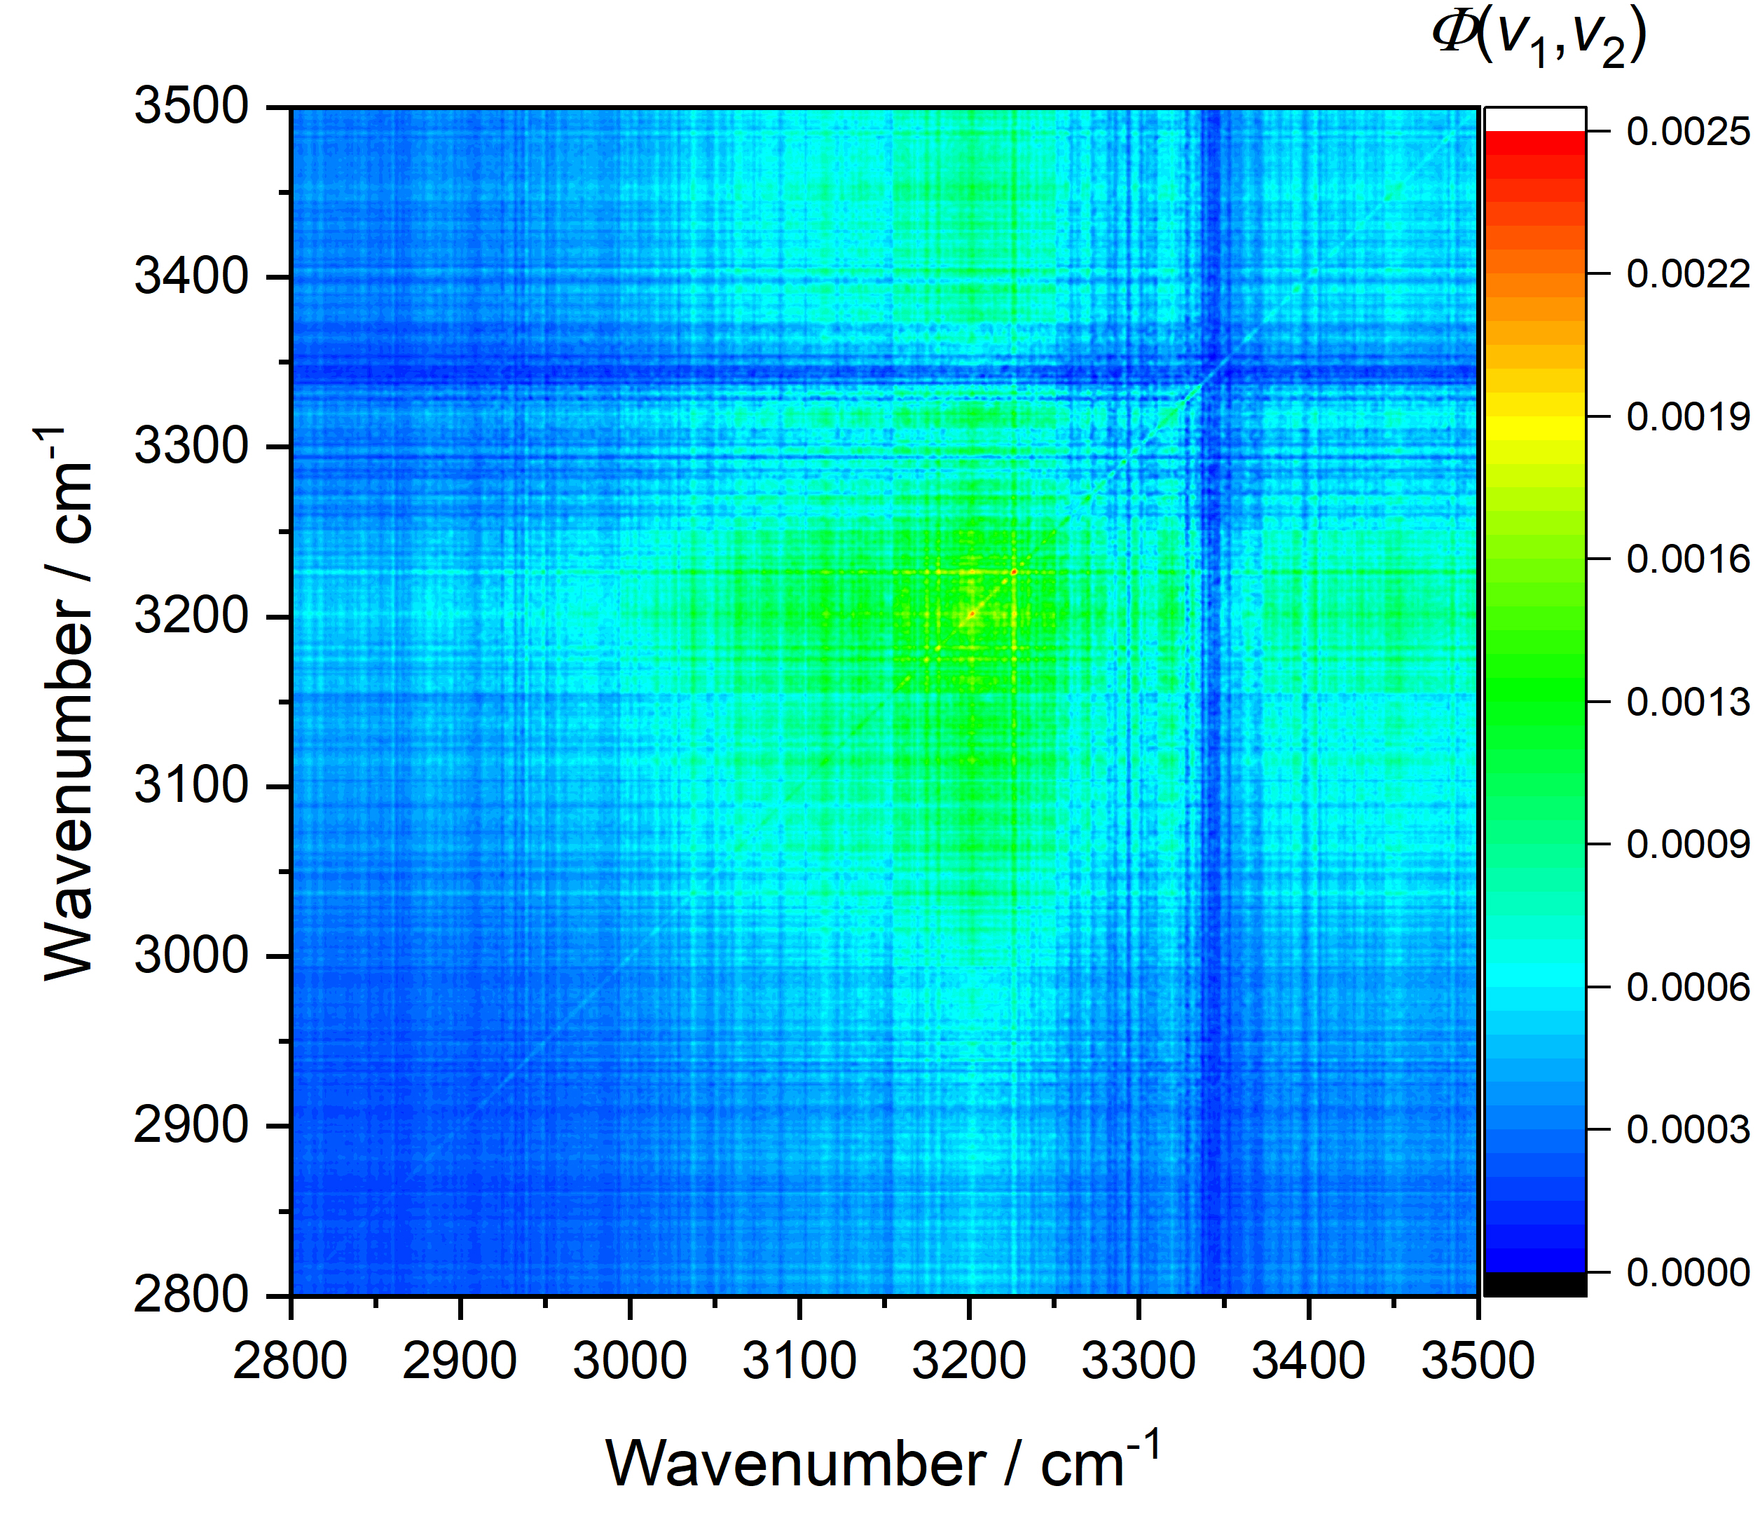
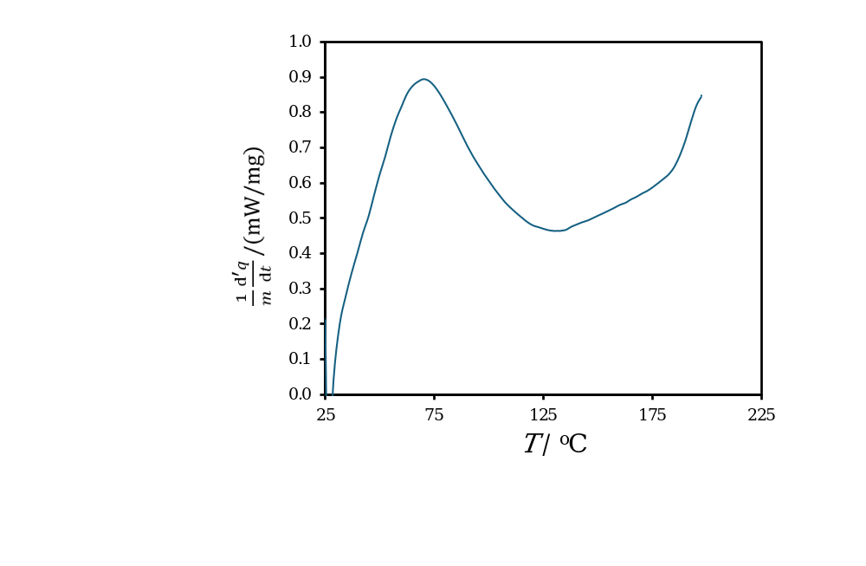
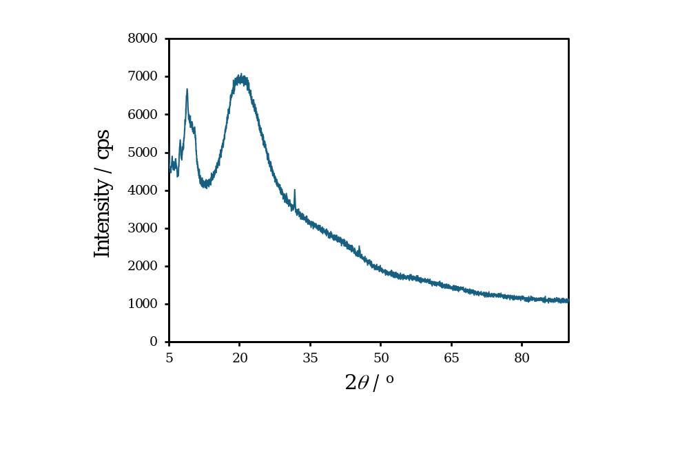
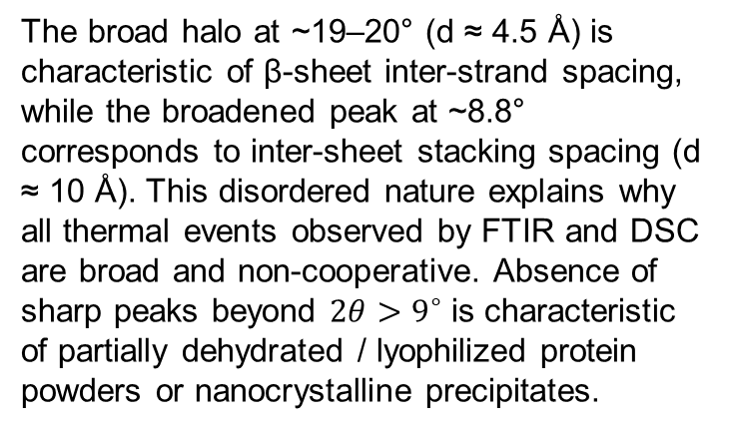
Results and discussions
The ~40 °C transition: melting/disordering of the myristic acid chains. The acyl chain contributes to the hydrophobic contacts that stabilize detemir’s self-association, and this event may also coincide with a change in association state (e.g., hexamer/dihexamer dissociation). This interpretation is consistent with dynamic light scattering studies.
The ~100 °C transition: irreversible thermal unfolding of the protein. In the amide I region, this is manifested as a loss of α-helical intensity (around 1652 cm⁻¹) and an increase in intermolecular β-sheet character.
DSC: A Composite Endotherm.The DSC thermogram (endo up) exhibits a single broad endotherm rising from ~30 °C, peaking near 70 °C, and declining to a minimum around 130 °C.
The broad halo at ~19–20° (d ≈ 4.5 Å) is characteristic of β-sheet inter-strand spacing, while the broadened peak at ~8.8° corresponds to inter-sheet stacking spacing (d ≈ 10 Å). This disordered nature explains why all thermal events observed by FTIR and DSC are broad and non-cooperative. Absence of sharp peaks beyond $2θ>9^{∘}$ is characteristic of partially dehydrated / lyophilized protein powders or nanocrystalline precipitates.
XRD pattern: exhibits broad, diffuse scattering features characteristic of limited long-range crystalline coherence, while retaining pronounced structural correlations on length scales of approximately 10 and 4.5 Å.

Slide 5
Conclusions
Integrated Structural Model
Temperature-dependent FTIR combined with MW2DCOS, XRD, and DSC provides a coherent picture of the thermal transitions of solid insulin detemir.
Below 40 °C: The myristic acid chains are in an ordered, all-trans conformation, and the protein is in its native-like secondary structure. The XRD pattern reflects short-range correlations from the lipid chains and protein packing.
~40 °C: The myristic acid chains melt/disorder, as indicated by the shift and broadening of the CH₂ stretching bands in FTIR. This may also trigger a change in the association state (e.g., hexamer/dihexamer dissociation). In DSC, this appears as the onset of the broad endotherm.
~70 °C: The DSC endotherm reaches its maximum. This temperature represents a composite of lipid melting, water loss, and the beginning of protein unfolding. The protein may still retain significant secondary structure, as suggested by the persistence of amide I features in FTIR.
~100 °C: The protein undergoes irreversible thermal unfolding. FTIR shows loss of α-helix and formation of intermolecular β-sheet, indicative of aggregation. In DSC, this falls on the declining tail of the broad endotherm and is not resolved as a separate peak.
XRD reveals pronounced diffuse scattering together with several broad low- and intermediate-angle features, indicating substantial structural disorder but retaining characteristic supramolecular and molecular length scales. The sample is best described as partially ordered or poorly crystalline insulin detemir containing both supramolecular and local molecular ordering, rather than as either a well-crystallized H3 phase or a completely amorphous material. These features explain the broad, non-cooperative nature of the thermal events. DSC shows a single broad endotherm centered near 70 °C, consistent with overlapping solid-state processes.
Future work: thermogravimetric analysis to separate water loss from unfolding, variable-temperature XRD to track changes in short-range order, and series of slower DSC scans to improve resolution of the overlapping events.

