Slide 1

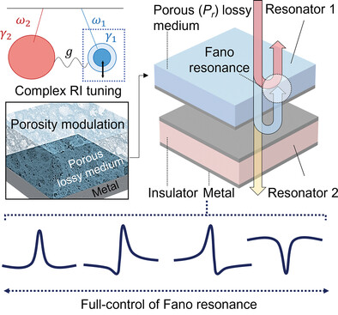
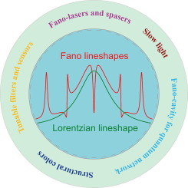
TWO-DIMENSIONAL CORRELATION ANALYSIS OF FANO RESONANCE LINE SHAPES: DISCOVERING NEW SPECTROSCOPIC FINGERPRINTS
Rola Moussa¹, Biljana Pejova², Vlado Lazarov¹, Ljupcho Pejov²
e-mail: ljupcop@pmf.ukim.mk
¹School of Physics Engineering and Technology, University of York, York, YO10 5DD, UK
²Institute of Chemistry, Faculty of Natural Sciences and Mathematics, SS Cyril and Methodius University, Skopje, Macedonia

Slide 2
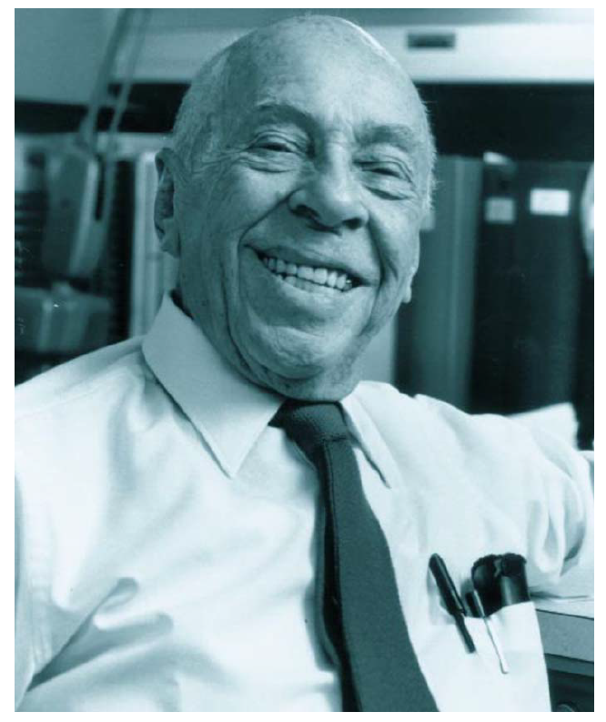
Fano Resonance: A Quantum Interference of Two Pathways/Processes
Fano resonance: fundamental wave-scattering phenomenon characterized by an asymmetric spectral line profile, arising from the quantum interference between a discrete (localized) state and a continuum of propagating states;
First observed by Beutler in 1935 as asymmetric profiles in atomic absorption spectra;
Theoretically explained by the Italian-American physicist Ugo Fano in the same year, with a more elaborate formulation published in his seminal 1961 paper—now recognized as one of the most influential works in 20th-century physics.

Slide 3
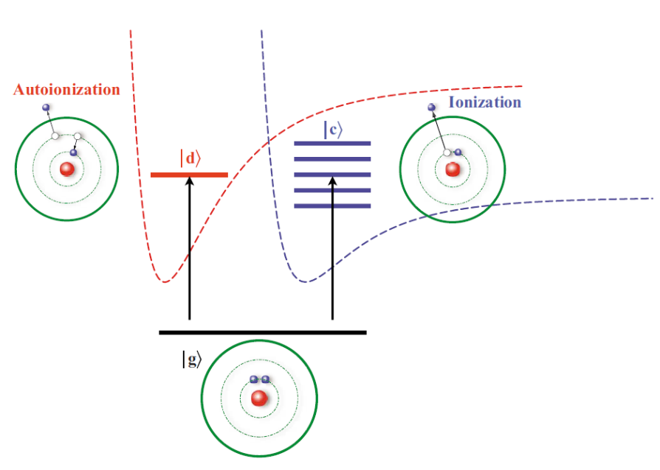
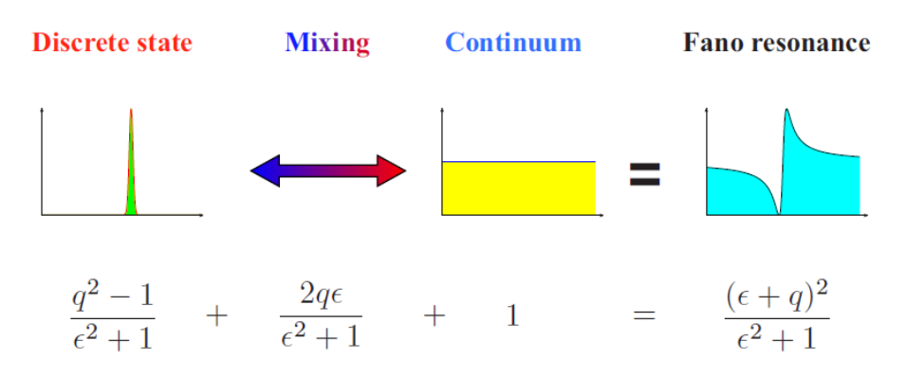
A + hv → A⁺ + e⁻
A + hv → A* → A⁺ + e⁻

Slide 4
The physical mechanism
The Fano resonance emerges when a system offers two competing pathways to reach the same final state:
Pathway 1 (direct): Scattering through the continuum (broad, featureless background);
Pathway 2 (indirect): Scattering via a discrete, quasi-bound state (narrow resonance)
The interference between these two pathways—constructive on one side of the resonance and destructive on the other—produces the hallmark asymmetric line shape
In essence, the Fano resonance describes the coupling and interference of a narrow discrete mode with a broad continuum mode

Slide 5
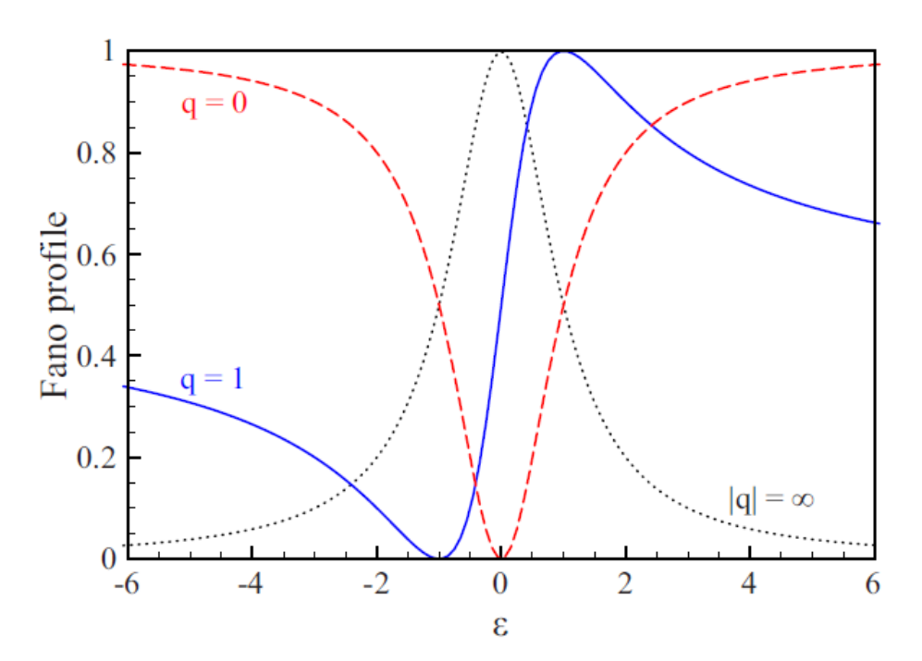
Mathematics & Discrete-Continuum Coupling
• Fano Formula:
where
• Coupling: Discrete |d⟩ interacts with Continuum |c⟩ via ${\hat{H}}_{int}$. This 'dresses' the state, giving finite lifetime.
• Tuning q:
- q=0 → Dip (Anti-resonance).
- q=∞ → Lorentzian.
- q=±1 → Maximum asymmetry.
$$I\left(E\right)=\frac{{\left(ε+q\right)}^{2}}{1+ε^{2}}$$
$$q\sim \frac{\left\langle d | \hat{T} | i\right\rangle }{π\left\langle d | {\hat{H}}_{int} | c\right\rangle \left\langle c | \hat{T} | i\right\rangle }$$
$$ε=\frac{2\left(E−E_{res.}\right)}{Γ}$$

Slide 6
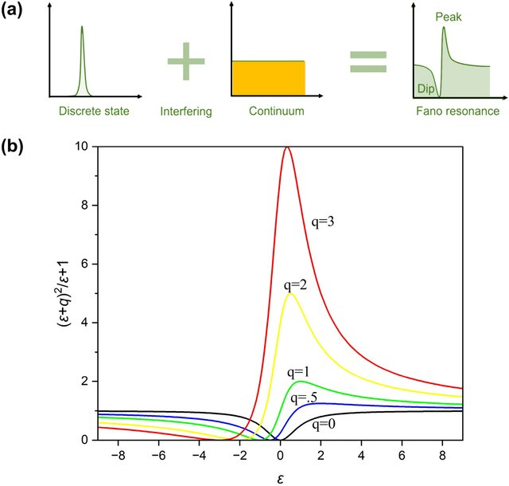

Slide 7
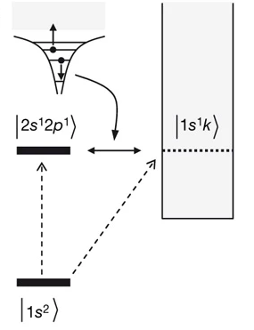
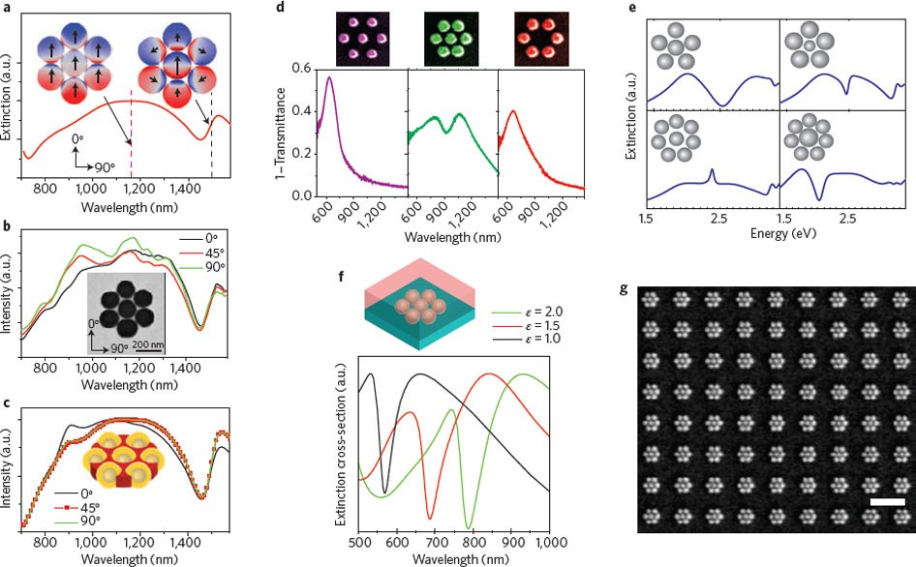
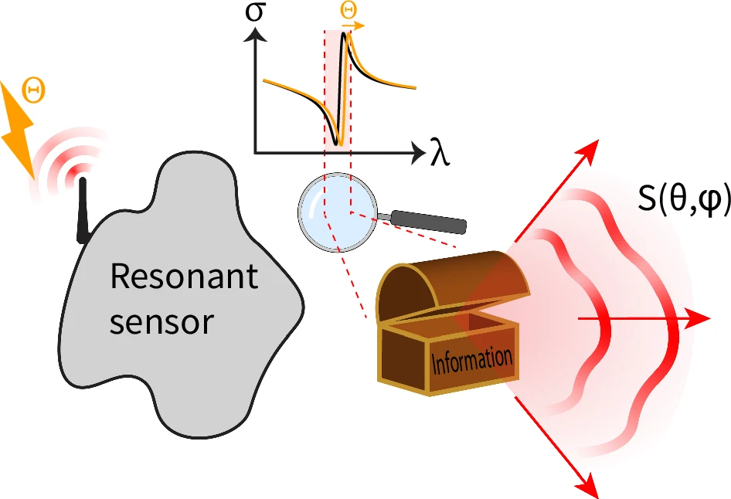
Ubiquity & Modern Applications
• Observed in:
- Atomic/Molecular photoionization.
- Quantum dots & 2D materials.
- Photonic crystals & Metamaterials.
- Plasmonic nanostructures.
• Key Applications:
- Ultra-sensitive Biosensing (high FOM).
- All-optical Switching & Modulation.
- High-Q Lasers and Optical Filters.
• Future: Topological Fano resonances and AI-designed metasurfaces.

Slide 8
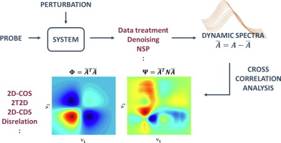
Two-dimensional correlation “spectroscopy”
2D correlation spectroscopy:
transforms subtle line-shape differences into characteristic correlation patterns;
provides a potentially powerful way to distinguish conventional resonances from interference-modified resonances even when their 1D spectra appear superficially similar.

Slide 9
2DCOS diagnostics:
2DCOS: offers an additional dimension of spectral information that can reveal differences between resonances that are difficult to resolve in conventional one-dimensional spectra.
Relevant for distinguishing Lorentzian and Fano line shapes: comparable spectral shifts and linewidth changes, originating from fundamentally different physical mechanisms.
Mechanism-sensitive diagnostic for distinguishing ordinary resonances from interference resonances.
How resonance displacement and line-shape asymmetry are transformed into multidimensional correlation features.
Such simulations provide a well-defined theoretical basis for identifying correlation signatures associated specifically with Fano interference and for determining whether these signatures remain distinguishable under finite spectral shifts and other realistic spectral perturbations.

Slide 10
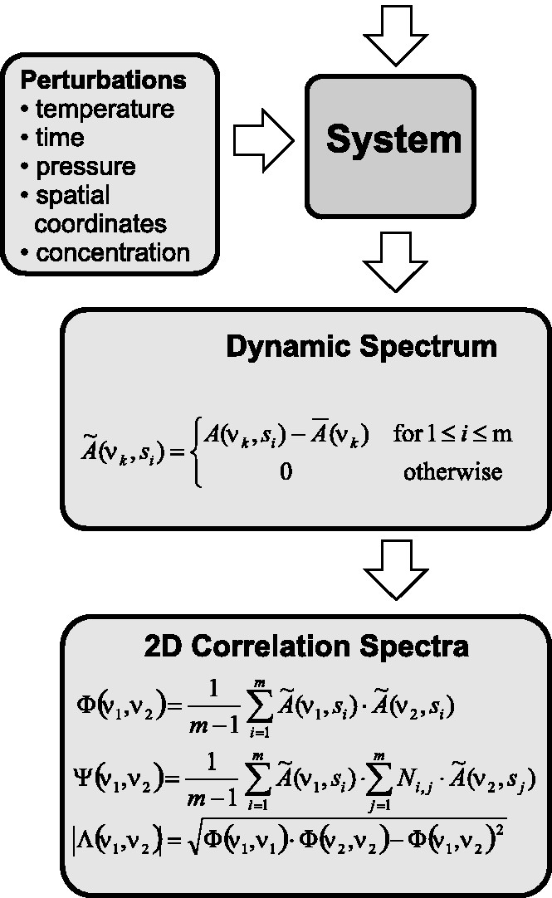

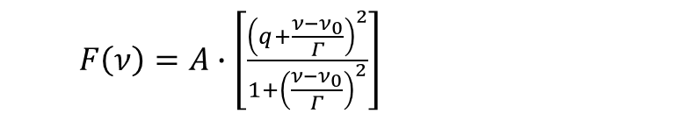
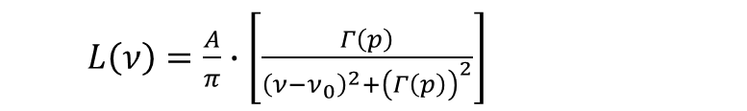
Lorentzian (Cauchy)
$L\left(ν\right)=\frac{A}{π}∙\left[\frac{Γ}{{\left(ν−ν_{0}\right)}^{2}+Γ^{2}}\right]$
$L\left(ν\right)=\frac{A}{π}∙\left[\frac{Γ}{{\left(ν−ν_{0}\left(p\right)\right)}^{2}+Γ^{2}}\right]$
$L\left(ν\right)=\frac{A}{π}∙\left[\frac{Γ\left(p\right)}{{\left(ν−ν_{0}\right)}^{2}+{\left(Γ\left(p\right)\right)}^{2}}\right]$
Fano
$F\left(ν\right)=A∙\left[\frac{{\left(q+\frac{ν−ν_{0}}{Γ}\right)}^{2}}{1+{\left(\frac{ν−ν_{0}}{Γ}\right)}^{2}}\right]$
$F\left(ν\right)=A∙\left[\frac{{\left(q\left(p\right)+\frac{ν−ν_{0}\left(p\right)}{Γ\left(p\right)}\right)}^{2}}{1+{\left(\frac{ν−ν_{0}\left(p\right)}{Γ\left(p\right)}\right)}^{2}}\right]$
$$ν_{0}\left(p\right)=ν_{0}^{\left(0\right)}+a∙p$$
$$Γ\left(p\right)=Γ^{\left(0\right)}+b∙p$$
$$q\left(p\right)=q^{\left(0\right)}+c∙p$$

Slide 11
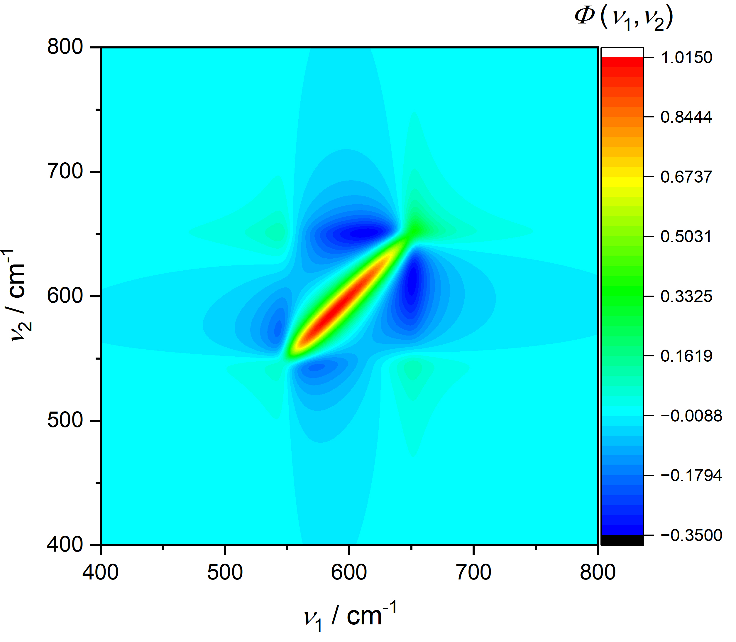
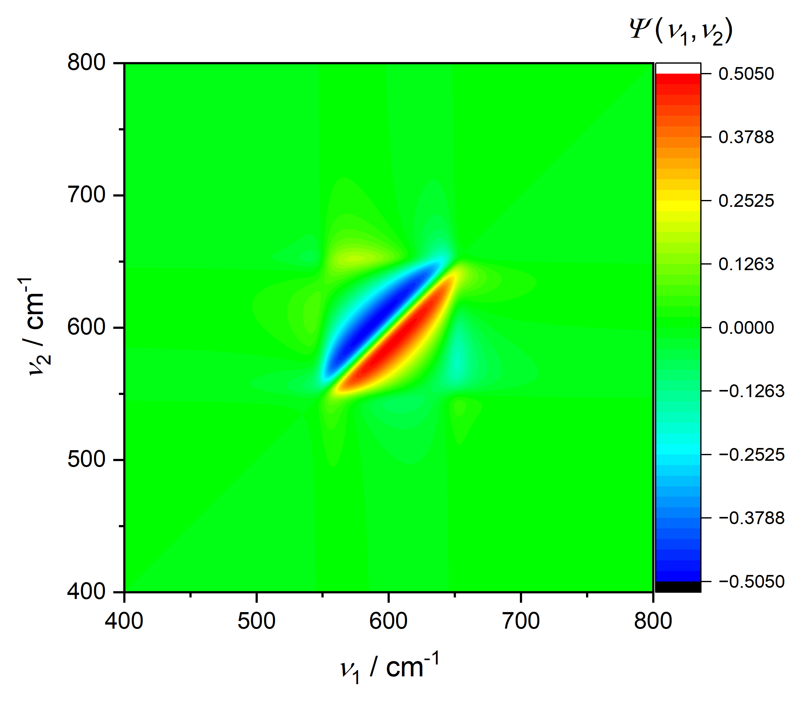
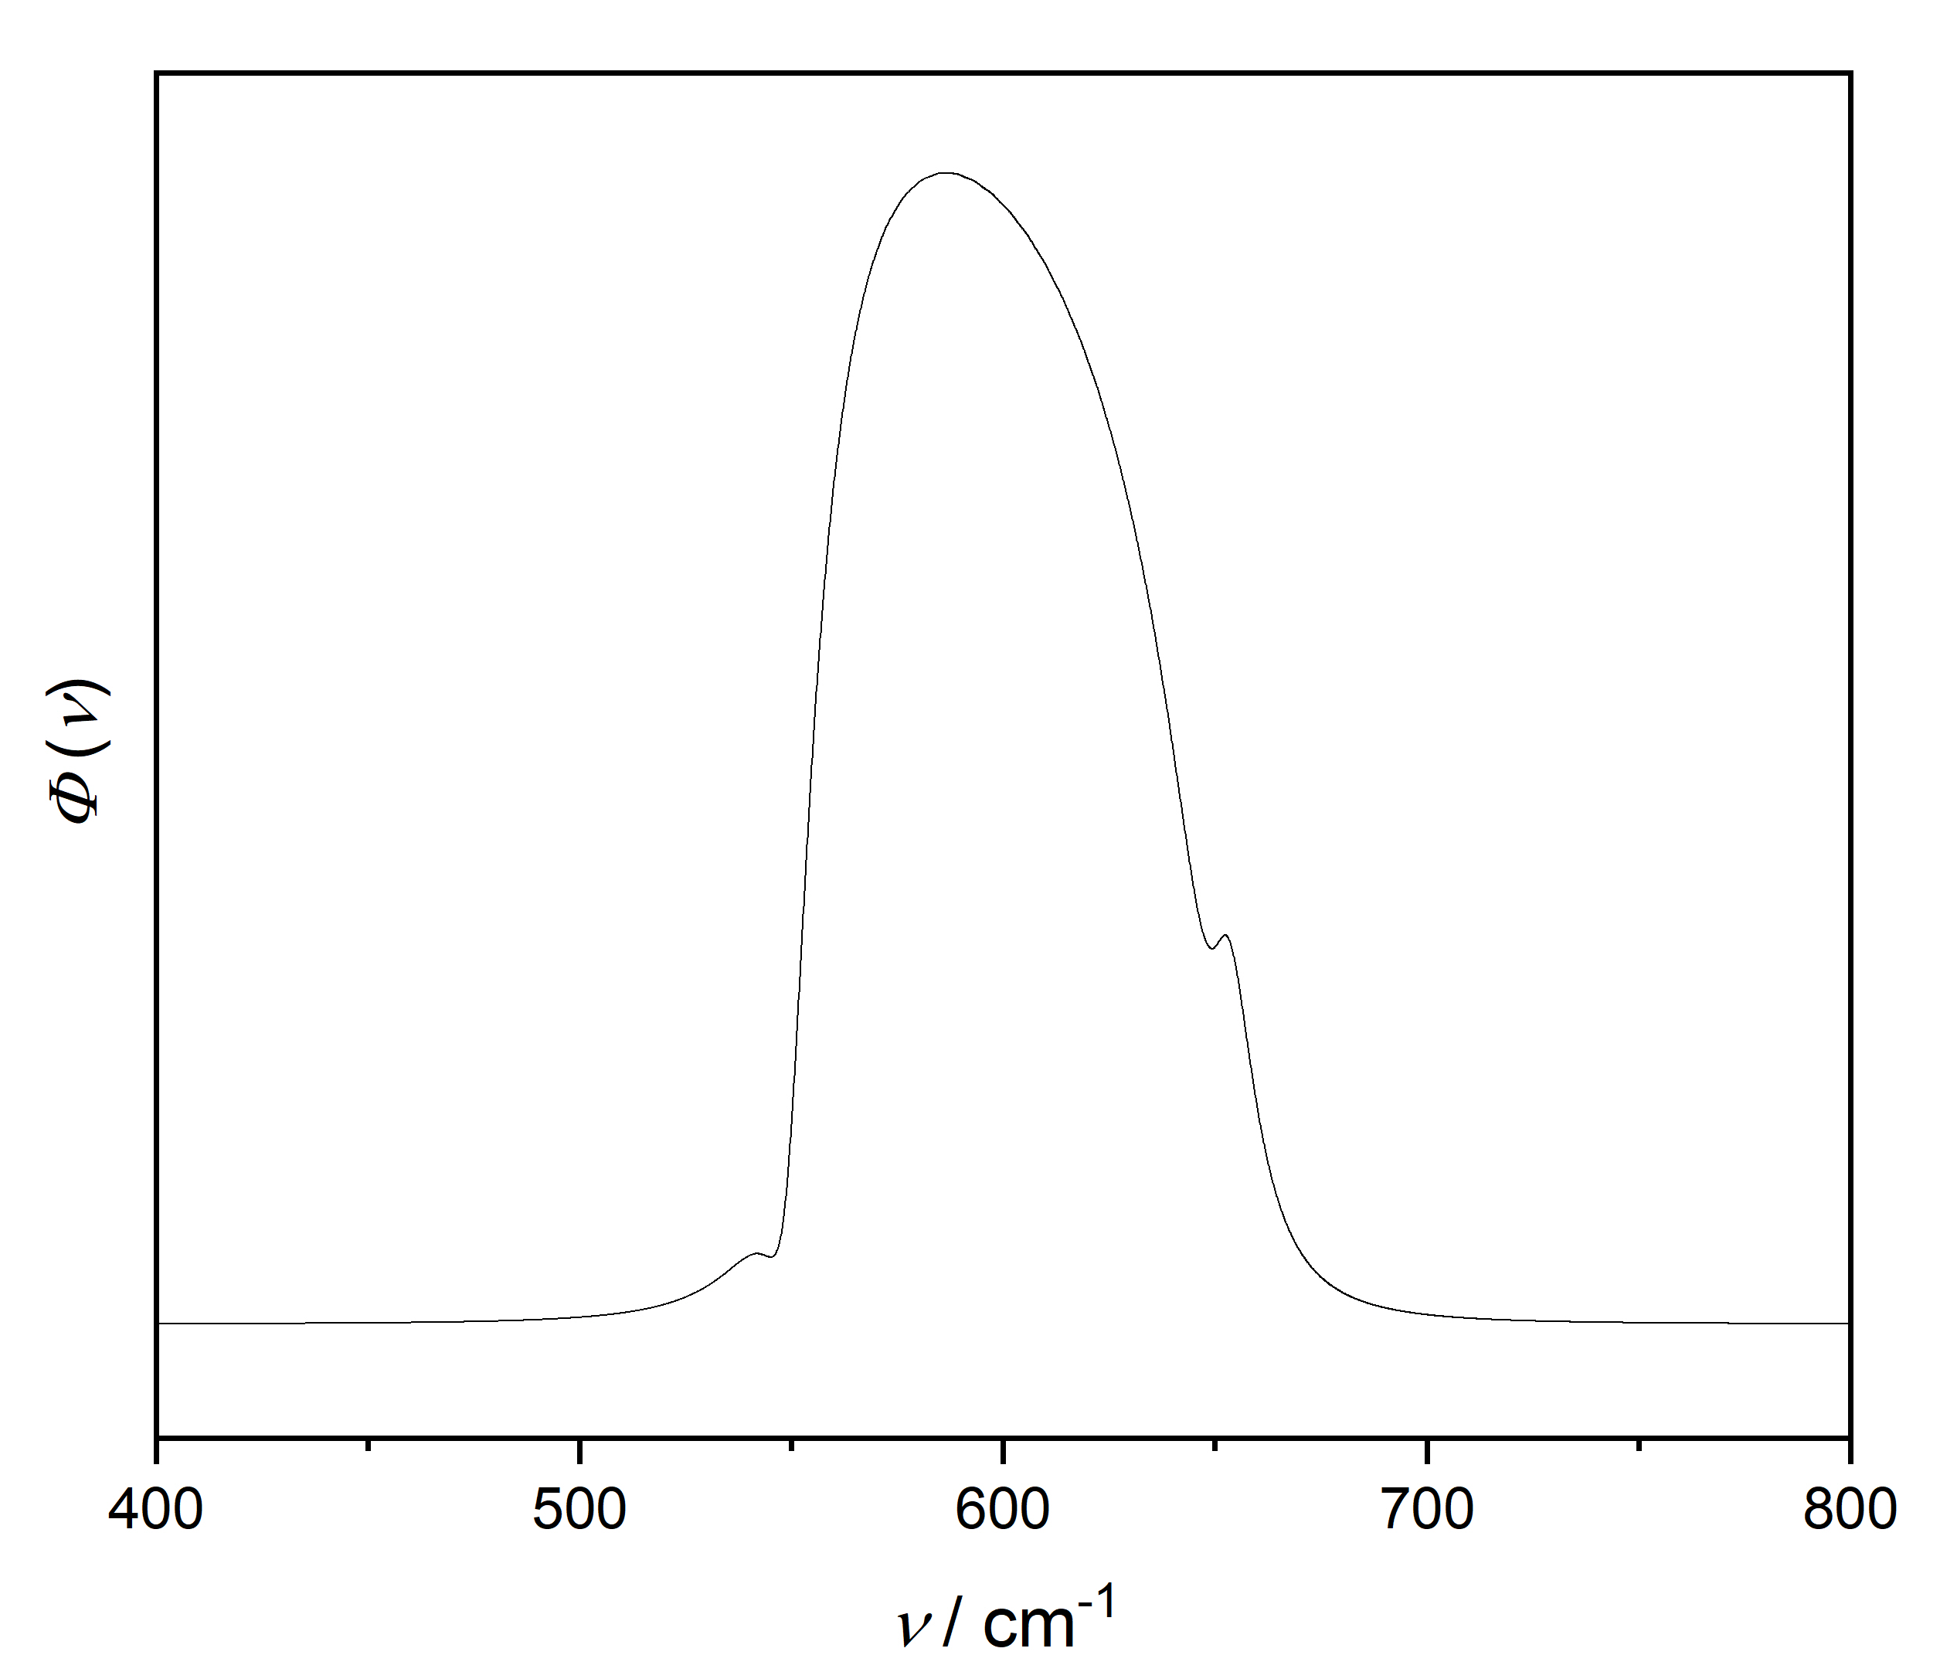
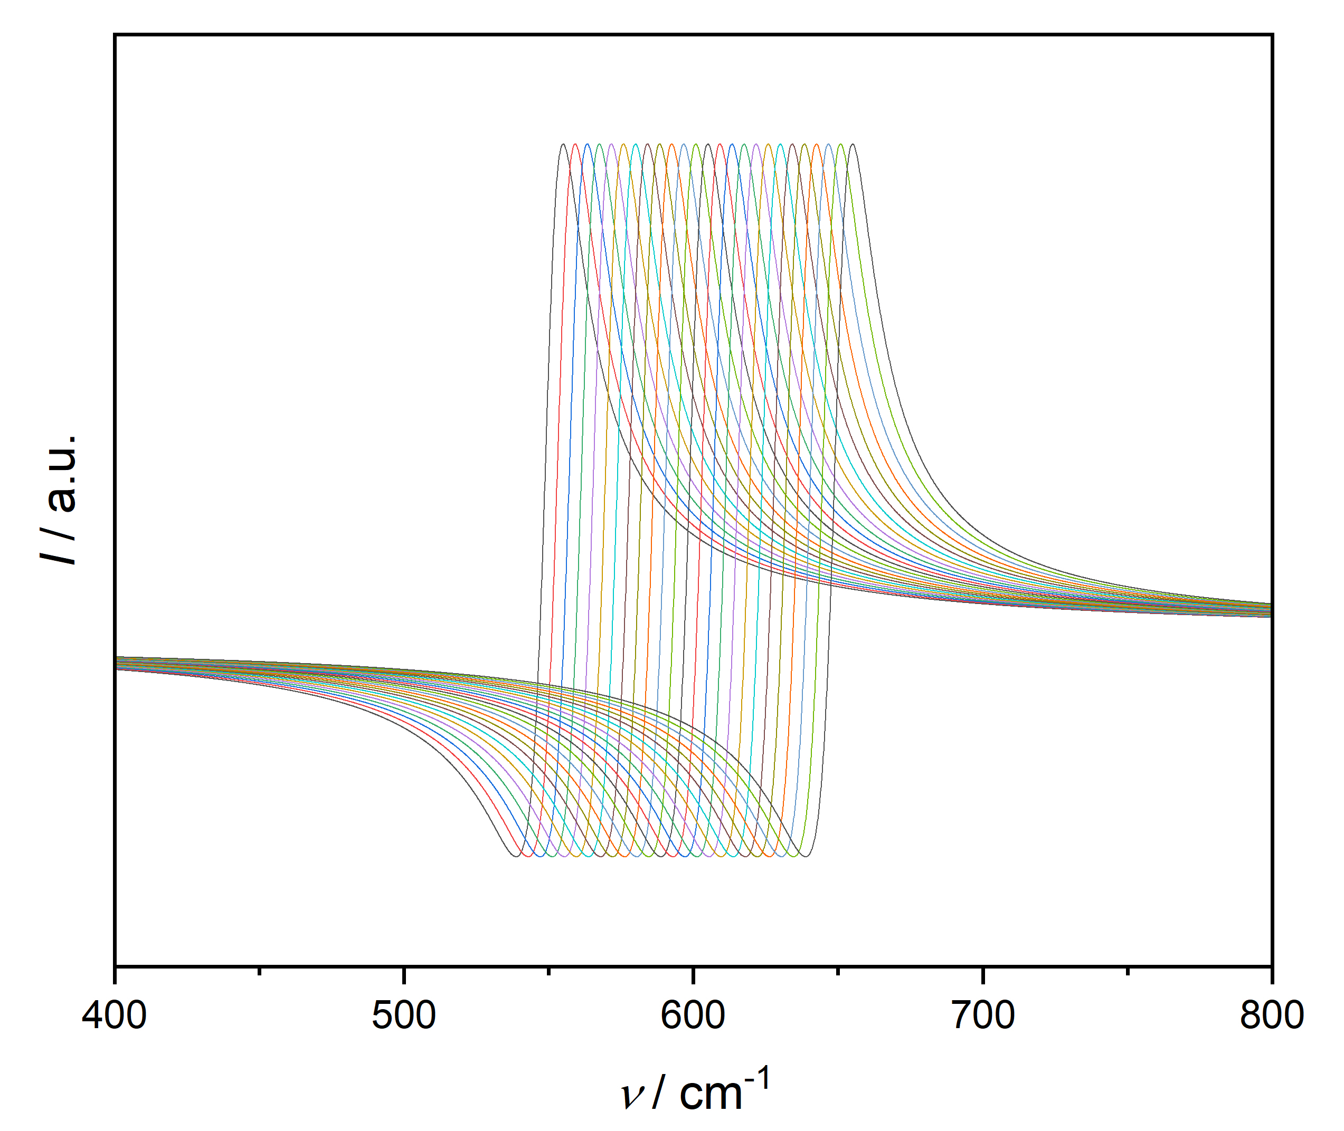
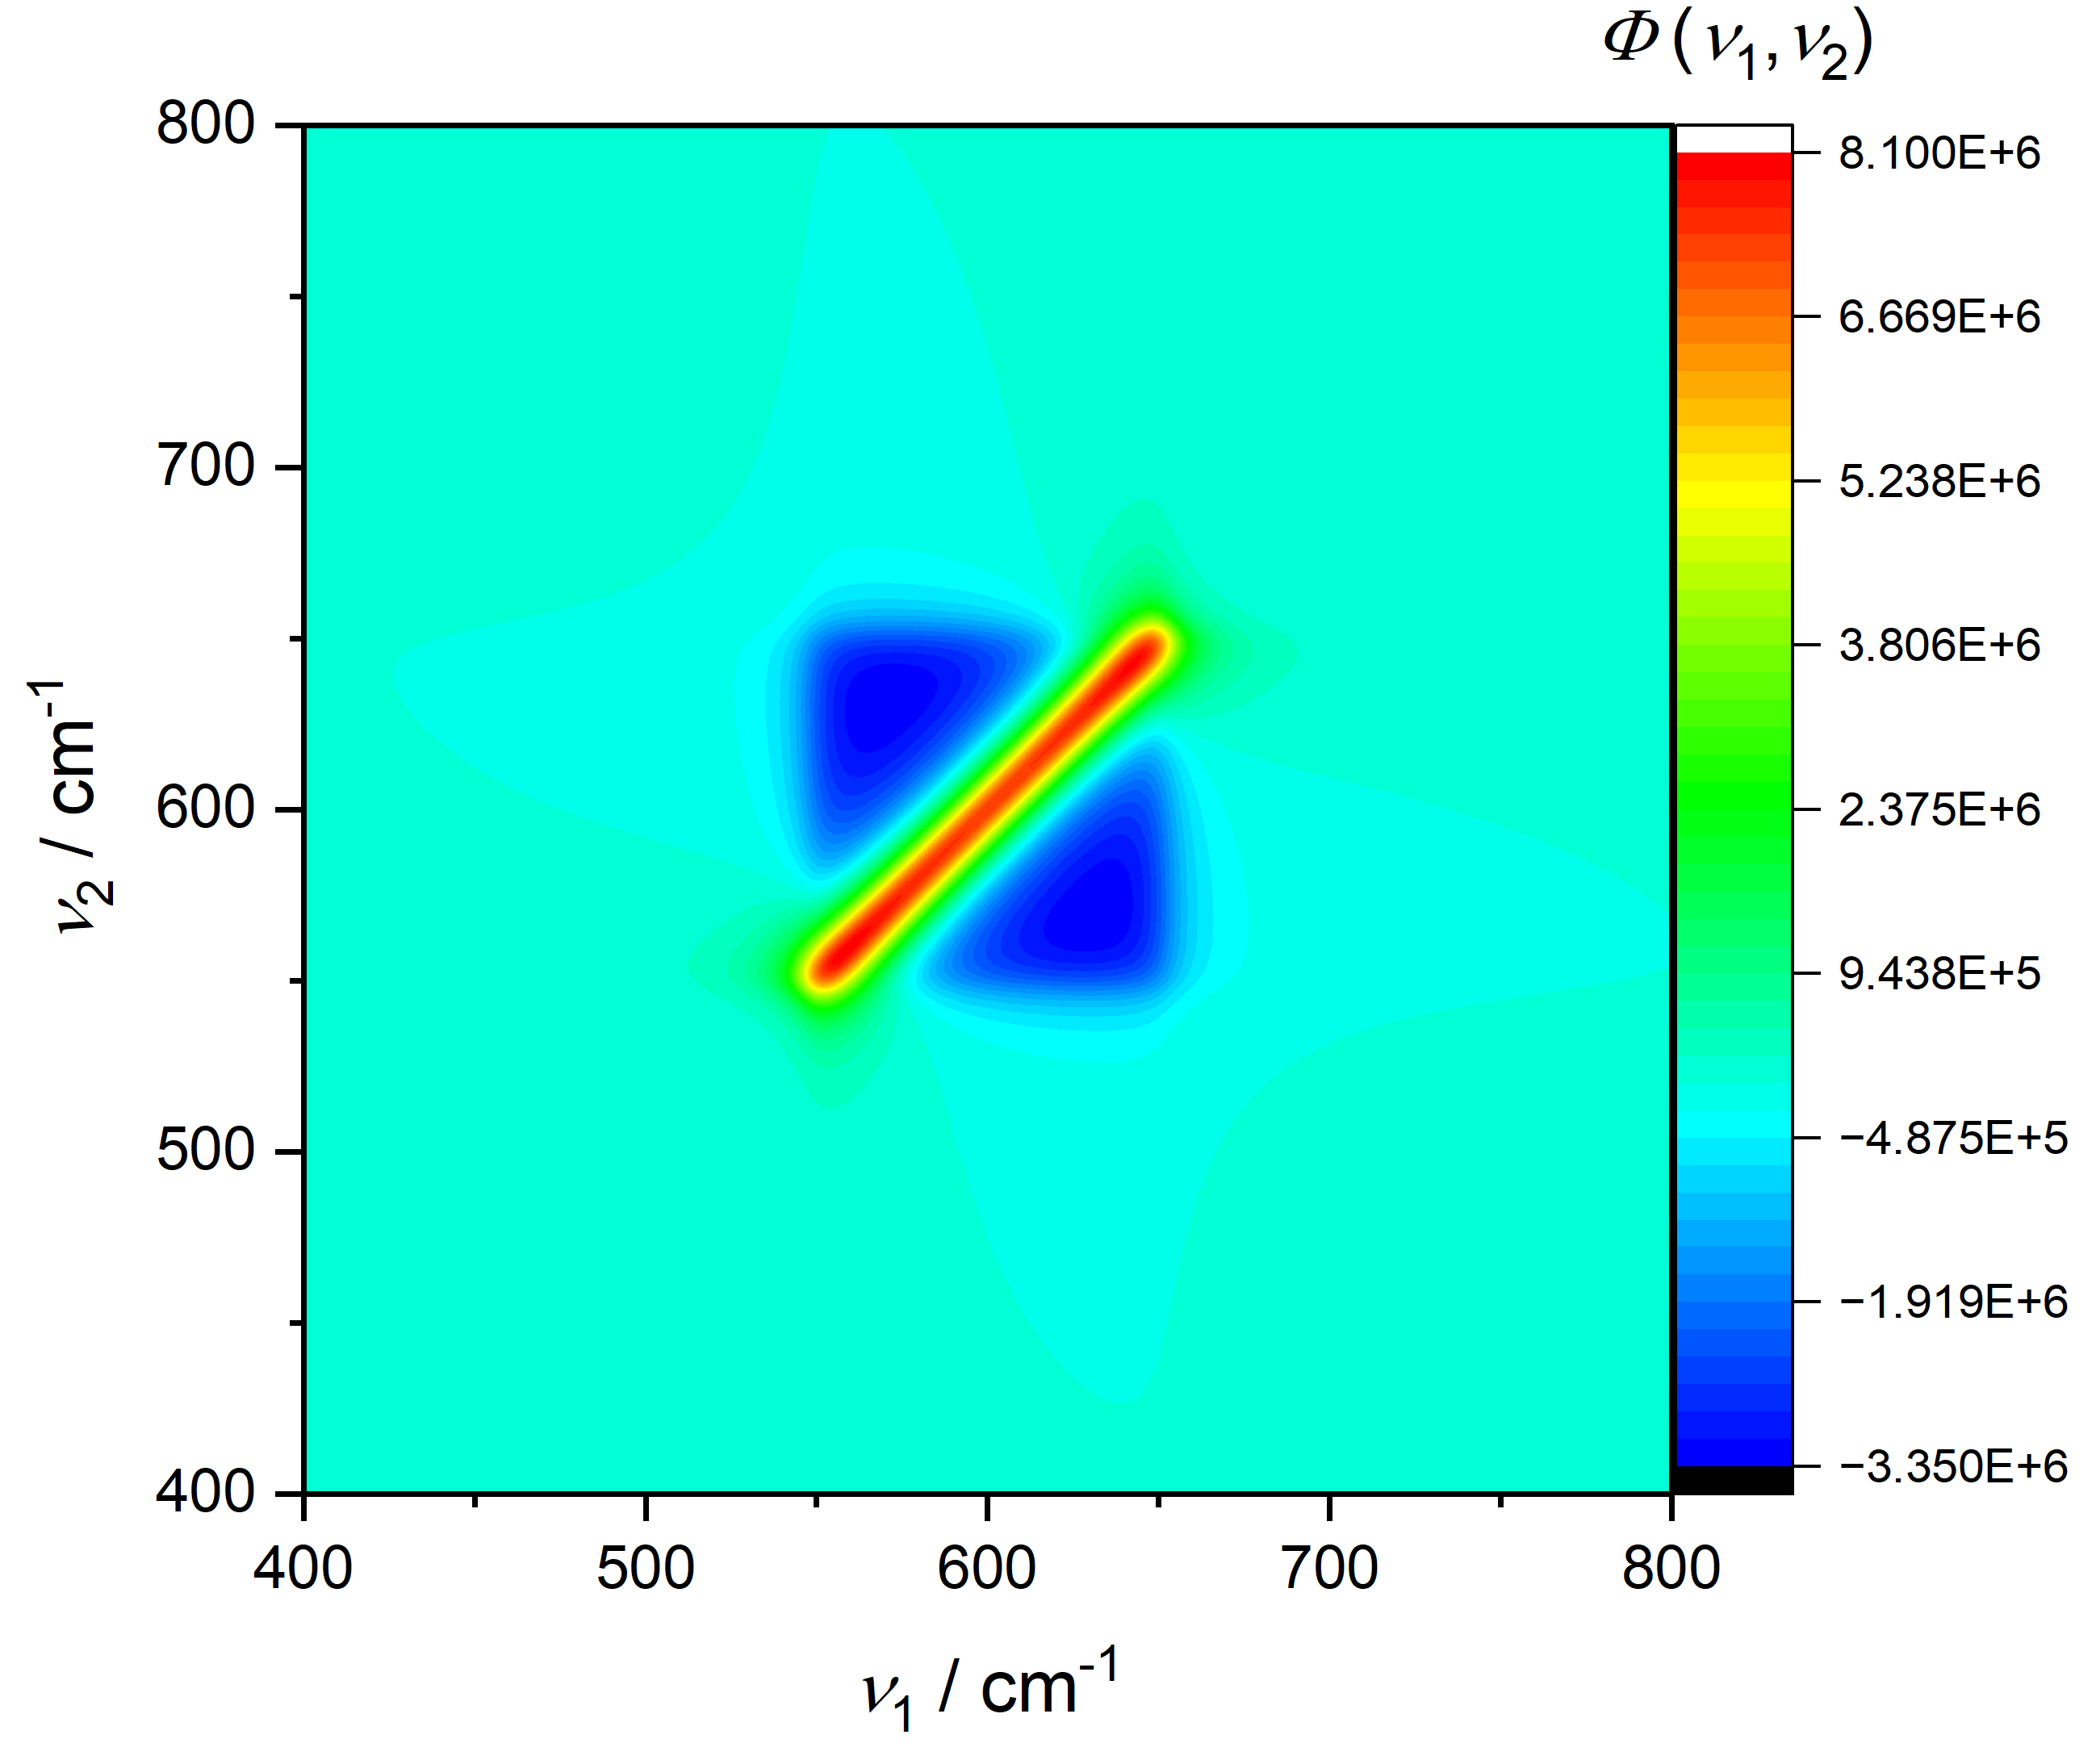
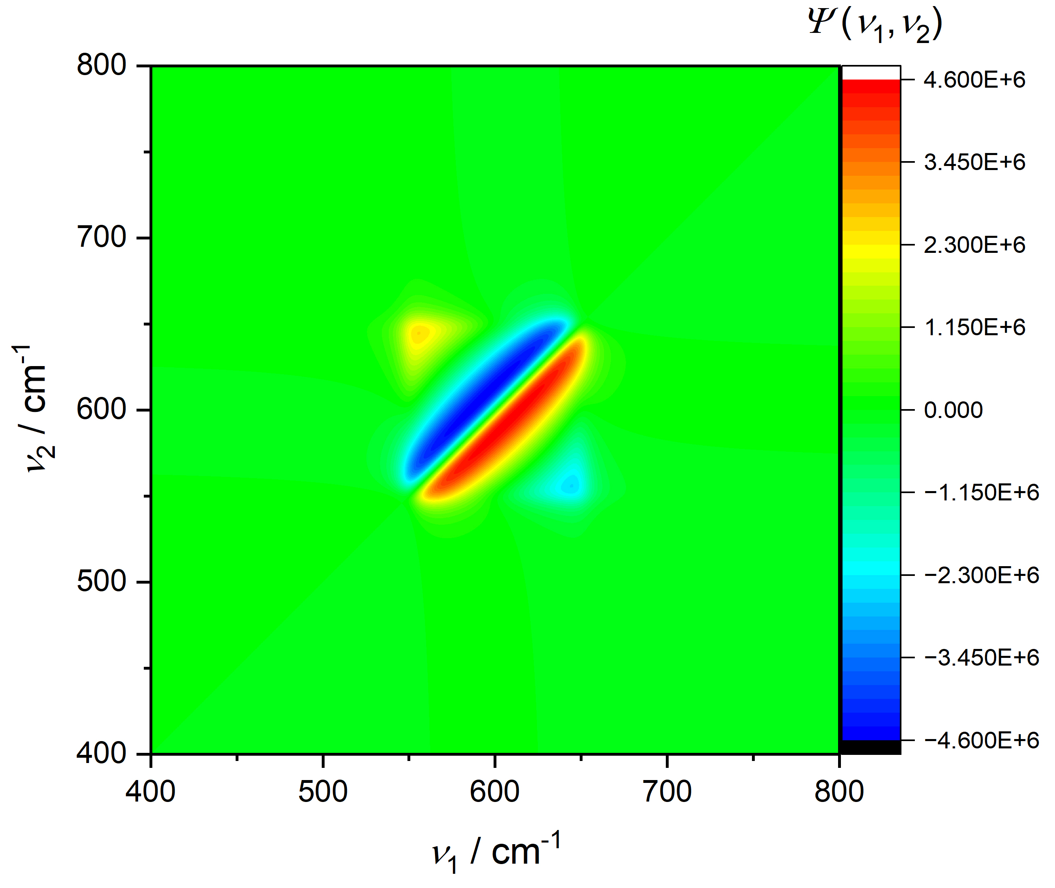
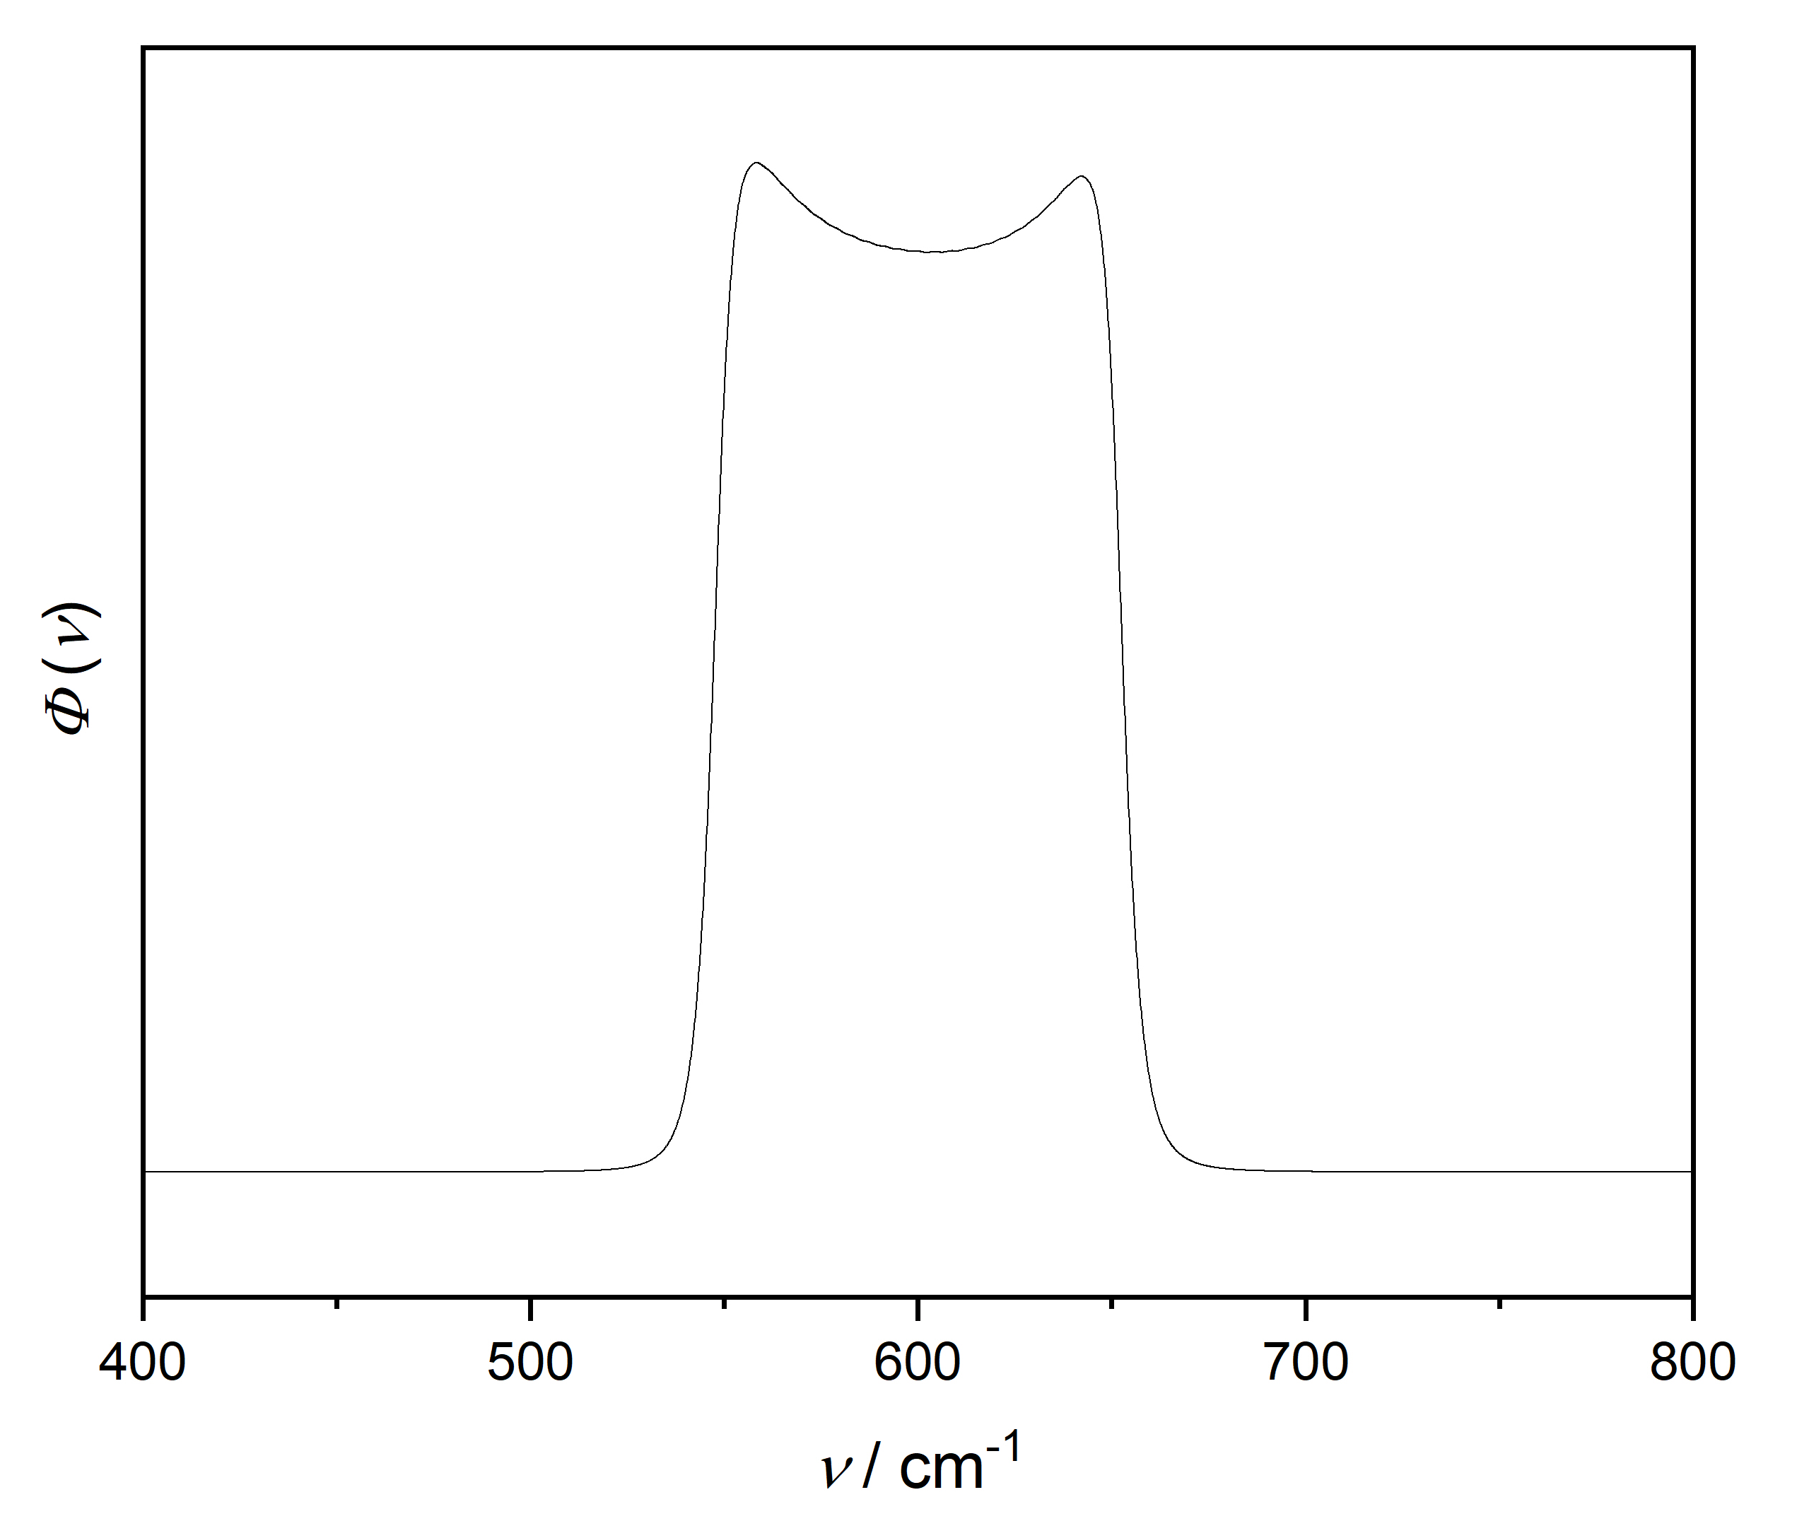
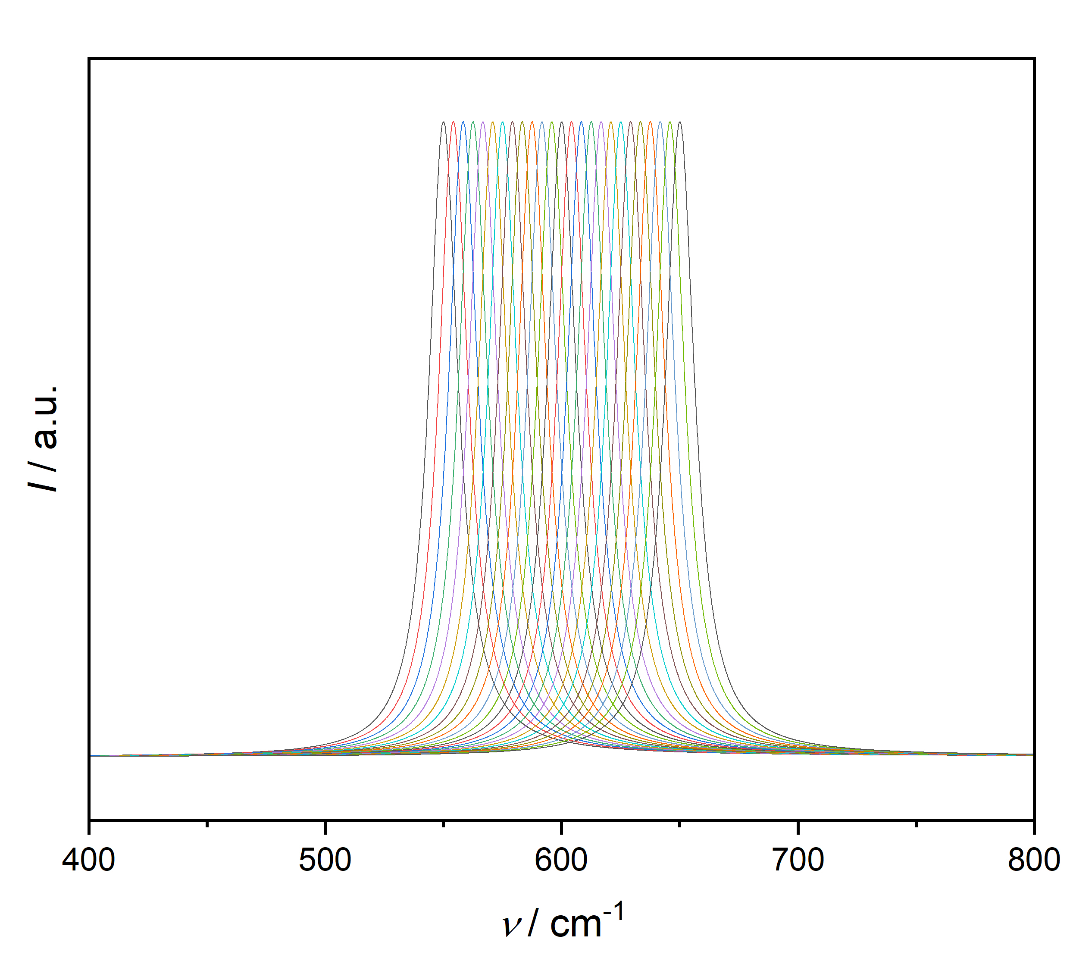
Single Fano/Cauchy band, uniform shift:
Fano (q = 1.5)
Cauchy

Slide 12
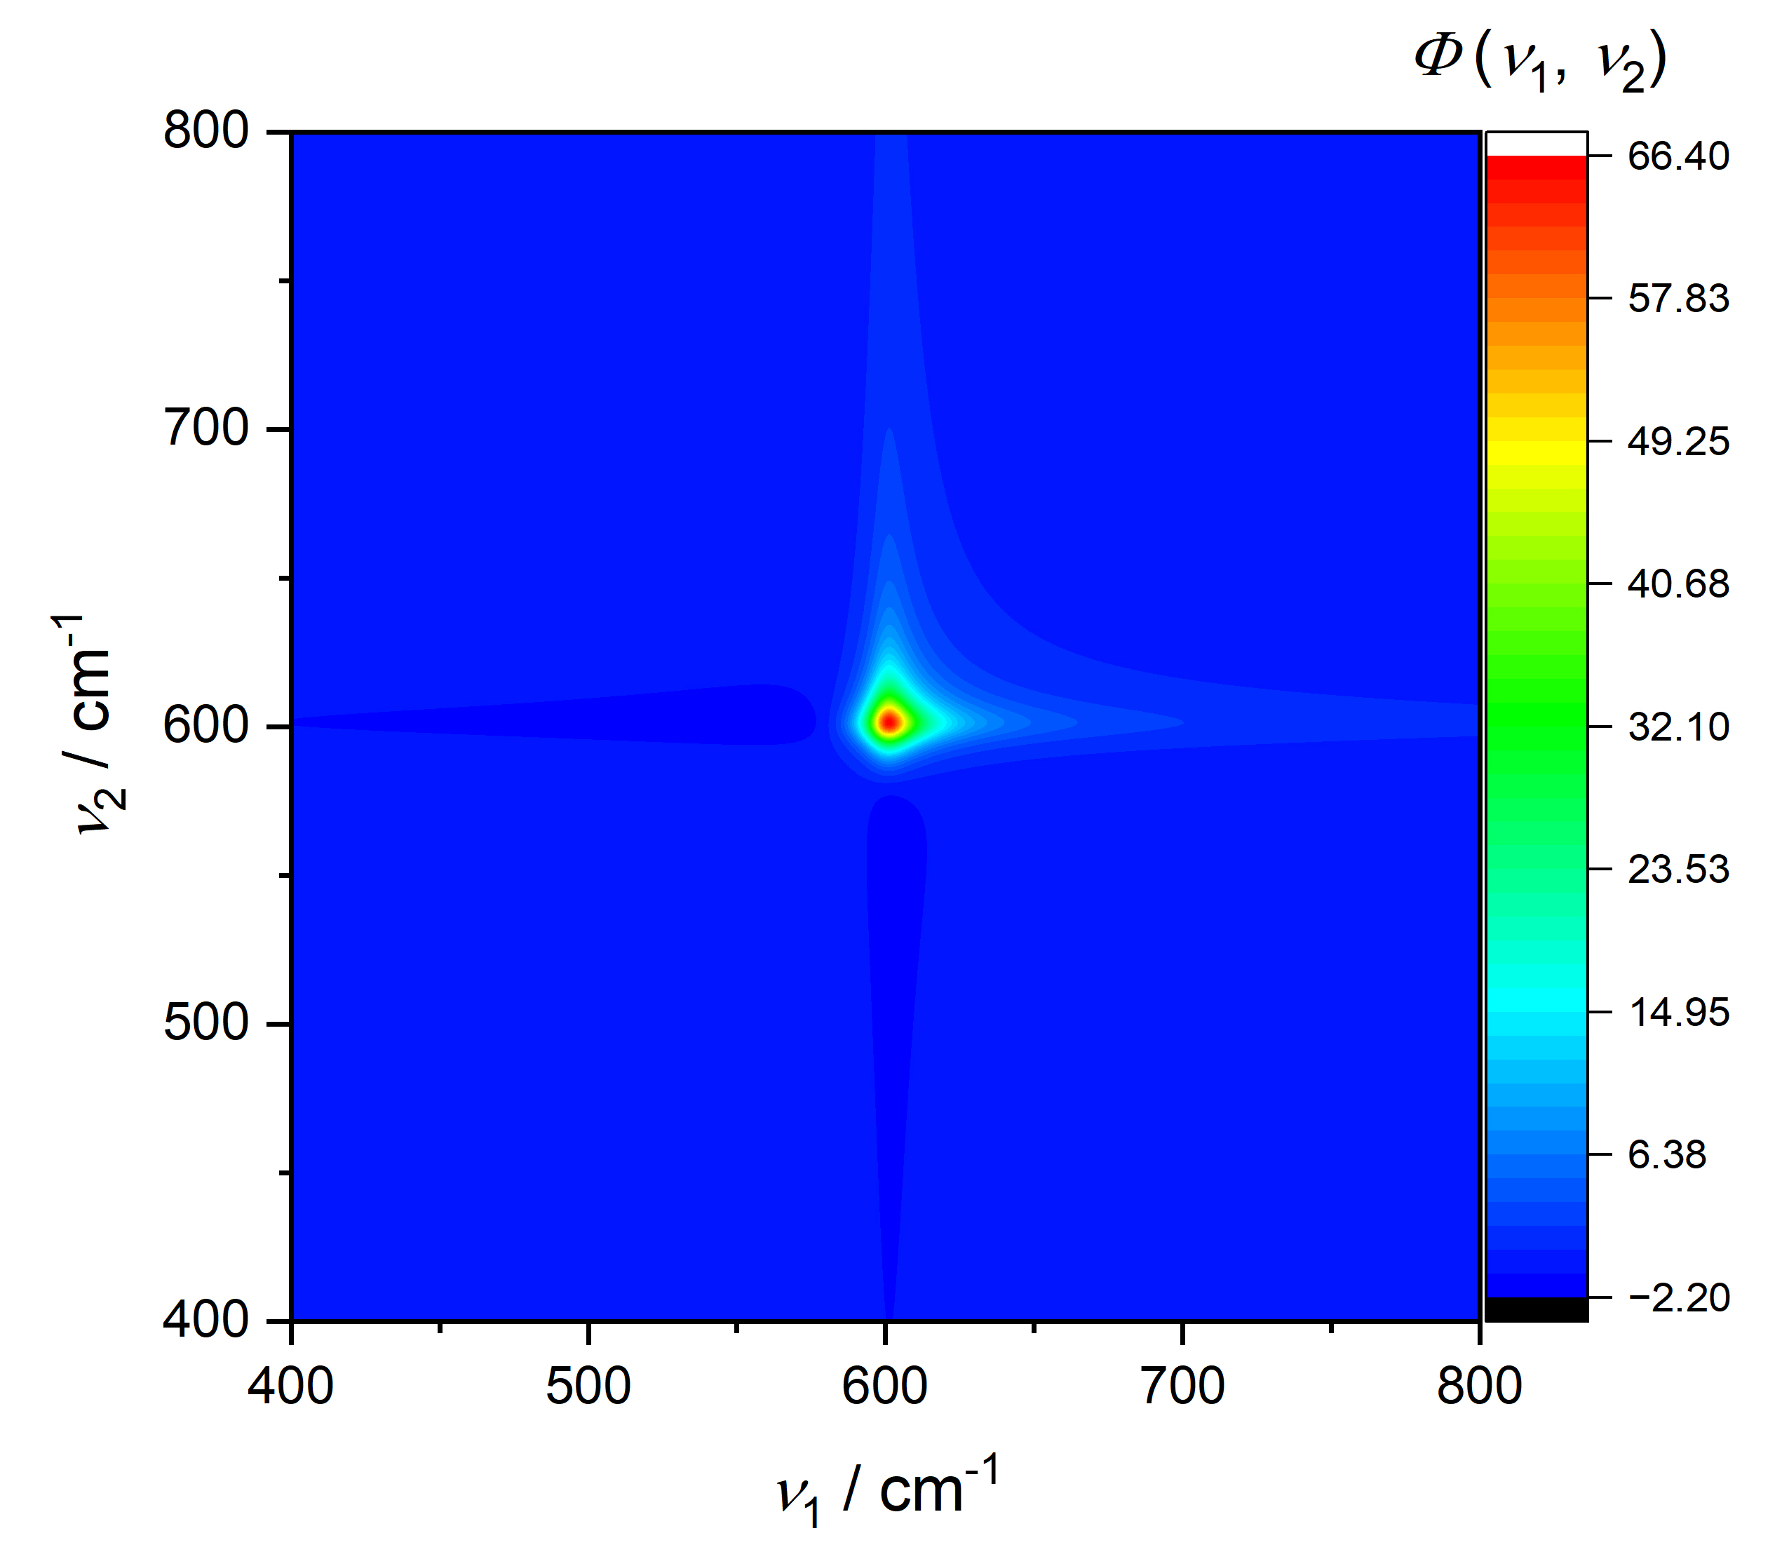
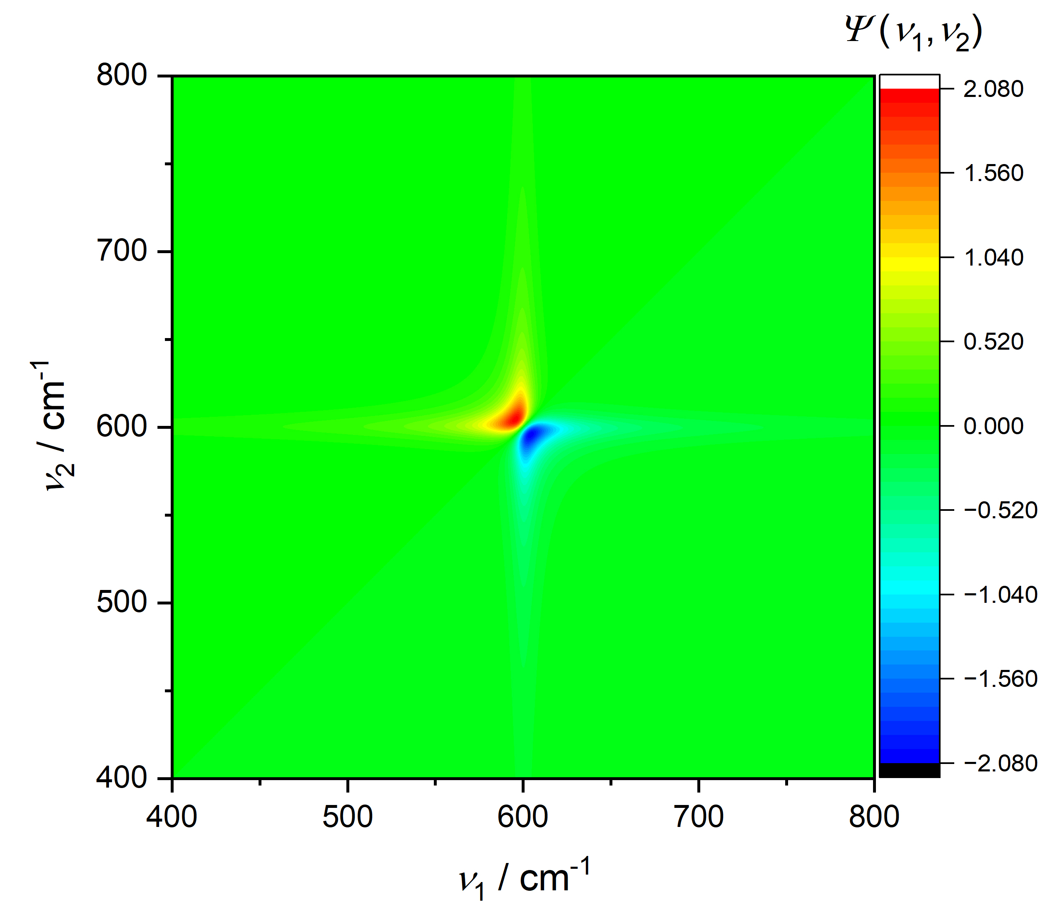
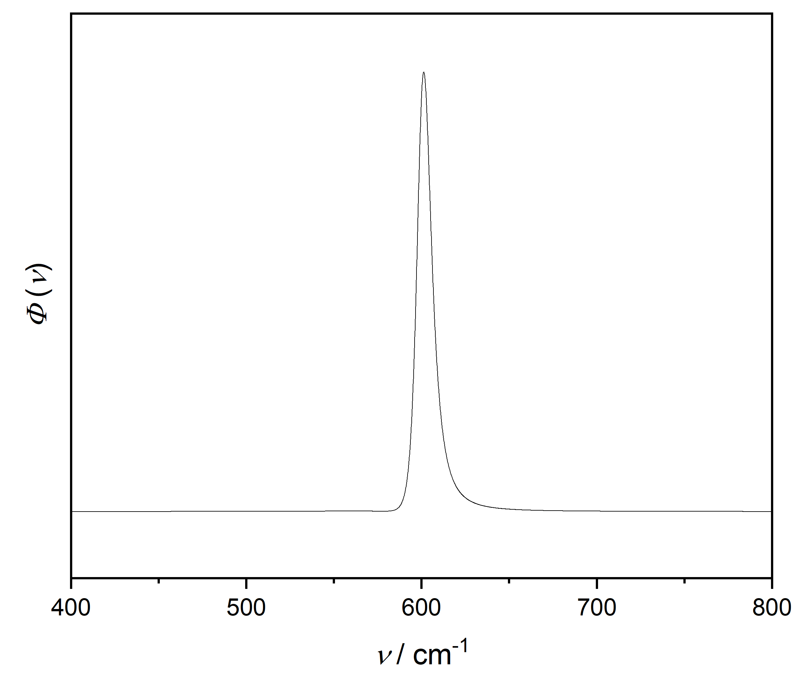
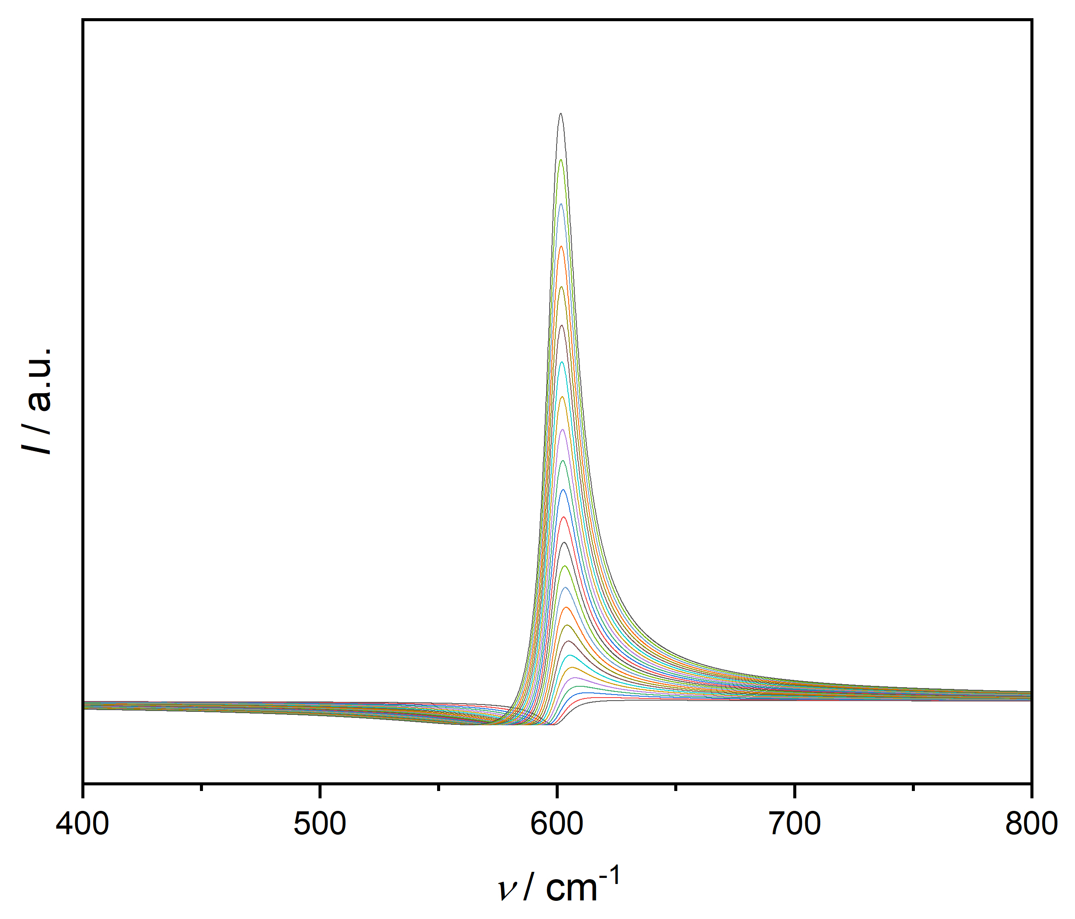
Single Fano band, q changes:
Fano

Slide 13
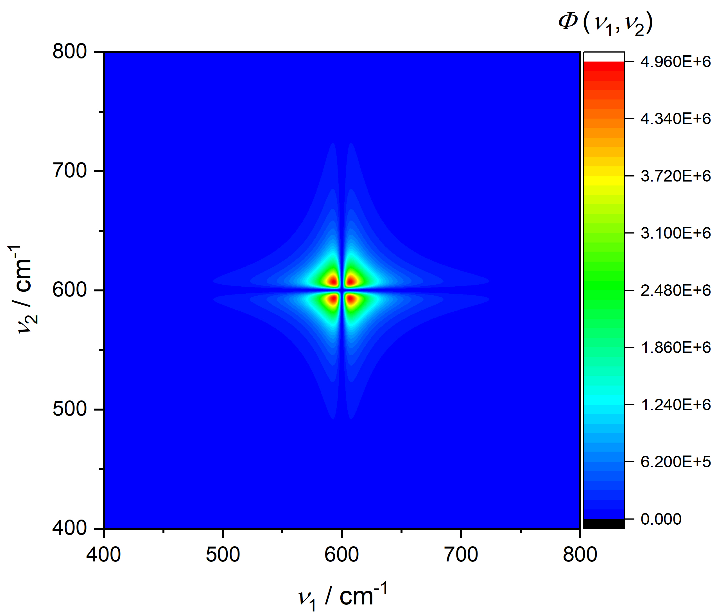

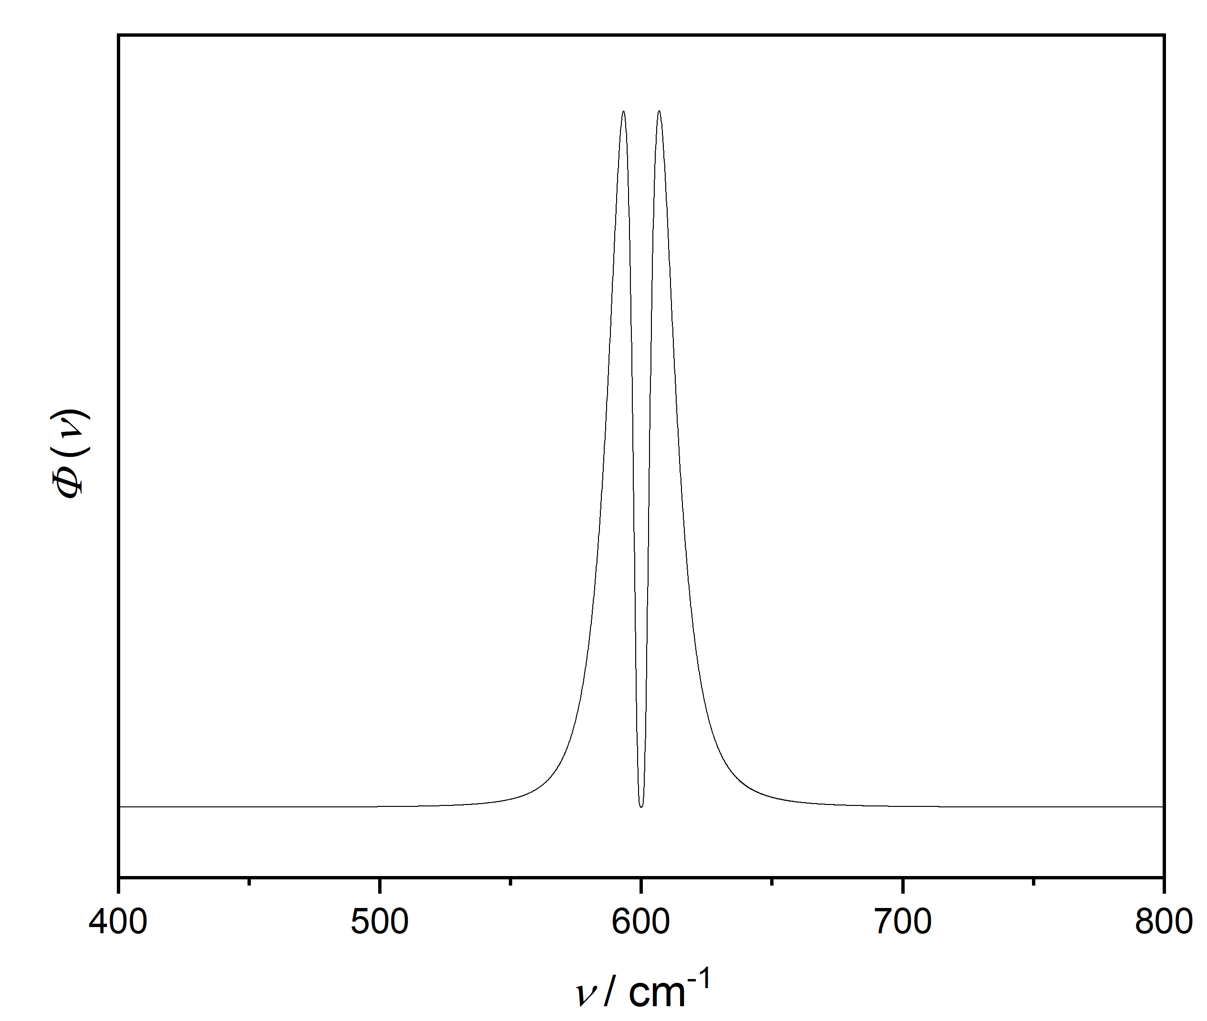
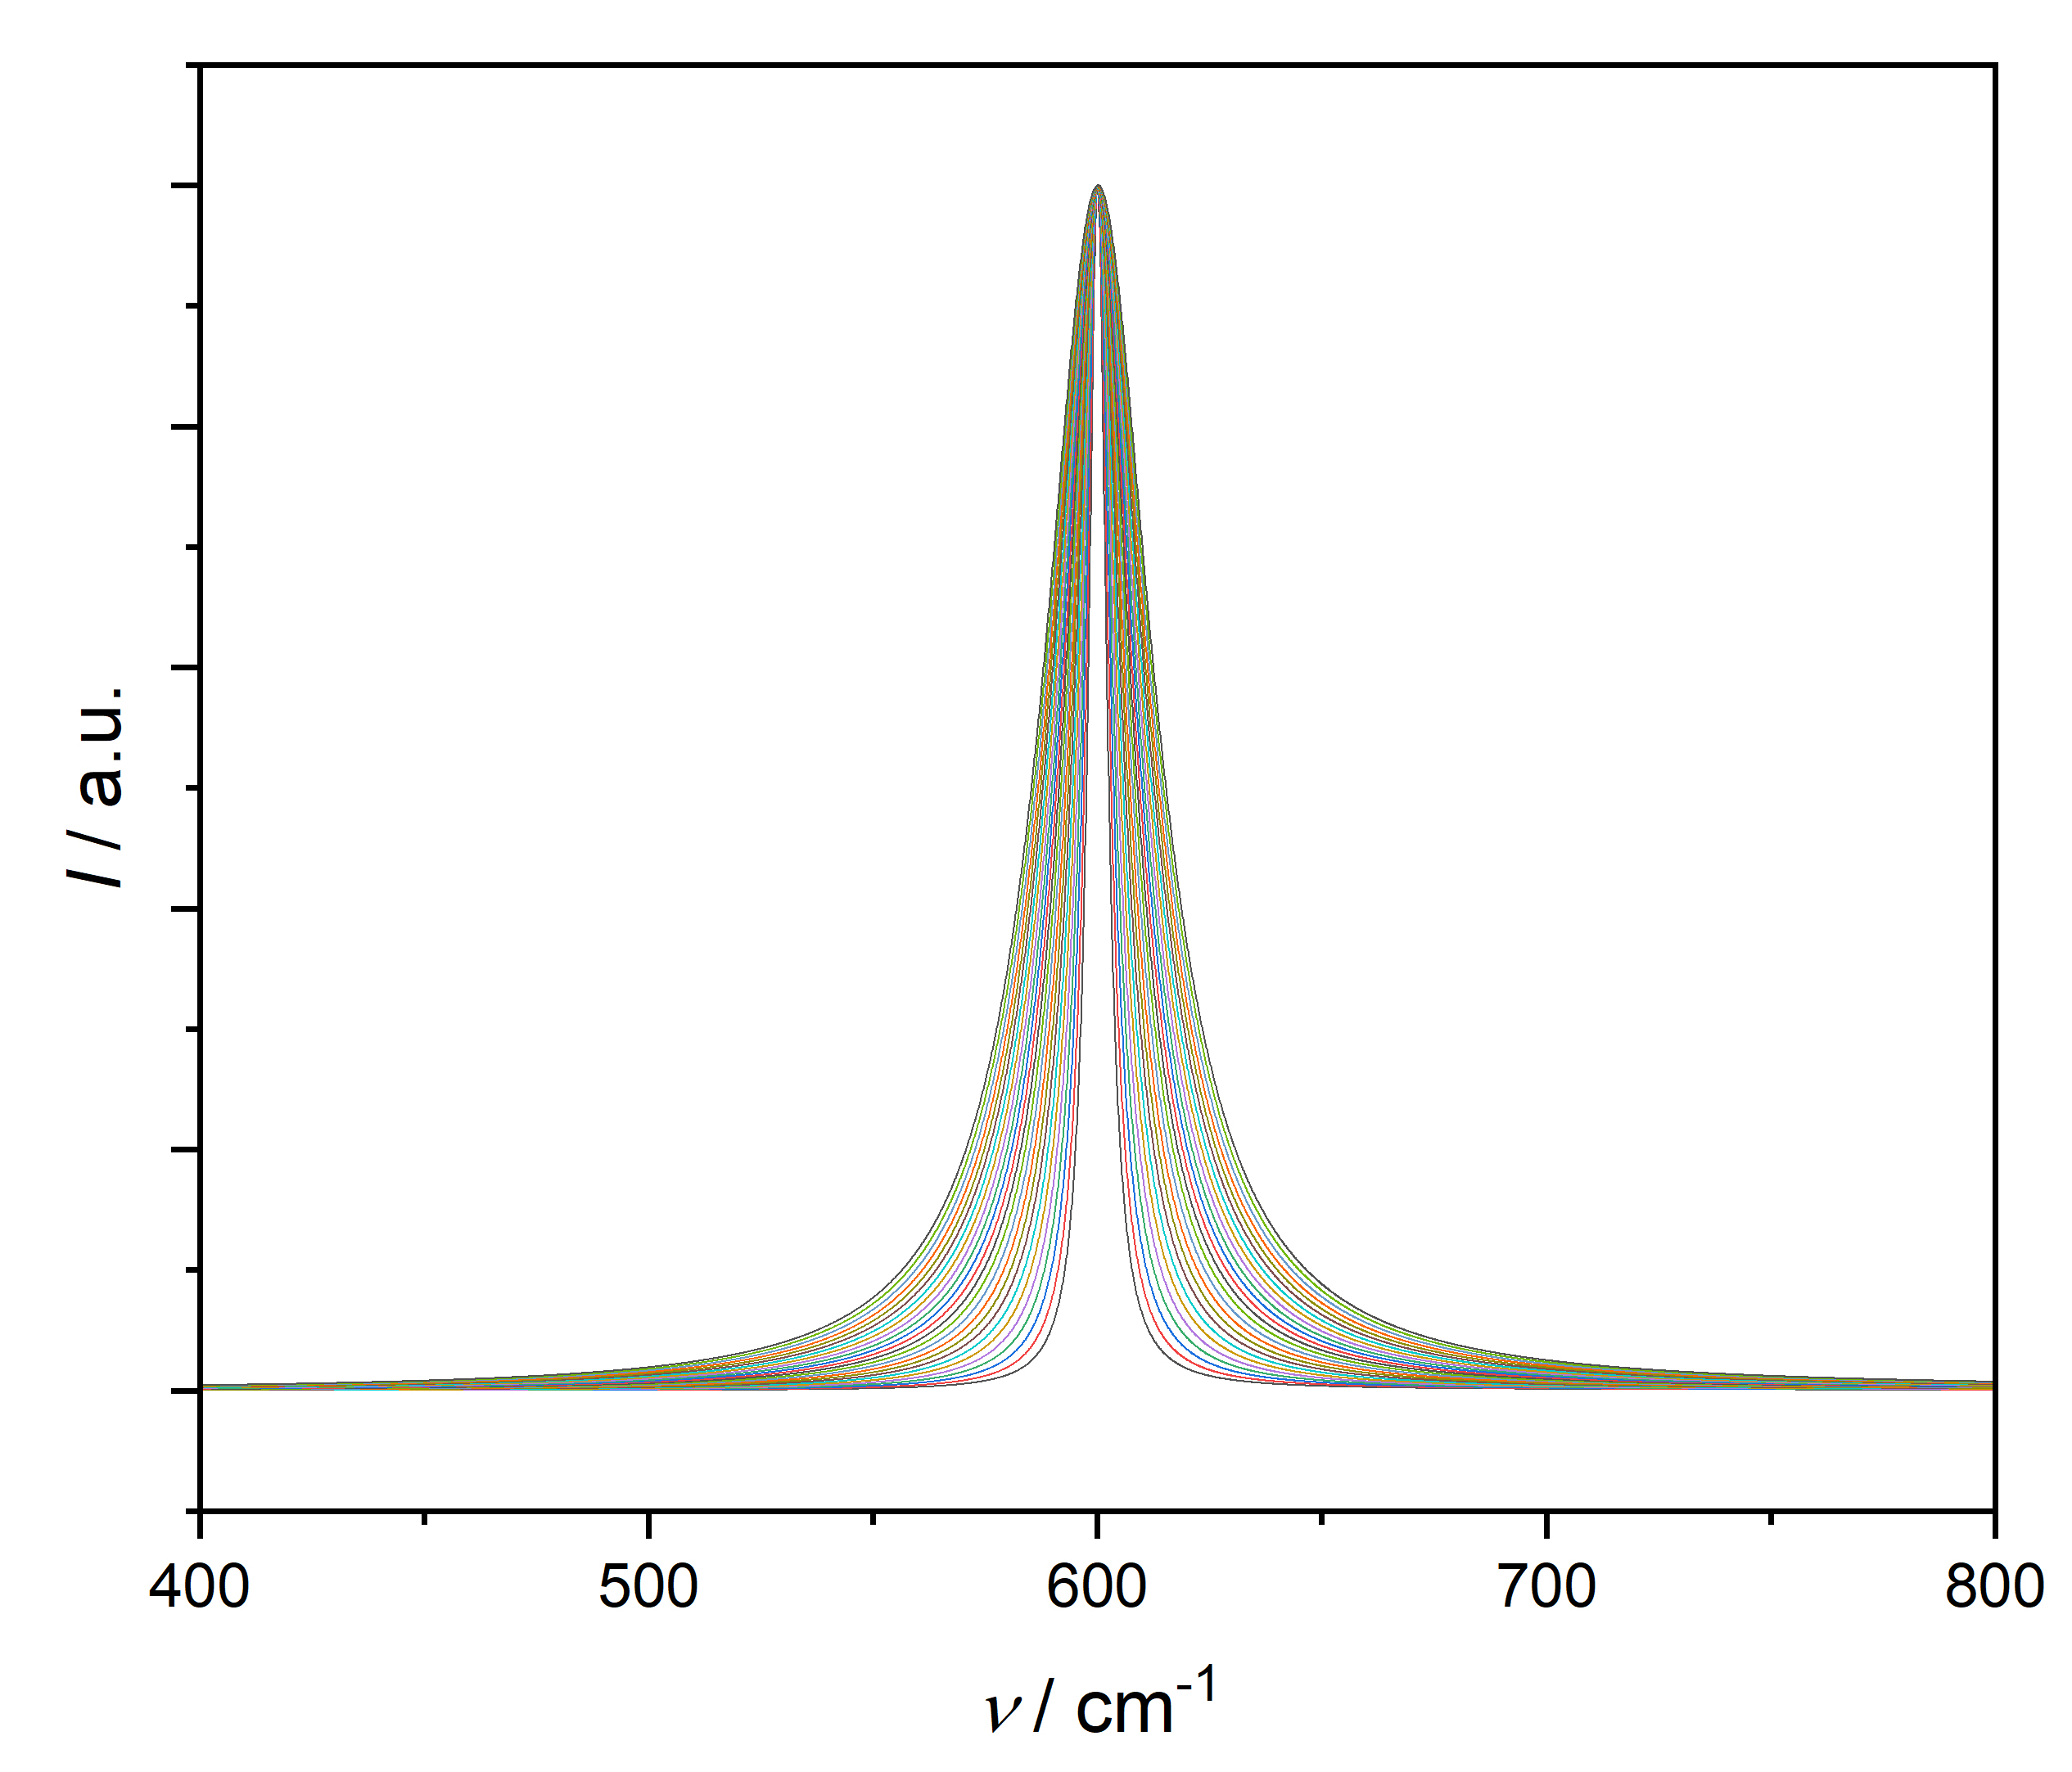
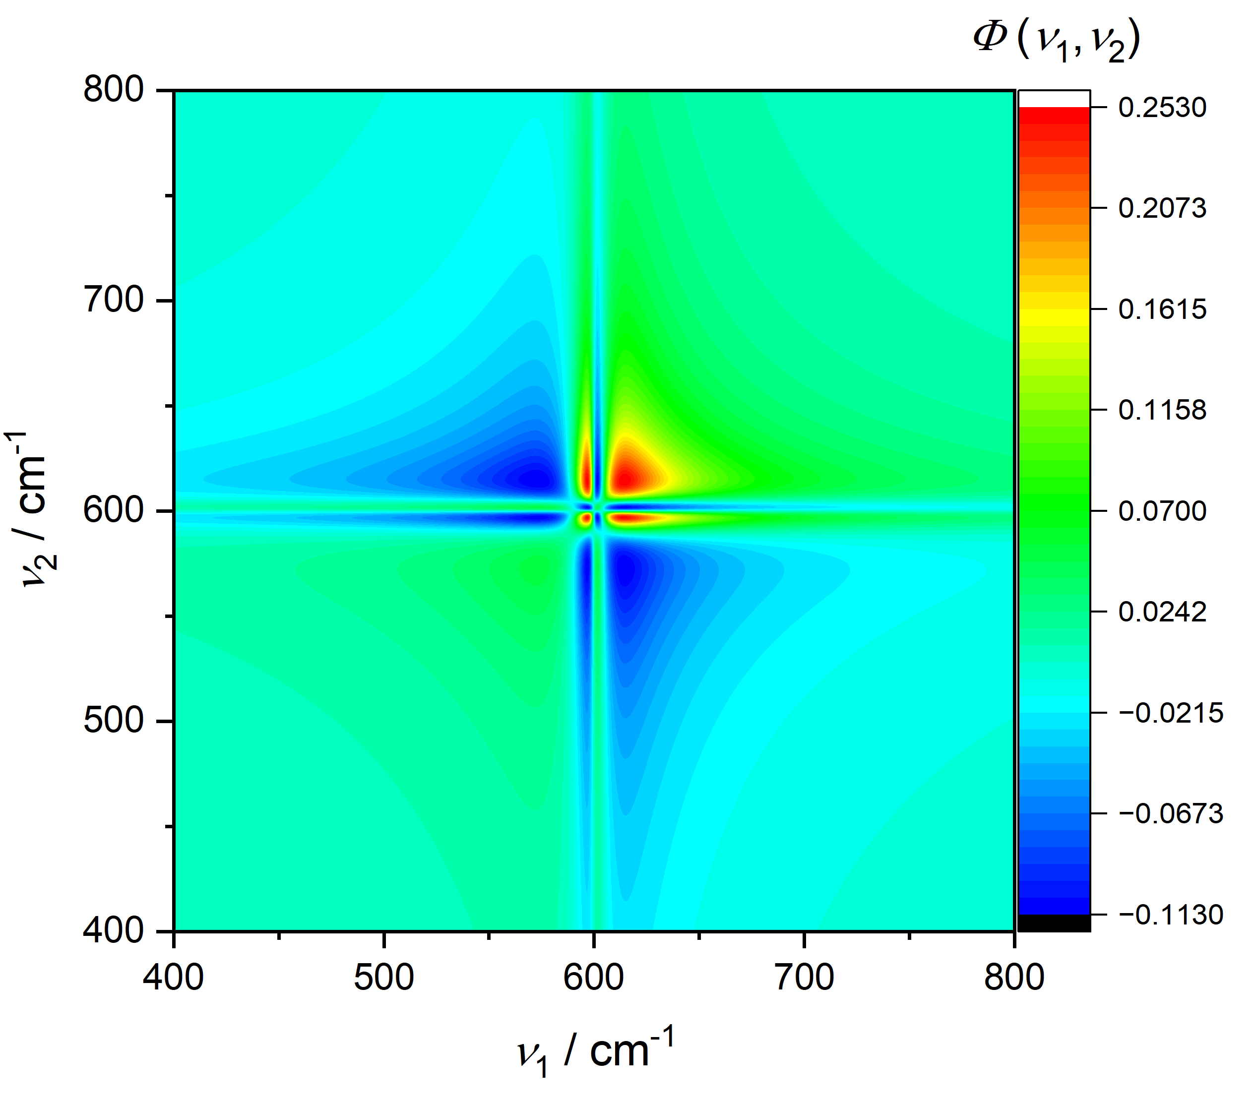
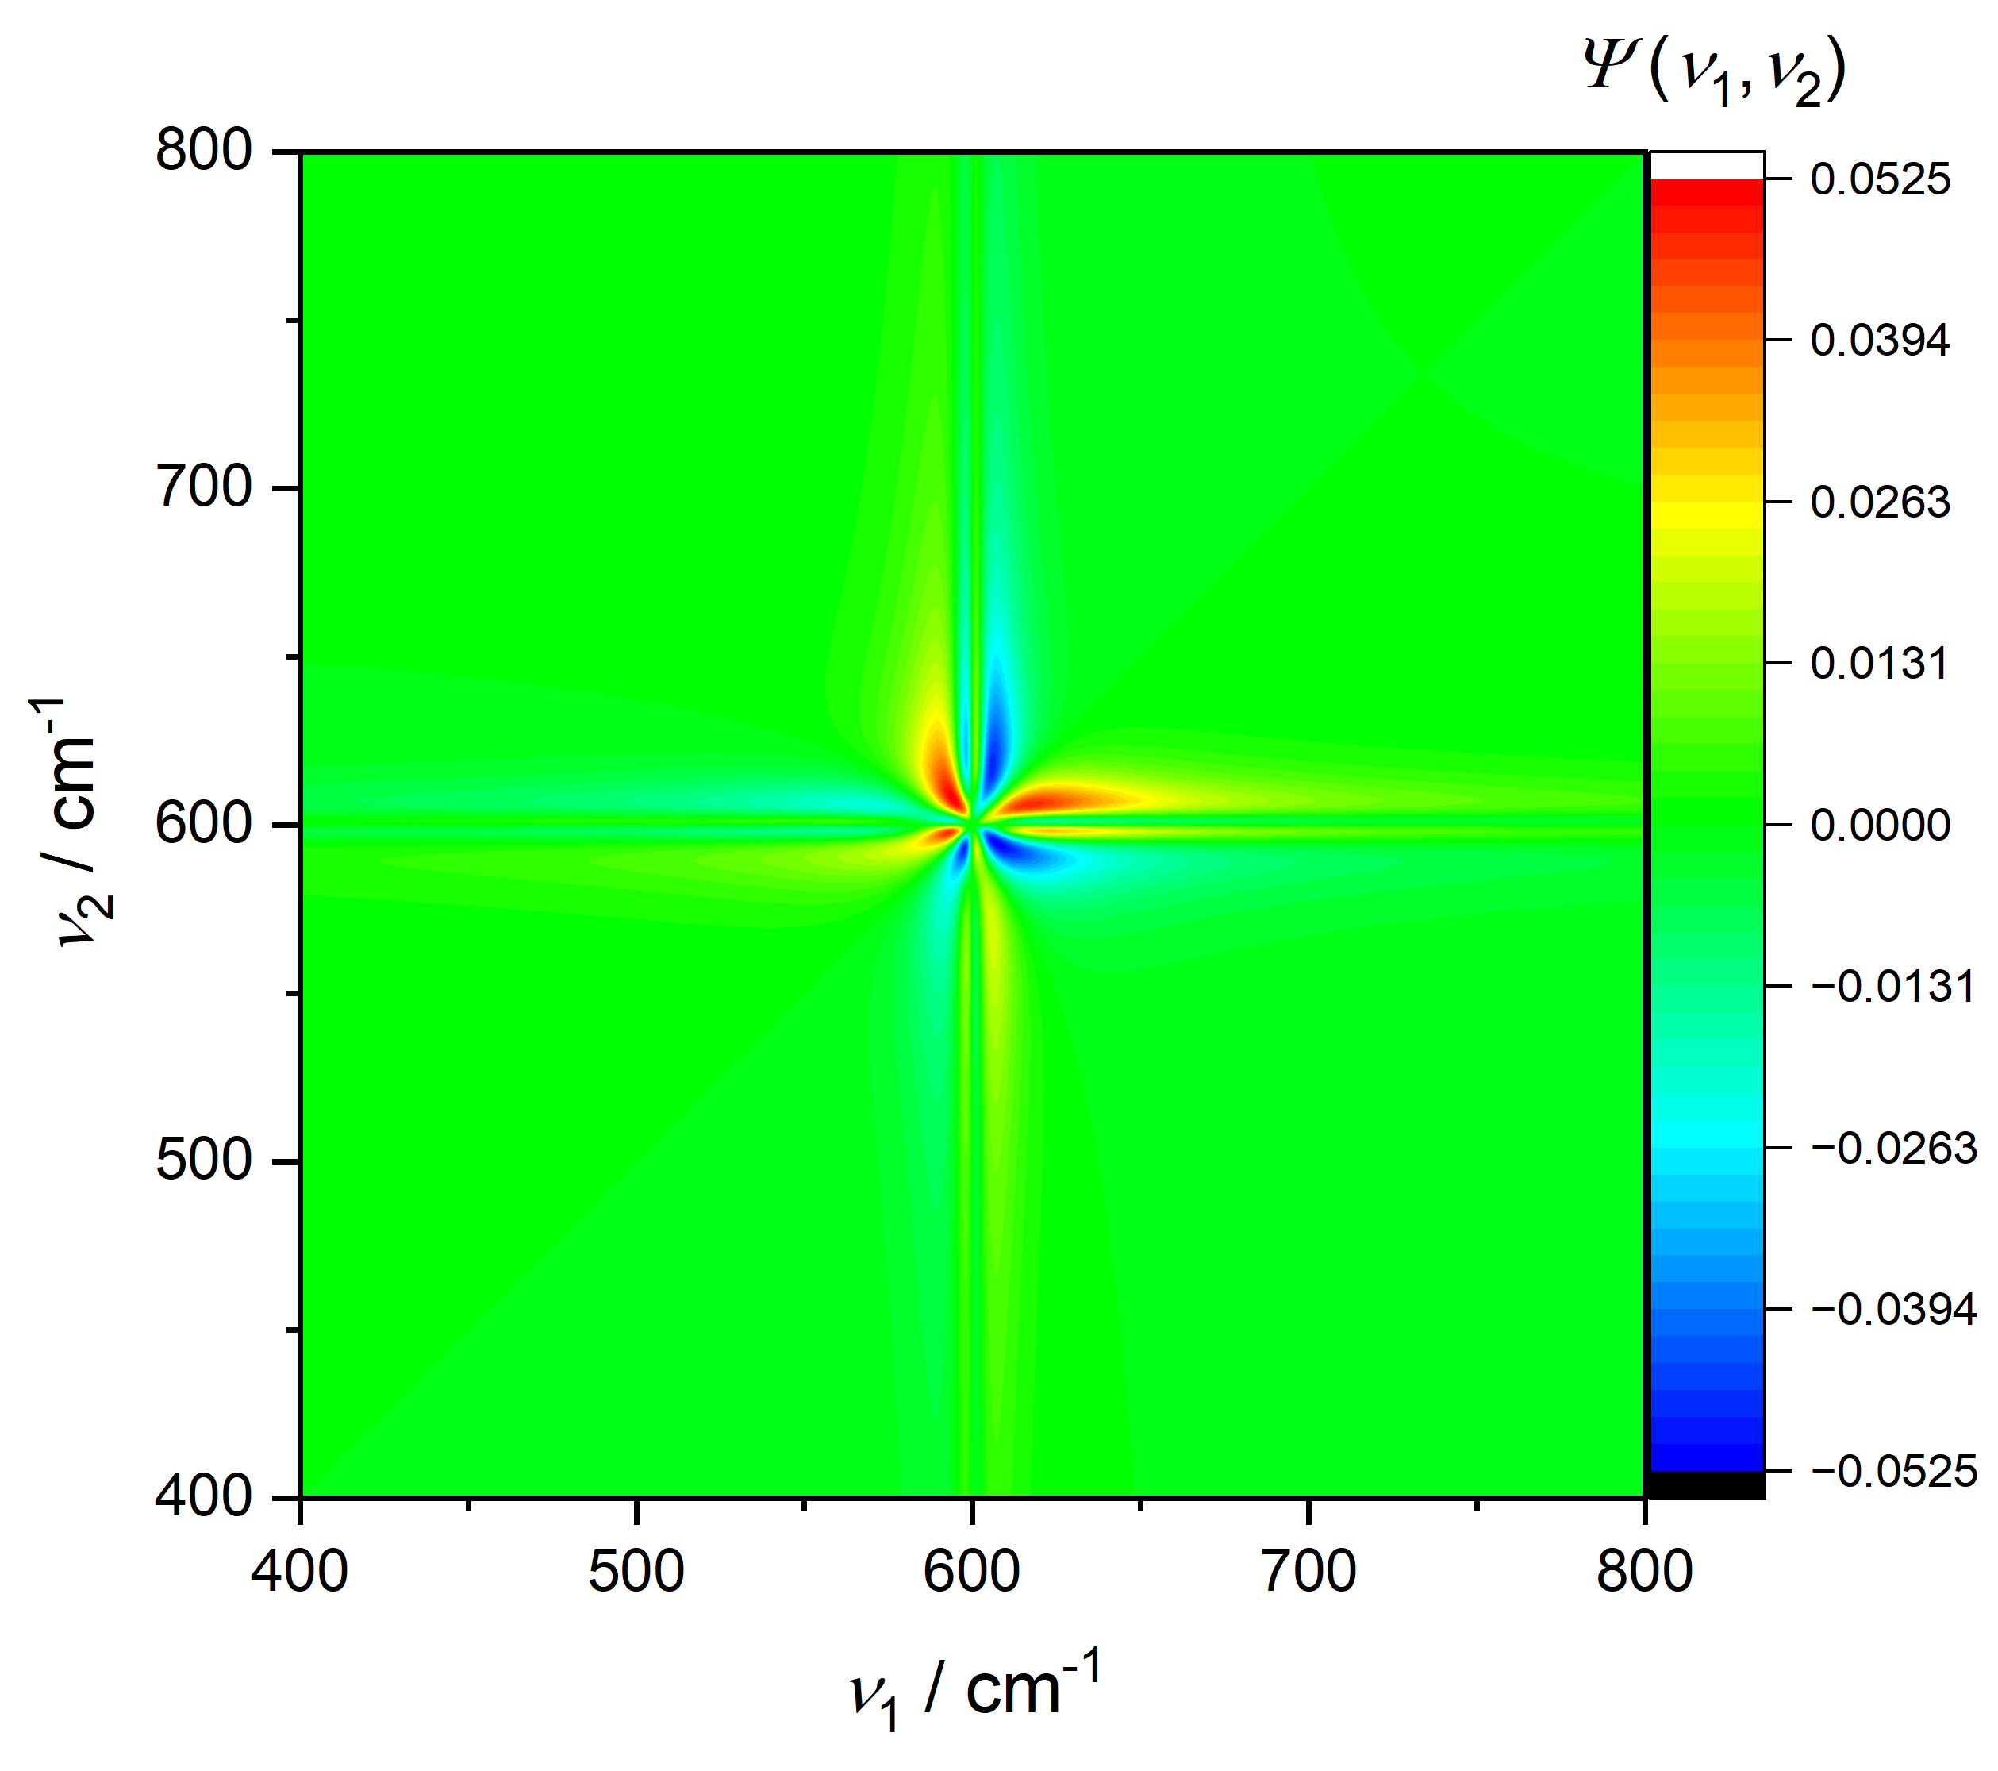
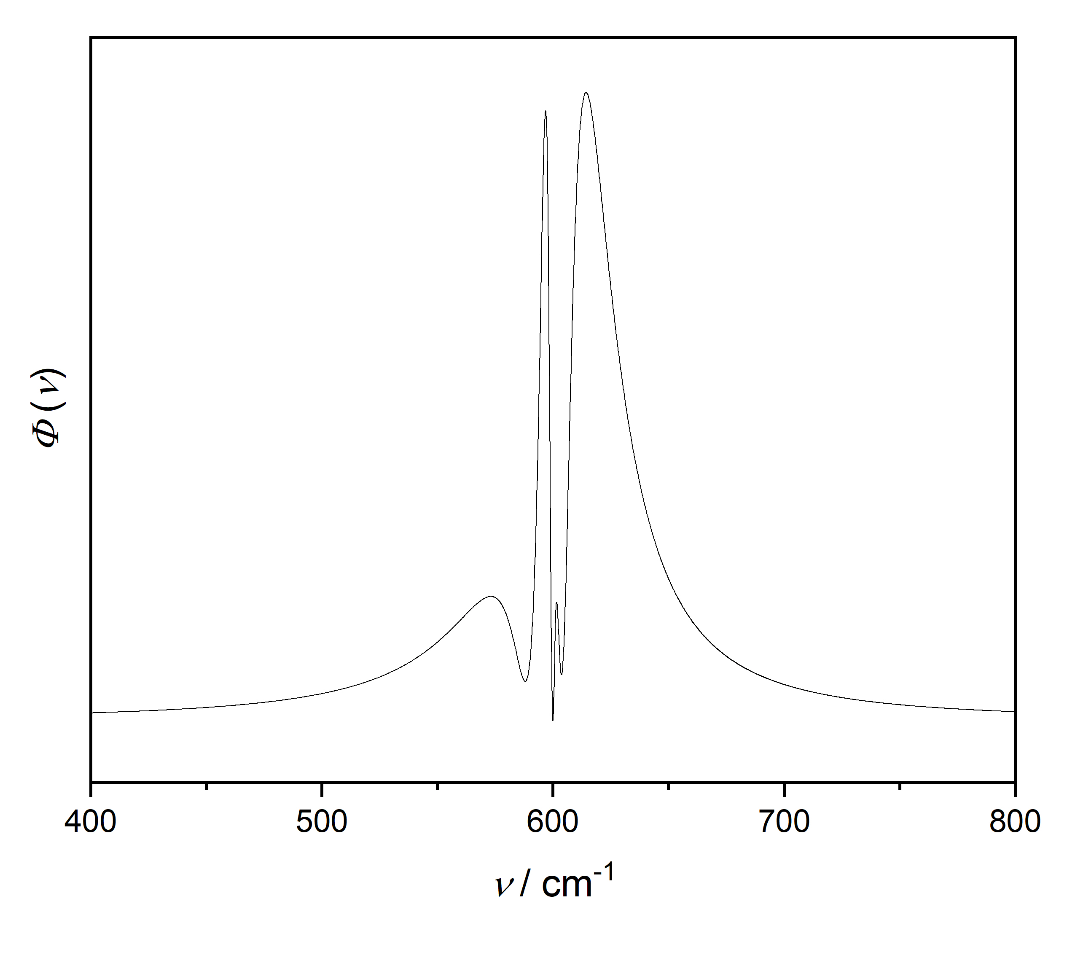
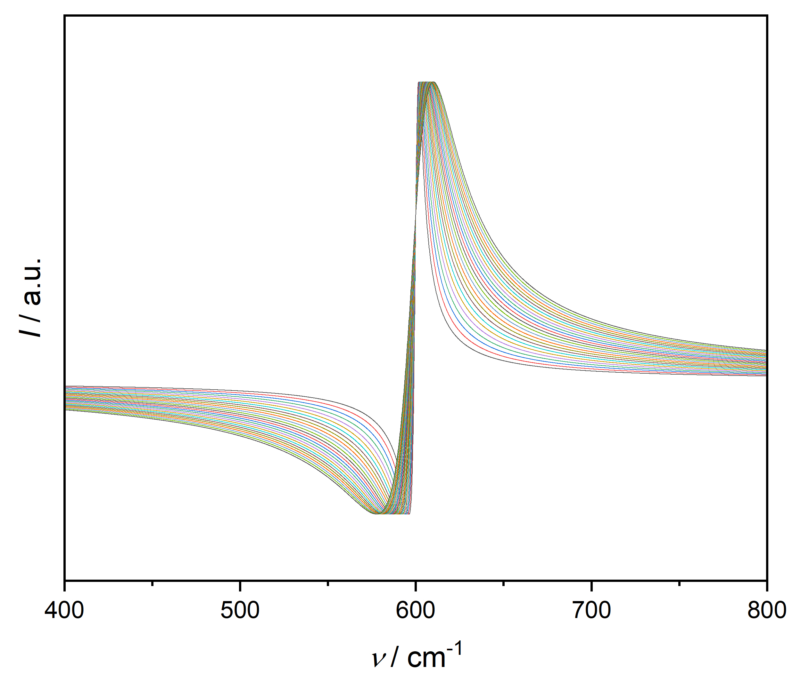
Single band, Γ changes:
Cauchy
Fano (q = 1.5)

Slide 14
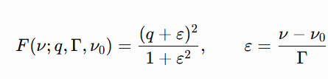








Slide 15






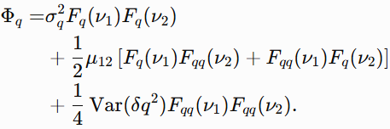

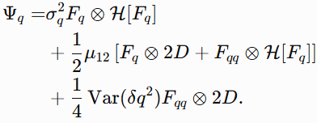

Slide 16
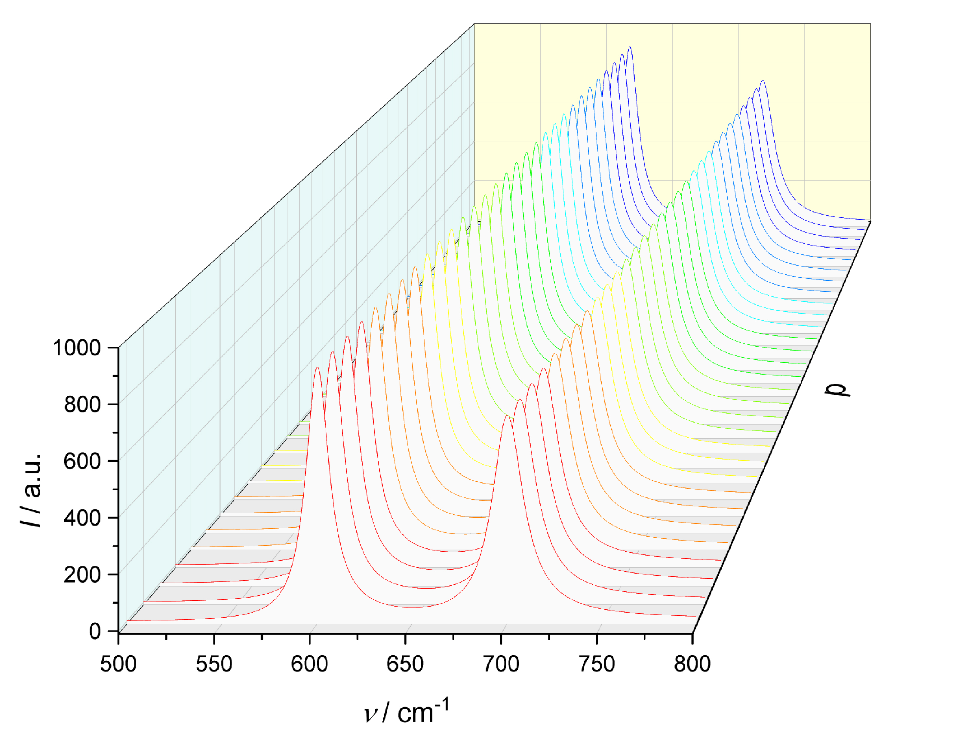
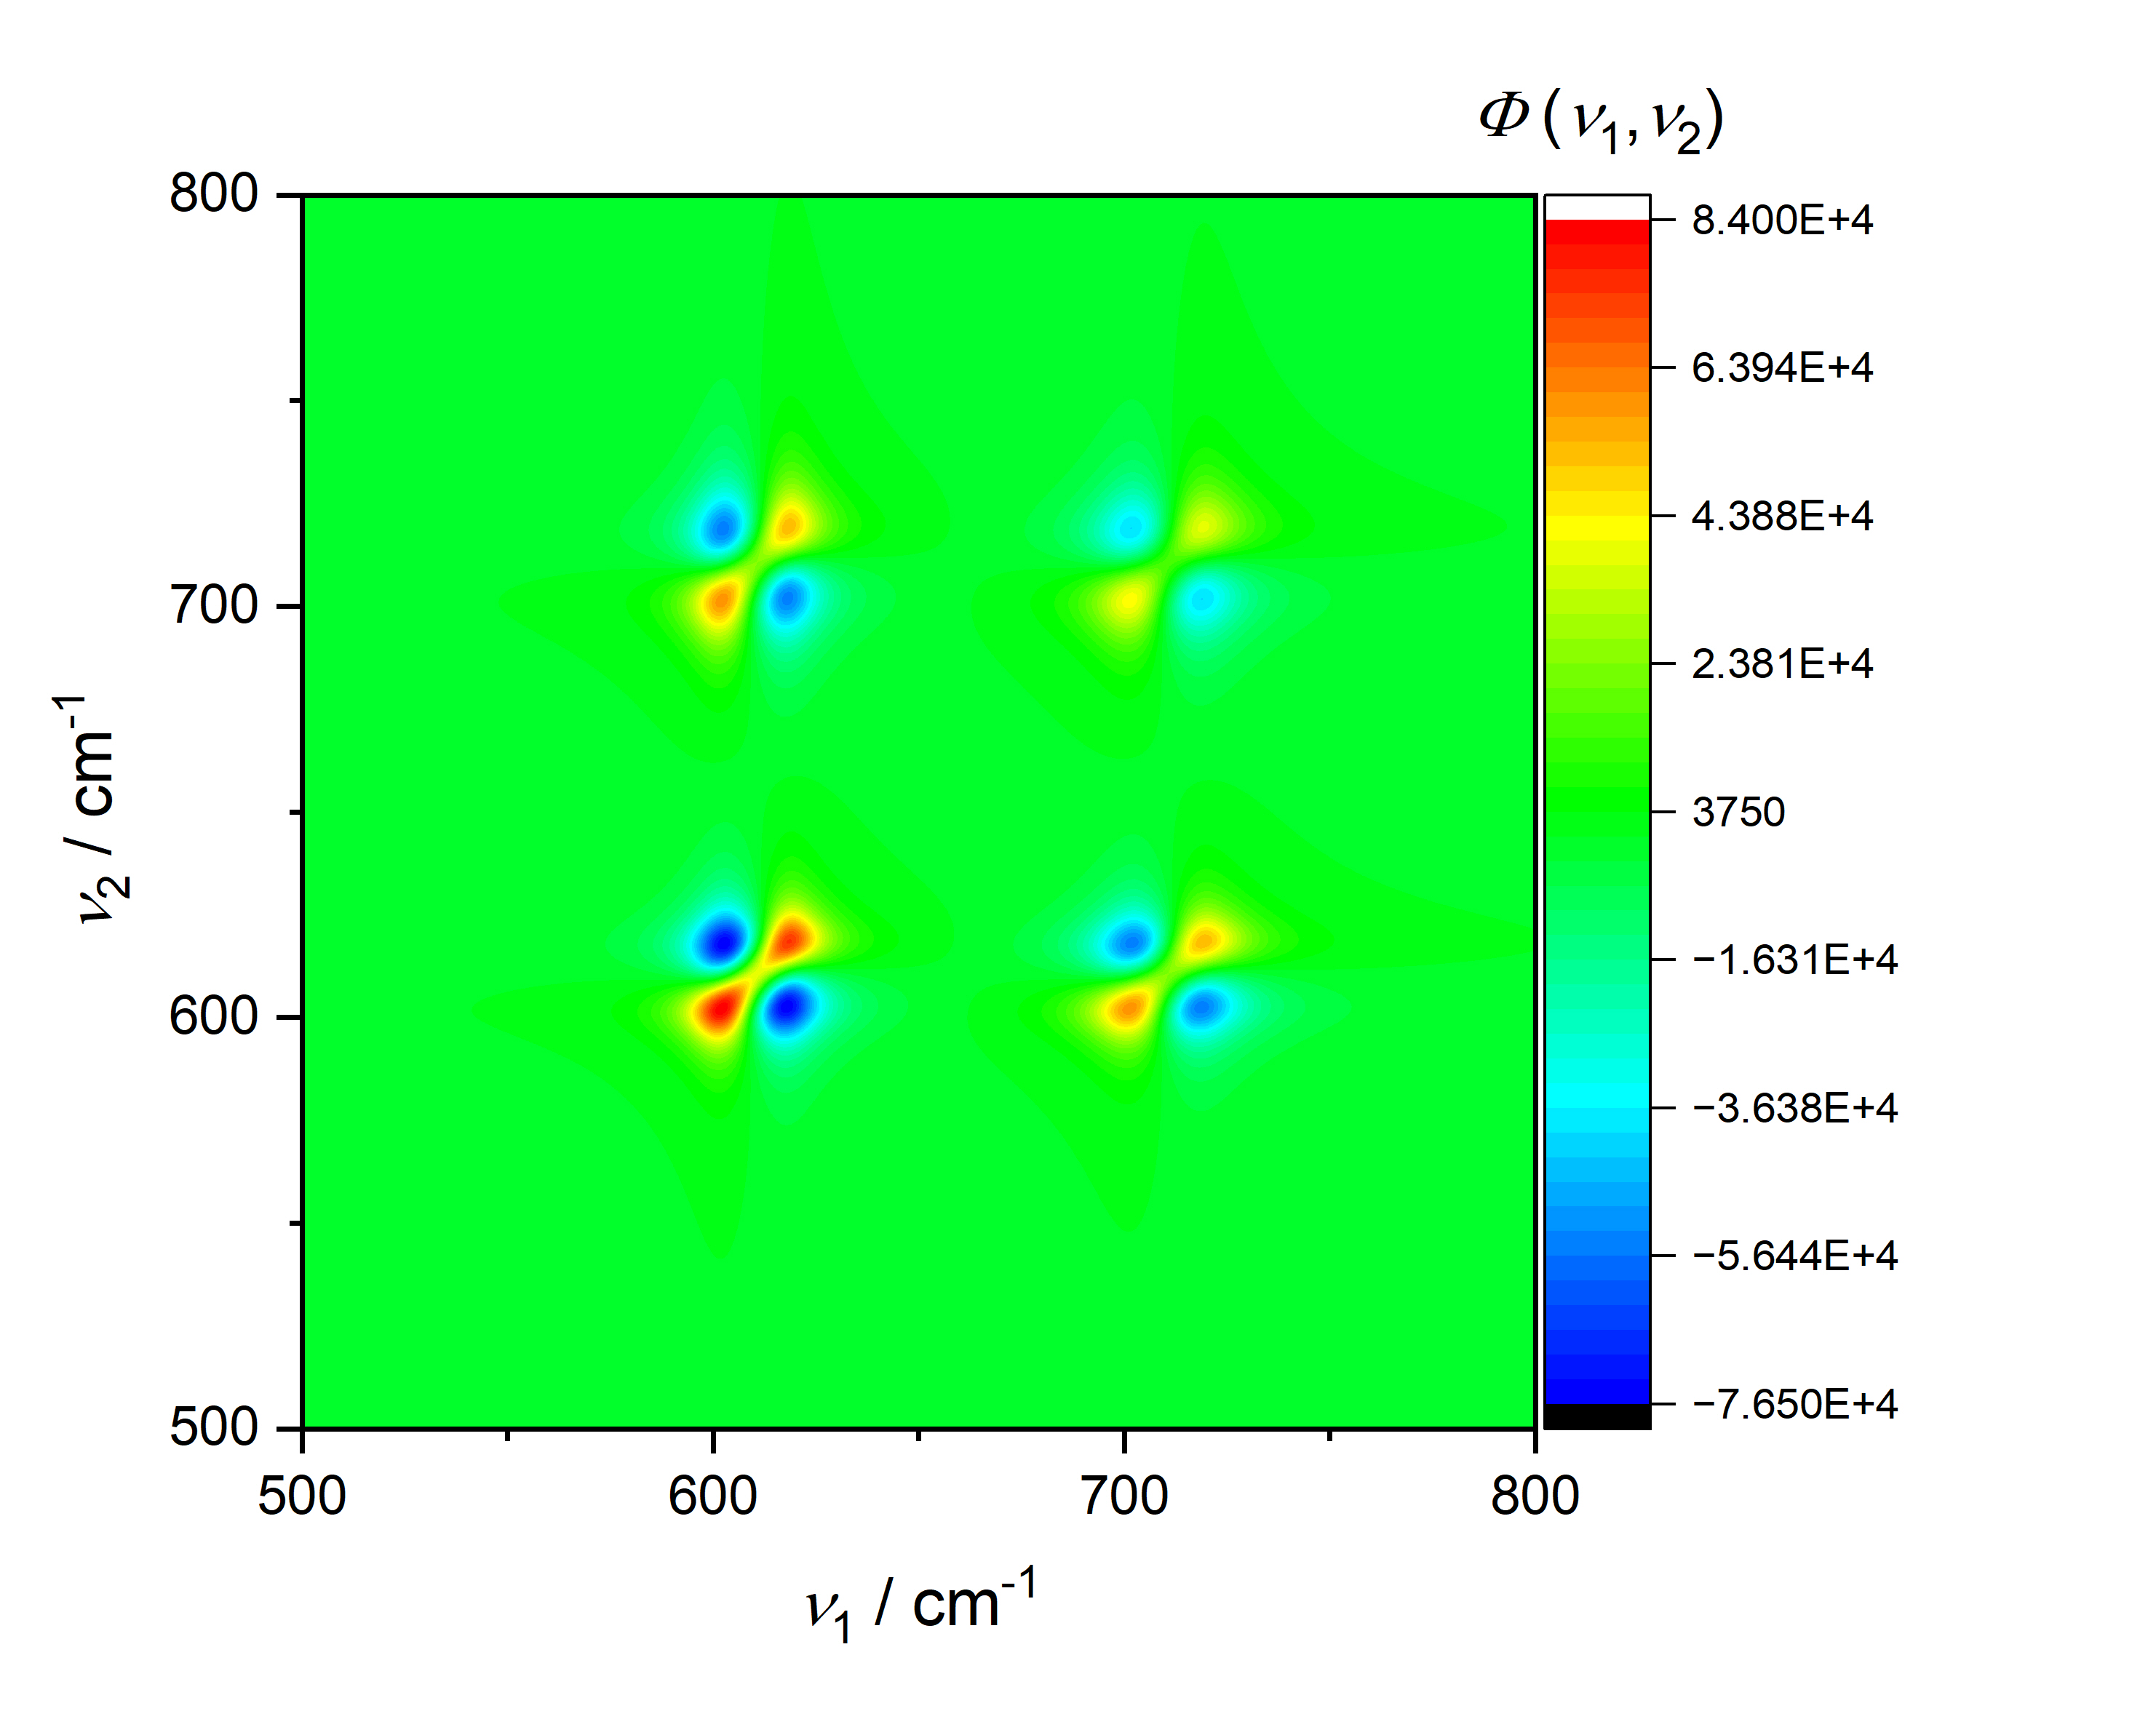
2 Lorentzian bands, uniform shift:

Slide 17
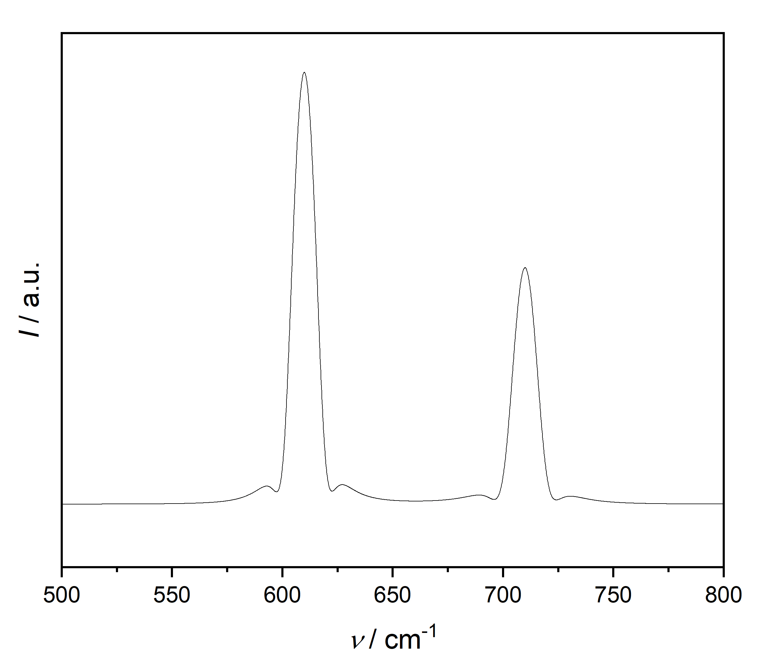
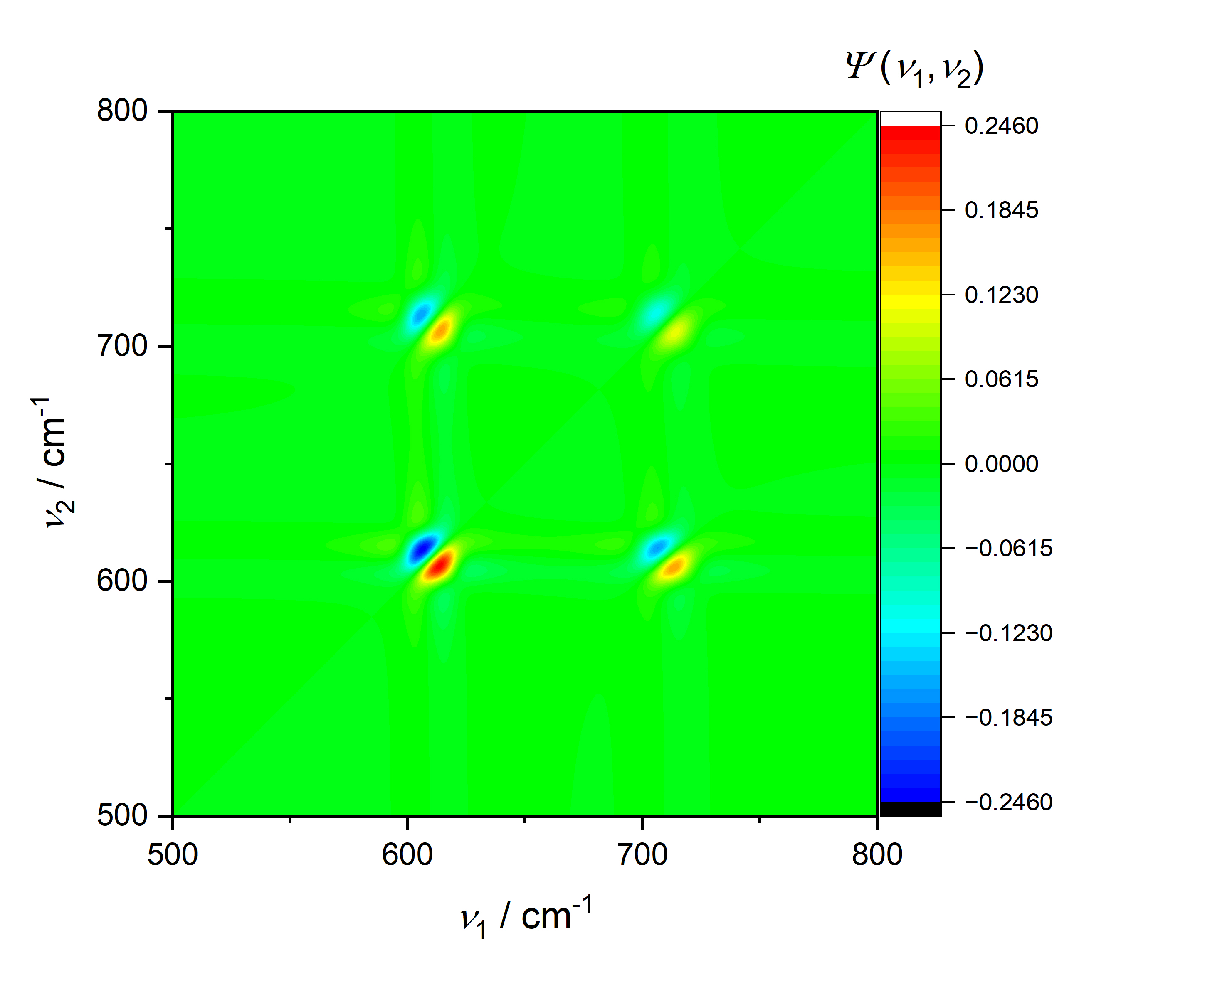
2 Fano bands, uniform shift:

Slide 18
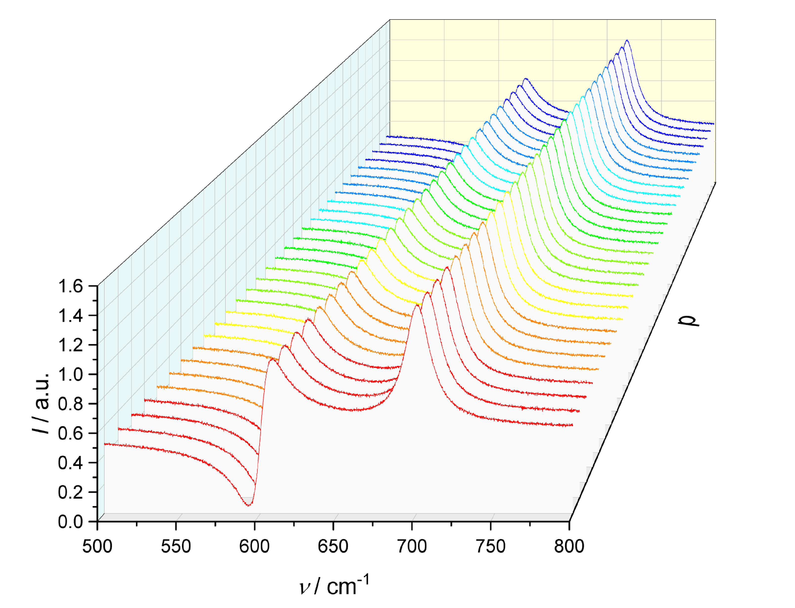
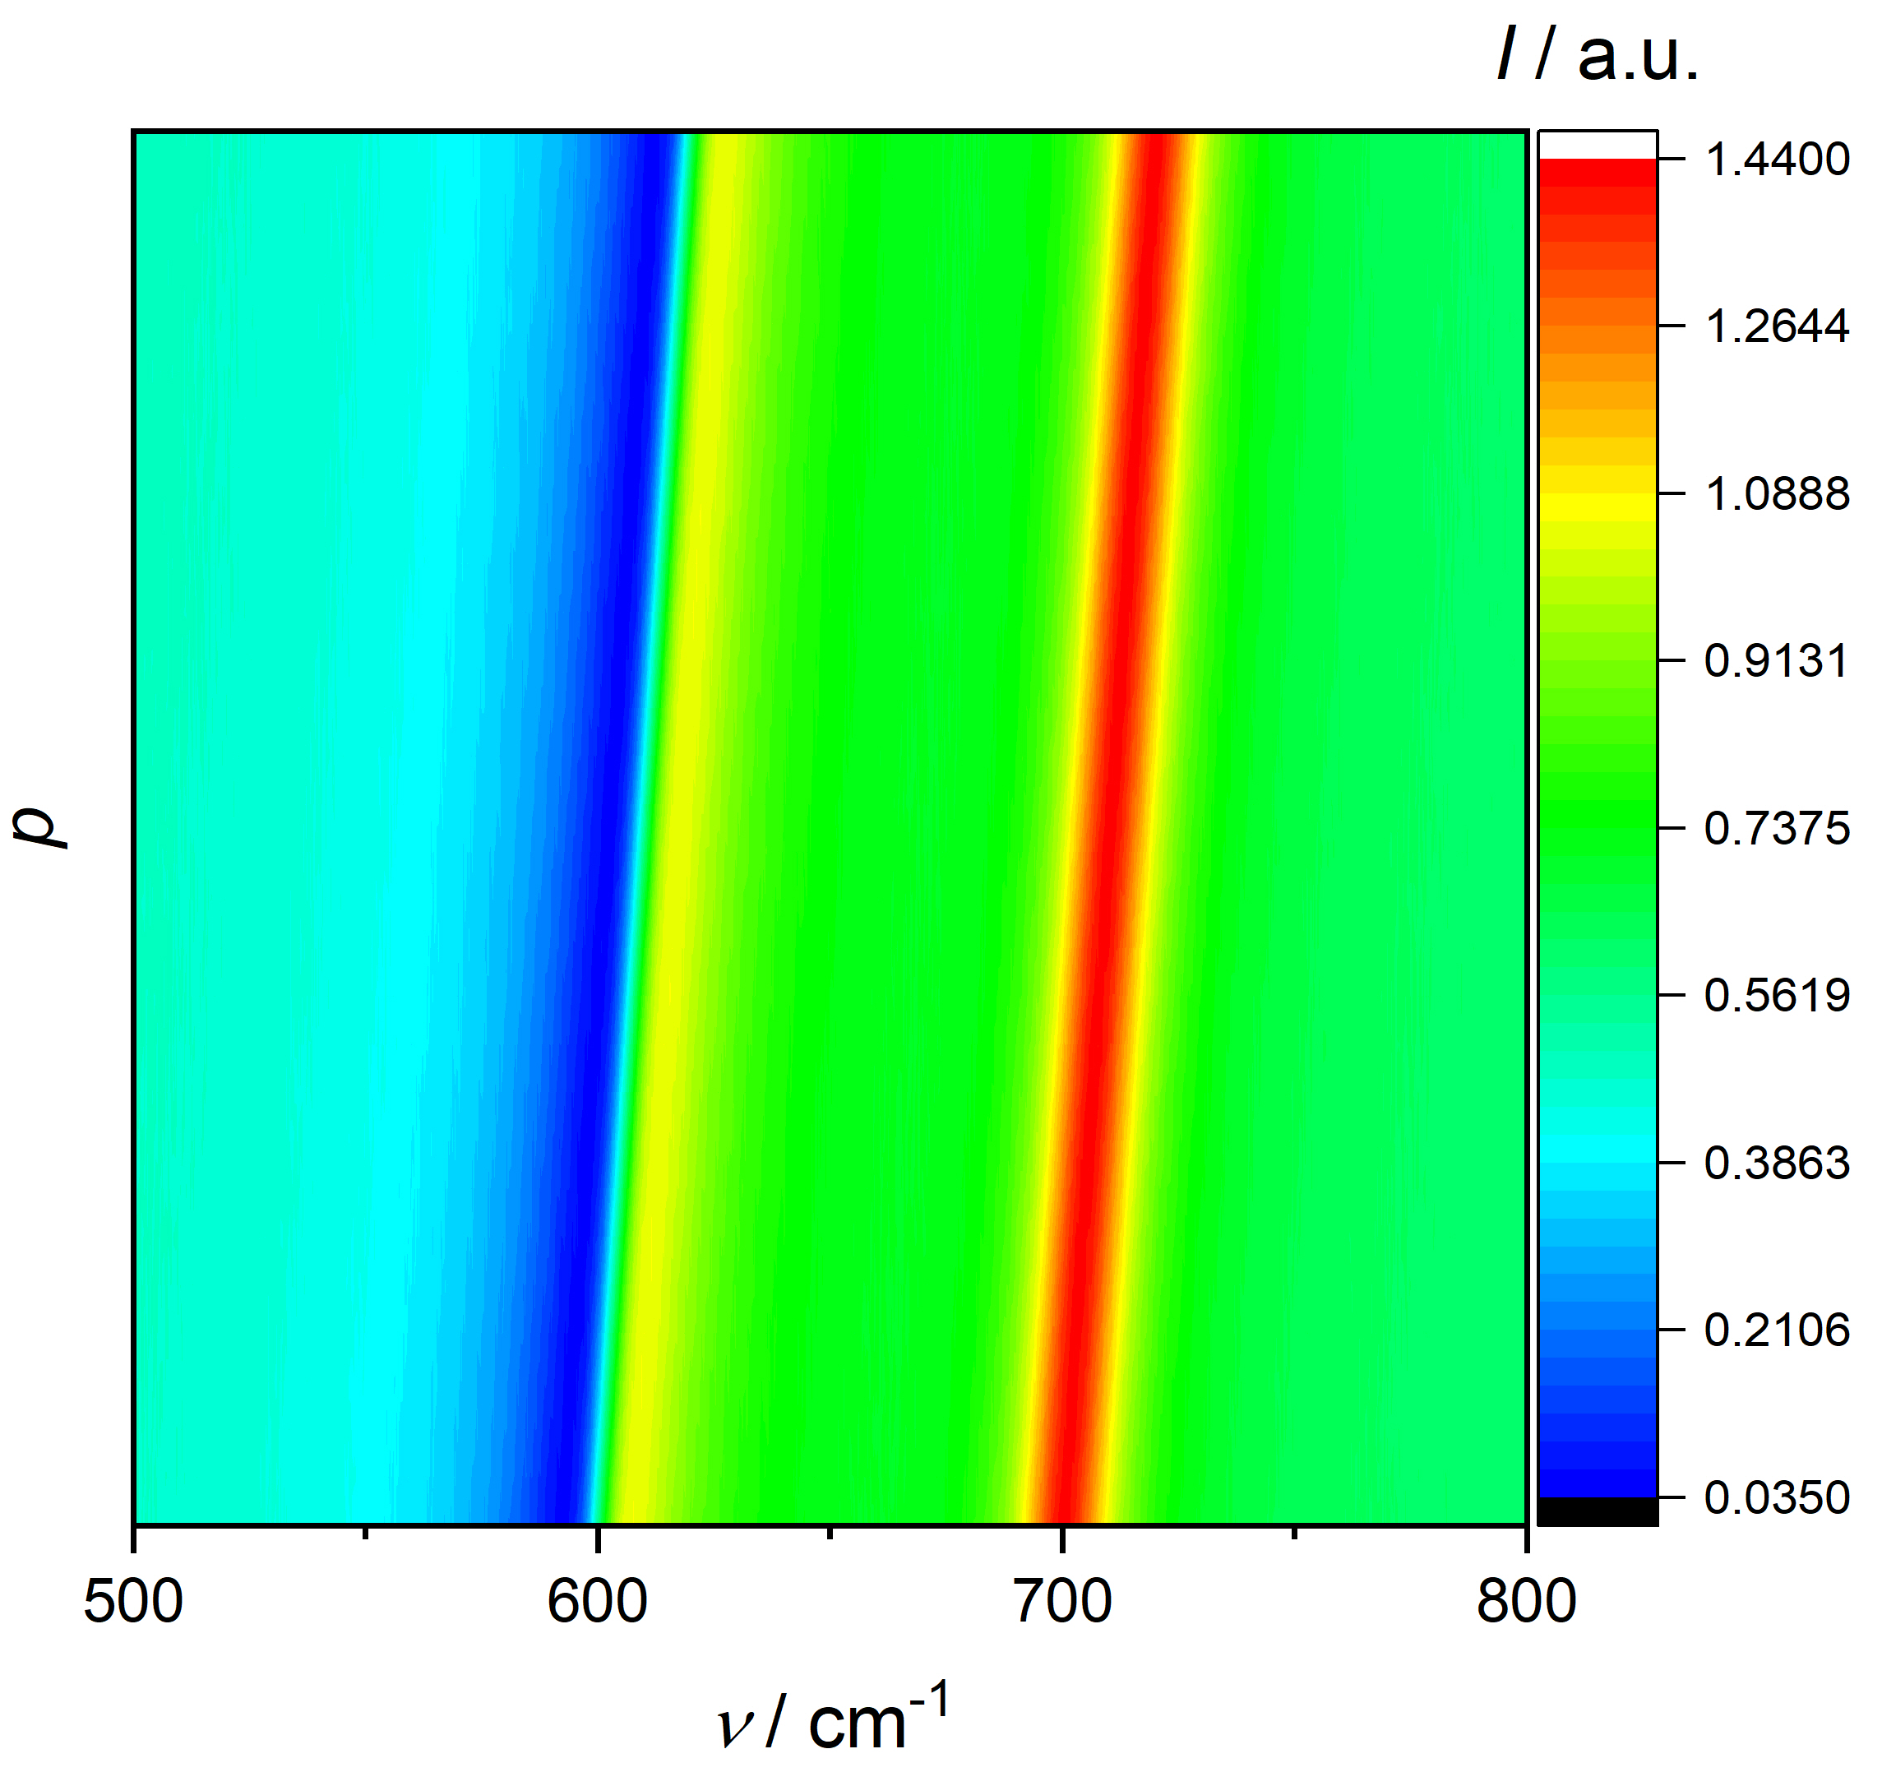
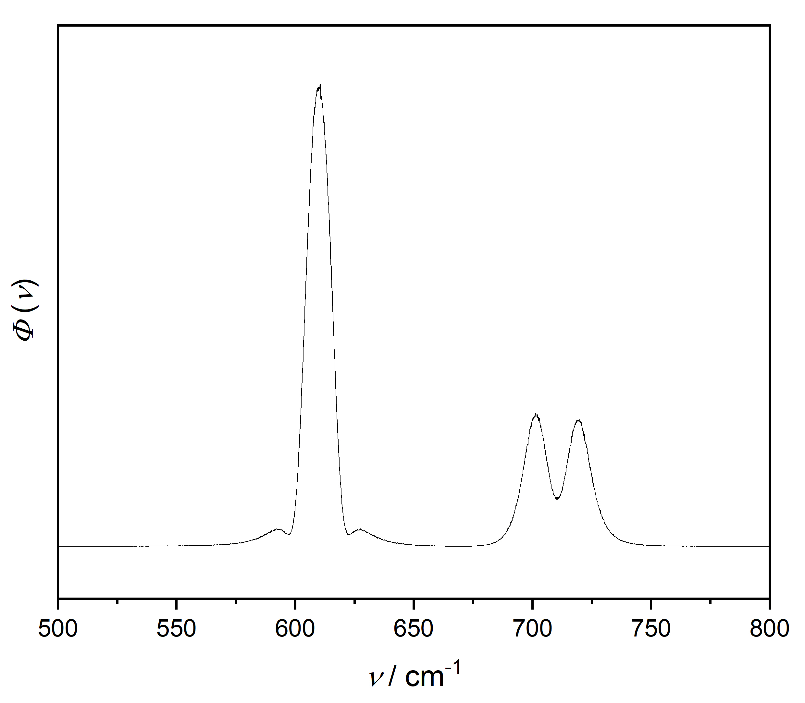
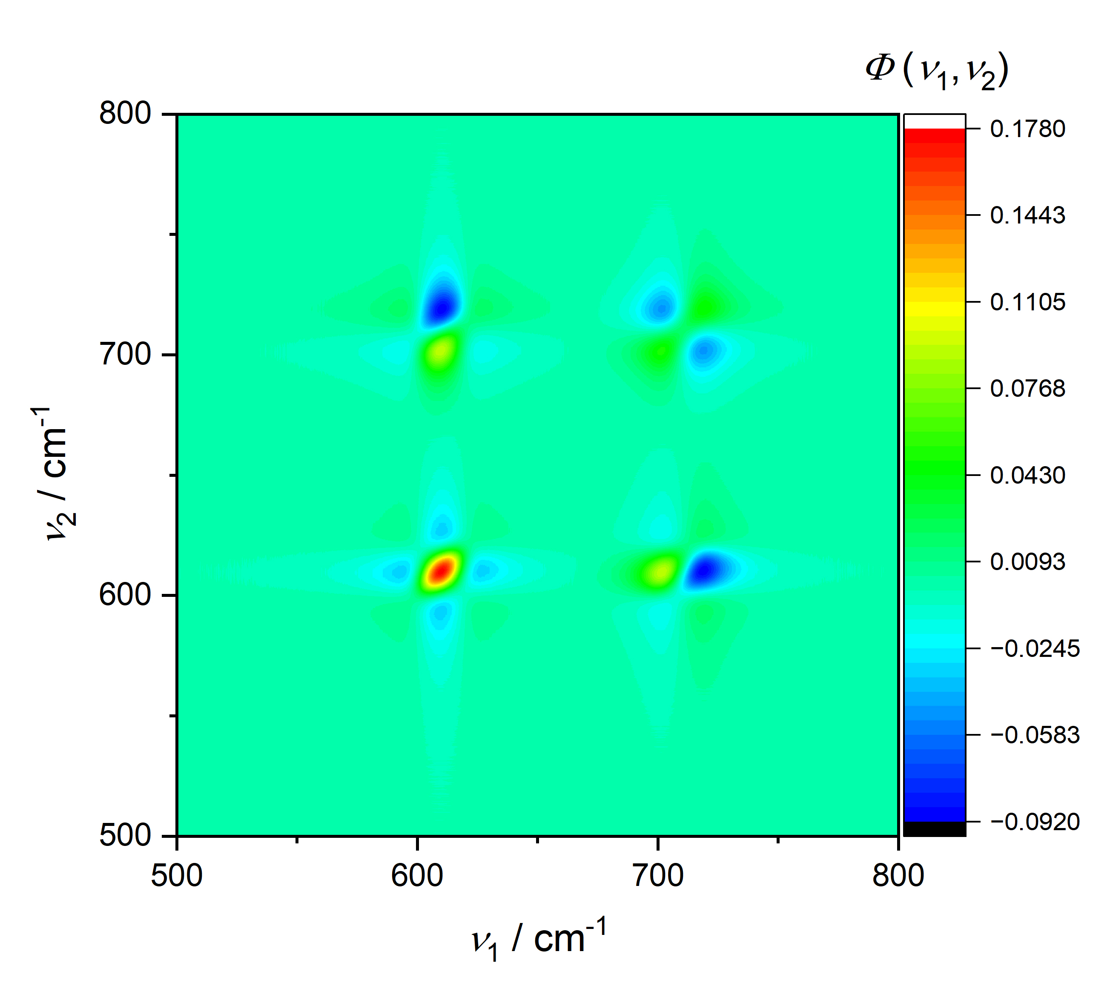
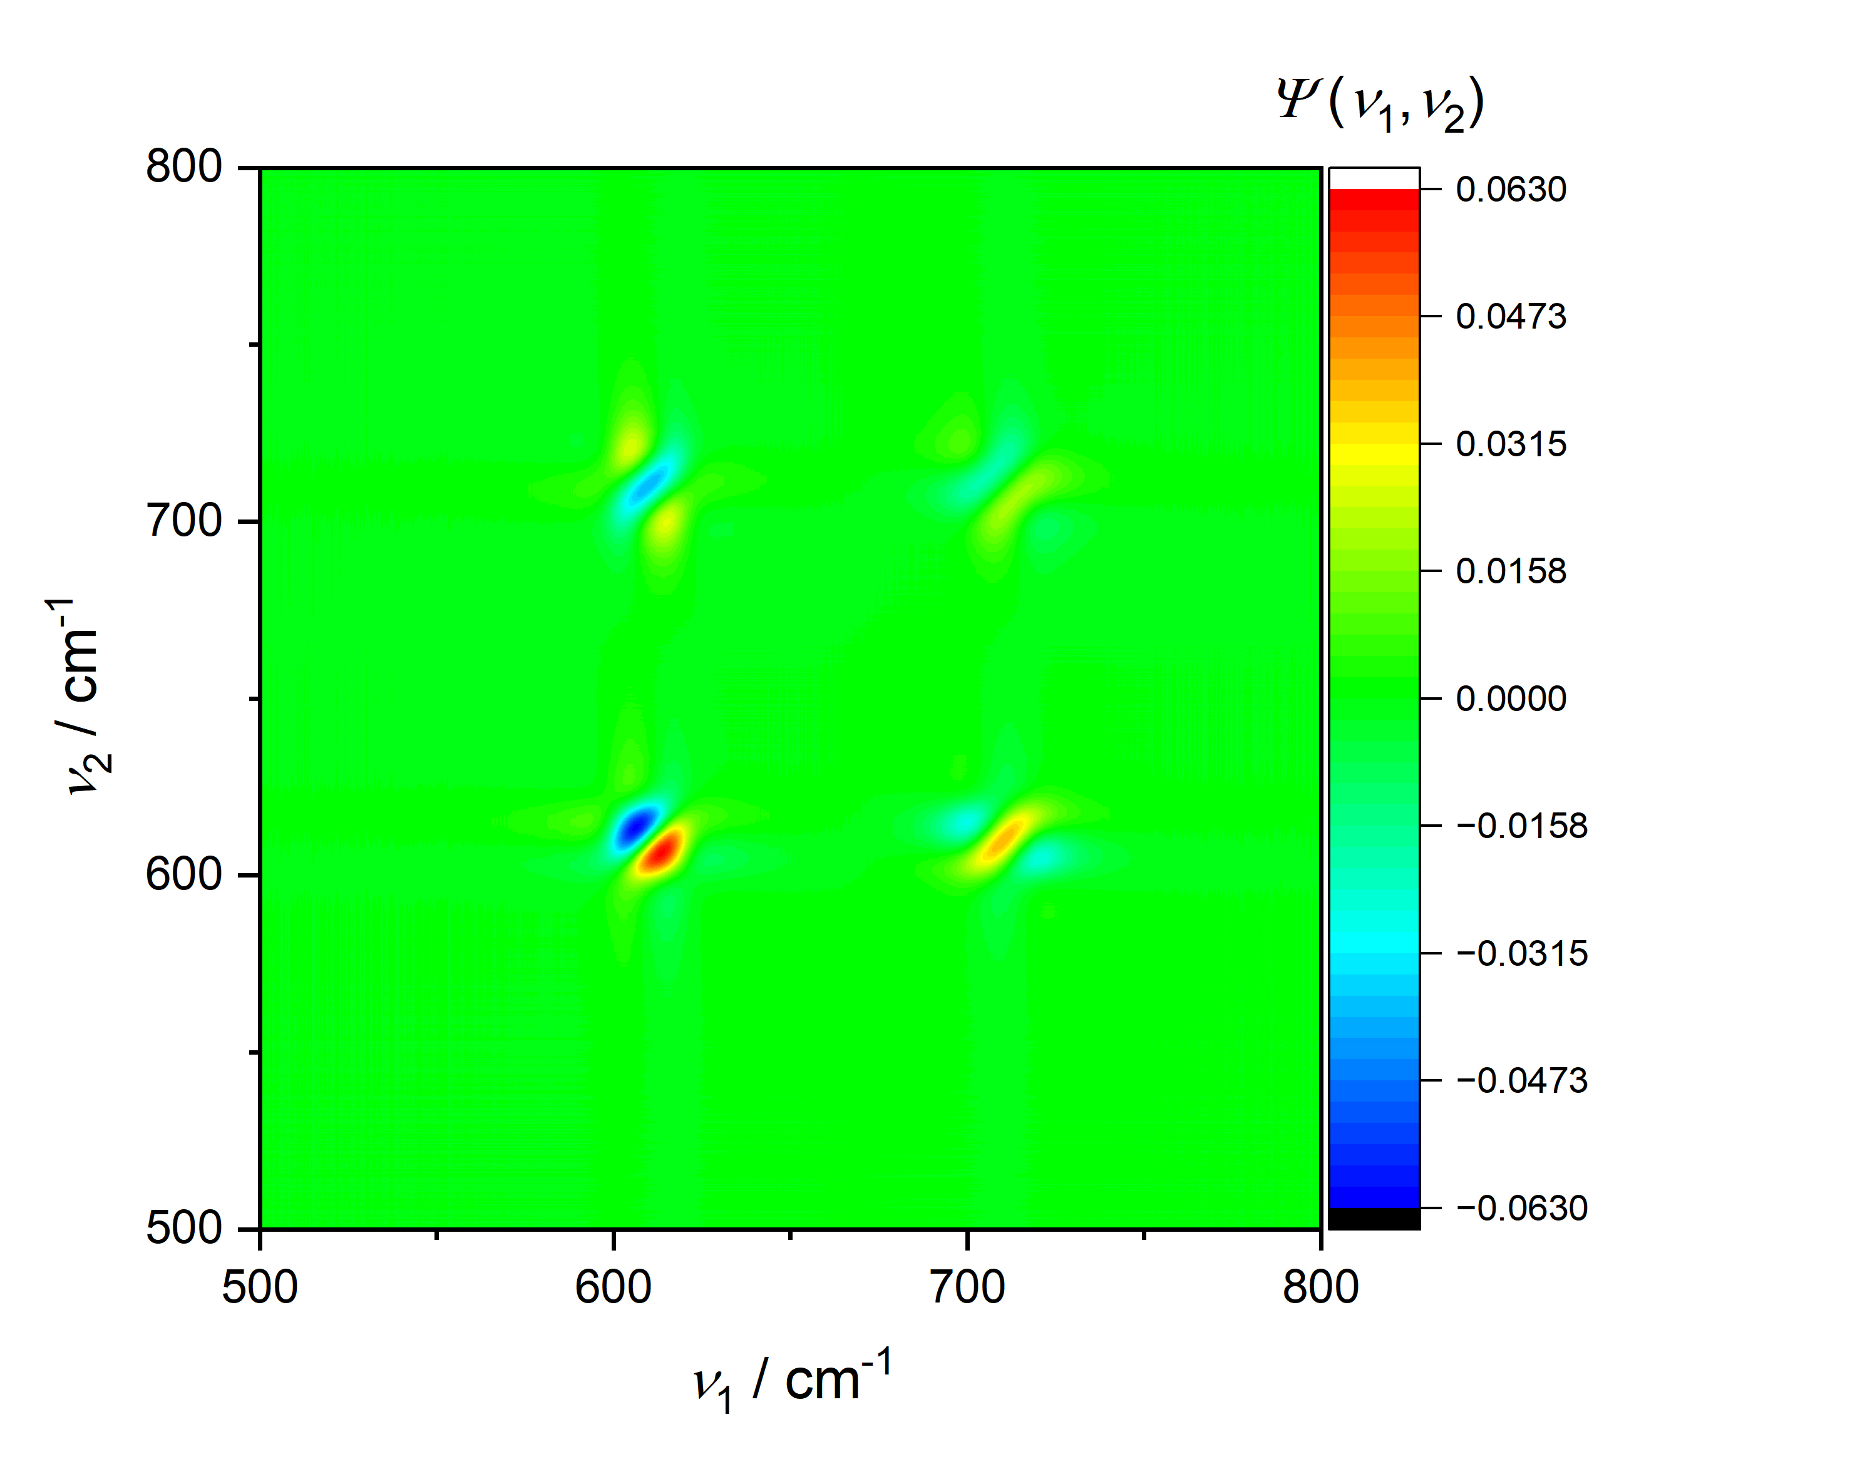
1 Fano + 1 Lorentzian band, uniform shift:

Slide 19
Conclusions:
The systematic investigation of synchronous and asynchronous 2D correlation spectra generated from synthetic Lorentzian and Fano line profiles provides a rigorous framework for determining how interference-induced spectral asymmetry is encoded in multidimensional correlation space.
For a Fano resonance, the intrinsic asymmetry couples these variations across the dispersive and absorptive components of the profile, potentially generating characteristic off-diagonal correlation features and sign patterns that distinguish it from the corresponding response of a symmetric Lorentzian resonance.
This distinction becomes especially important for finite spectral displacements, for which the commonly invoked small-perturbation approximation may no longer adequately describe the correlation structure.
A controlled comparison of simulated Lorentzian and Fano series therefore serves as a model system for separating effects arising from simple spectral displacement from those associated with interference-driven line-shape asymmetry.

Slide 20
Conclusions:
By systematically varying resonance position, linewidth, amplitude, and Fano asymmetry parameter, one can establish the mathematical correspondence between physical perturbations and their 2D correlation signatures.
Such an approach has the potential to provide a multidimensional spectroscopic criterion for identifying Fano-type interference and disentangling it from conventional resonance behavior, particularly in systems where the distinction is obscured in the one-dimensional spectrum by broadening, overlapping bands, or relatively small asymmetries.

Slide 21

Thank you for your attention

