Slide 1

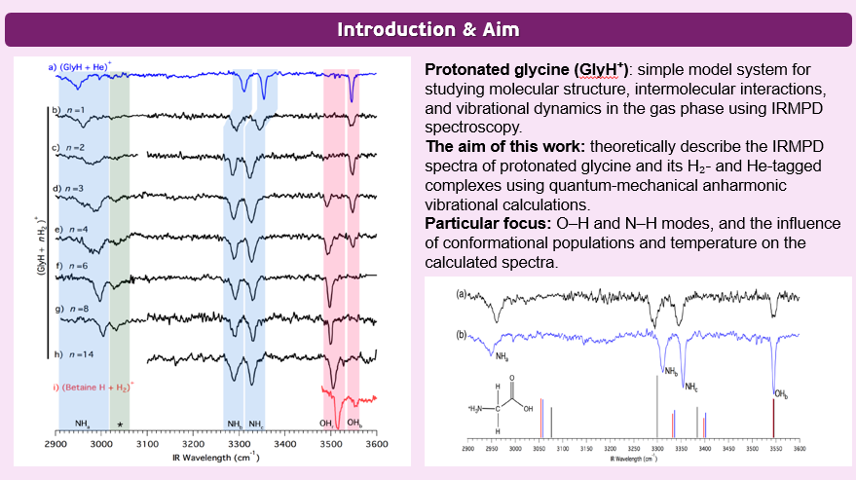
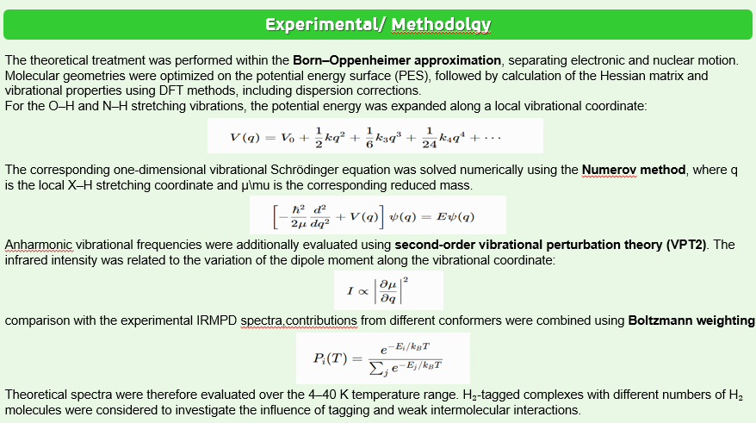
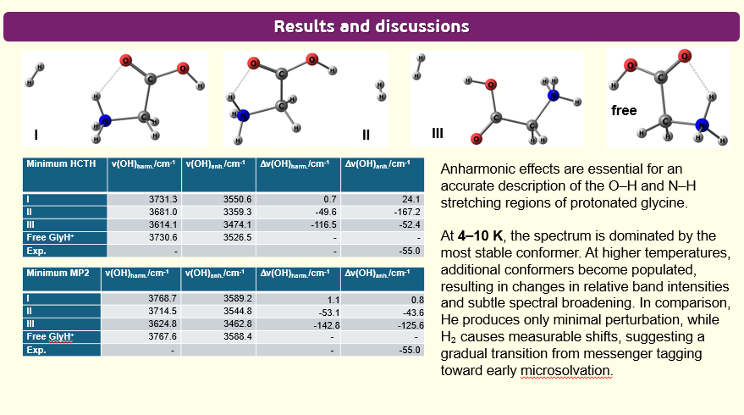
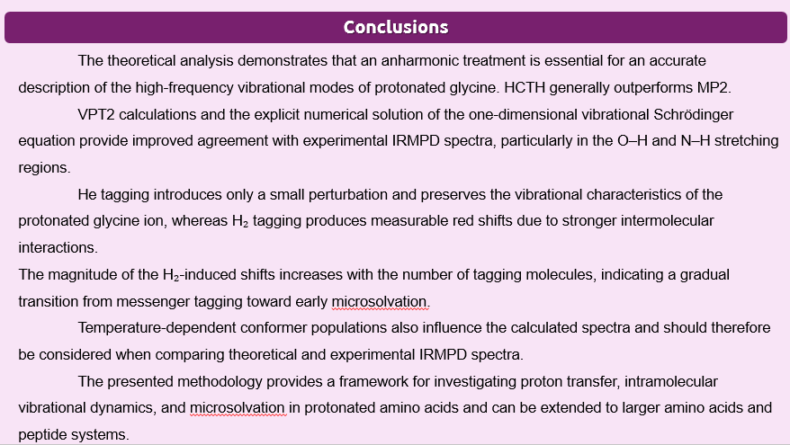
28th Congress of SCTM, 23-26 September, Ohrid, Macedonia
PSSE-P16
THEORETICAL IRMPD SPECTROSCOPY OF HYDROGEN- AND HELIUM-TAGGED PROTONATED GLYCINE
Adela Asani¹ Blagoj Achevski² Ljupcho Pejov¹
¹Institute of Chemistry, Faculty of Natural Sciences and Mathematics,SS Cyril and Methodius University, Skopje, Macedonia, adelaasanii@gmail.com ² Faculty of Pharmacy, SS Cyril and Methodius University, Skopje, Macedonia

Slide 2
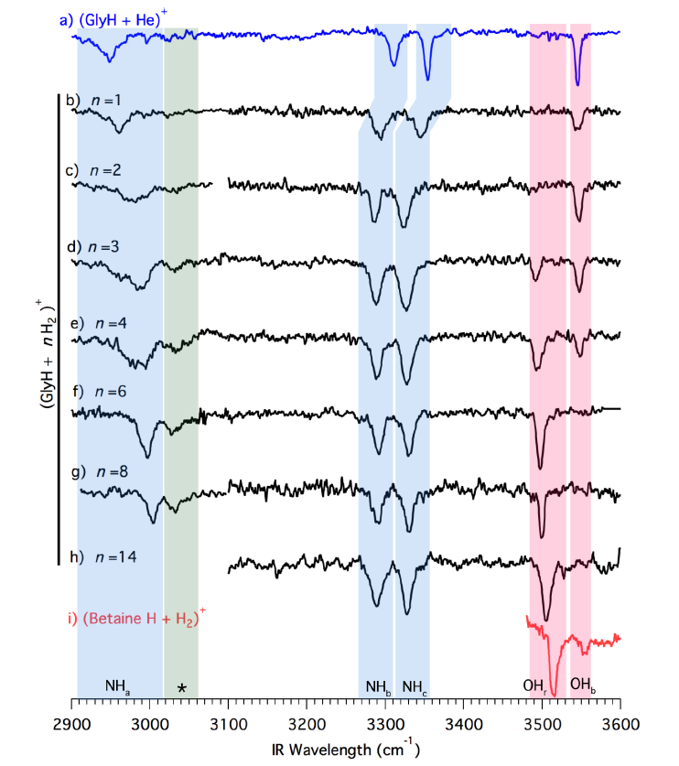
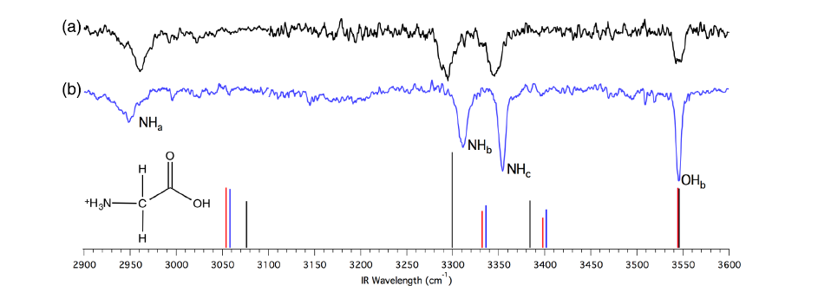
Introduction & Aim
Protonated glycine (GlyH⁺): simple model system for studying molecular structure, intermolecular interactions, and vibrational dynamics in the gas phase using IRMPD spectroscopy.
The aim of this work: theoretically describe the IRMPD spectra of protonated glycine and its H₂- and He-tagged complexes using quantum-mechanical anharmonic vibrational calculations.
Particular focus: O–H and N–H modes, and the influence of conformational populations and temperature on the calculated spectra.

Slide 3
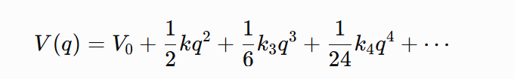
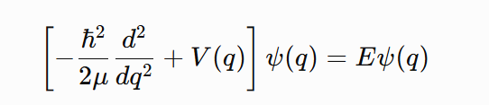
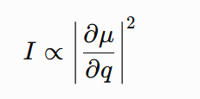
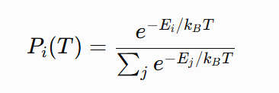
Experimental/ Methodolgy
The theoretical treatment was performed within the Born–Oppenheimer approximation, separating electronic and nuclear motion. Molecular geometries were optimized on the potential energy surface (PES), followed by calculation of the Hessian matrix and vibrational properties using DFT methods, including dispersion corrections.
For the O–H and N–H stretching vibrations, the potential energy was expanded along a local vibrational coordinate:
The corresponding one-dimensional vibrational Schrödinger equation was solved numerically using the Numerov method, where q is the local X–H stretching coordinate and μ\mu is the corresponding reduced mass.
Anharmonic vibrational frequencies were additionally evaluated using second-order vibrational perturbation theory (VPT2). The infrared intensity was related to the variation of the dipole moment along the vibrational coordinate:
comparison with the experimental IRMPD spectra,contributions from different conformers were combined using Boltzmann weighting
Theoretical spectra were therefore evaluated over the 4–40 K temperature range. H₂-tagged complexes with different numbers of H₂ molecules were considered to investigate the influence of tagging and weak intermolecular interactions.

Slide 4
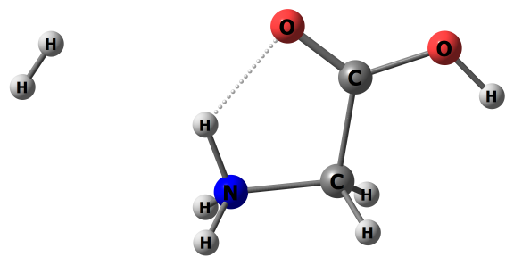
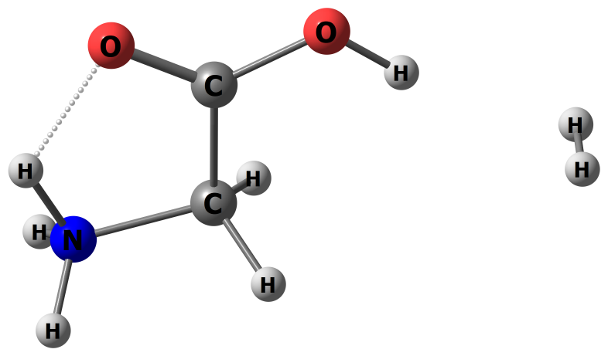
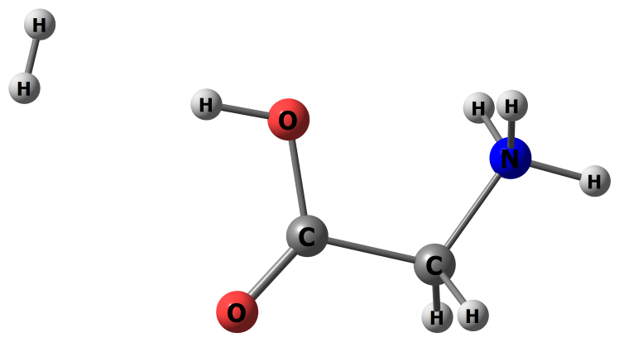
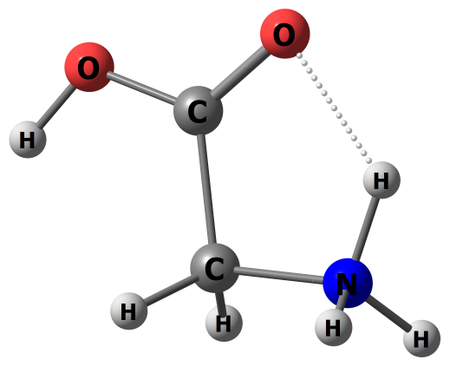
Results and discussions
free
I
II
III
Minimum HCTH | v(OH)_{harm.}/cm⁻¹ | v(OH)_{anh.}/cm⁻¹ | Δv(OH)_{harm.}/cm⁻¹ | Δv(OH)_{anh.}/cm⁻¹
I | 3731.3 | 3550.6 | 0.7 | 24.1
II | 3681.0 | 3359.3 | -49.6 | -167.2
III | 3614.1 | 3474.1 | -116.5 | -52.4
Free GlyH⁺ | 3730.6 | 3526.5 | - | -
Exp. | - |  | - | -55.0
Anharmonic effects are essential for an accurate description of the O–H and N–H stretching regions of protonated glycine.
At 4–10 K, the spectrum is dominated by the most stable conformer. At higher temperatures, additional conformers become populated, resulting in changes in relative band intensities and subtle spectral broadening. In comparison, He produces only minimal perturbation, while H₂ causes measurable shifts, suggesting a gradual transition from messenger tagging toward early microsolvation.
Minimum MP2 | v(OH)_{harm.}/cm⁻¹ | v(OH)_{anh.}/cm⁻¹ | Δv(OH)_{harm.}/cm⁻¹ | Δv(OH)_{anh.}/cm⁻¹
I | 3768.7 | 3589.2 | 1.1 | 0.8
II | 3714.5 | 3544.8 | -53.1 | -43.6
III | 3624.8 | 3462.8 | -142.8 | -125.6
Free GlyH⁺ | 3767.6 | 3588.4 | - | -
Exp. | - |  | - | -55.0

Slide 5
Conclusions
The theoretical analysis demonstrates that an anharmonic treatment is essential for an accurate description of the high-frequency vibrational modes of protonated glycine. HCTH generally outperforms MP2.
VPT2 calculations and the explicit numerical solution of the one-dimensional vibrational Schrödinger equation provide improved agreement with experimental IRMPD spectra, particularly in the O–H and N–H stretching regions.
He tagging introduces only a small perturbation and preserves the vibrational characteristics of the protonated glycine ion, whereas H₂ tagging produces measurable red shifts due to stronger intermolecular interactions.
The magnitude of the H₂-induced shifts increases with the number of tagging molecules, indicating a gradual transition from messenger tagging toward early microsolvation.
Temperature-dependent conformer populations also influence the calculated spectra and should therefore be considered when comparing theoretical and experimental IRMPD spectra.
The presented methodology provides a framework for investigating proton transfer, intramolecular vibrational dynamics, and microsolvation in protonated amino acids and can be extended to larger amino acids and peptide systems.

