Slide 1
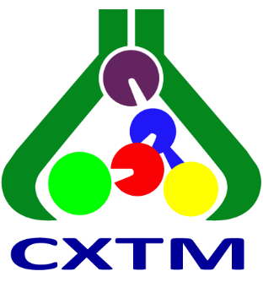
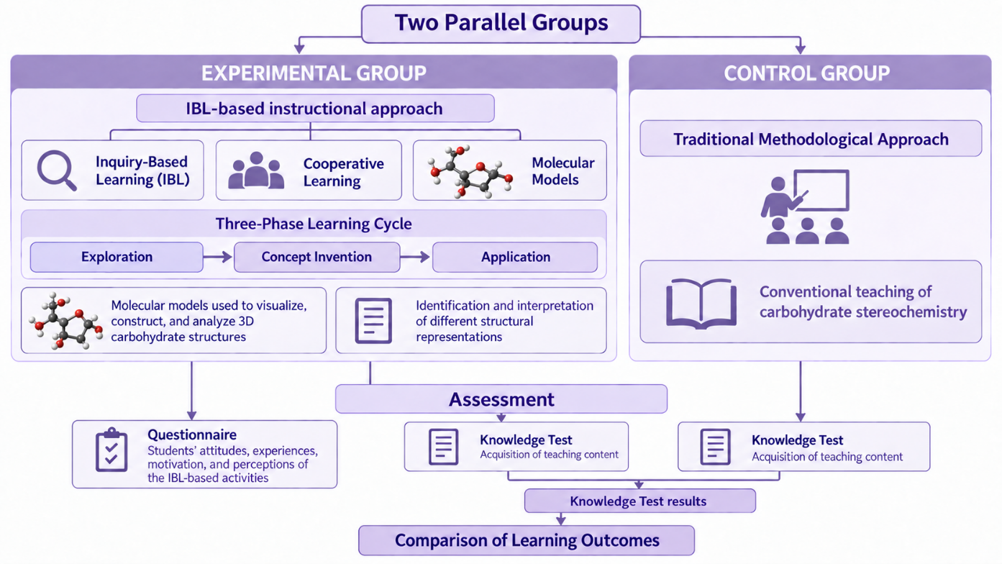
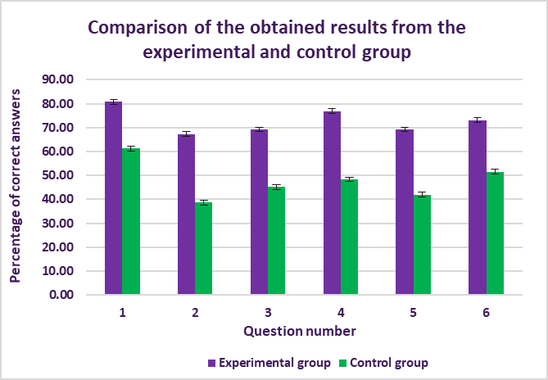
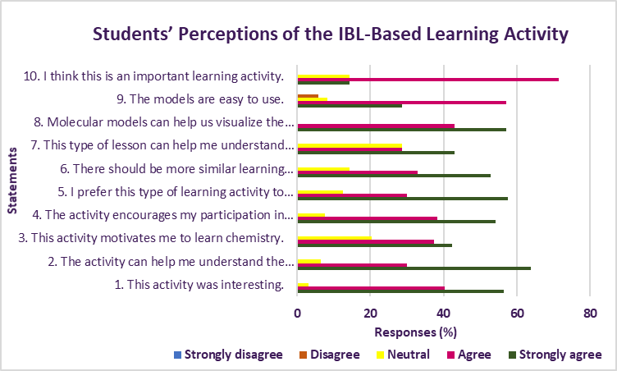
28th Congress of SCTM, 23-26 September, Ohrid, Macedonia
EDU-P1
A STUDY OF COOPERATIVE INQUIRY-BASED INSTRUCTION SUPPORTED
BY MOLECULAR MODELS IN CARBOHYDRATE STEREOCHEMISTRY EDUCATION
Aleksandra Naumoska¹, Pece Sherovski¹, Slobotka Aleksovska¹
¹ Institute of Chemistry, Faculty of Natural Sciences and Mathematics, Ss. Cyril and Methodius University in Skopje, Republic of N. Macedonia
e-mail: aleksandra.naumoska@pmf.ukim.mk
Introduction & Aim
Stereochemistry is essential for understanding the structure, properties, and biological activity of biomolecules.
The spatial complexity of stereochemical structures poses challenges to students’ visualization and conceptual understanding.
The aim was to evaluate the impact of an instructional approach that integrated Inquiry-Based Learning (IBL), cooperative work, and molecular models
on students’ knowledge acquisition in carbohydrate stereochemistry.
Experimental
Results and discussion
Participants
83 students from two high school:
SUSG “Nikola Karev” in Skopje;
Medical High School “Dr. Jovan Kalauzi” in Bitola.
Fig.1 Comparison of the results achieved from the experimental and control group
Fig.2 Results of the questionnaire
Conclusions
Table 1. Descriptive statistics and t-test outcomes for experimental vs. control group
Group | N | M/% | SD | ΔM/% | t | t_{(crit.)} | df | p
Experimental | 52 | 72.8 | 19.81 | 24.91 | 5.58 | 1.99 | 63.8 | < 0.001
Control | 31 | 47.85 | 19.60
Considering these findings, integrating IBL, cooperative learning, and
molecular models can enhance students’ conceptual understanding,
engagement, and stereochemistry learning outcomes.

