Slide 1
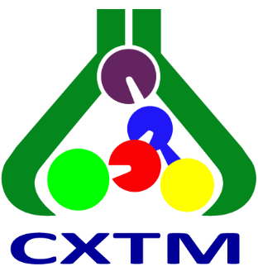
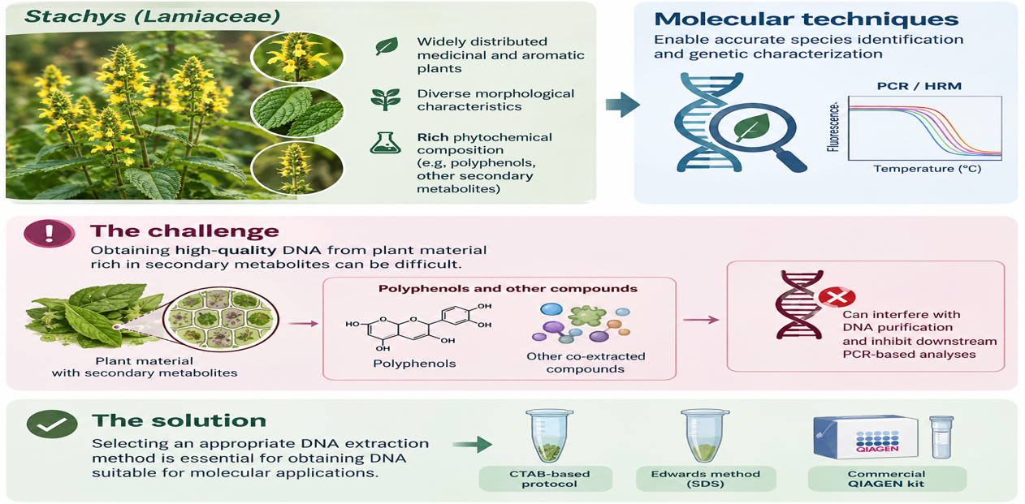
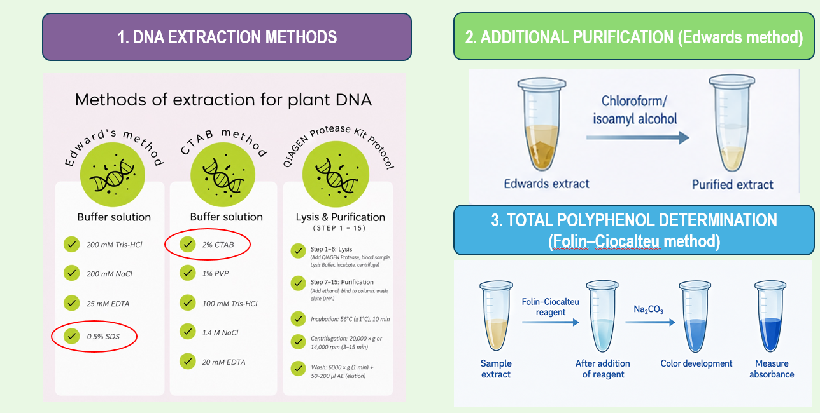
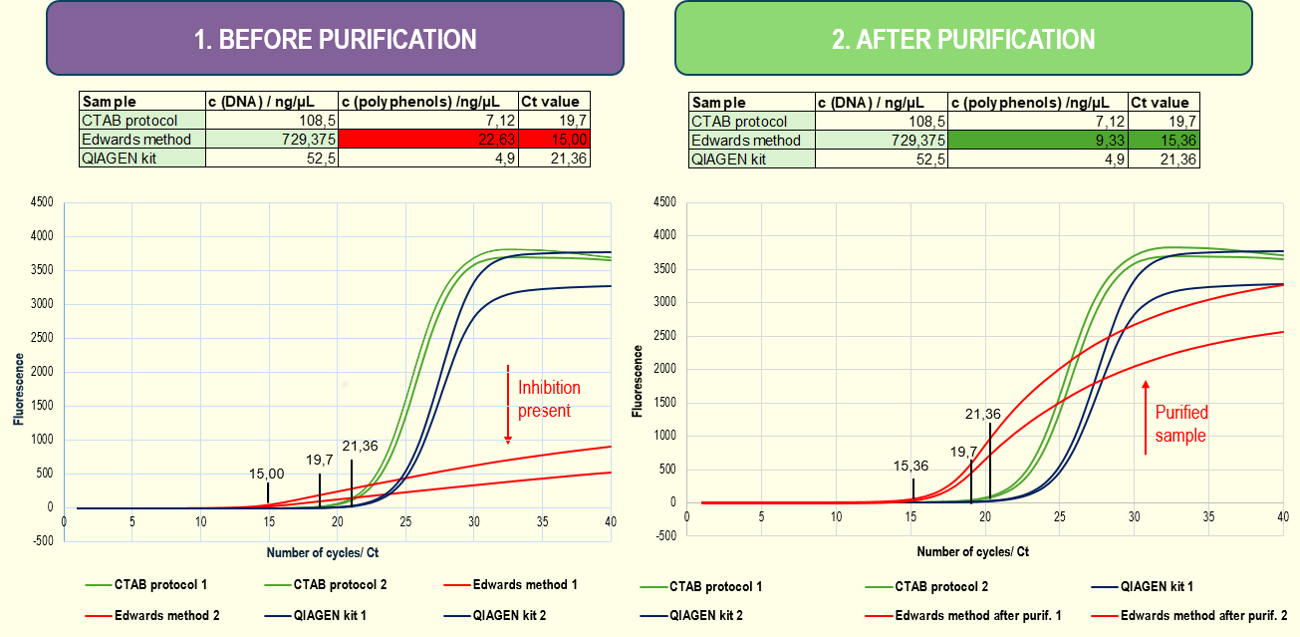
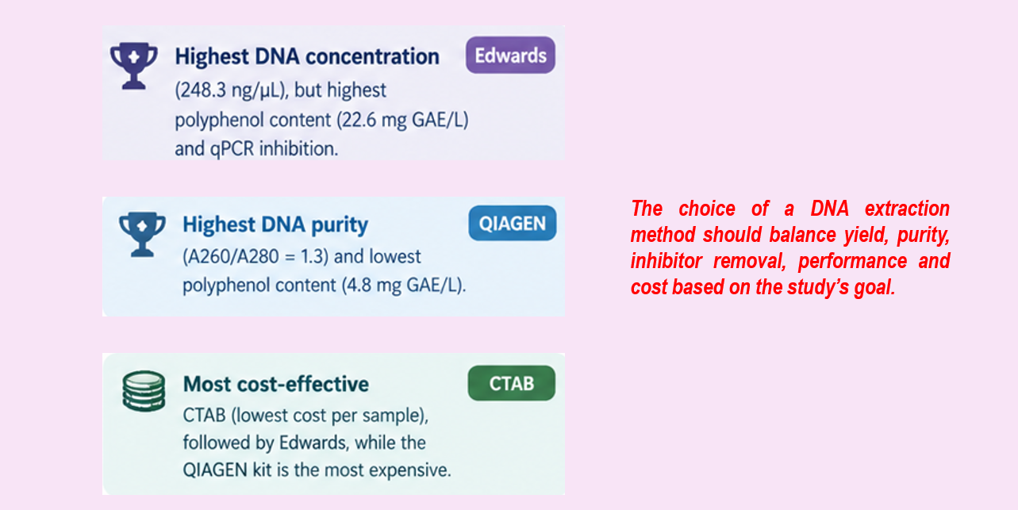
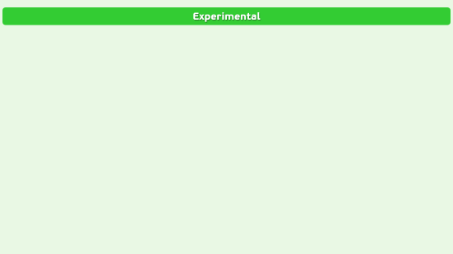
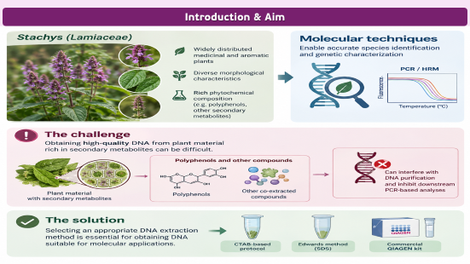
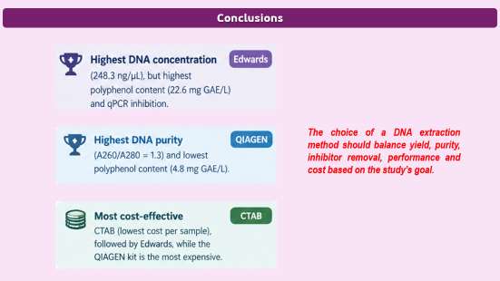
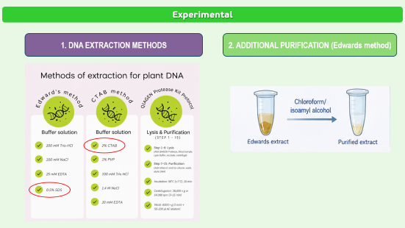

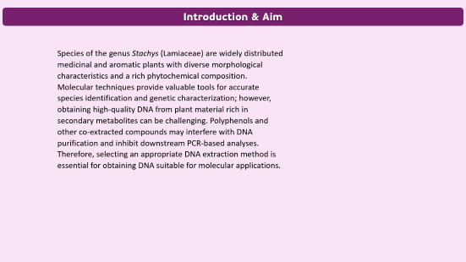
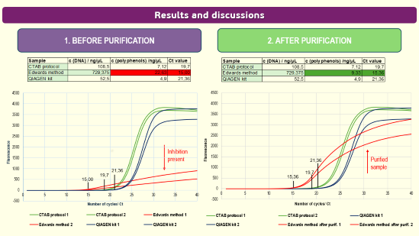
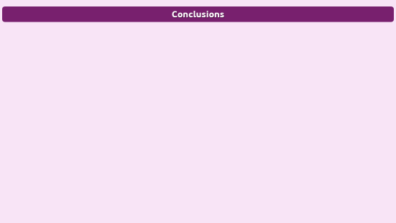
INFLUENCE OF DNA EXTRACTION METHODS ON DNA QUALITY,
POLYPHENOL CONTENT AND PCR-HRM PERFORMANCE IN STACHYS SPECIES
28th Congress of SCTM, 23-26 September, Ohrid, Macedonia
OBPC-P2
Marinela Cvetanoska, Blagica Janeva, Kristijan Trajkovski, Jasmina Petreska Stanoeva, Pece Sherovski
¹Institute of Chemistry, Faculty of Natural Sciences and Mathematics, Ss. Cyril and Methodius University in Skopje, Skopje, North Macedonia, blagicajaneva148@gmail.com

Slide 2
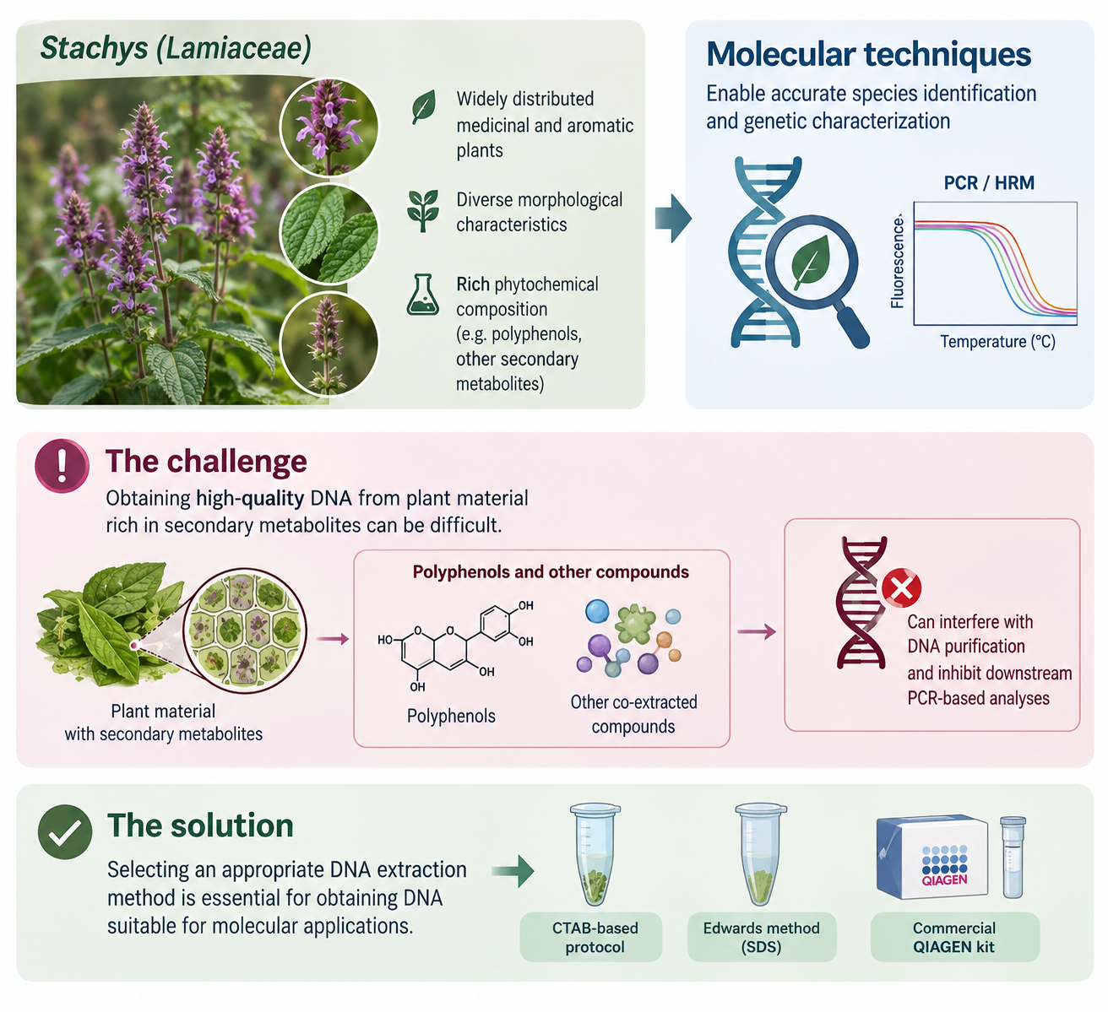
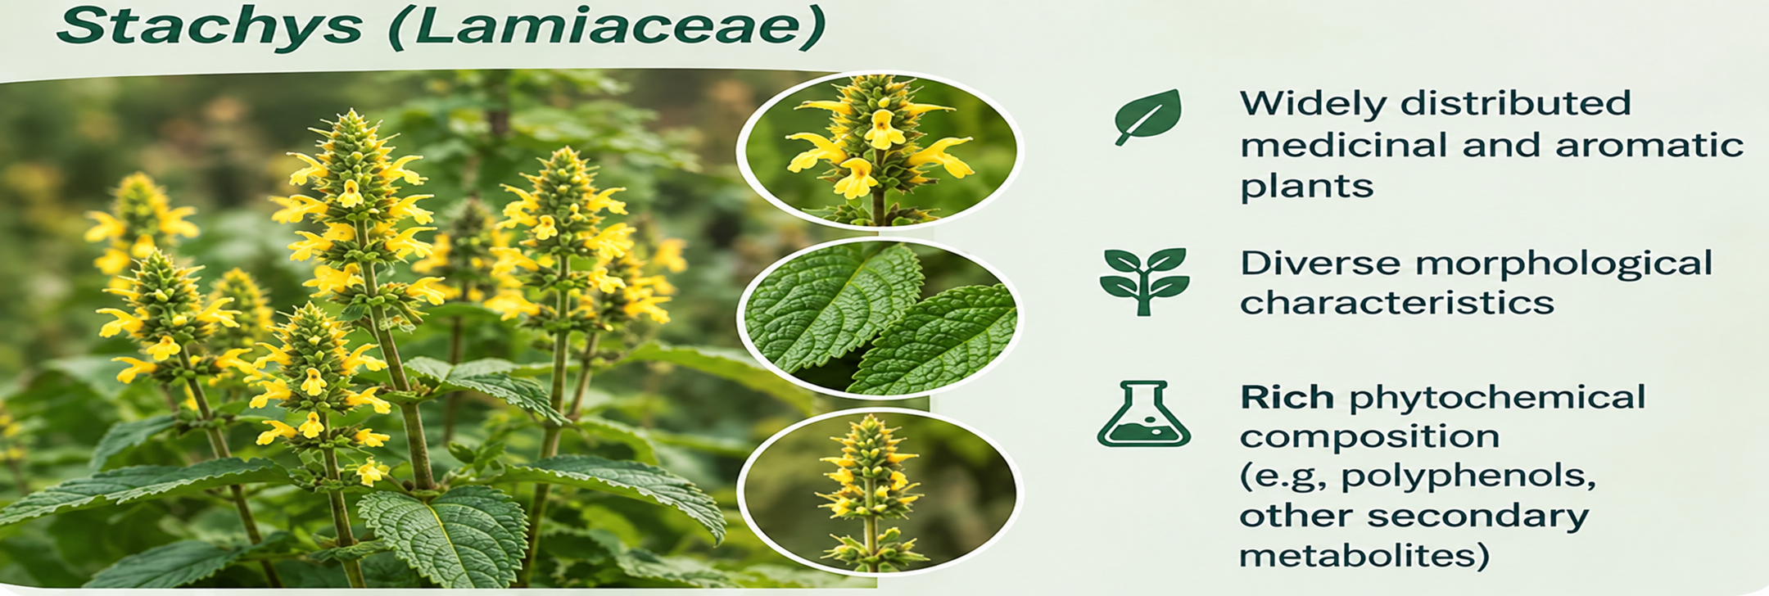
Introduction & Aim

Slide 3
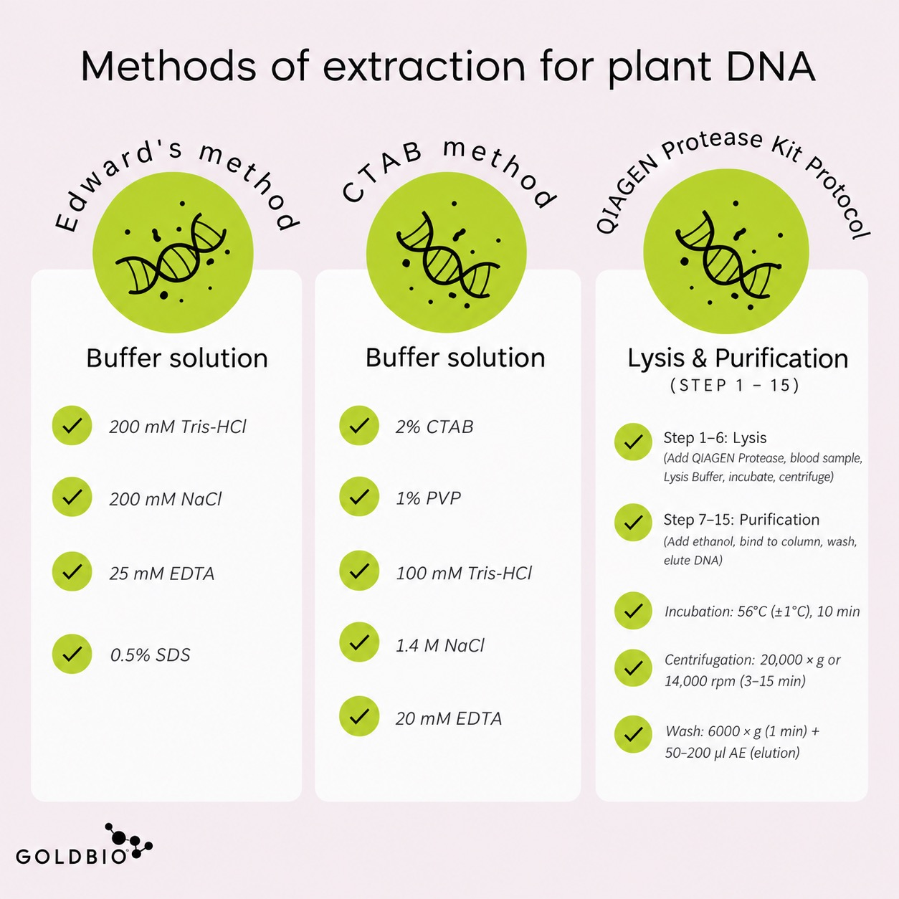
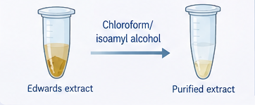
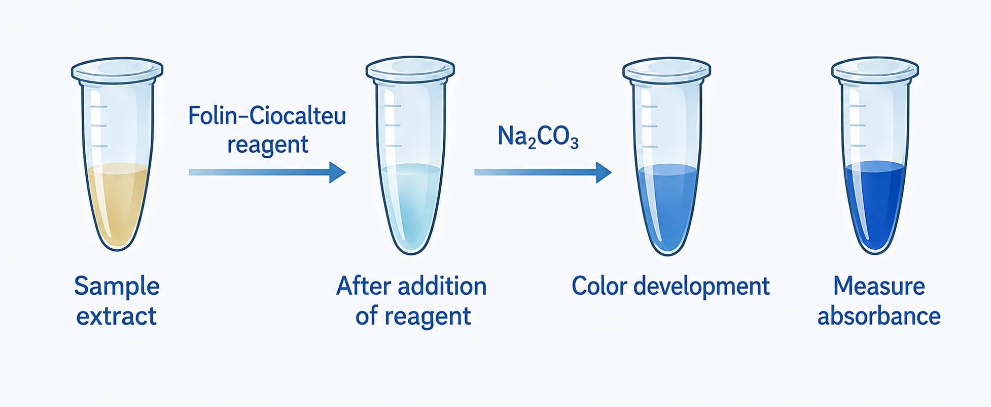
Experimental
1. DNA EXTRACTION METHODS
2. ADDITIONAL PURIFICATION (Edwards method)
3. Total polyphenol determination
(Folin–Ciocalteu method)

Slide 4
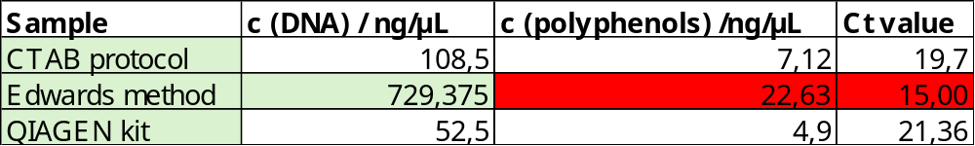
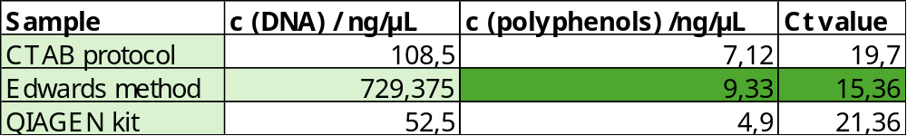
Results and discussions
1. BEFORE PURIFICATION
2. AFTER PURIFICATION
Inhibition present
21,36
Purified sample
15,00

Slide 5
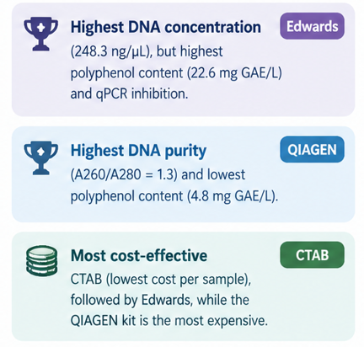
Conclusions
The choice of a DNA extraction method should balance yield, purity, inhibitor removal, performance and cost based on the study’s goal.

