Slide 1


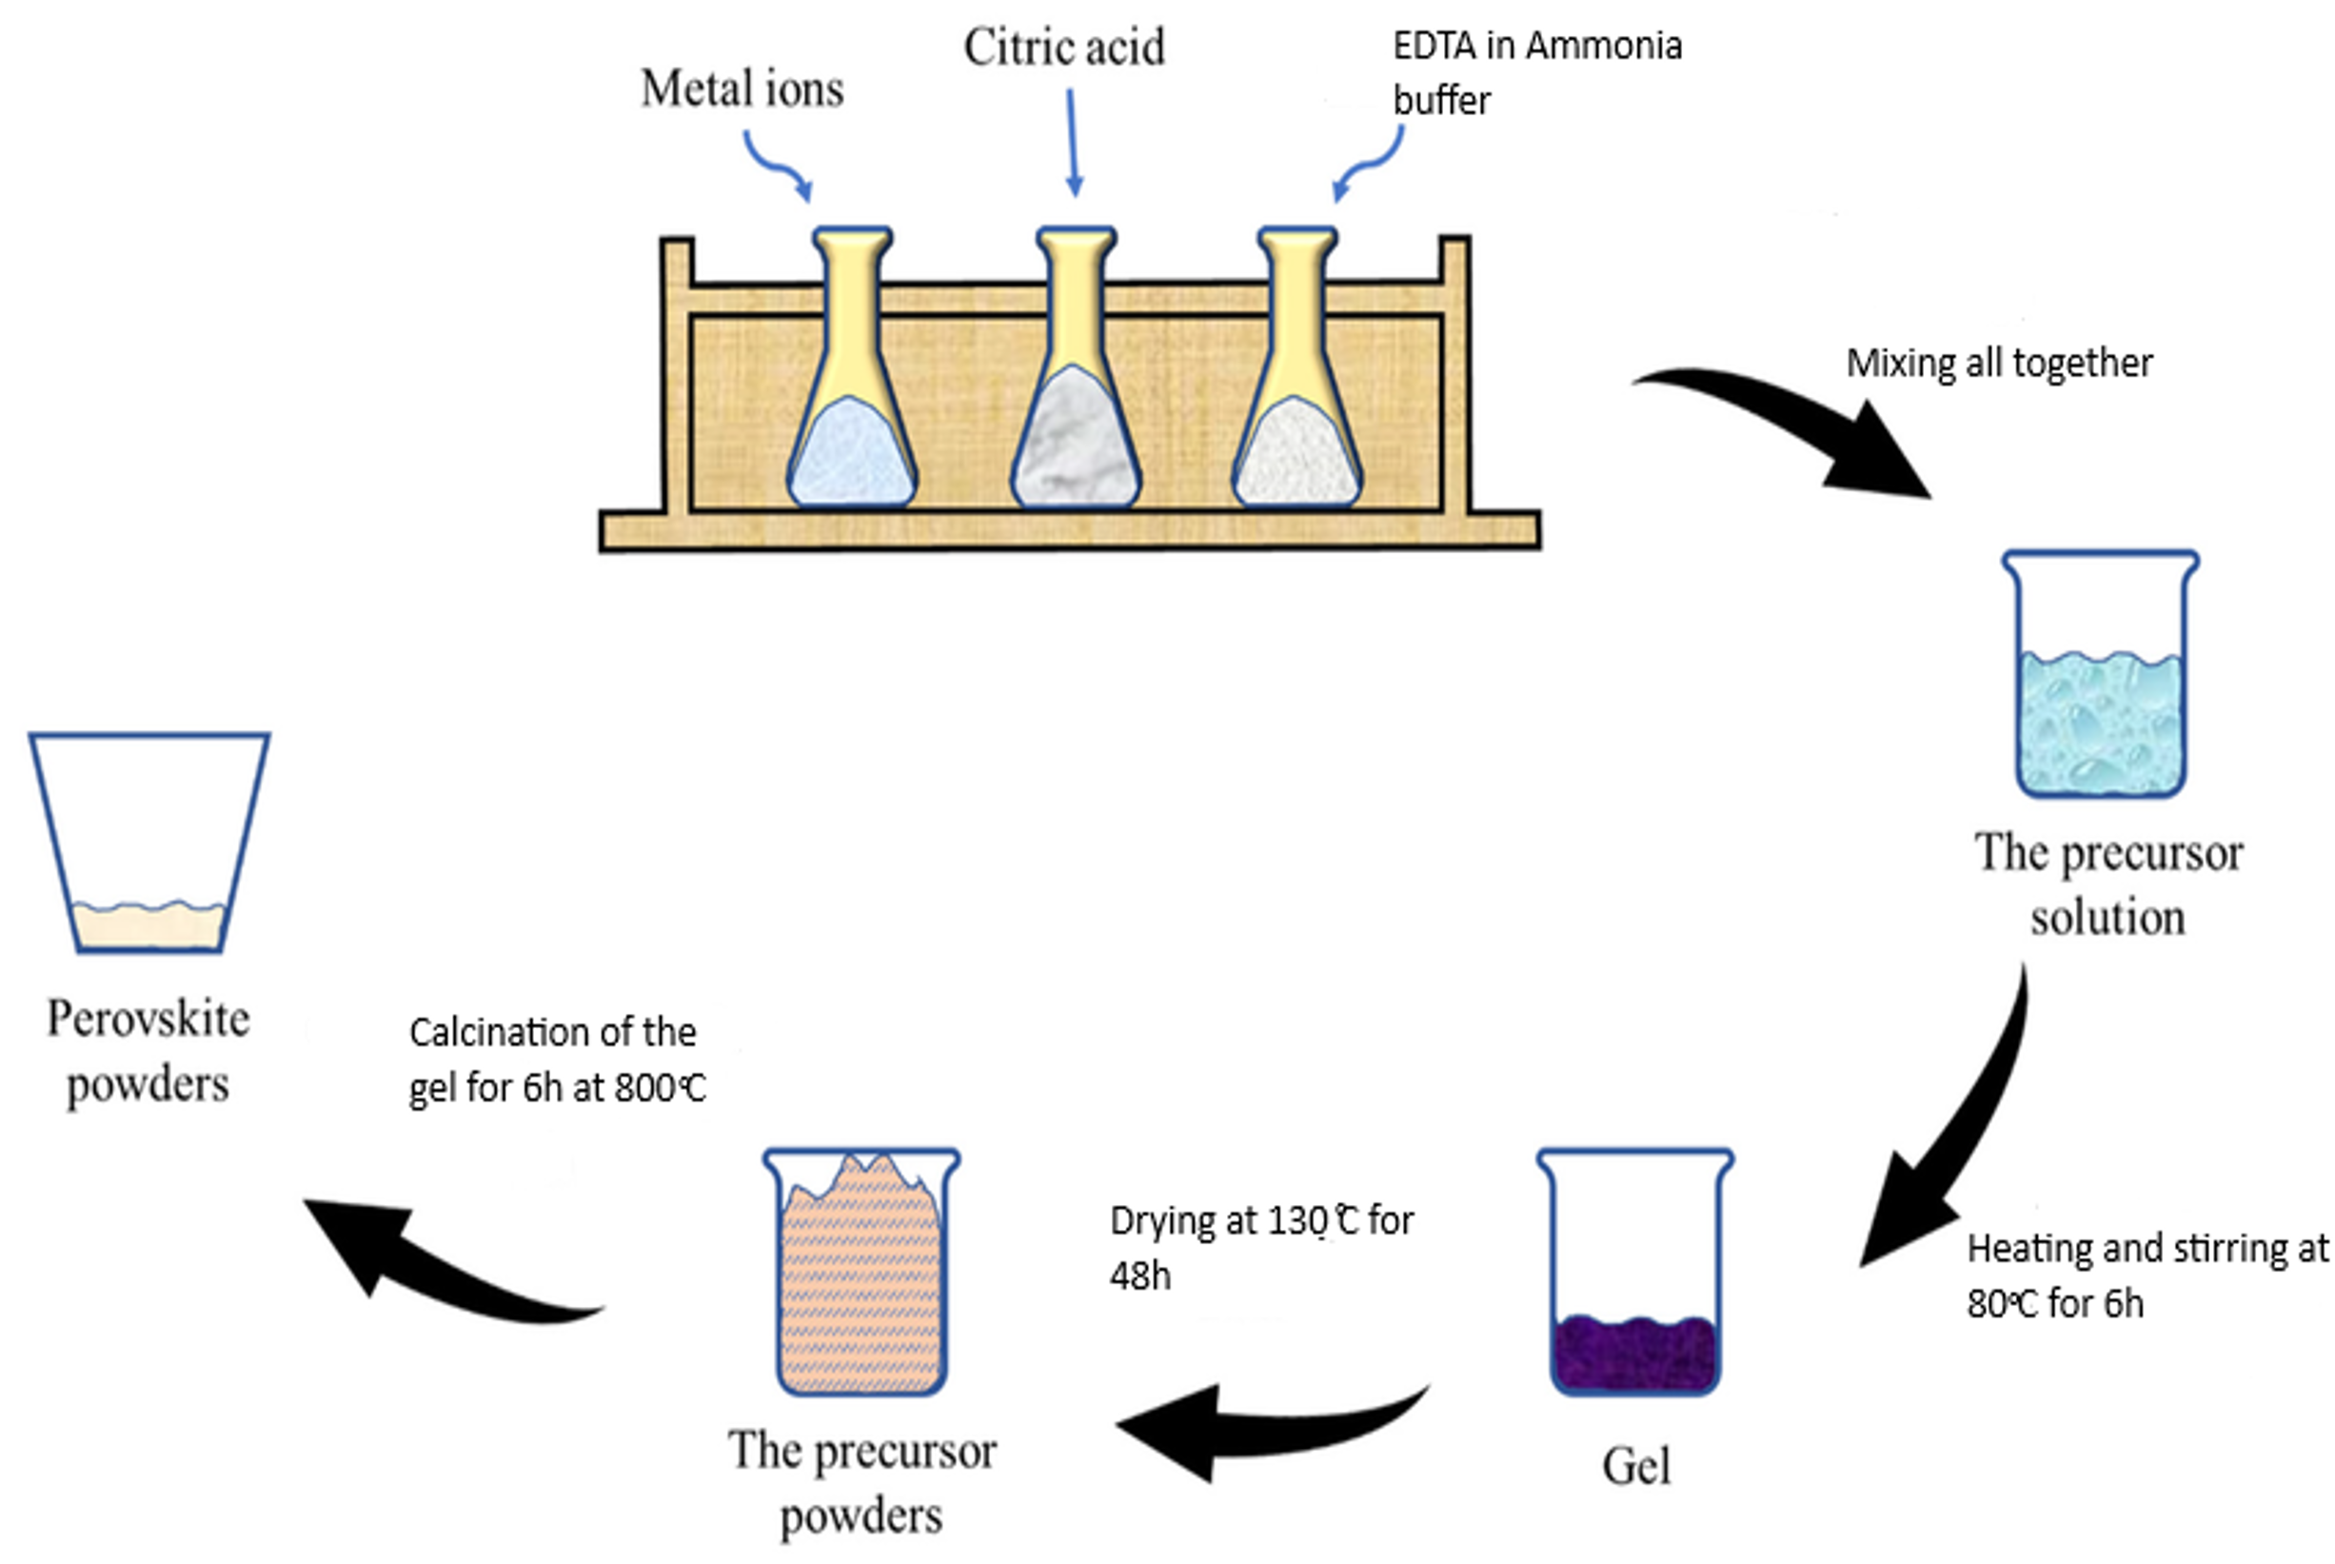
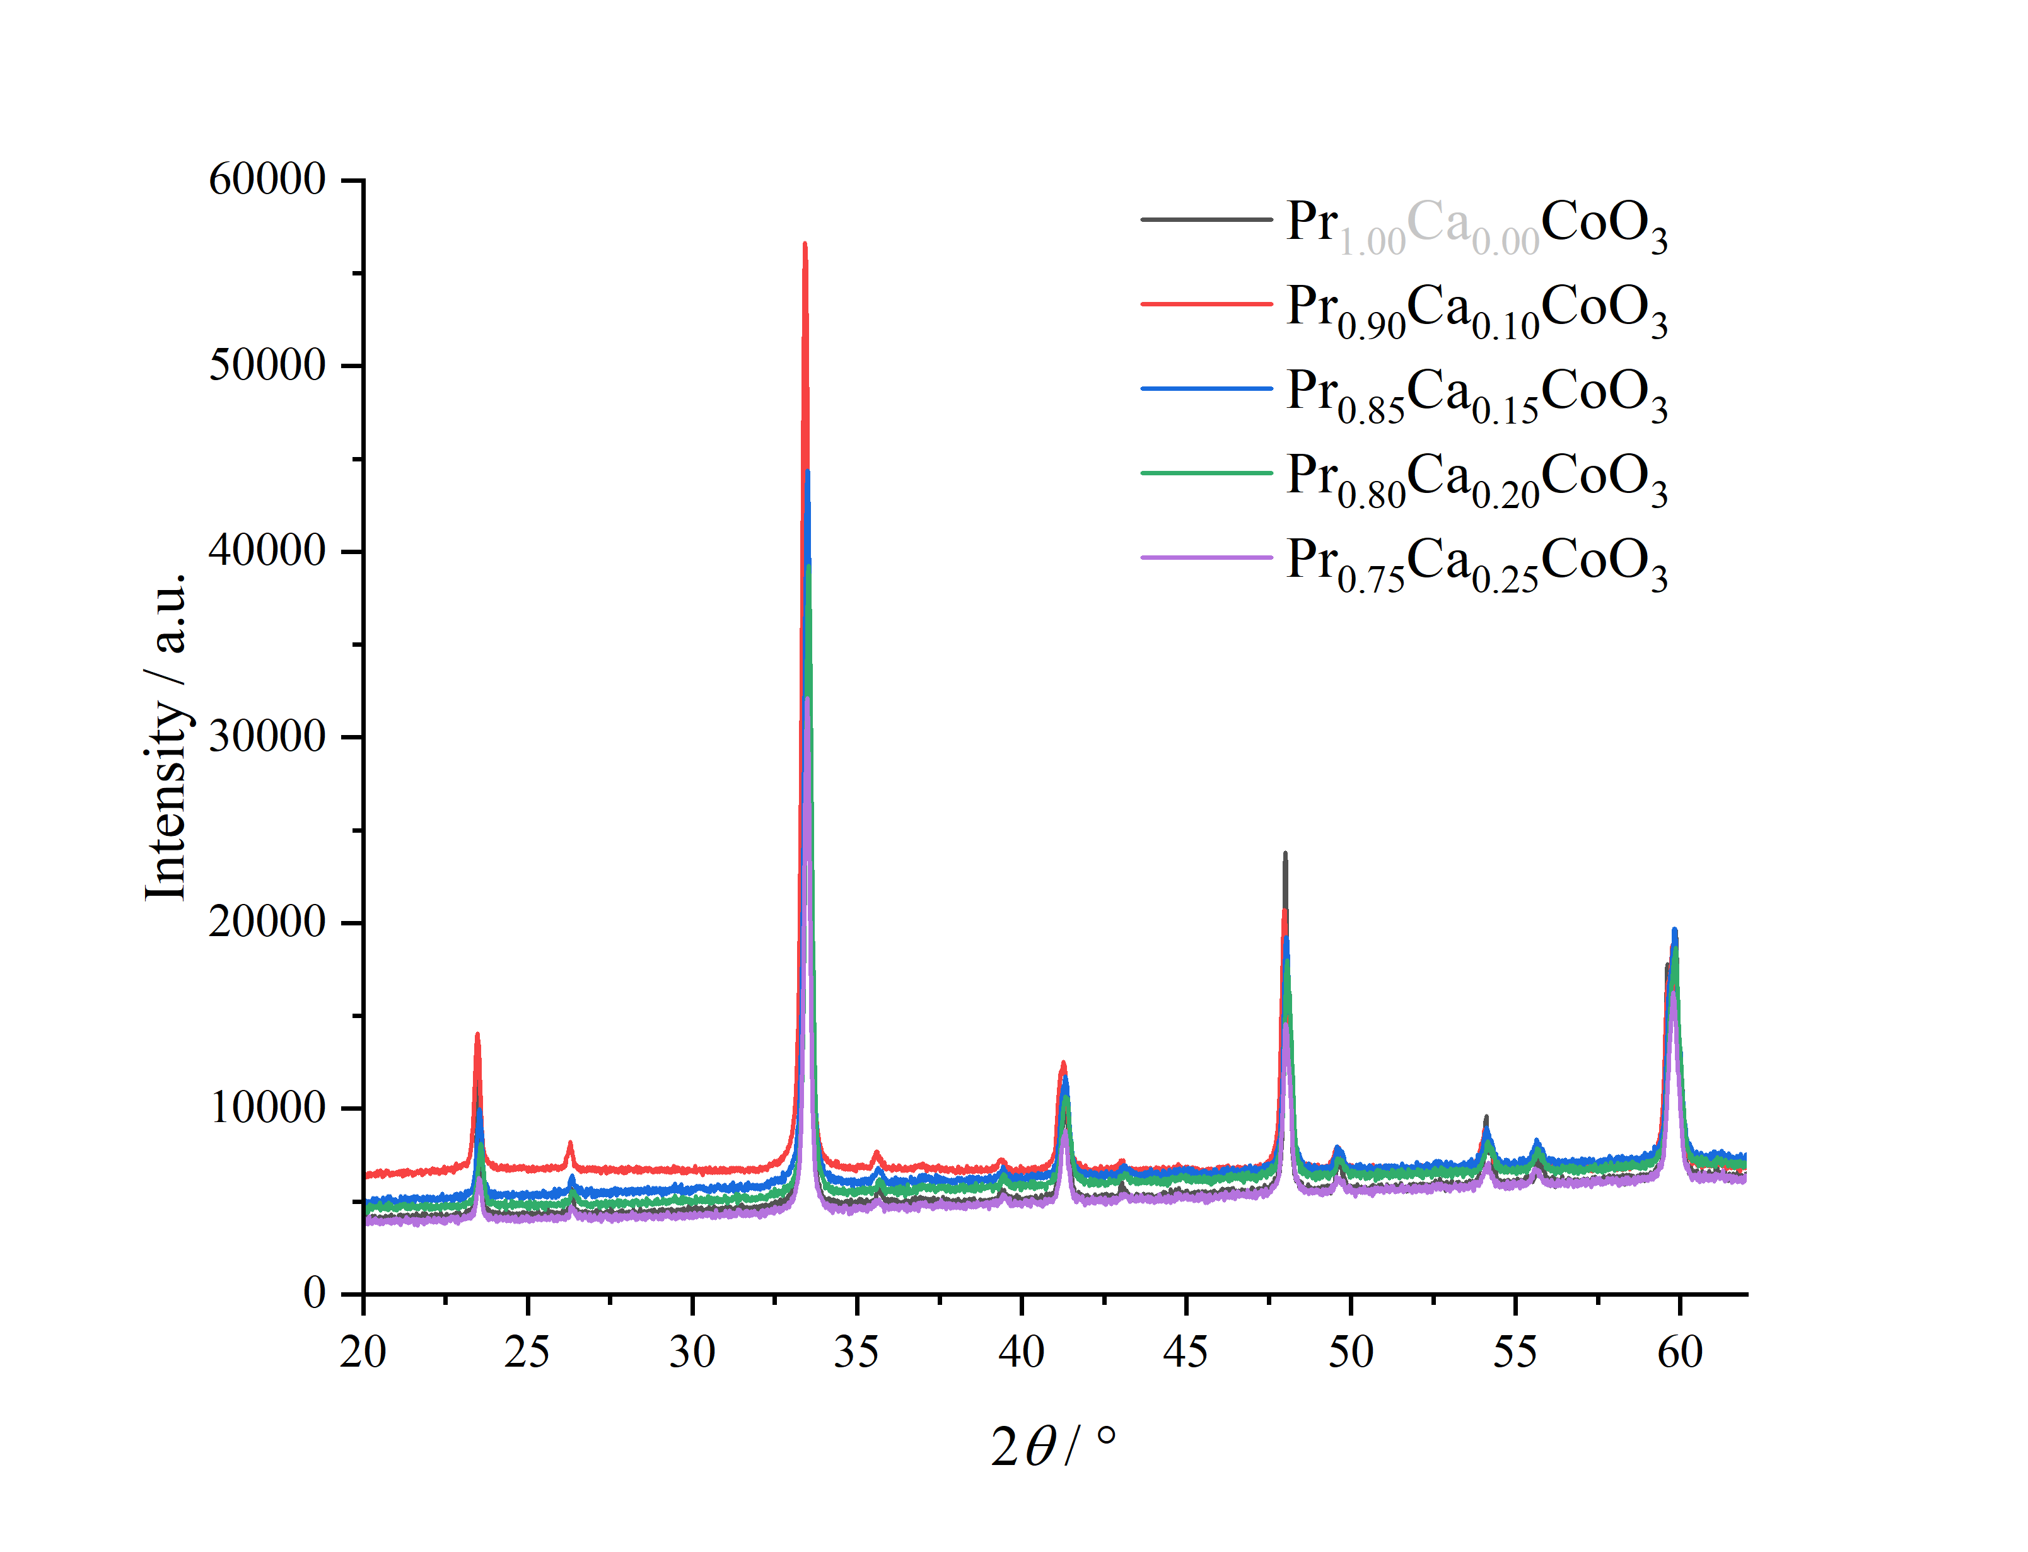
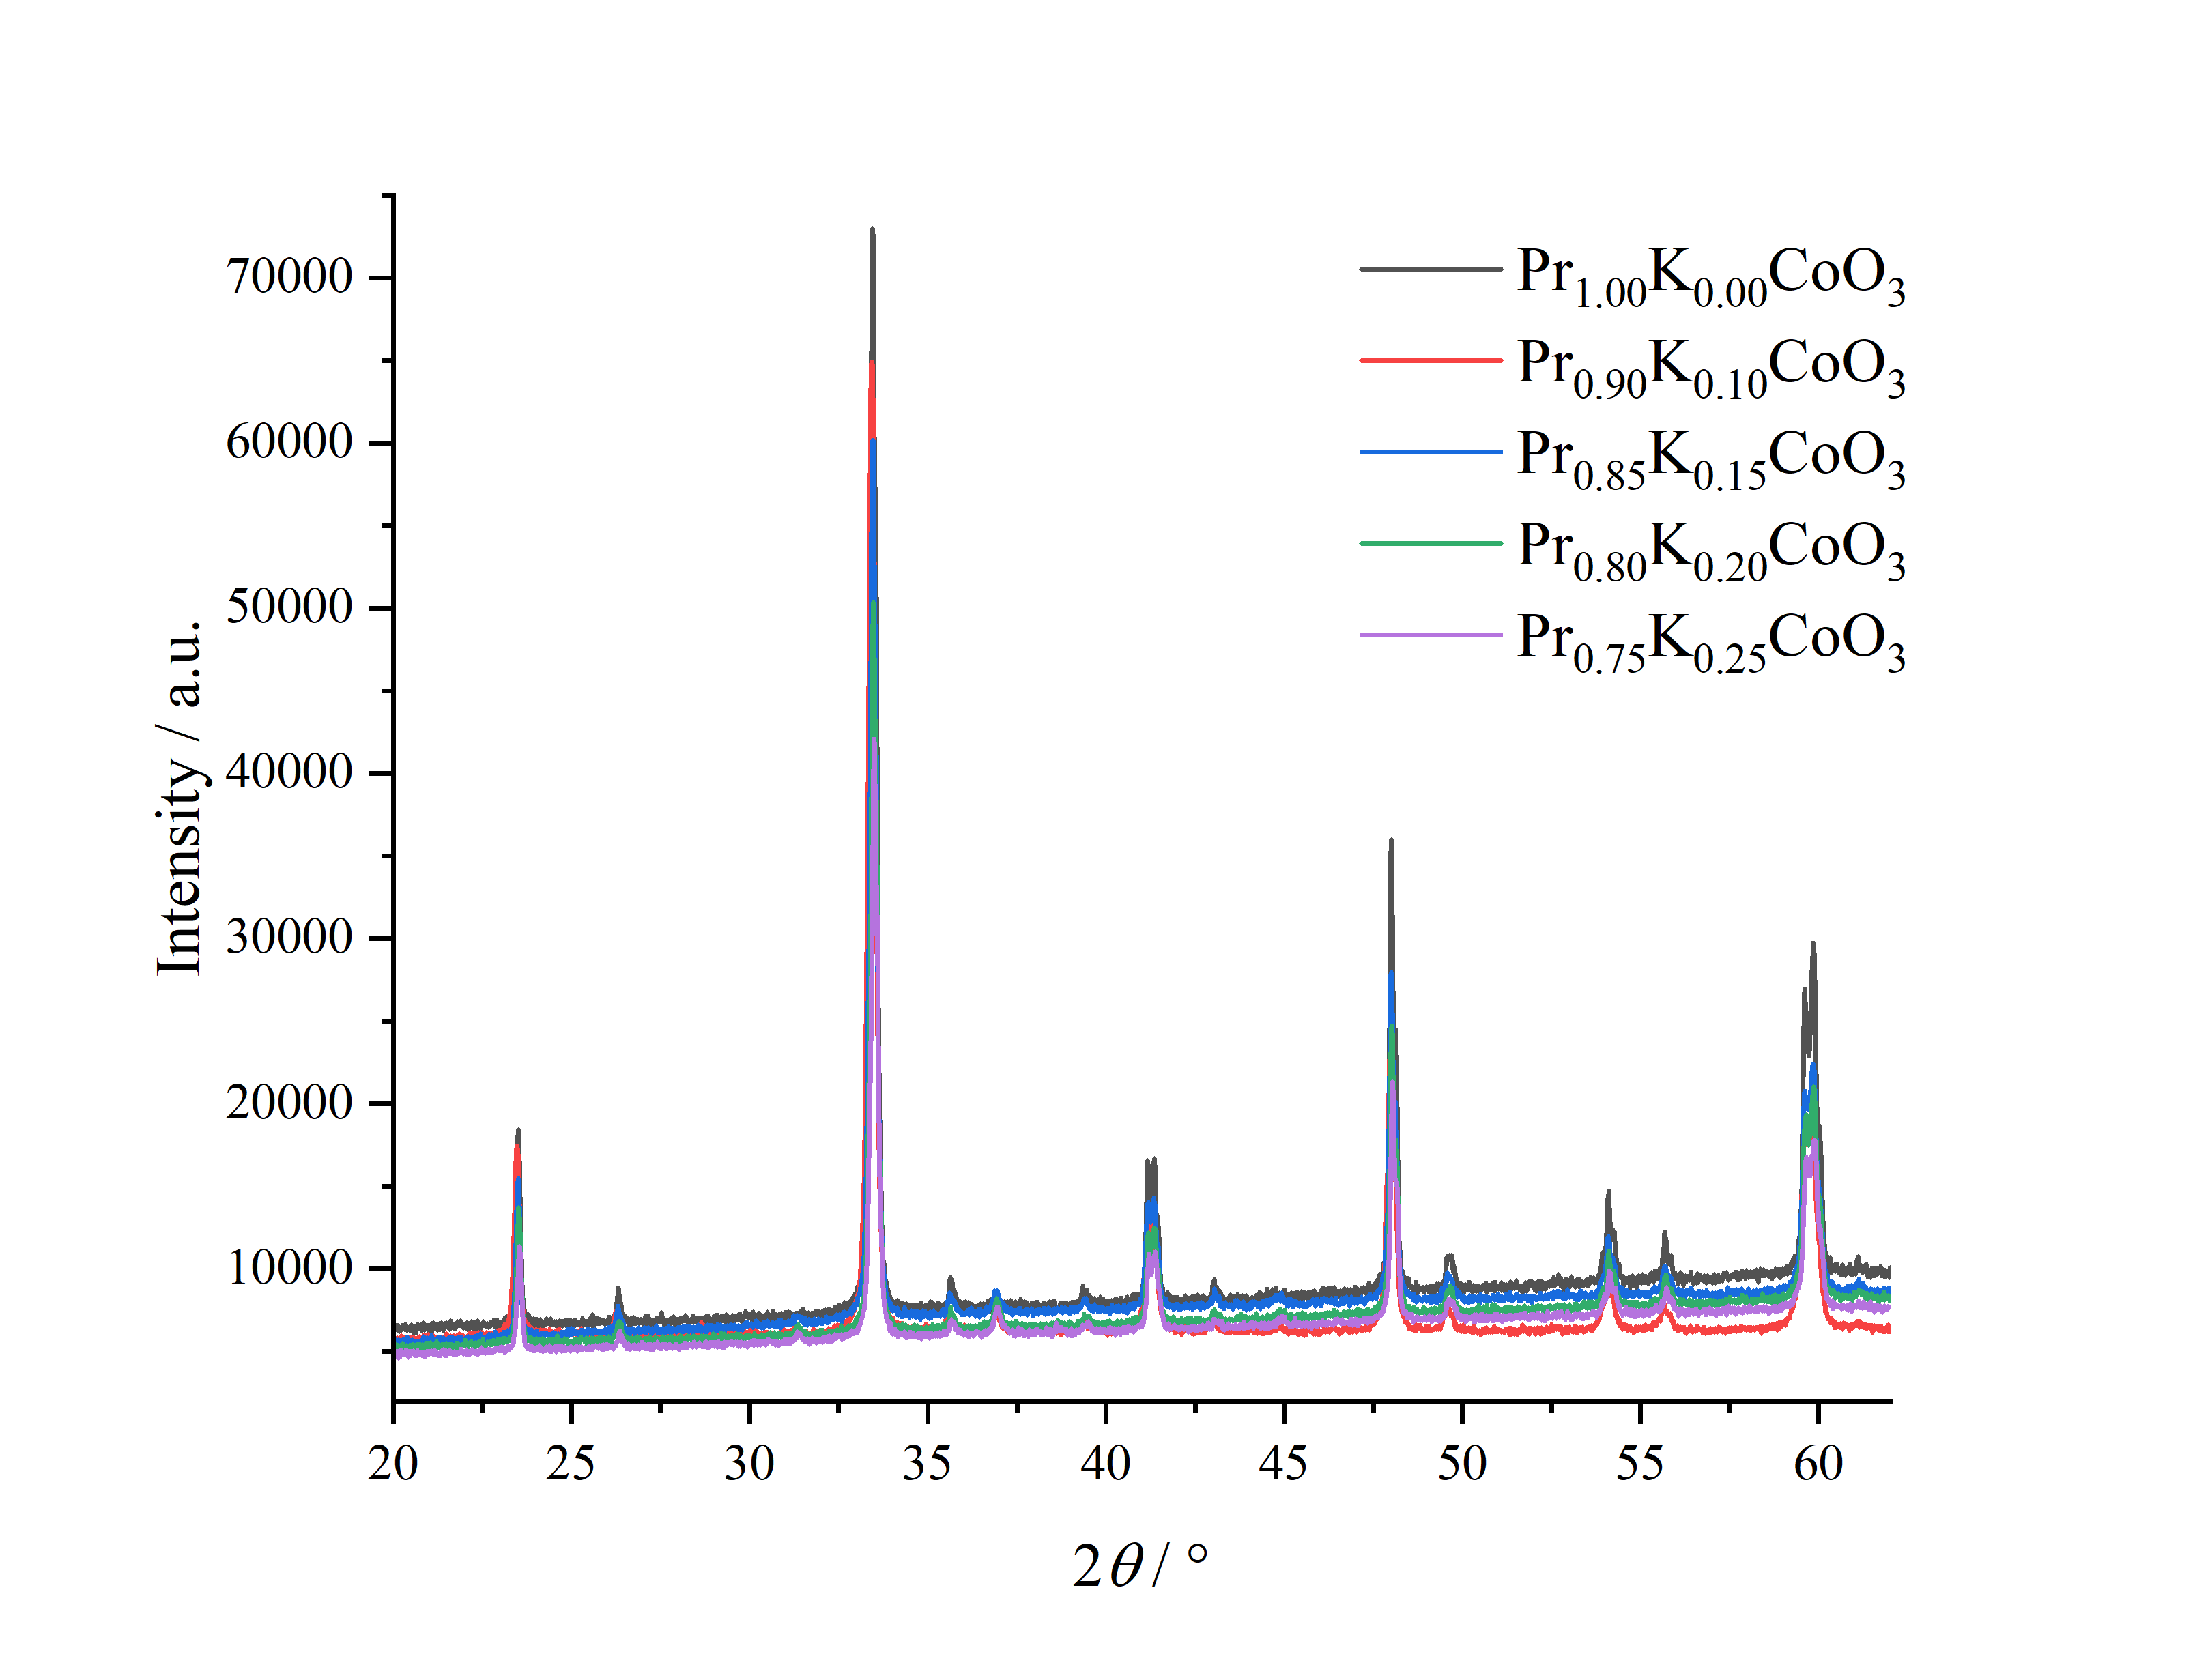
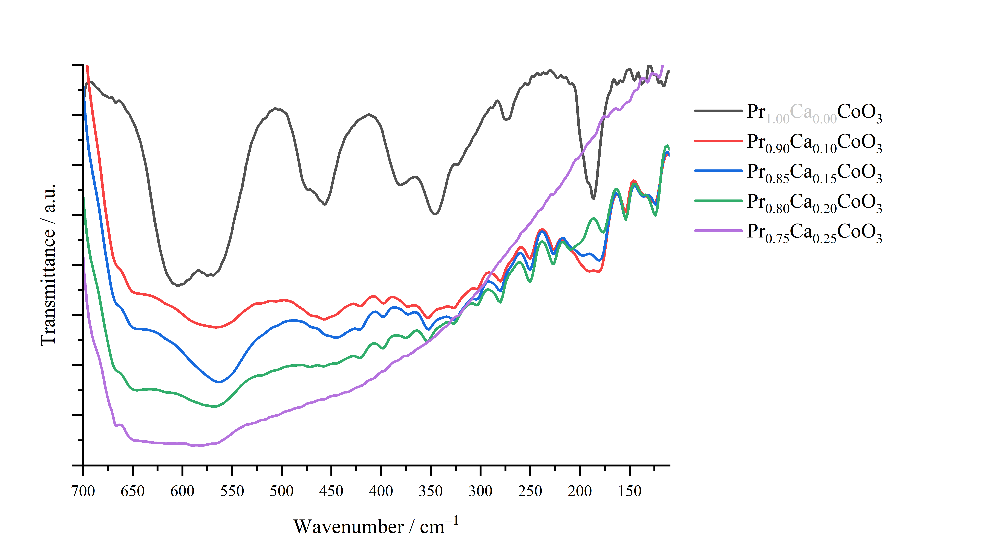
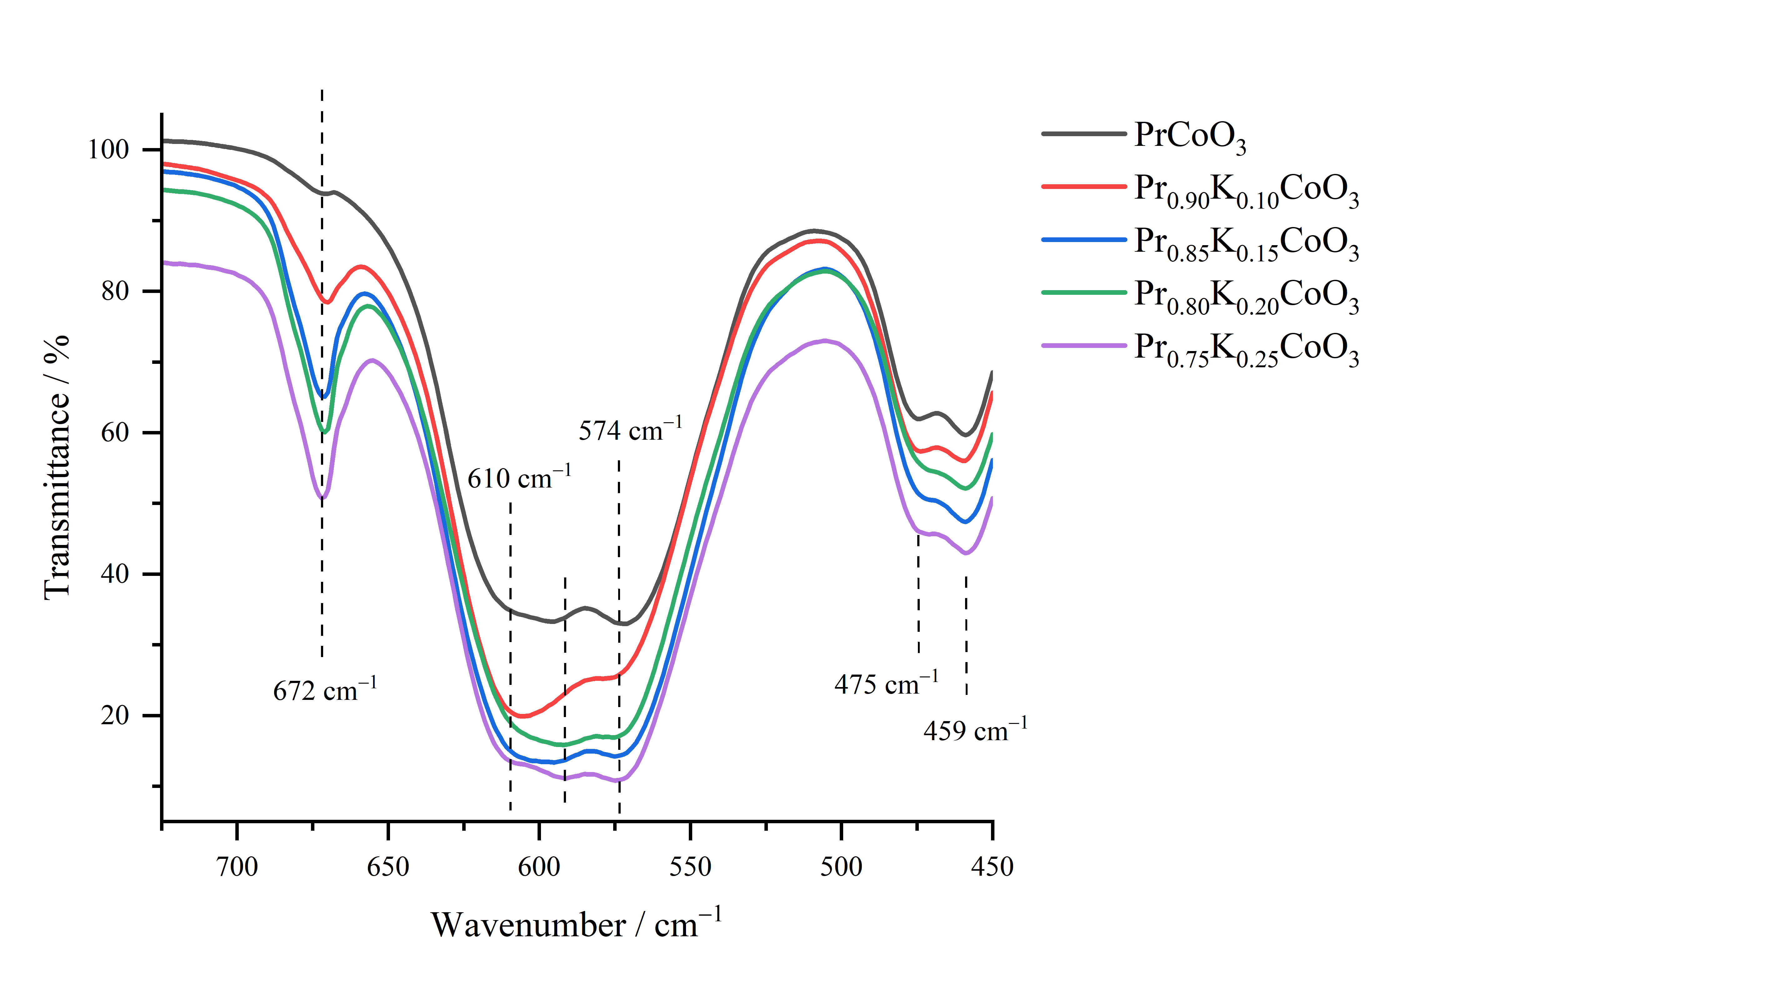
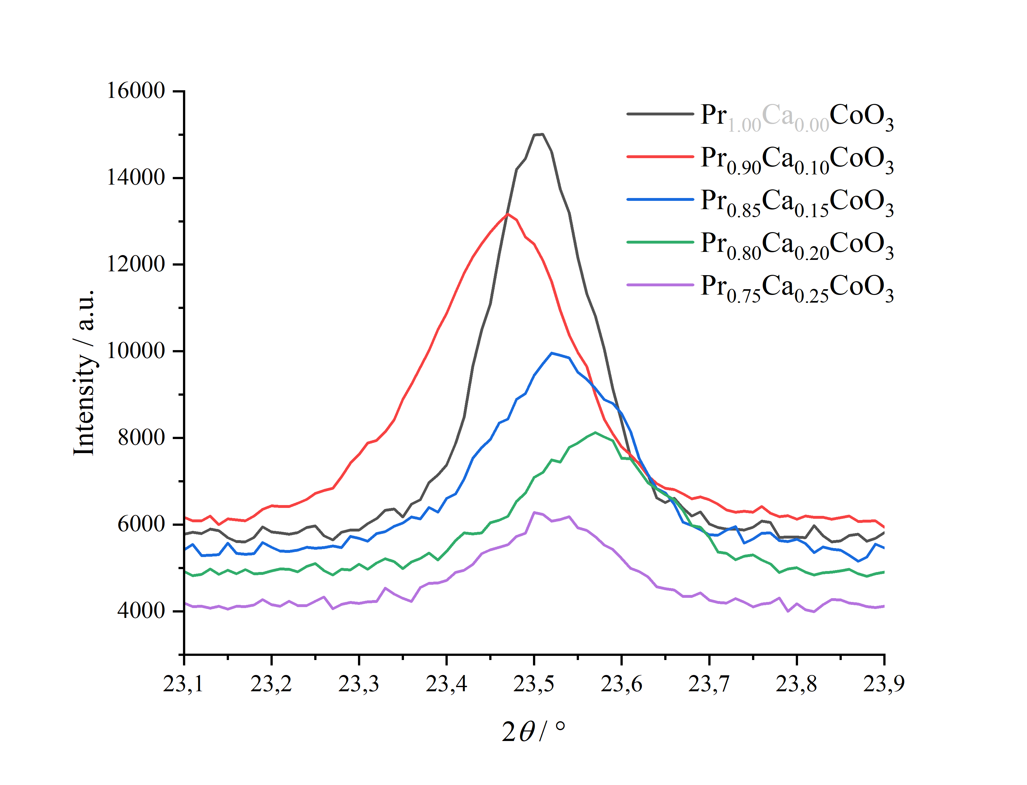
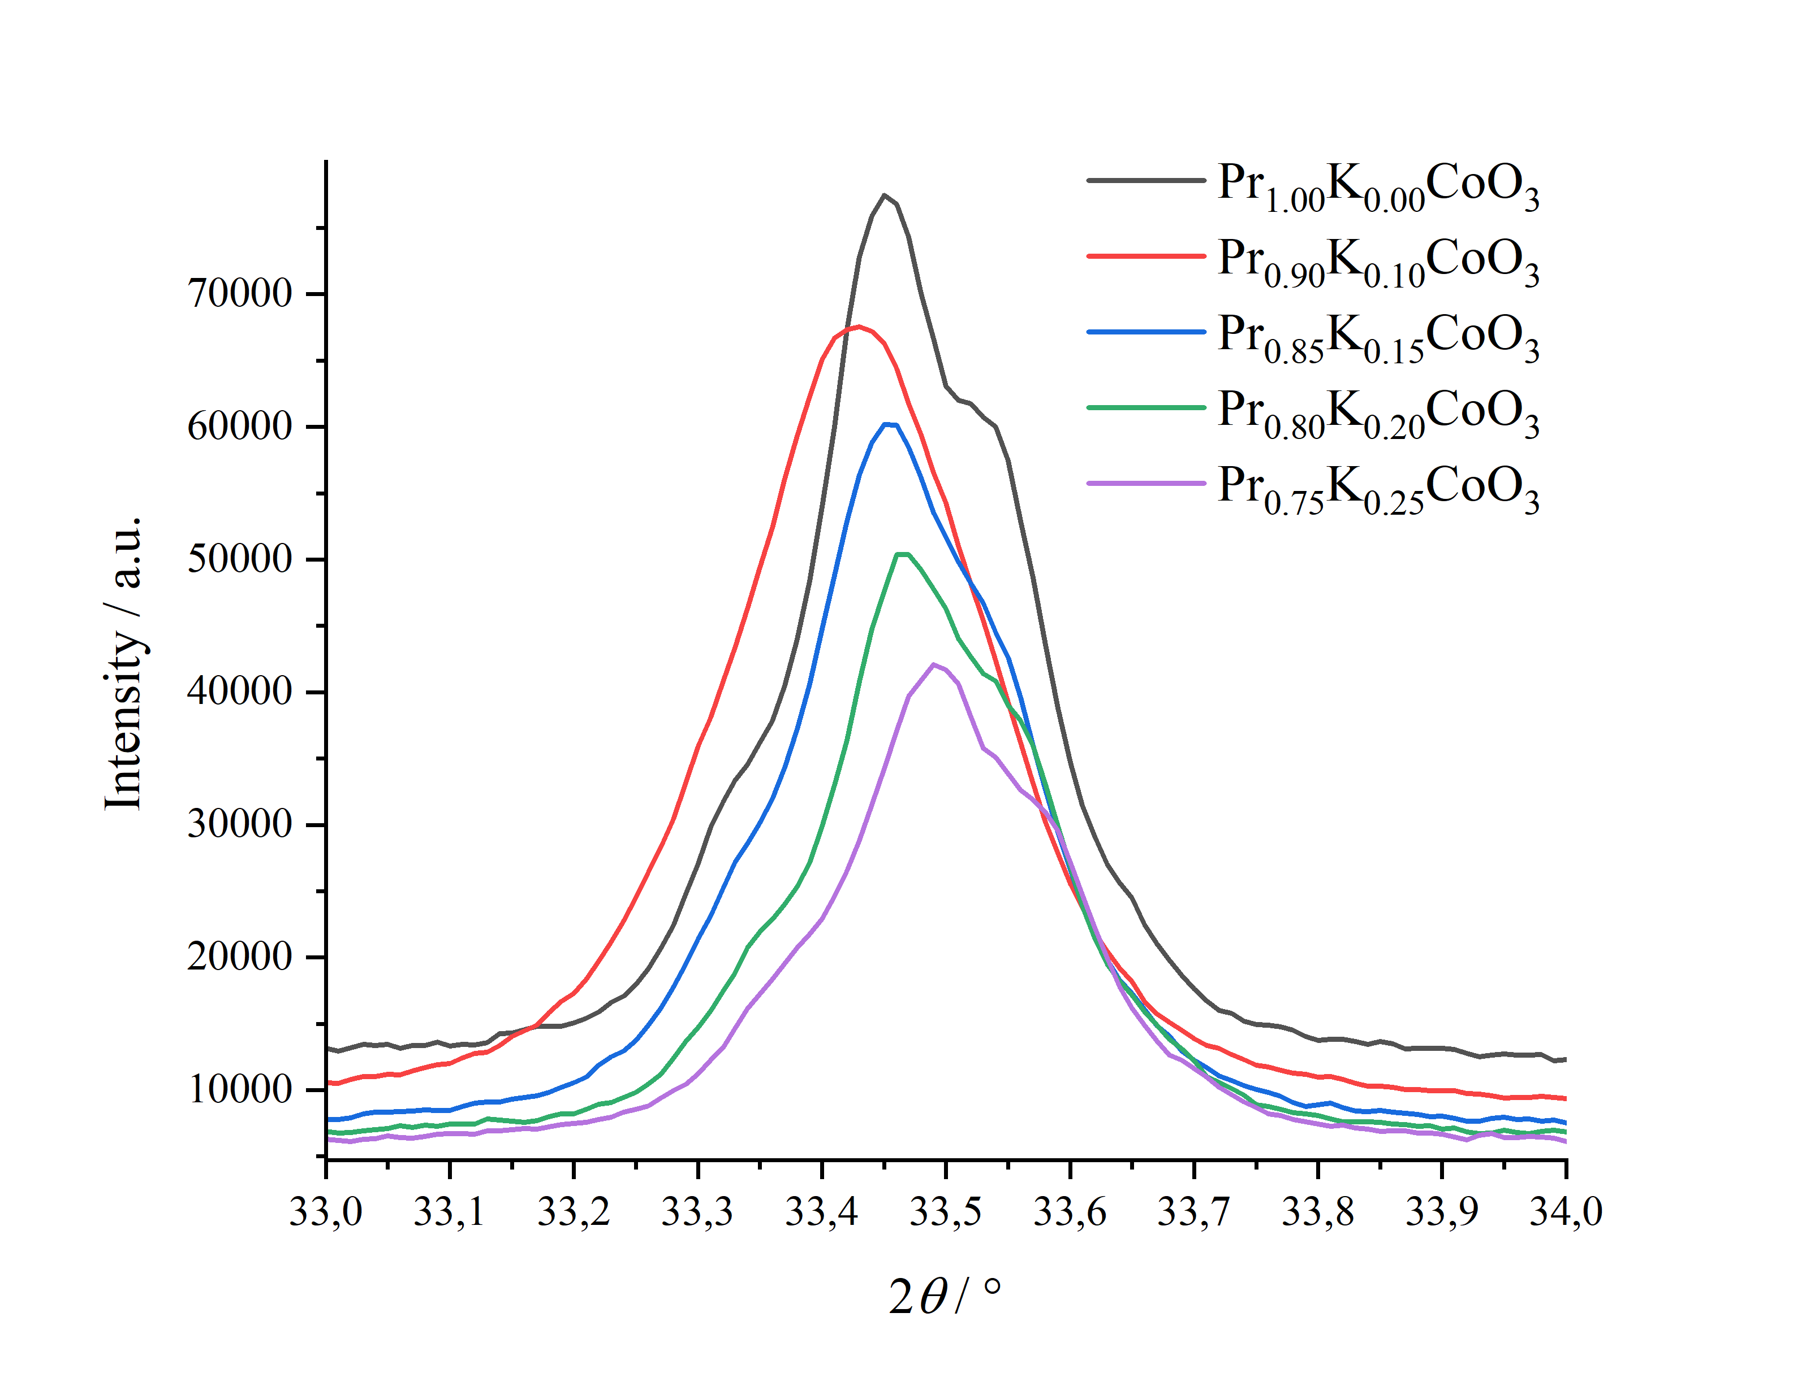
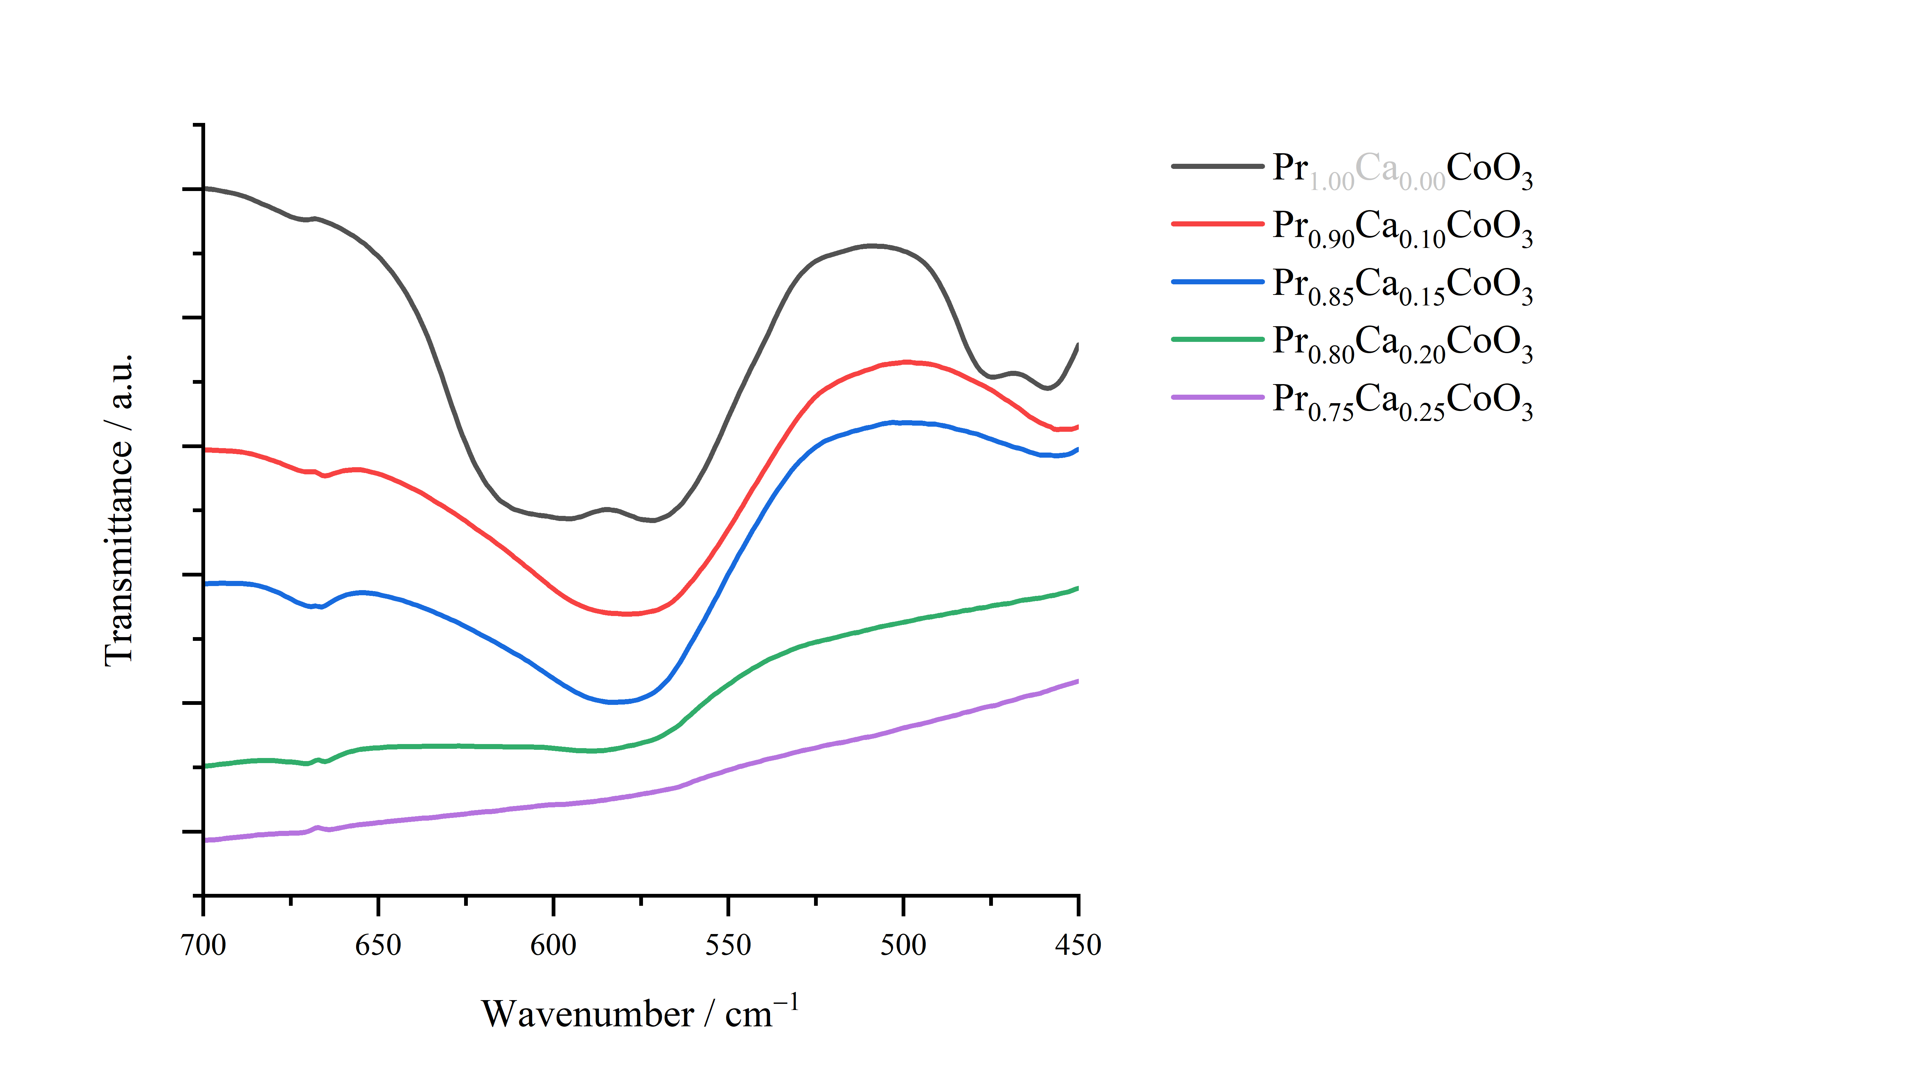
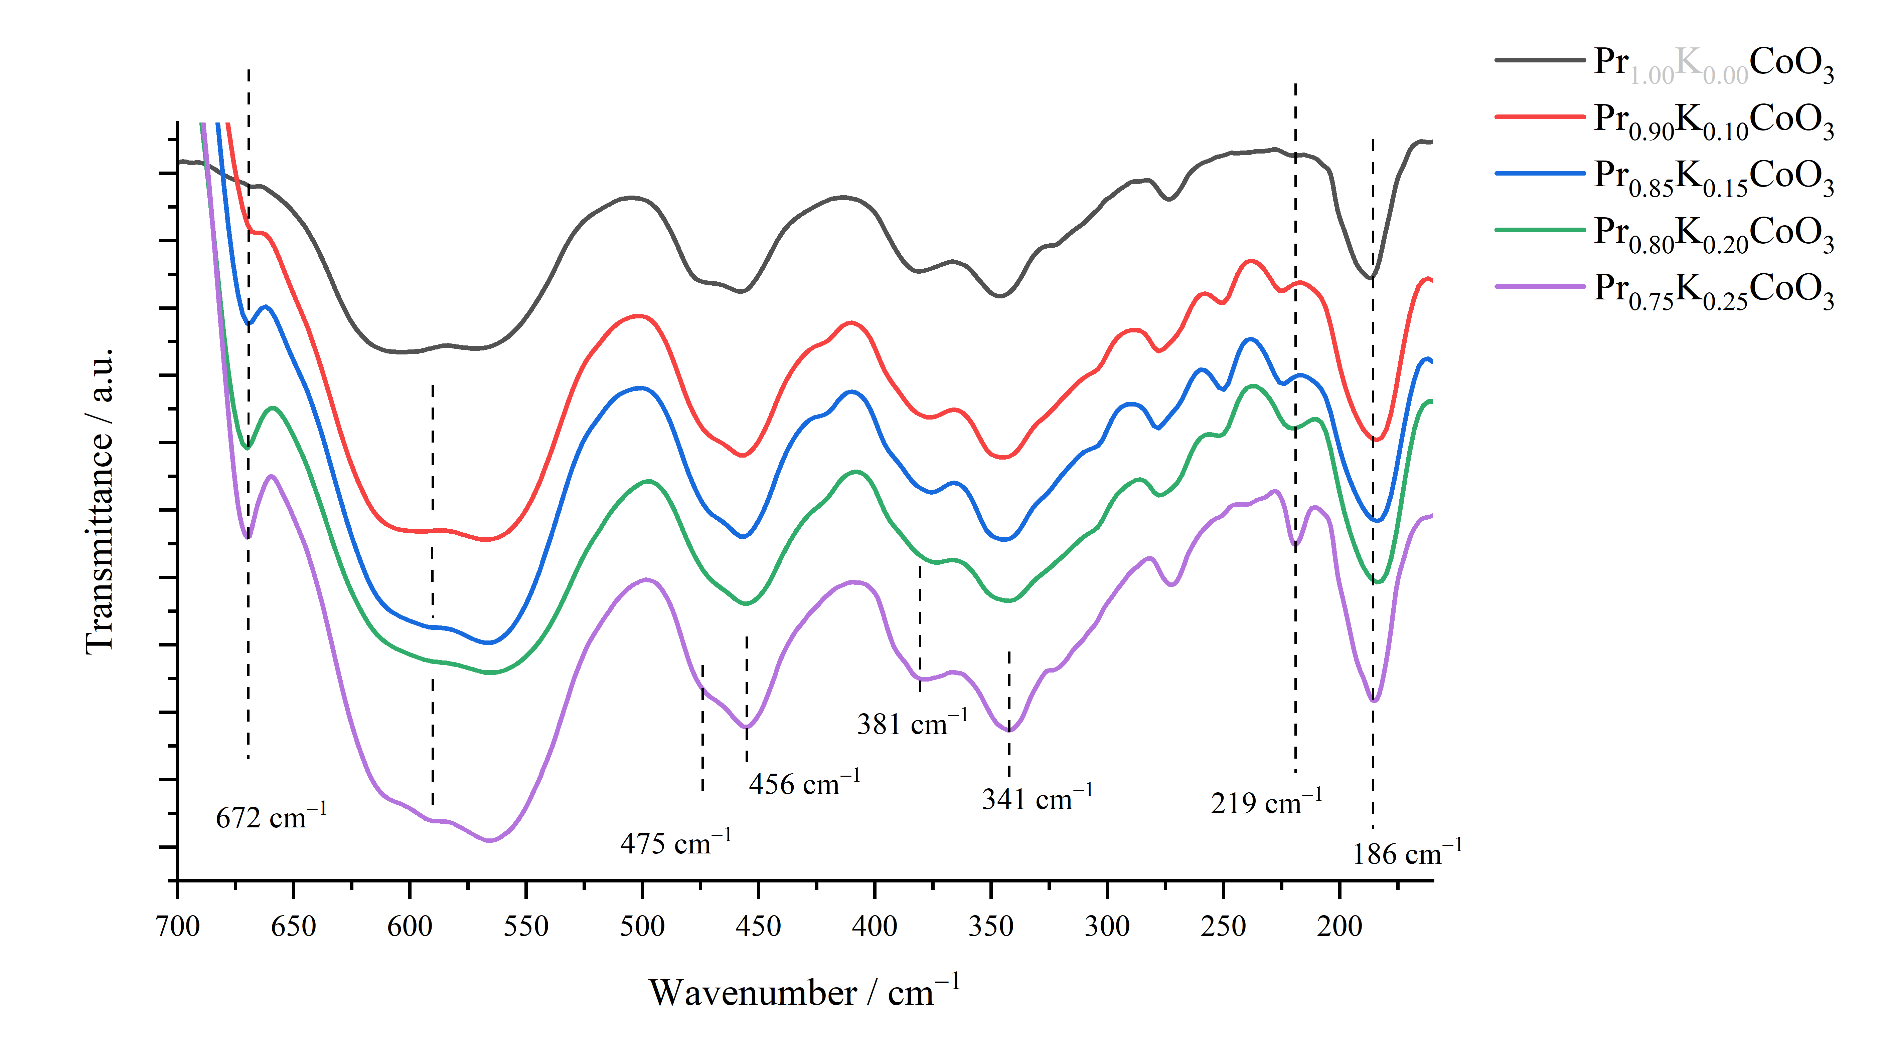

28th Congress of SCTM, 23-26 September, Ohrid, Macedonia
123
Synthesis and structural characterization of Pr_{1–x}A_{x}CoO₃ type of perovskites, A = K and Ca
Behima Ademovski¹ ², Sofija Popovska-Blazevska¹, Miha Bukleski¹ , David Thompsett³ , Slobotka Aleksovska¹,
¹ Institute of Chemistry, Faculty of Natural Sciences and Mathematics, Ss Cyril and Methodius, Skopje, N.Macedonia, Behima.Jakuposki@matthey.com, ²Johnson Matthey, Skopje, N.Macedonia, ³Johnson Matthey, Royston UK
Introduction & Aim
Cobalt-based perovskites incorporating rare-earth elements at the A-site, partially substituted with alkali and alkaline-earth cations, have attracted considerable attention for their potential applications in solid oxide fuel cells and catalytic processes. Among them, praseodymium-cobalt perovskites stand out as a particularly interesting class of materials, combining structural complexity with promising functional properties. The aim of this study is on their synthesis and characterization, and the influence of the rare-earth substitution on their structural stability and properties.
Experimental
For the synthesis of Pr_{1–x}A_{x}CoO₃, where A = K and Ca, the EDTA-citric acid complexing method was used. In this approach, EDTA acts as a chelating agent, ensuring controlled distribution of metal ions and promoting the formation of homogeneous particles with nanoscale dimensions, while citric acid is used as fuel. The obtained perovskites were investigated by X-ray powder diffraction (XRPD) and Infrared (IR) spectroscopy.
Results and discussion
Powder X-ray diffraction diffractograms
Infrared Spectroscopy measurements
Figure 1. Schematic representation of the synthesis method EDTA-Citric Complexing method
Table 1. Synthesized perovskite types and conditions
Perovskite type | Pr_{1–x}Ca_{x}CoO₃ | Pr_{1–x}K_{x}CoO₃
Precursors | Metal nitrates | Metal nitrates
Solvent | EDTA Dissolved in Ammonia 0.1 M | EDTA Dissolved in Ammonia 0.1 M
Fuel | Citric acid | Citric acid
Conditions | controlled pH and temperature | controlled pH and temperature
x | 0.1; 0.2; 0.25; | 0; 0.1; 0.25;
Synthesized perovskite
Figure 2. X-Ray diffractogram of Ca substituted perovskite
Figure 3. X-Ray diffractogram of K substituted perovskite
Figure 4. IR Spectra of Ca substituted perovskite
Figure 6. IR spectra of K substituted perovskite
Conclusions
The XRD patterns confirmed the purity and crystallinity of the obtained rare-earth perovskites that contain Co and Pr doped with Ca/K (Fig.2 and 3).
The peaks in XRD patterns are shifted to higher 2θ values as the substitution of Ca and K increases in series
The intensity of the IR band of K substituted perovskite increase as the substitution of K increase in series
The used method of synthesis was appropriate for perovskites with this type of substitution.
The crystal structures of the obtained perovskites were assigned to be orthorhombic, indicating that octahedral tilting is evident.
The progressive increase in the intensity of the FTIR band at 672 cm^{–1} in Pr_{1–х} K_{x}CoO₃ with increasing K content can be attributed to lattice distortion and coexistence of Co³⁺/ Co⁴⁺ ions, which enhance the polarity of Co-O bonds and increase change in dipole moment, this leads to stronger distortion od CoO₆ octahedra.
The shift of the diffraction peaks towards higher 2θ values indicates lattice contraction, which may be related to Co⁴⁺ formation and presence of oxygen vacancies.
.
References:
[1] Zhichao Zeng, Yueshan Xu, Zheshan Zhang, Zhansheng Gao, Meng Luo, Zongyou Yin, Chao Zhang, Jun Xu, Bolong Huang, Feng Luo, Yaping Du, Chunhua Yan, Rare-earth-containing perovskite nanomaterials: design, synthesis, properties and applications, Chem. Soc. Rev., Vol. 49, Iss. 4, 1109 (2020), doi: 10.1039/C9CS00330D
[2] Xifeng, Yingija Liu, Liu Gao, Lucun Guo, Synthesis and characterization of doped LaCrO₃ perovskite prepared by EDTA-citrate Complexing method, Journal of Alloys and Compounds 458 (2008 doi: https://doi.org/10.1016/j.jallcom.2007.03.110

