Slide 1

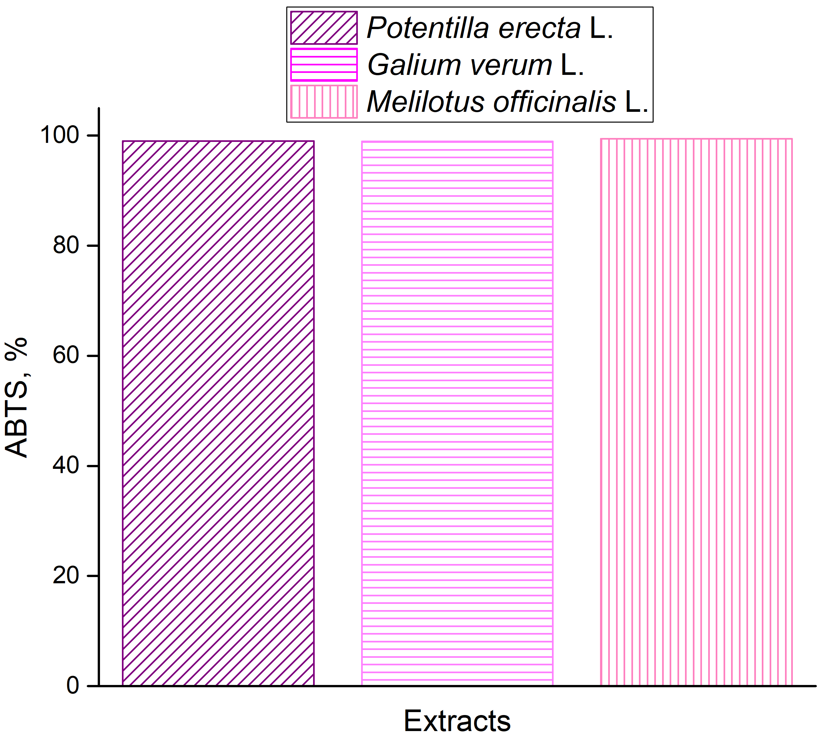
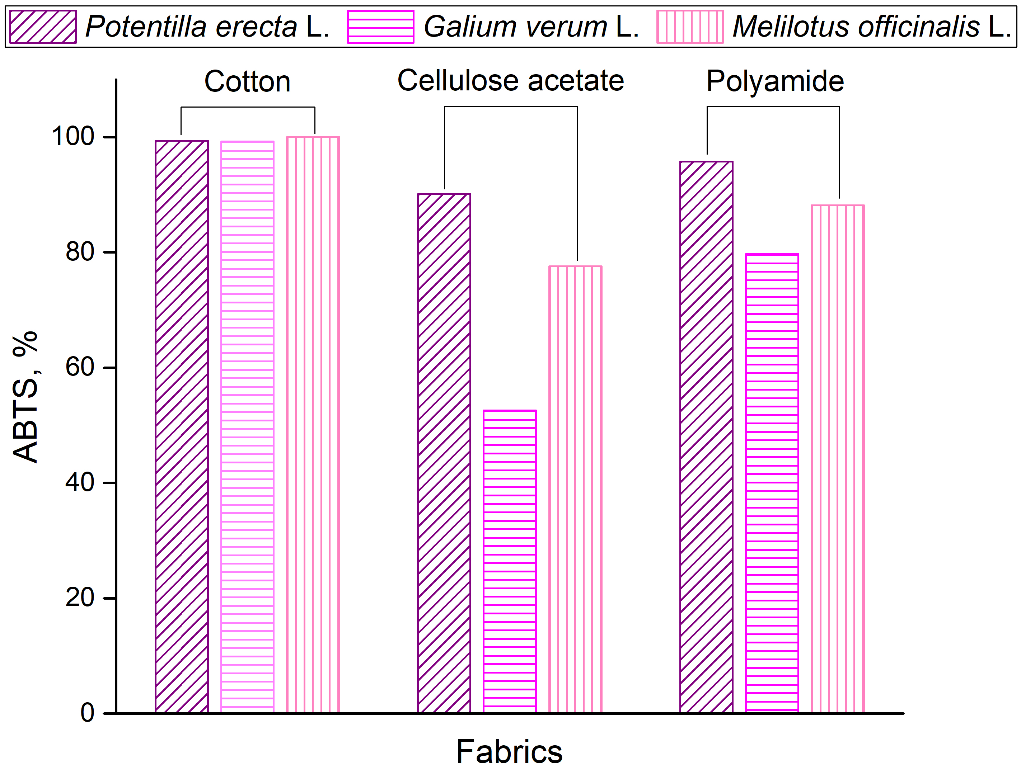
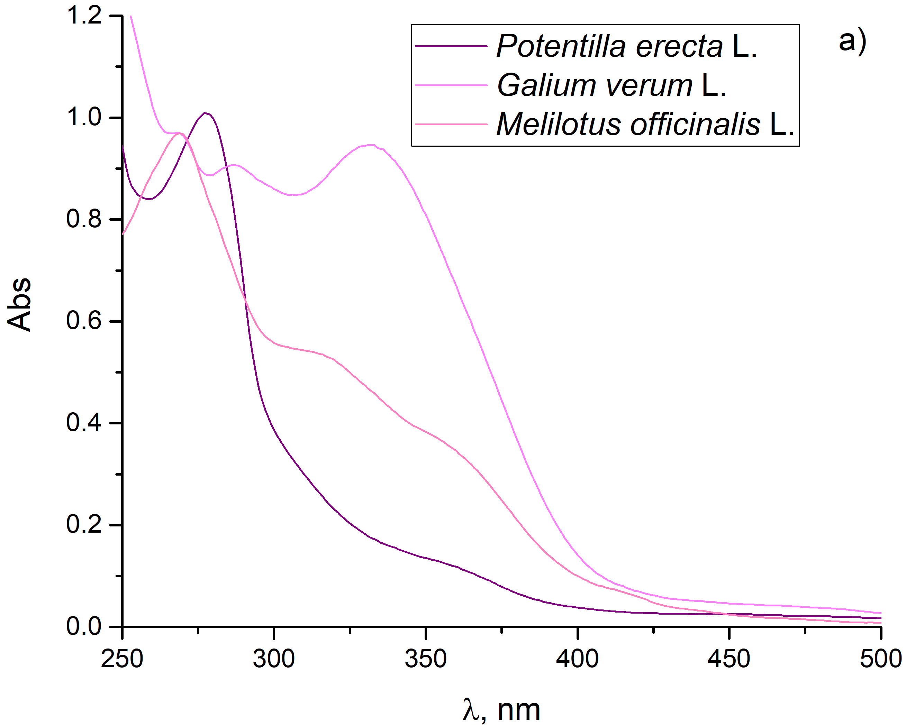
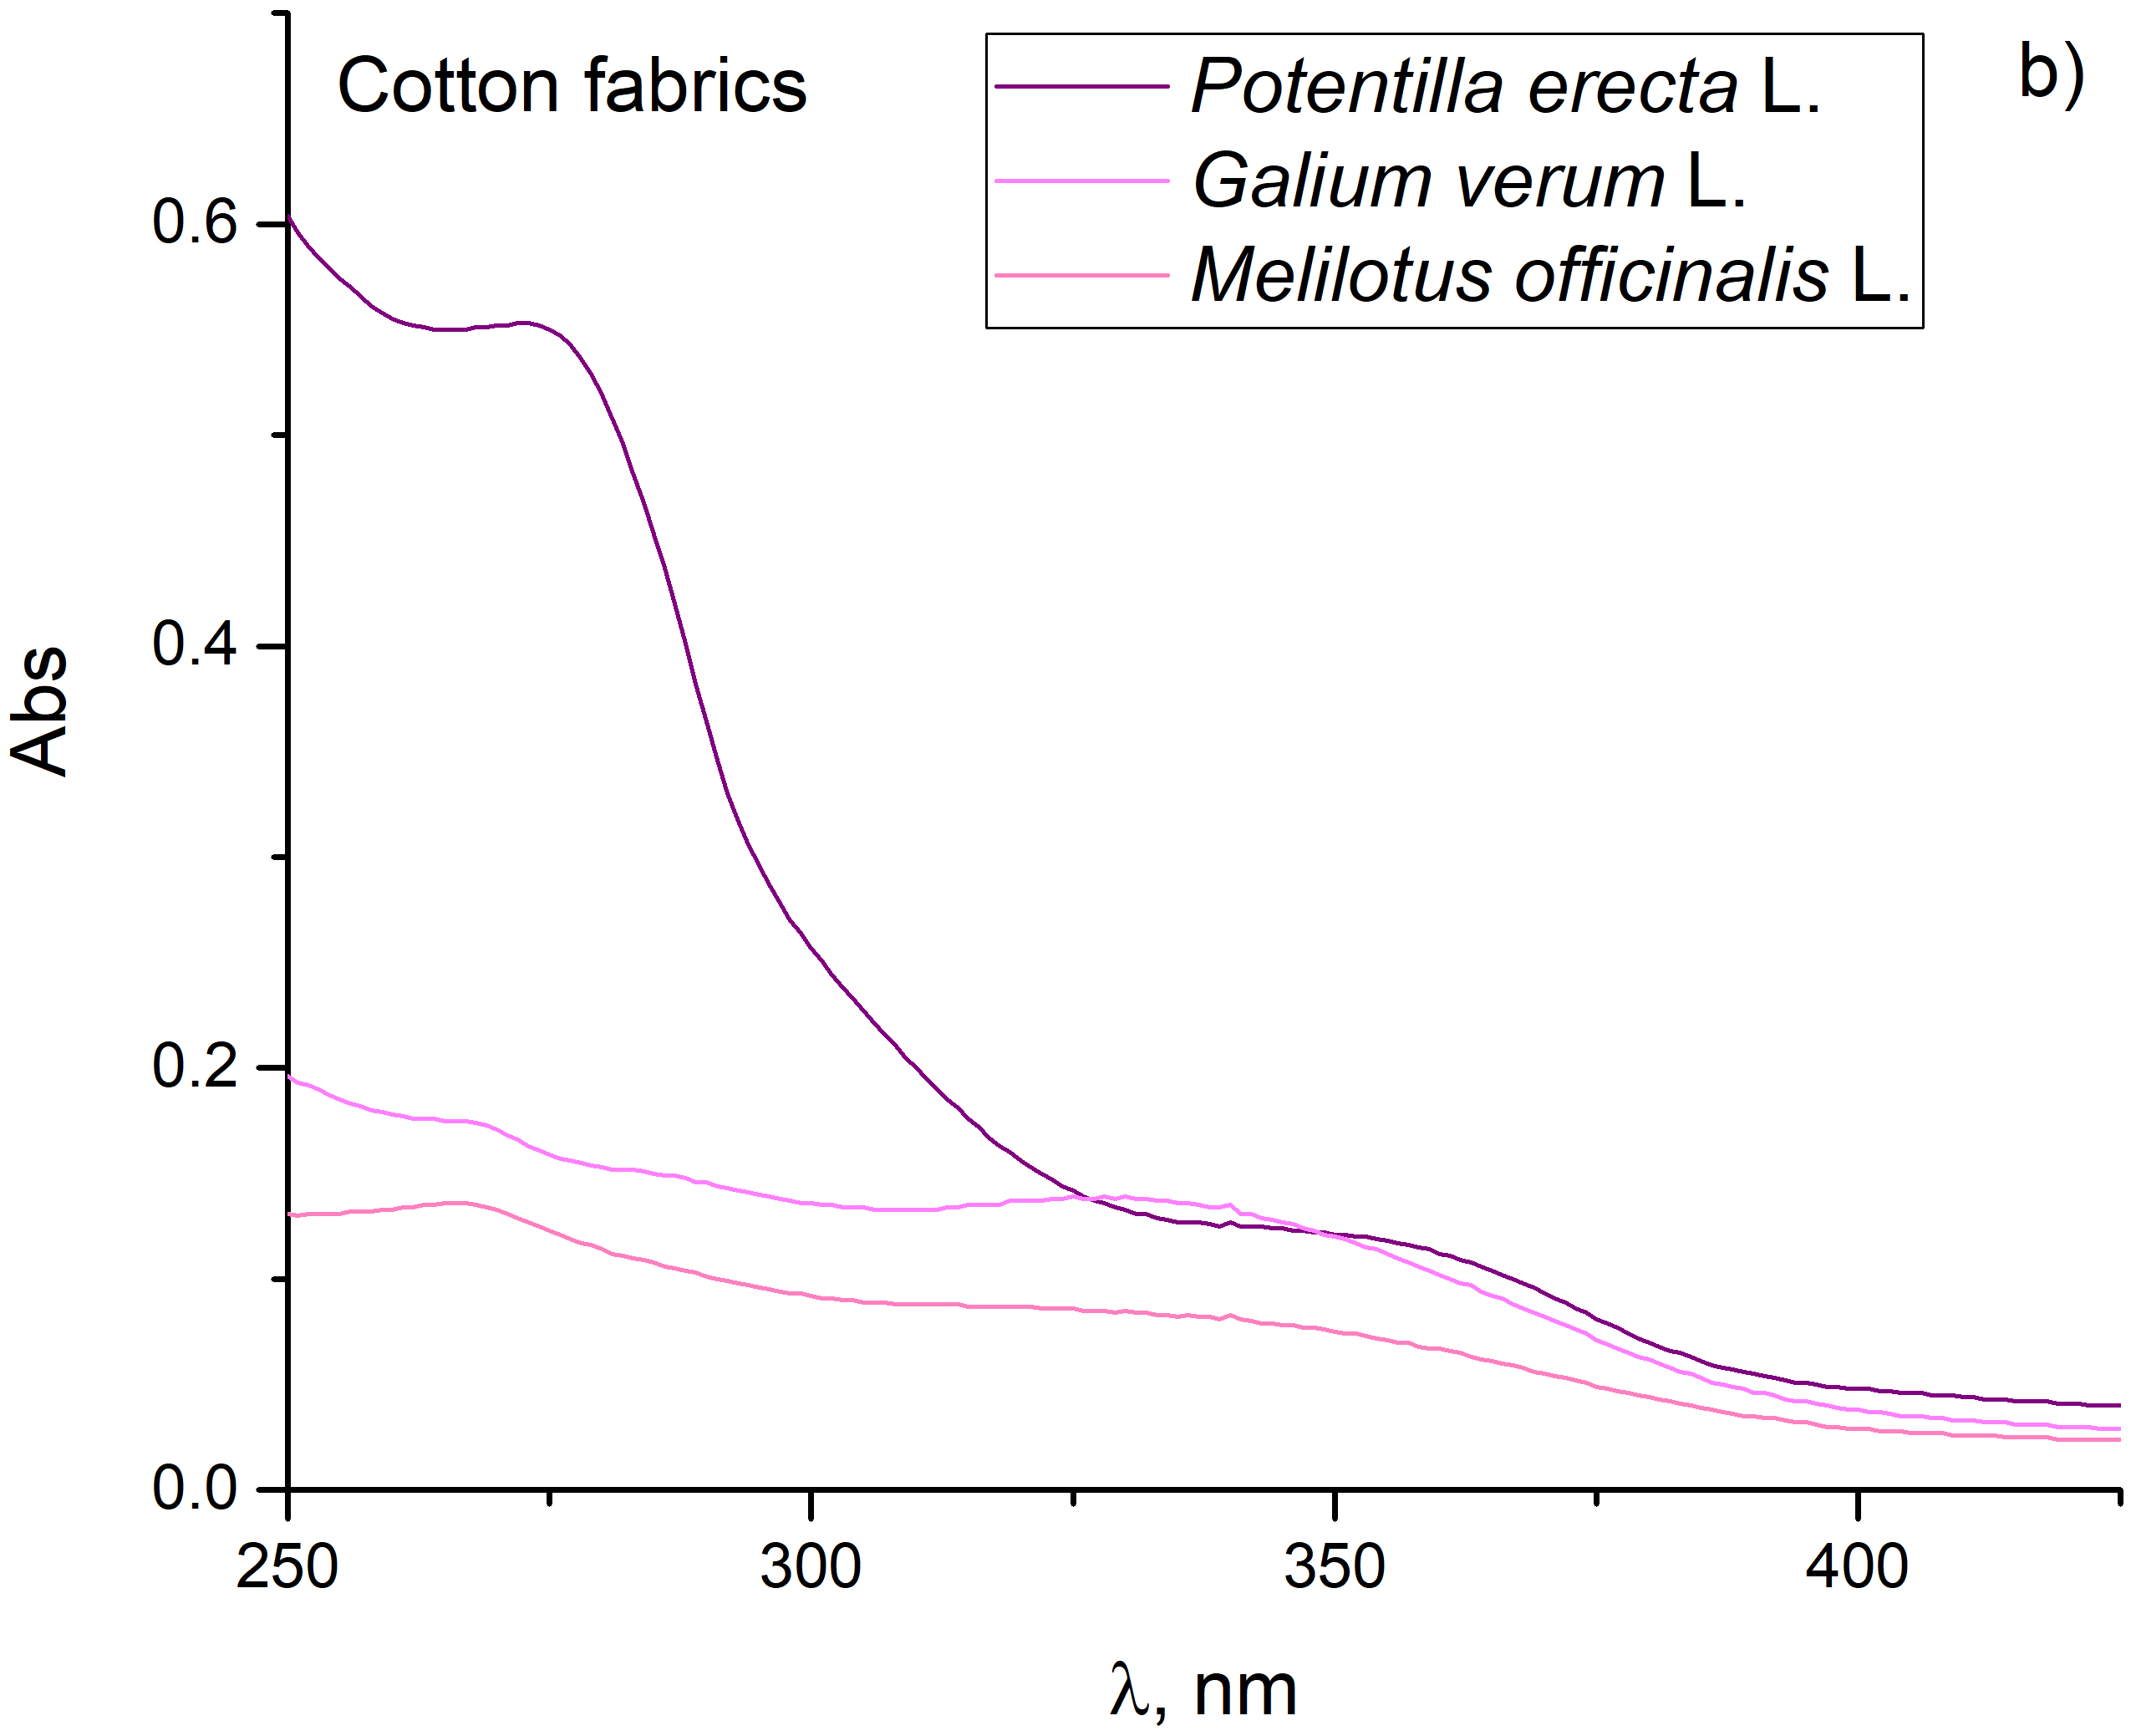
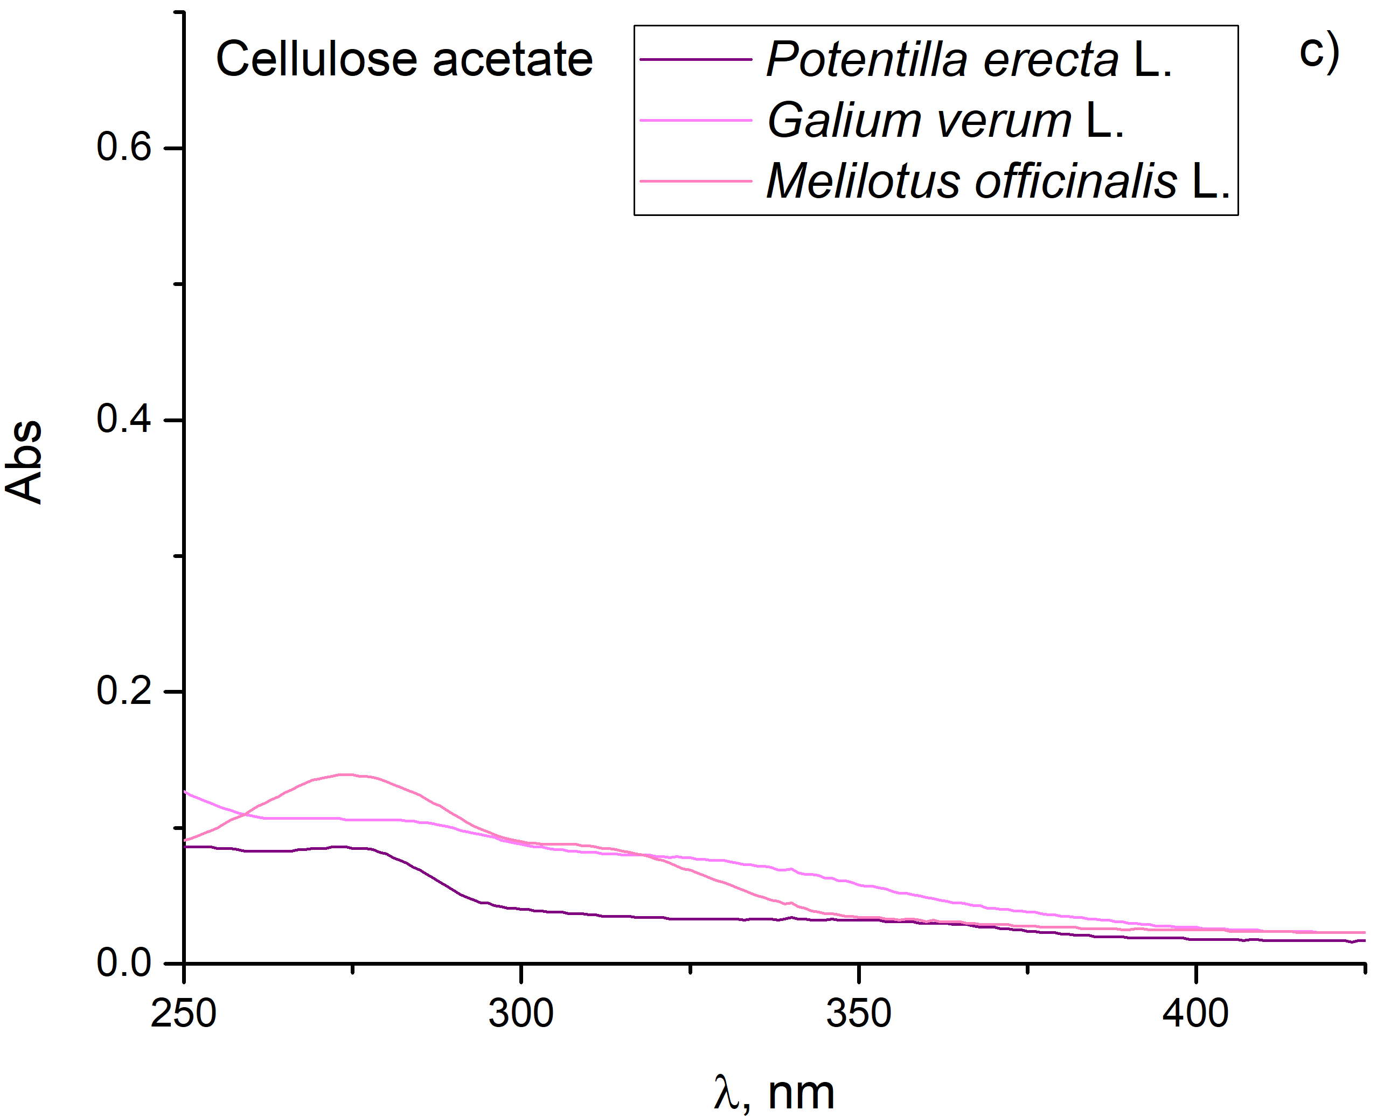
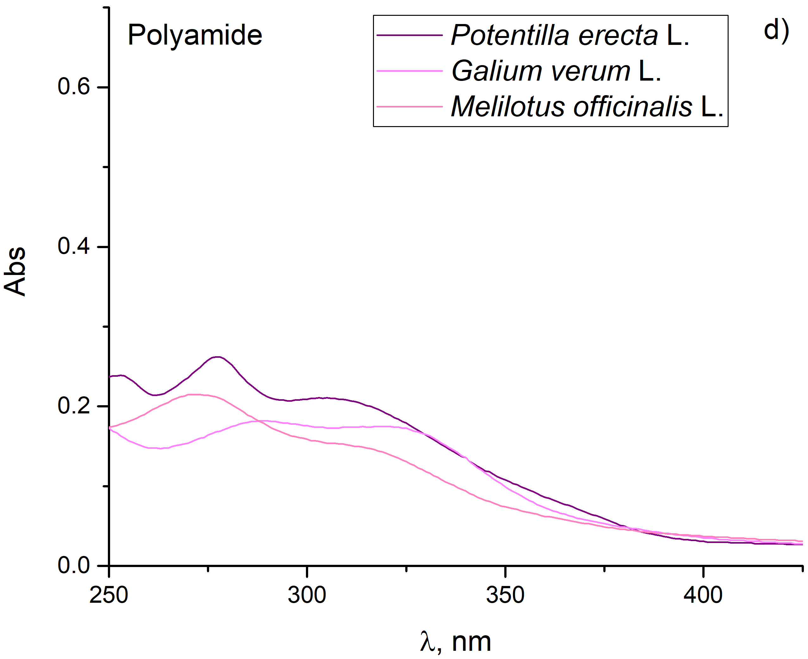
28th Congress of SCTM, 23-26 September, Ohrid, Macedonia
000
Using natural extracts for imparting color and antioxidant
Activity to cotton, cellulose acetate, and polyamide fabrics
Aleksandra Ivanovska¹, Jovana Bradić², Jelena Lađarević³, Anica Petrović²
¹University of Belgrade, Innovation Center of the Faculty of Technology and Metallurgy, Belgrade, Serbia (aivanovska@tmf.bg.ac.rs), ²University of Kragujevac, Faculty of Medical Sciences, Kragujevac, Serbia, ³University of Belgrade, Faculty of Technology and Metallurgy, Belgrade, Serbia
Introduction & Aim
Natural extracts derived from sustainable sources have emerged as compelling candidates for fabric functionalization and dyeing owing to the presence of colored bioactive compounds with inherent antioxidant activity. This study aims to evaluate the potential of Potentilla erecta L., Galium verum L. and Melilotus officinalis L. ethanol extracts for simultaneous dyeing and functionalization of cotton, cellulose acetate, and polyamide fabrics.
Experimental
Results and discussion
An ultrasound-assisted extraction of bioactive compounds from Potentilla erecta L., Galium verum L. and Melilotus officinalis L. was conducted with 70% ethanol at 60 °C for 30 min. Prepared extracts were used for the functionalization of cotton, cellulose acetate and polyamide fabrics (24 h at 40 °C). Fabric color coordinates (L, a*, b*) and extract and fabric antioxidant activity (ABTS method) were determined spectrophotometrically. The release of bioactive compounds from fabrics in a physiological saline solution was monitored for 24 h at 37 °C.
Acknowledgement
Table 1 Color coordinates of fabrics functionalized
with Potentilla erecta L. extract
This work was supported by the Ministry of Science, Technological Development and Innovation of the Republic of Serbia (Contract No. 451-03-33/2026-03/200287)
Fabric | L* | a* | b*
Cotton | 83.57 | 5.59 | 15.27
Cellulose acetate | 88.04 | 2.02 | 14.71
Polyamide | 79.55 | 5.11 | 14.67
Figure 1 Antioxidant activity of extracts
Figure 2 Antioxidant activity of fabrics
Conclusions
All studied extracts impart good to excellent antioxidant activity to examined fabrics. Potentilla erecta L. has an affinity for dyeing fabrics, while cotton functionalized with this extract demonstrated the highest release of bioactive compounds, making it suitable for wound dressing.
Figure 3 UV-Vis absorption spectra of a) extracts and b-d) release of bioactive compounds from functionalized cotton, cellulose acetate, and polyamide

