Slide 1

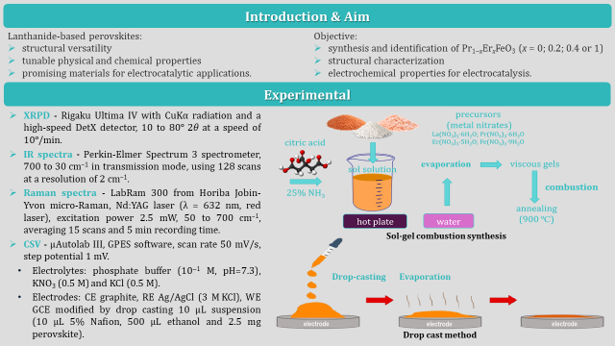
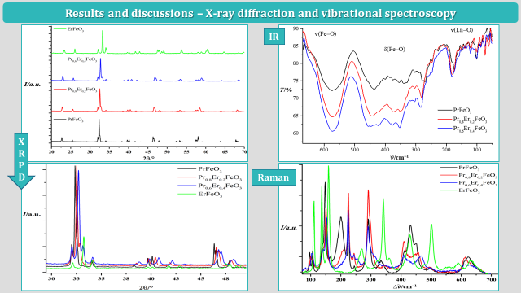
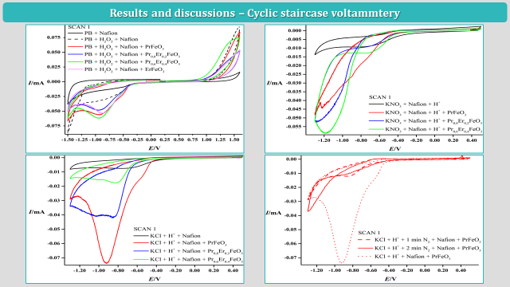
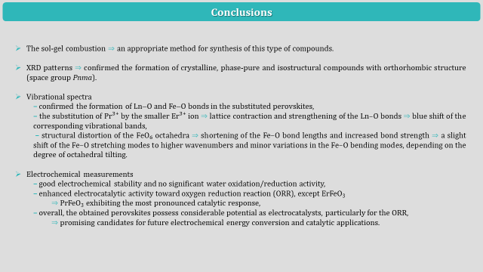
28th Congress of SCTM, 23-26 September, Ohrid, Macedonia
000
SYNTHESIS, CHARACTERIZATION, AND ELECTROCATALYTIC PROPERTIES
OF Pr_{1−x}Er_{x}FeO₃ (x = 0; 0.2; 0.4 or 1)
Sofija Popovska Blazhevska, Leon Stojanov, Miha Bukleski, Slobotka Aleksovska, Valentin Mirceski
Institute of Chemistry, Faculty of Natural Sciences and Mathematics, “Ss. Cyril and Methodius“ University in Skopje, Macedonia, sofija.popovska@pmf.ukim.mk

Slide 2
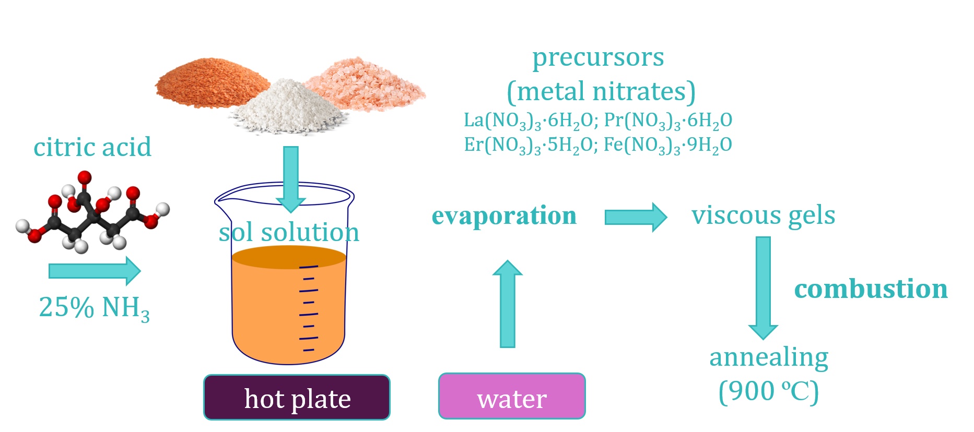
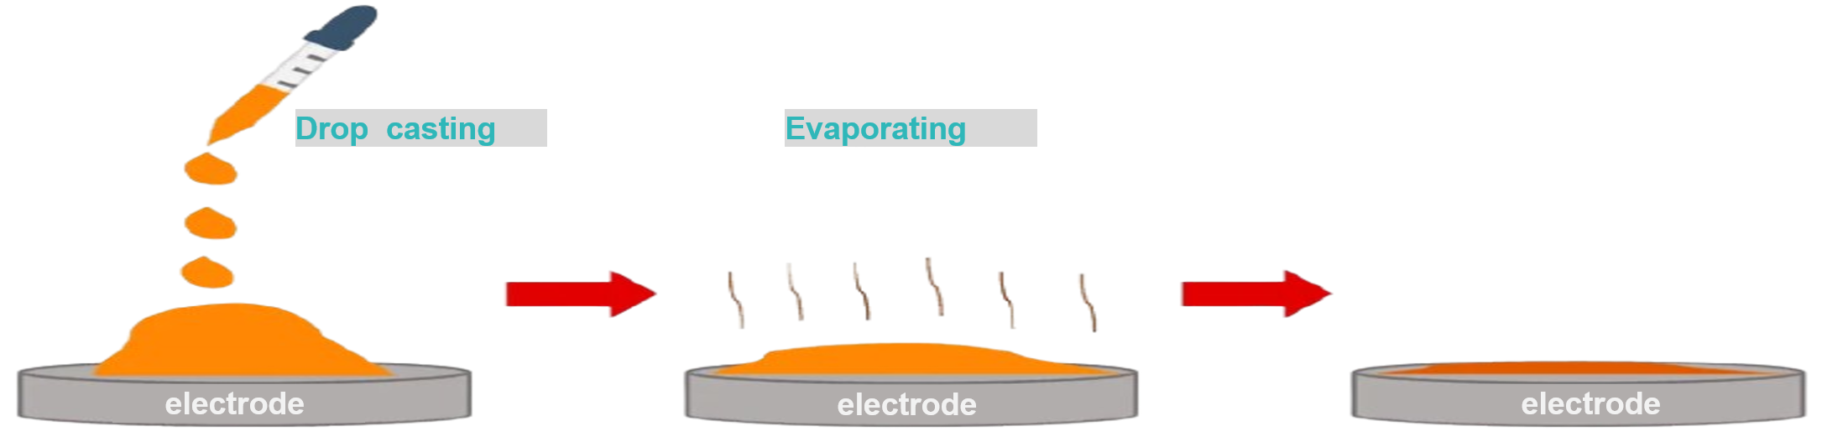
Introduction & Aim
Lanthanide-based perovskites:
structural versatility
tunable physical and chemical properties
promising materials for electrocatalytic applications.
Objective:
synthesis and identification of Pr_{1−x}Er_{x}FeO₃ (x = 0; 0.2; 0.4 or 1)
structural characterization
electrochemical properties for electrocatalysis.
Experimental
XRPD – Rigaku Ultima IV with CuKα radiation and a high-speed DetX detector, 10 to 80º 2θ at a speed of 10º/min.
IR spectra – Perkin-Elmer Spectrum 3 spectrometer, 700 to 30 cm^{–1} in transmission mode, using 128 scans at a resolution of 2 cm^{–1}.
Raman spectra – LabRam 300 from Horiba Jobin-Yvon micro-Raman, Nd:YAG laser (λ = 632 nm, red laser), excitation power 2.5 mW, 50 to 700 cm^{–1}, averaging 15 scans and 5 min recording time.
CSV – µAutolab III, GPES software, scan rate 50 mV/s, step potential 1 mV.
Electrolytes: phosphate buffer (10⁻¹ M, pH=7.3), KNO₃ (0.5 M) and KCl (0.5 M).
Electrodes: CE graphite, RE Ag/AgCl (3 M KCl), WE GCE modified by drop casting 10 µL suspension (10 µL 5% Nafion, 500 µL ethanol and 2.5 mg perovskite).
Sol-gel combustion synthesis
Drop-casting Evaporation
Drop cast method

Slide 3
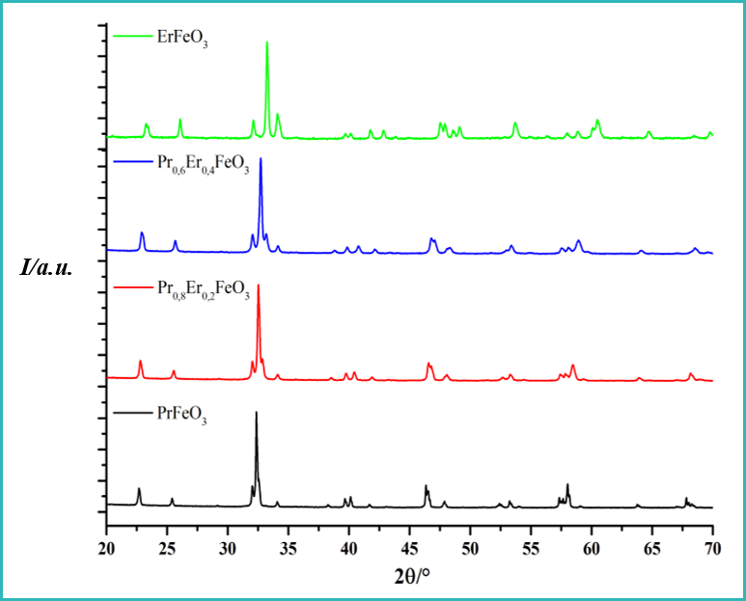
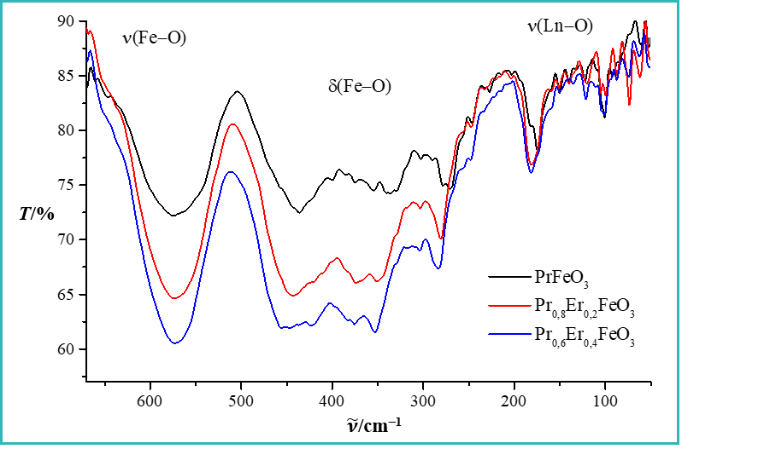
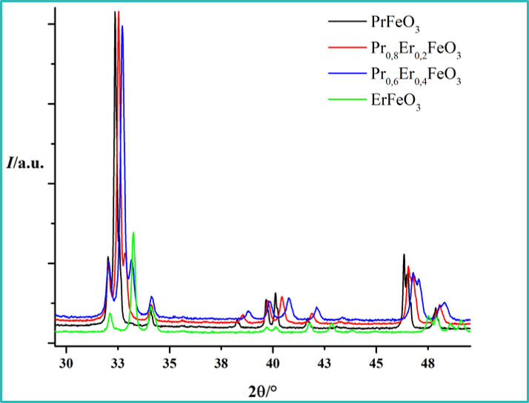
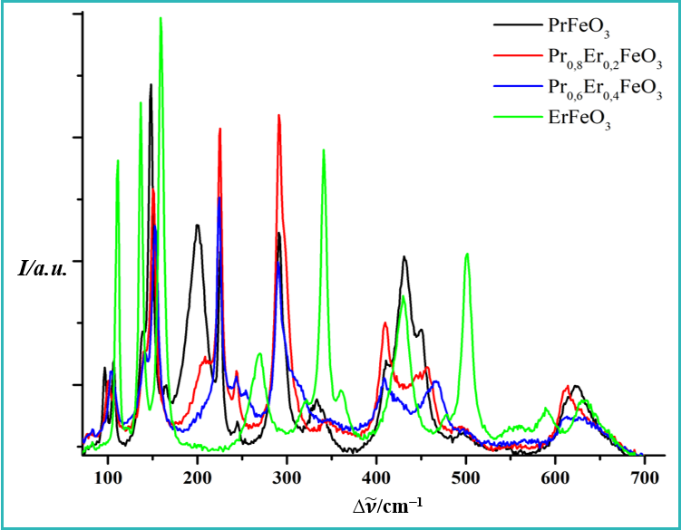
Results and discussions – X-ray diffraction and vibrational spectroscopy
IR
XRPD
Raman

Slide 4
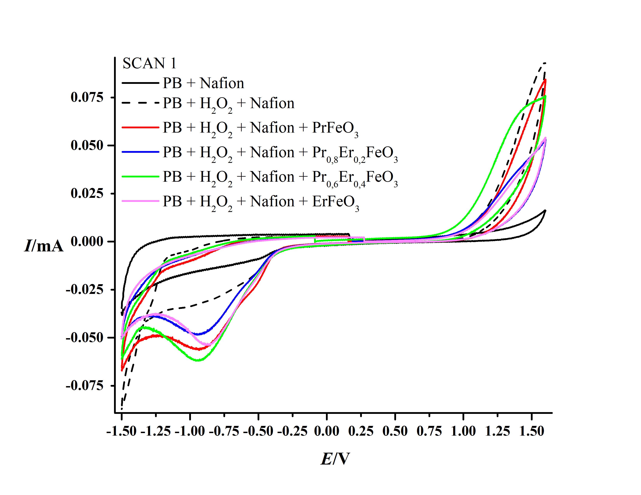
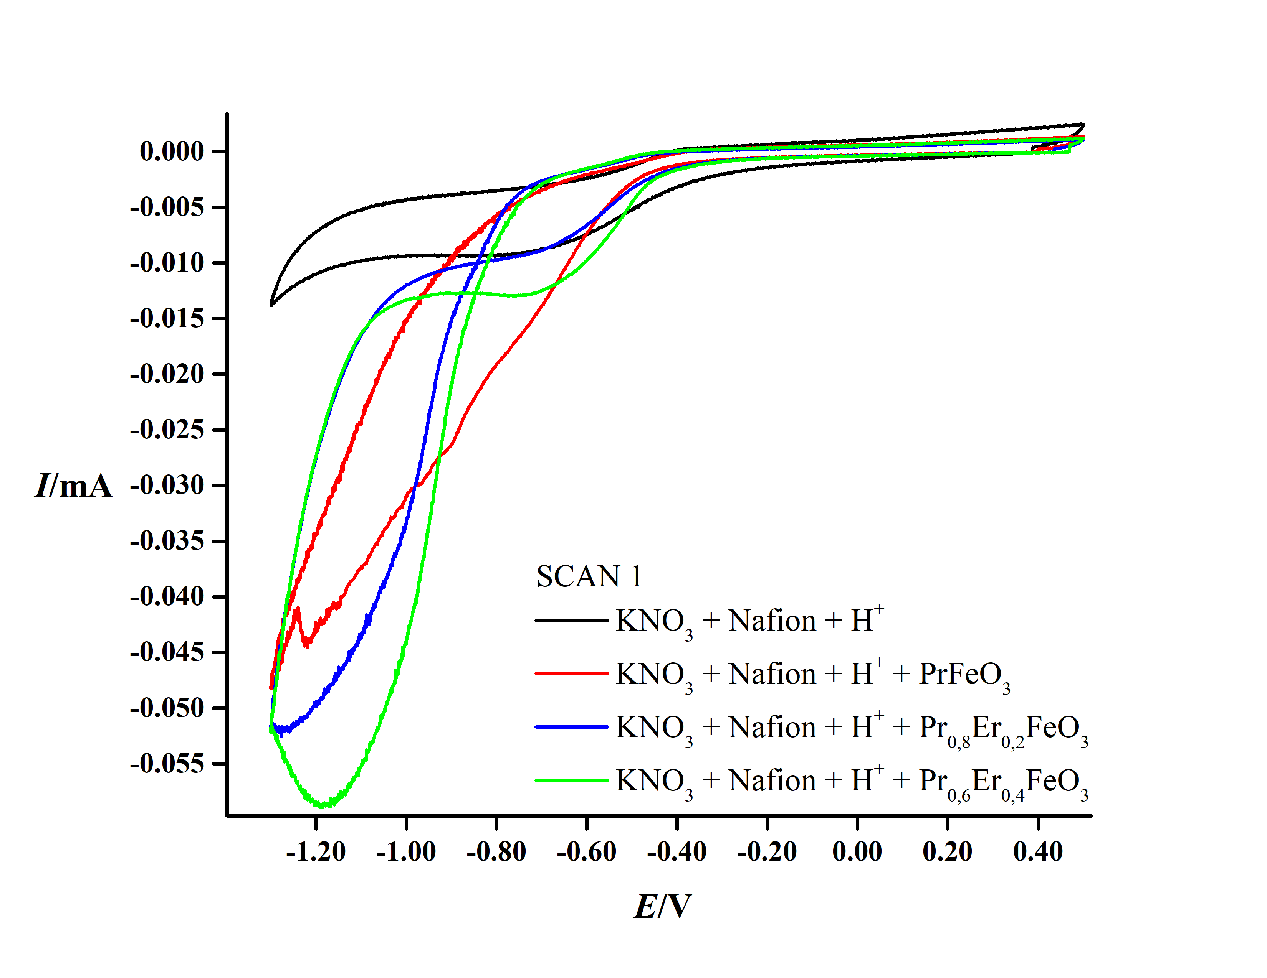
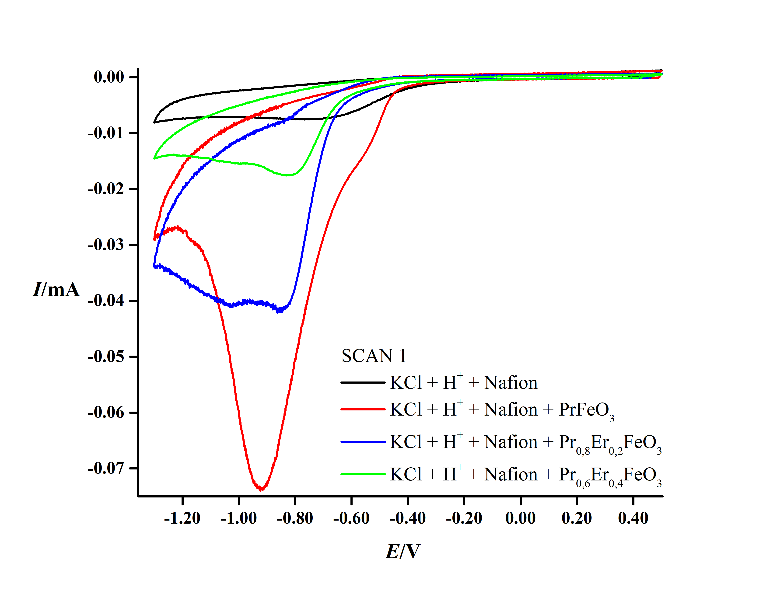
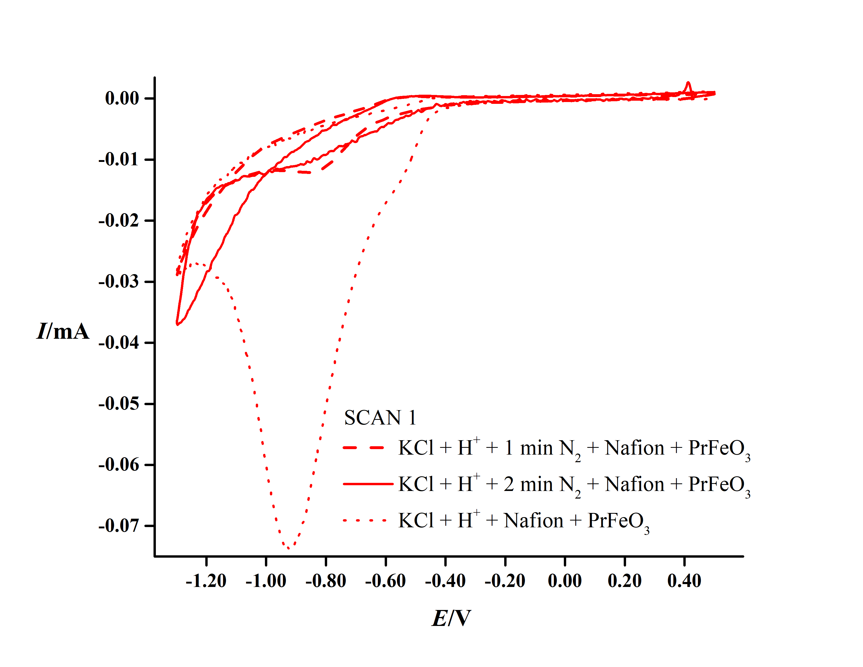
Results and discussions – Cyclic staircase voltammtery

Slide 5
Conclusions
The sol-gel combustion ⇒ an appropriate method for synthesis of this type of compounds.
XRD patterns ⇒ confirmed the formation of crystalline, phase-pure and isostructural compounds with orthorhombic structure (space group Pnma).
Vibrational spectra
– confirmed the formation of Ln−O and Fe−O bonds in the substituted perovskites,
– the substitution of Pr³⁺ by the smaller Er³⁺ ion ⇒ lattice contraction and strengthening of the Ln–O bonds ⇒ blue shift of the corresponding vibrational bands,
– structural distortion of the FeO₆ octahedra ⇒ shortening of the Fe–O bond lengths and increased bond strength ⇒ a slight shift of the Fe–O stretching modes to higher wavenumbers and minor variations in the Fe–O bending modes, depending on the degree of octahedral tilting.
Electrochemical measurements
  – good electrochemical stability and no significant water oxidation/reduction activity,
  – enhanced electrocatalytic activity toward oxygen reduction reaction (ORR), except ErFeO₃
  ⇒ PrFeO₃ exhibiting the most pronounced catalytic response,
  – overall, the obtained perovskites possess considerable potential as electrocatalysts, particularly for the ORR,
  ⇒ promising candidates for future electrochemical energy conversion and catalytic applications.

