Slide 1


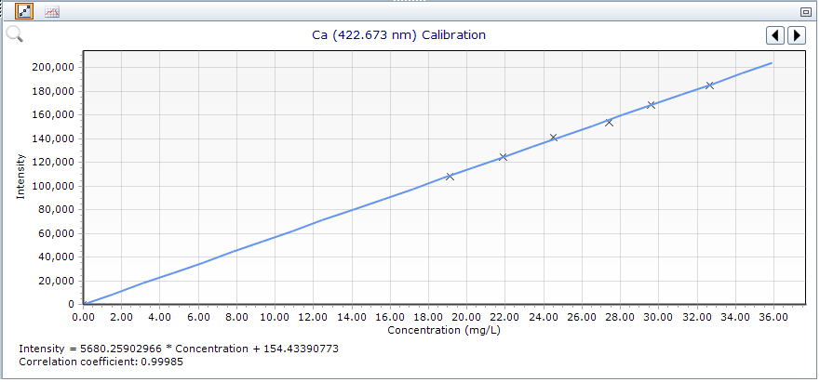
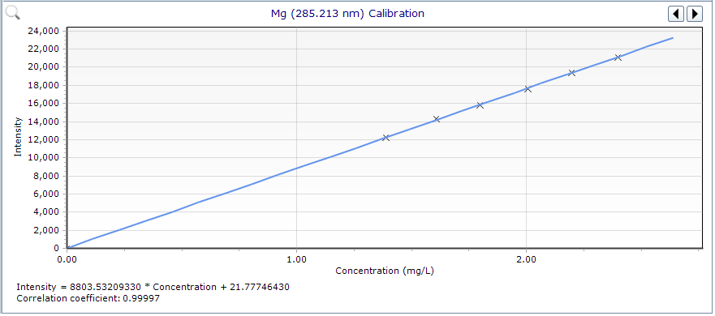
28th Congress of SCTM, 23-26 September, Ohrid, Macedonia
Optimization of an analytical method for the determination of calcium and magnesium content using ICP technic
Stojance Kirovski, Aleksandra Damjanoska, Cveta Dolikjoska-Trajkova, Stefan Radevski, Liljana Velkovska
Alkaloid AD Skopje, Blvd. Aleksandar Makedonski 12, Skopje, Republic of N. Macedonia
Introduction & Aim
Results
This study describes the optimization of an ICP analytical method for the determination of calcium and magnesium content during its lifecycle, based on continuous monitoring of result trends, which indicated the need for improved accuracy and robustness.
 | Blue dot |  | Blue dot (saturated) |  | RC 0.45µm
 | % Ca | % Mg | % Ca | % Mg | % Ca | % Mg
Sample 1_Assay (Rep 1) | 94.22 | 95.74 | 93.82 | 96.22 | 93.01 | 95.26
Sample 2_Assay (Rep 1) | 94.35 | 96.20 | 94.35 | 96.68 | 94.17 | 96.20
Sample 1_Assay (Rep 2) | 94.59 | 96.22 | 93.52 | 96.22 | 93.38 | 95.74
Sample 2_Assay (Rep 2) | 95.16 | 97.16 | 94.54 | 97.16 | 94.21 | 96.20
Average | 94.58 | 96.33 | 94.06 | 96.57 | 93.69 | 95.85
SD | 0.42 | 0.60 | 0.47 | 0.45 | 0.59 | 0.45
RSD | 0.44 | 0.62 | 0.50 | 0.47 | 0.63 | 0.47
Filtration: The results demonstrated that the type of filter (blue dot paper or regenerated cellulose (RC) 0.45 µm) does not significantly affect the accuracy or precision of the results, enabling the use of RC filters for routine analysis.
Calibration Range: Extension of the calibration range from 80% - 120% to 70% - 120% improved linearity and correlation coefficients. However, discrepancies in assay values were observed when using externally sourced solution standards. This was successfully resolved by introducing in-house solid-state standards prepared from API materials, which ensured accurate recoveries (~100%) and improved agreement with expected results.
Conclusion
This study illustrates how a lifecycle-based approach to method optimization can significantly enhance method performance and reliability. The use of in-house solid secondary standards combined with optimized sample preparation conditions ensures a robust and fit-for-purpose analytical method suitable for routine quality control.

