Slide 1


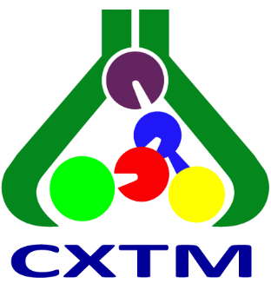
Ss. Cyril and Methodius University in Skopje
Faculty of Agricultural Sciences and Food - Skopje
Skopje, North Macedonia
EVALUATION OF DIFFERENT SOLVENTS FOR LIQUID–LIQUID EXTRACTION OF SELECTED PESTICIDE RESIDUES FROM WATER SAMPLES
Lenche Velkoska-Markovska, Biljana Petanovska-Ilievska
28th Congress of SCTM, 23-26 September, Ohrid, Macedonia

Slide 2
Introduction
Detremination of pesticide residues in water – analytical challenge
WATER SAMPLE
EXTRACTION
RP-HPLC
Present at low concentration levels
Different physicochemical properties

Slide 3
Introduction
EXTRACTION
Sample preparation - important step
efficient extraction of the target analytes from the aqueous matrix and,
sufficient recovery for reliable chromatographic determination
LLE - widely used approach
choice of the organic solvent is particularly important
different pesticides may show different extraction behavior
a solvent that provides high recovery for one pesticide may not necessarily be equally effective for another.
main reason for comparing several extraction solvents in the present study

Slide 4
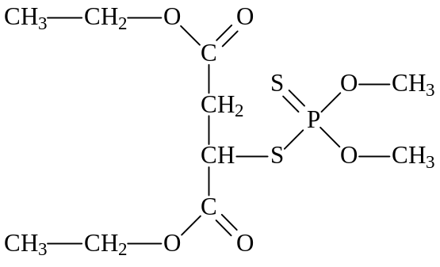
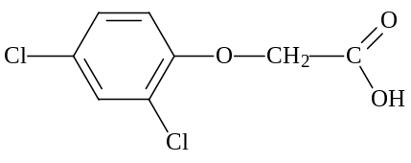
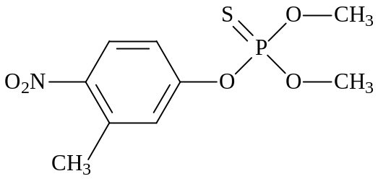
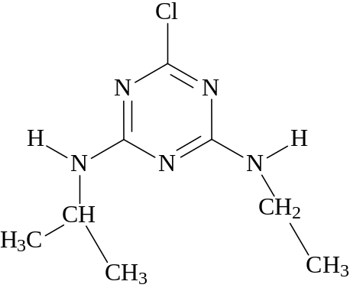
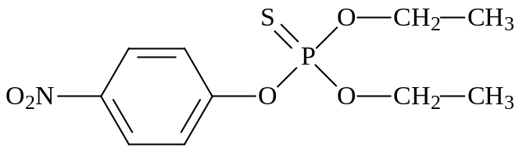
Aim
To evaluate the extraction efficiency of four extraction solvents for the LLE of five selected pesticides from water samples.
Selected pesticides
Extraction solvents
Dichloromethane (DCM)
Diethyl ether
Petroleum benzine
n-Hexane/acetone (4:1, V/V)
2,4-D
Malathion
Atrazine
Fenitrothion
Objective: to compare the recovery of the individual pesticides and to evaluate the overall differences in extraction performance among the four solvents.
Parathion

Slide 5
Experimental
Standards and RP-HPLC Analysis
Pestanal Analytical
standards
RP-HPLC system
Chromatographic conditions
Agilent 1260 Infinity RRLC
UV-Vis DAD
Chromatographic data processed using ChemStation software
LiChrospher 60 RP-select B (125 × 4 mm, 5 µm)
ACN/H₂O (55:45, V/V)
Flow rate: 1.0 mL/min
Column temperature: 25 °C
Detection: 220 and 270 nm
Injection volume: 5 µL
2,4-D
Atrazine
Malathion
Fenitrothion
Parathion
Supplier: Sigma-Aldrich
The RP-HPLC method was used for quantitative evaluation of pesticide recoveries after LLE

Slide 6
Experimental
Fortified distilled
water (1 L)
3 concentration
levels
4 independent
samples per level
LLE
RP-HPLC
4 solvents
Recovery (%)
Fortification levels (mg/L)
Pesticide | Level 1 | Level 2 | Level 3
2,4-D | 0.010 | 0.020 | 0.050
Atrazine | 0.005 | 0.010 | 0.025
Malathion | 0.010 | 0.020 | 0.050
Fenitrothion | 0.001 | 0.002 | 0.005
Parathion | 0.005 | 0.010 | 0.025

Slide 7
Experimental
Liquid–Liquid Extraction Procedure
Organic phases
Na₂SO₄ drying
1 L fortified water
Evaporation
40 °C
2 × 500 mL
sequential portions
Processed sequentaly | 1 L Separatory funnel
10 mL ACN
evaporate again
3 × 50 mL solvent
per portion
2 mL ACN
0.45 µm PTFE
Shake 2 min | Separate 5 min
RP-HPLC
5 µL injection

Slide 8
Results and discussions
Extraction Efficiency of the Investigated Solvents
Mean recovery obtained across the investigated fortification levels
ᵃ For petroleum benzine, mean recoveries were calculated from Levels 2 and 3; analytes were not detected at Level 1.
Overall, these results demonstrate that the choice of extraction solvent can substantialy affect the recovery of individual pesticides

Slide 9
Results and discussions
Analyte-Dependent Extraction Behavior
2,4-D
Malathion
Organophosphorus pesticides
Petroleum benzine
5.24 % mean recovery
Very poor extraction under the applied conditions.
Dichloromethane 78.89%
Diethyl ether 71.95%
lower recovery than for most other analytes with these two solvents.
n-hexane/acetone
96.59–105.78% mean recovery
high extraction efficiency
These examples clearly demonstrate that extraction performance should be evaluated not only in terms of the overall efficiency of a solvent, but also in relation to the individual analyte

Slide 10
Results and discussions
Overall Comparison of Extraction Solvents
Highest
Highest overall extraction performance
Generally good recoveries across the five pesticides, Lower recovery for malathion
1
Dichloromethane
Good overall extraction performance
Lower recovery for malathion
2
Diethyl ether
Particularly effective for organophosphorus pesticides
3
n-Hexane/acetone
(4:1, V/V)
More analyte-dependent behavior
4
Petroleum benzine
Lowest overall extraction performance
Particularly poor recovery for 2,4-D
Lowest
This overall ranking should not be interpreted as a universal ranking for every individual pesticide; the analyte-dependent extraction behavior should also be taken into consideration

Slide 11
Conclusions
The efficiency of liquid–liquid extraction was strongly dependent on both the extraction solvent and the individual pesticide
Dichloromethane provided the highest overall extraction performance.
Diethyl ether also showed generally good extraction efficiency.
n-Hexane/acetone was particularly effective for the organophosphorus pesticides.
Petroleum benzine showed the lowest overall performance, particularly for 2,4-D.
Solvent selection should consider both overall extraction efficiency and individual analyte behavior.
These results provide a basis for further evaluation of the selected extraction conditions using real environmental water samples.

Slide 12
Thank you for your attention!

