Slide 1


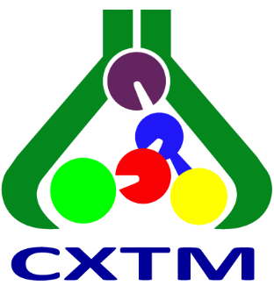
Ss. Cyril and Methodius University in Skopje
Faculty of Agricultural Sciences and Food –Skopje
Skopje, North Macedonia
COMPARATIVE EVALUATION OF THREE VALIDATED RP-HPLC METHODS FOR ASSESSING LIQUID–LIQUID EXTRACTION EFFICIENCY OF SELECTED PESTICIDES
Lenche Velkoska-Markovska, Biljana Petanovska-Ilievska
28th Congress of SCTM, 23-26 September, Ohrid, Macedonia

Slide 2
Introduction
In this study, the emphasis is placed on the chromatographic determination and, more specifically, on whether different RP-HPLC conditions provide a consistent evaluation of extraction performance.
Why Compare RP-HPLC Methods?
For reliable evaluation of LLE efficiency, the chromatographic method should provide adequate separation and reliable quantitative determination of the extracted pesticides.
Differences in column dimensions and mobile-phase composition may affect
Therefore, it is important to determine whether different chromatographic conditions lead to the same overall assessment of extraction efficiency.
Chromatographic separation
Run time
Sensitivity
Precision
Recovery

Slide 3
Introduction
LLE extracts
Same extraction procedure
RP-HPLC
Method I
RP-HPLC
Method II
RP-HPLC
Method III
Question
consistent assessment of extraction efficiency

Slide 4
Aim
To compare the applicability of three previously established RP-HPLC methods for evaluating the efficiency of LLE of five selected pesticides from water samples.
Chromatographic performance
Analytical performance
LLE evaluation
Separation
Resolution
Chromatographic run time
Consistent Recovery
Comparable assessment of LLE efficiency
Linearity
Sensitivity
Precision
5 pesticides × 4 extraction solvents × 3 RP-HPLC methods

Slide 5
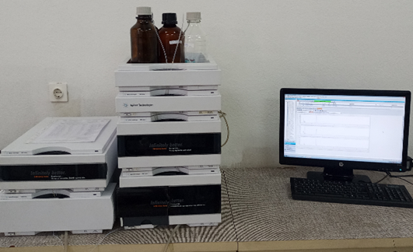
Experimental
Analytical standards
Instrumentation
2,4-D, Atrazine, Malathion, Fenitrothion, Parathion
Agilent 1260 Infinity RRLC
Binary pump, Autosampler, Thermostatted column compartment, UV-Vis DAD, ChemStation software
Solvents and reagents
HPLC-grade acetonitrile and water;
Dichloromethane, diethyl ether, petroleum benzine, n-hexane, acetone
Chromatographic columns
LiChrospher 60 RP-select B
(125 x 4 mm; 5 μm),
LiChrospher 60 RP-select B
(250 x 4 mm; 5 μm),
Purospher STAR RP-8e
(30 x 4 mm; 3 μm)

Slide 6
Experimental
RP-HPLC Methods I–III
Previously established under optimized isocratic conditions
Parameter | Method I | Method II | Method III
Column | 125 × 4 mm, 5 µm | 250 × 4 mm, 5 µm | 30 × 4 mm, 3 µm
Stationary phase | RP-8 | RP-8 | RP-8
ACN/H₂O (V/V) | 55:45 | 60:40 | 45:55
Flow rate | 1.0 mL/min | 1.0 mL/min | 1.0 mL/min
Temperature | 25 °C | 25 °C | 25 °C
Detection | 220 / 270 nm | 220 / 270 nm | 220 / 270 nm
Injection volume | 5 µL | 5 µL | 5 µL

Slide 7
Experimental
Experimental Design and LLE
Fortified distilled water
3 levels per pesticide
Pesticide | Fortification levels (mg/L)
2,4-D | 0.010 · 0.020 · 0.050
Atrazine | 0.005 · 0.010 · 0.025
Malathion | 0.010 · 0.020 · 0.050
Fenitrothion | 0.001 · 0.002 · 0.005
Parathion | 0.005 · 0.010 · 0.025
Independent samples per level
n = 4
DCM · Diethyl ether · Petroleum benzine · n-hexane/acetone
LLE
Methods I–III
Same LLE approach
Comparison
Recovery results and consistency

Slide 8
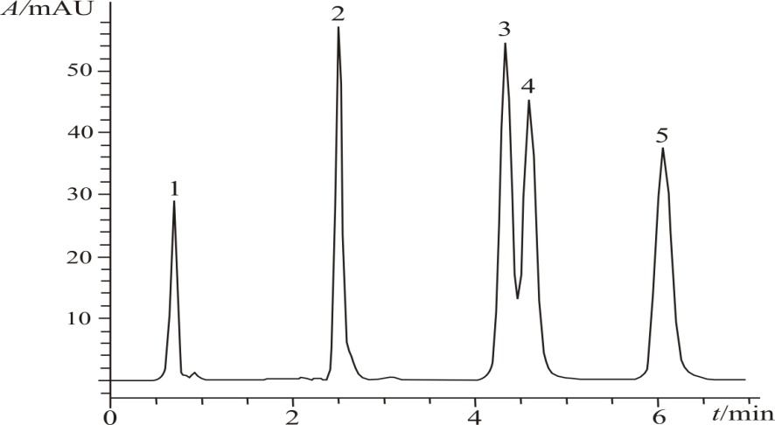
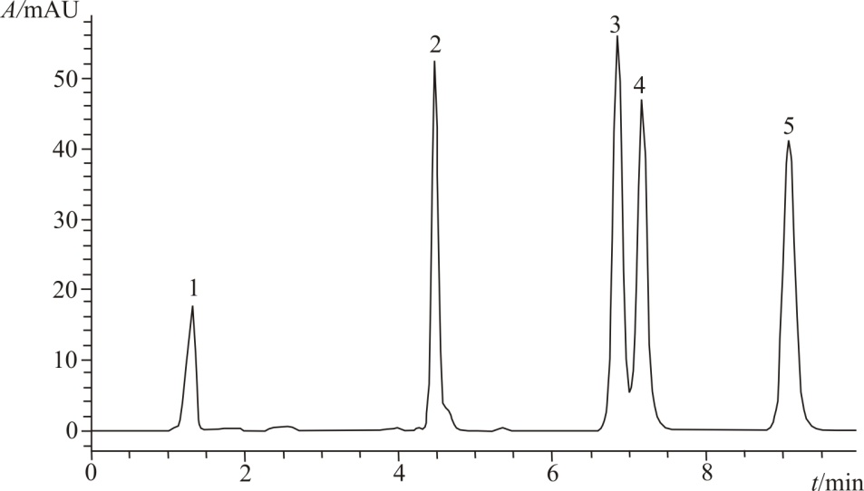
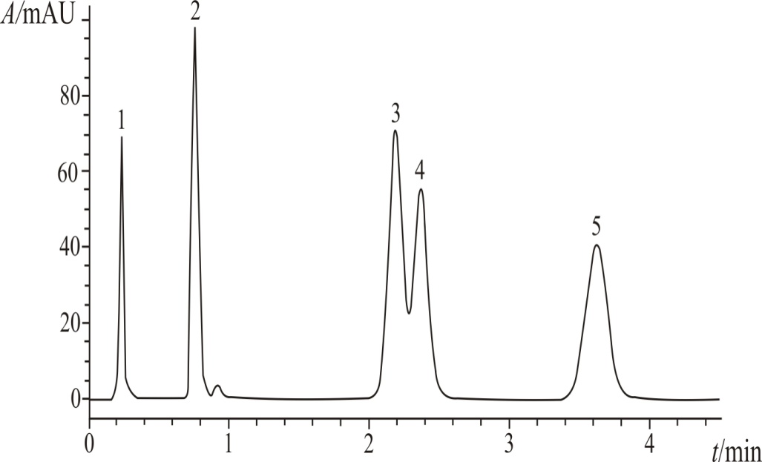
Results and discussions
Chromatographic Separation and Run Time
Method I
Method II
Method III
Rs = 1.7
Rs = 2.1
Rs = 1.5
Run time < 7 min
Run time < 10 min
Run time < 4 min
Critical pair: Malathion–Fenitrothion
Method II → highest resolution | Method III → shortest chromatographic run time

Slide 9
Results and discussions
Analytical Performance
Linearity
Precision
Sensitivity
Method I: R² ≥ 0.9990
Method II: R² ≥ 0.9999
Method III: R² ≥ 0.9992
RSD ≤ 1.8%
Satisfactory precision
LOD and LOQ determined for all analytes
No systematic sensitivity loss with Method III
Analyte | M I (LOD / LOQ) | M II (LOD / LOQ) | M III (LOD / LOQ)
2,4-D | 0.314 / 0.953 | 0.251 / 0.760 | 0.112 / 0.338
Atrazine | 0.032 / 0.096 | 0.025 / 0.077 | 0.028 / 0.086
Malathion | 0.357 / 1.083 | 0.457 / 1.385 | 0.326 / 0.986
Fenitrothion | 0.227 / 0.689 | 0.293 / 0.888 | 0.280 / 0.847
Parathion | 0.347 / 1.052 | 0.411 / 1.245 | 0.304 / 0.921
LOD / LOQ expressed as injected analyte mass (ng)

Slide 10
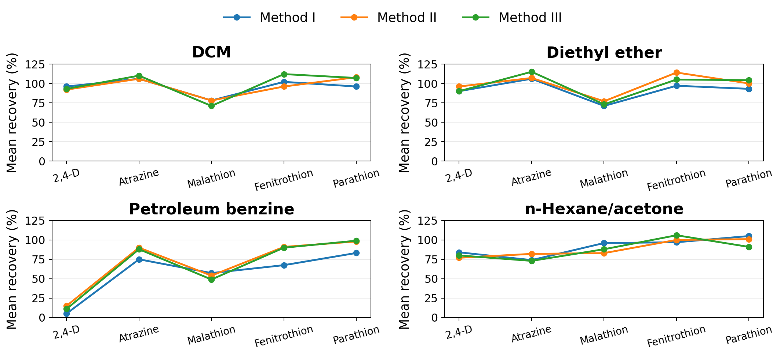
Results and discussions
Recovery Patterns across the Three Methods
Mean recovery values across the investigated fortification levels
It is evident that the overall evaluation of extraction performance was generally consistent across the three RP-HPLC methods.

Slide 11
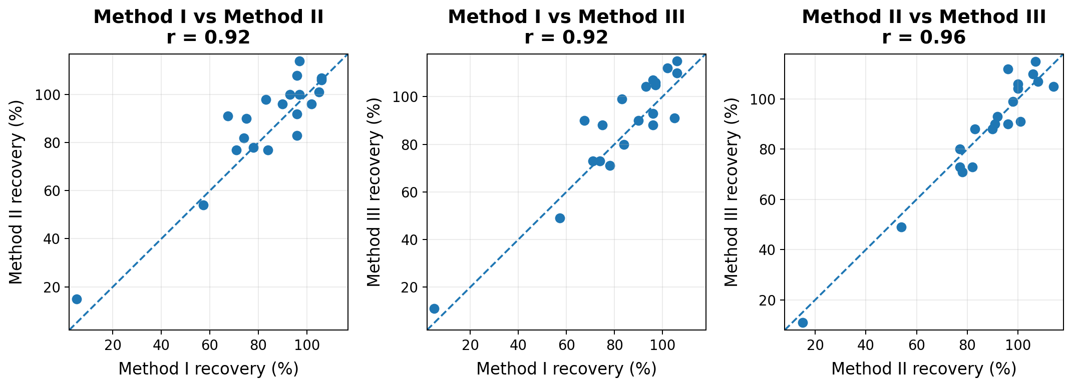
Results and discussions
Correlation of Recovery Results
Pairwise comparison of 20 mean pesticide–solvent recovery values
Strong correlations indicate consistent recovery patterns across the three RP-HPLC methods.

Slide 12
Conclusions
All three RP-HPLC methods provided satisfactory chromatographic separation of the five investigated pesticides.
Method II provided the highest resolution of the critical malathion–fenitrothion pair (Rs = 2.1).
Method III substantially reduced the chromatographic run time (< 4 min) while maintaining satisfactory separation and quantitative performance.
The three methods showed strong correlations in recovery patterns
(r ≈ 0.92–0.96).
Comparative evaluation of LLE performance was generally consistent across the three RP-HPLC methods.
Method selection can be guided by the required balance between chromatographic resolution and analysis speed.

Slide 13
Thank you for your attention!

