Slide 1


28th C-SCTM
Surface Interaction of Ni based Electrocatalyst with Hydrogen Peroxide
Name: Nabi Ullah
Sep 24, 2026
Faculty of Chemistry, University of Lodz, Poland
Part 1
Part 2
Part 3
Part 4
Part 5

Slide 2
01
Importance of H₂O₂
02
Motivation
Outline
Sep 24, 2026
03
Catalyst Synthesis
04
Results and Discussion
05
Acknowledgment

Slide 3





Importance of H₂O₂
Part 1
Textile Paper Pharma Disinfection
Importance
Environment
Security
Immunity
Physiological

Slide 4
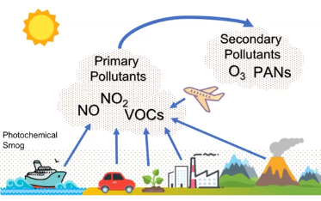
Pollution upgradation
Part 1
H₂O₂ → OH*
Importance
Environment
Security
Immunity
Physiological

Slide 5



Part 1
Security and Terrorism
Importance
Environment
Security
Immunity
Physiological
Notes:
Triacetone triperoxide and diacetone diperoxide

Slide 6
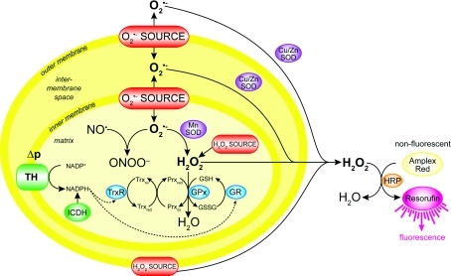


Part 1
Immunity
Importance
Environment
Security
Immunity
Physiological
Notes:
Antipathogen

Slide 7
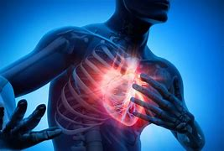
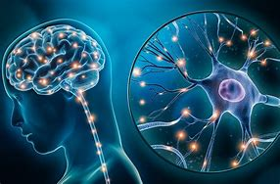
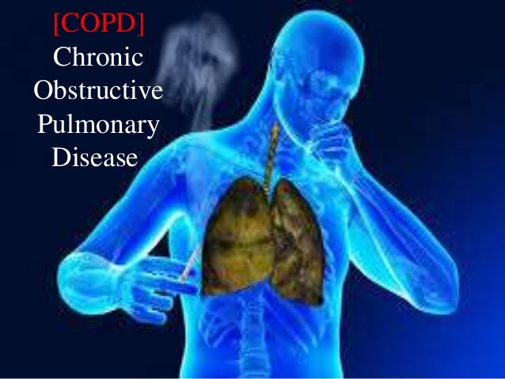
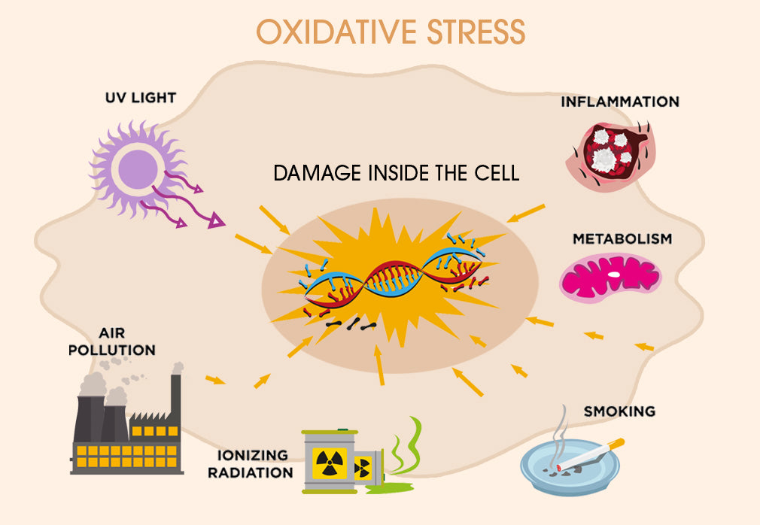
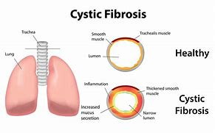
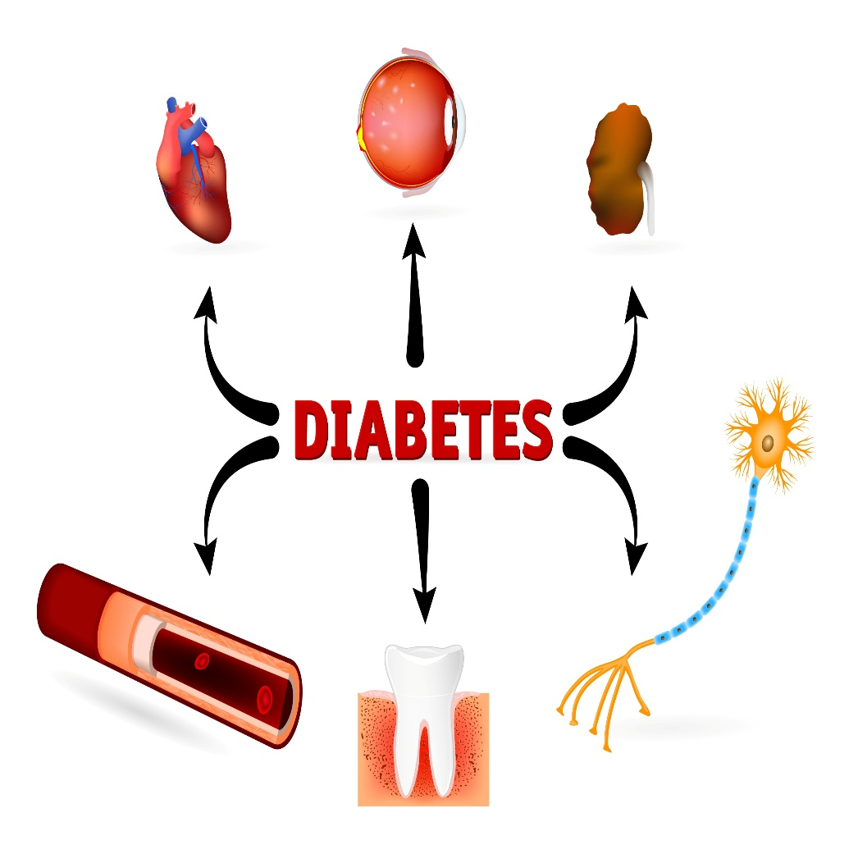
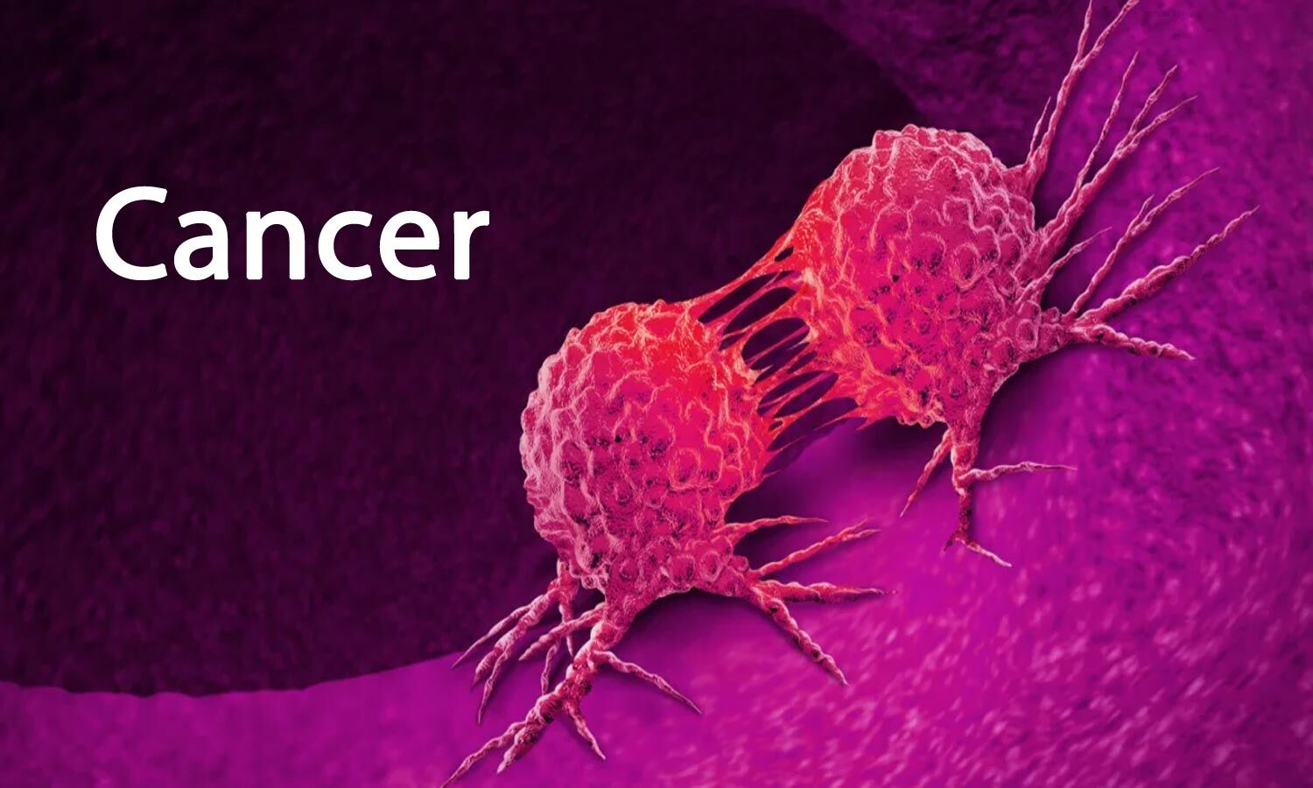
Physiological role
Part 1
Importance
Environment
Security
Immunity
Physiological

Slide 8
Detection of H₂O₂
Part 2
Electrochemical techniques | CV | SWV | EFS | DSWV | SWV (gas phase)
Linear range, mol L⁻¹ | 1.0 × 10⁻⁴ – 1.0 × 10⁻³ | 2.0 × 10⁻⁵ – 1.0 × 10⁻³ | 2.0 × 10⁻⁵ – 2.0 × 10⁻⁴ | 2.0 × 10⁻⁵ – 1.0 × 10⁻⁴ | 7.4× 10⁻¹² – 3.7 × 10⁻¹¹
Slope, A mol⁻¹ L | 4.0× 10⁻⁶ | 2.6× 10⁻⁶ | 4.1× 10⁻⁶ | 1.1× 10⁻⁵ | 3.3× 10⁻¹¹
Intercept, A | 4.4× 10⁻⁷ | 1.5× 10⁻⁷ | 2.9× 10⁻⁶ | 4.9× 10⁻⁷ | 1.2× 10⁻¹²
LOD, mol L⁻¹ | 1.9 × 10⁻⁵ | 5.2 × 10⁻⁶ | 5.9 × 10⁻⁶ | 4.9 × 10⁻⁶ | 4.1× 10⁻¹³
LOQ, mol L⁻¹ | 6.3 × 10⁻⁵ | 1.7 × 10⁻⁵ | 2.0 × 10⁻⁵ | 1.6 × 10⁻⁵ | 1.4× 10⁻¹²
https://doi.org/10.1007/s00604-025-07325-4
Detection
Mechanism

Slide 9
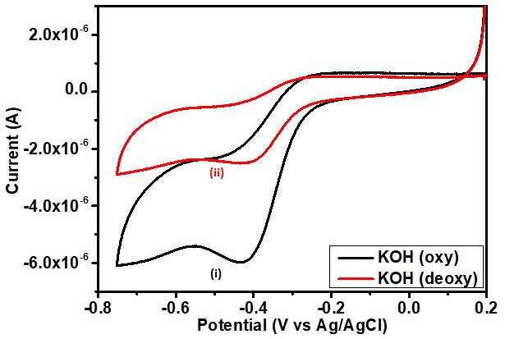
Reaction Mechanism H₂O₂ reduction
Part 2
H₂O₂ reduction in absence of O₂
H₂O₂ reduction in Presence of O₂
2HO₂⁻_{(ads)} ⇆ O_{2(ads)} + 2HO⁻_{(ads)} (1)
O_{2(ads)} + 2e⁻ + H⁺_{(aq)} → HO₂⁻ _{(ads)} (2)
https://doi.org/10.1007/s00604-025-07325-4
Detection
Mechanism
Notes:
CE mechanism,

Slide 10
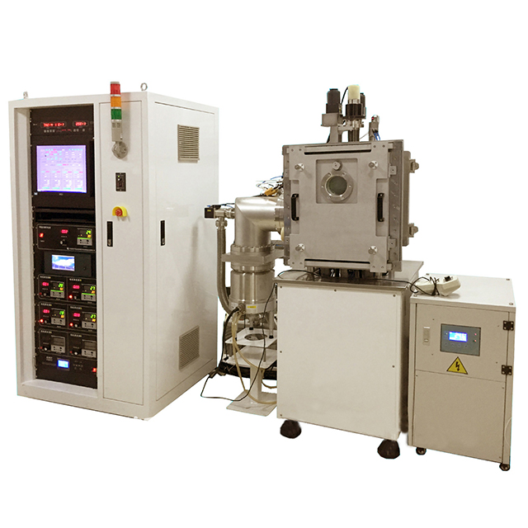
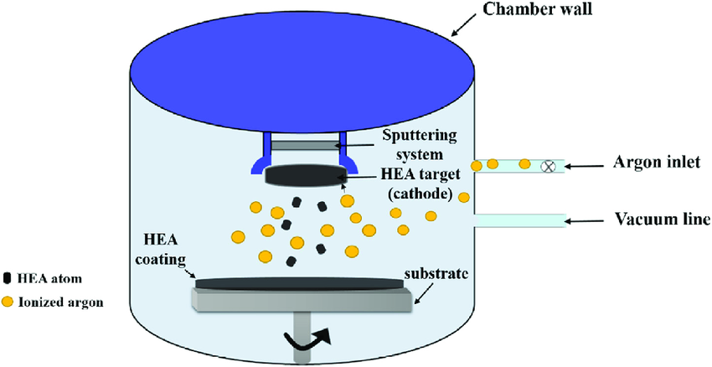
Catalyst Synthesis
Part 3
https://doi.org/10.1007/s11581-025-06856-3
Synthesis
Conditions

Slide 11
Part 3
Reaction/synthesis conditions
Temperature: 305 K
Substrate: Si wafer (with native SiO₂
Substrate rotation: 20 rpm
Ni source angle: 40°
Ni Source distance: 12.5 cm
Base pressure: 4.5 × 10⁻⁶ Pa.
Inner atmosphere: Ar and oxygen,
Total pressure: 0.5 Pa.
Oxygen partial pressure: 0.03, 0.04, and 0.05 Pa,
oxygen purity: 99.9995%
https://doi.org/10.1007/s11581-025-06856-3
Synthesis
Conditions

Slide 12
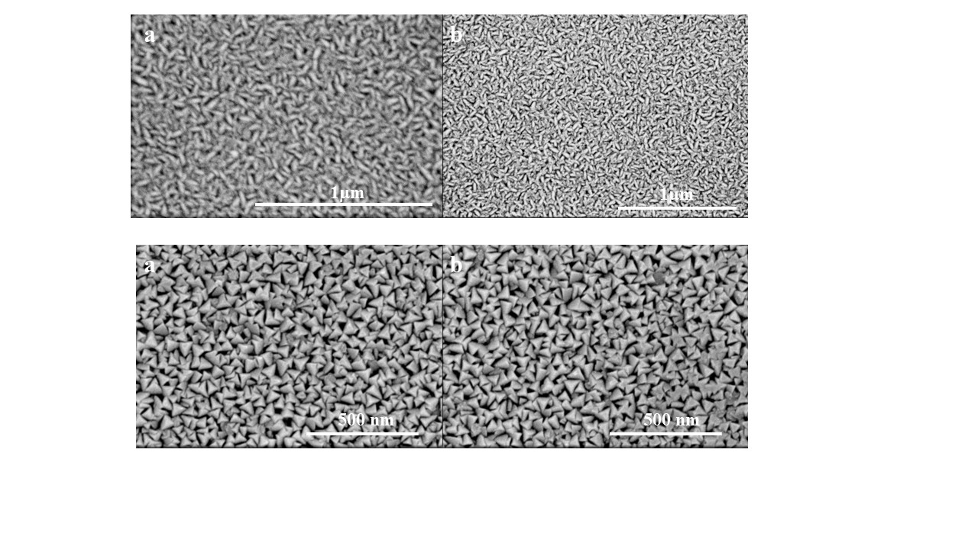
Part 4
SEM of Ni/NiO Thin Film (sample 1)
https://doi.org/10.1007/s11581-025-06856-3
SEM
XRD, EDX
XPS
Raman
Electrochem
DFT

Slide 13
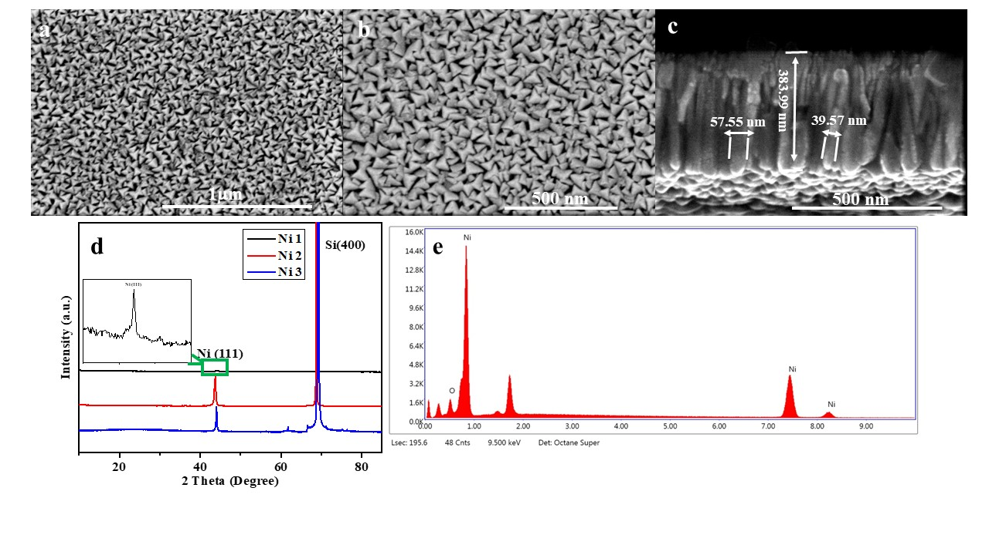
Part 4
SEM of Ni/NiO Thin Film (sample 2)
https://doi.org/10.1007/s11581-025-06856-3
SEM
XRD, EDX
XPS
Raman
Electrochem
DFT

Slide 14
Part 4
SEM of Ni/NiO Thin Film (sample 3)
https://doi.org/10.1007/s11581-025-06856-3
SEM
XRD, EDX
XPS
Raman
Electrochem
DFT

Slide 15
Part 4
XRD and EDS of Ni/NiO
https://doi.org/10.1007/s11581-025-06856-3
SEM
XRD, EDX
XPS
Raman
Electrochem
DFT
Notes:
Adatom motion 44° and 69°

Slide 16
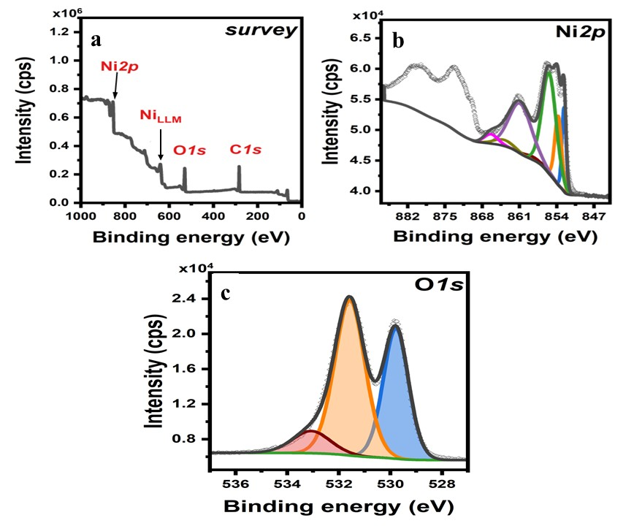
XPS of Ni/NiO
Part 4
https://doi.org/10.1007/s11581-025-06856-3
SEM
XRD, EDX
XPS
Raman
Electrochem
DFT
Notes:
The peak at 852.6 eV and corresponding peaks at 856.3 and 858.7 eV, confirms the presence of Ni⁰.
853.7 and 855.4 eV, along with corresponding peaks at 860.8, 863.9, and 866.3 eV, indicate the presence of partially oxidized nickel

Slide 17
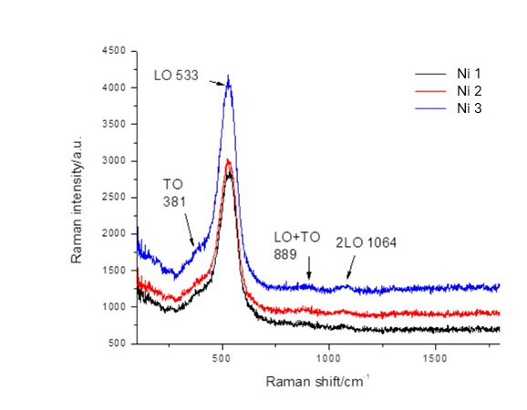
Raman of Ni/NiO Thin Films
Part 4
https://doi.org/10.1007/s11581-025-06856-3
SEM
XRD, EDX
XPS
Raman
Electrochem
DFT
Notes:
intense band at 533 cm⁻ ¹, the structure with imperfections, and low crystallinity
The very low intensities, compared to the LO band, of the second order transition at 889 and 1064 cm⁻ ¹, indicate that probably the structure is amorphous
Another indication for this kind of phase is the complete absence of 2 M magnon band above 1500 cm⁻ ¹, which appears in a highly ordered structures.

Slide 18
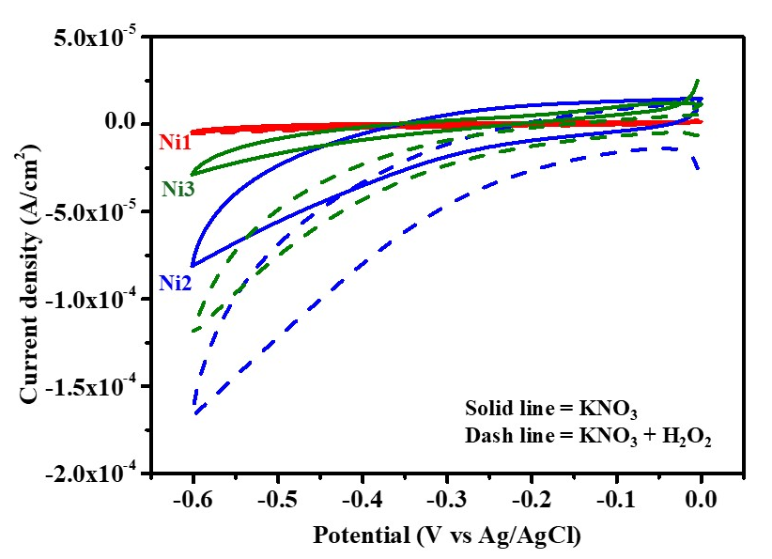
Electrochemical H₂O₂ reduction
at Ni/NiO-modified electrode
Part 4
https://doi.org/10.1007/s11581-025-06856-3
SEM
XRD, EDX
XPS
Raman
Electrochem
DFT
Notes:
−1.64 × 10⁻⁴ A/cm² at a potential of −0.6 V vs. Ag/AgCl

Slide 19
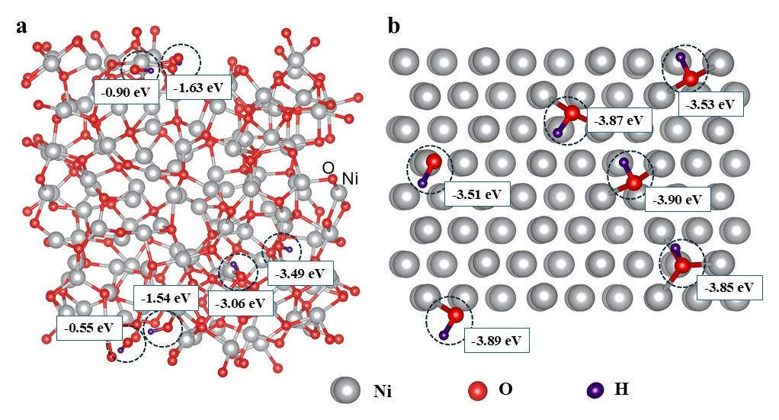
Part 4
DFT Confirmation
https://doi.org/10.1007/s11581-025-06856-3
SEM
XRD, EDX
XPS
Raman
Electrochem
DFT
Notes:
The average adsorption energies of OH groups on amorphous NiO and crystalline Ni(111) are − 1.86 and − 3.76 eV, respectively.

Slide 20





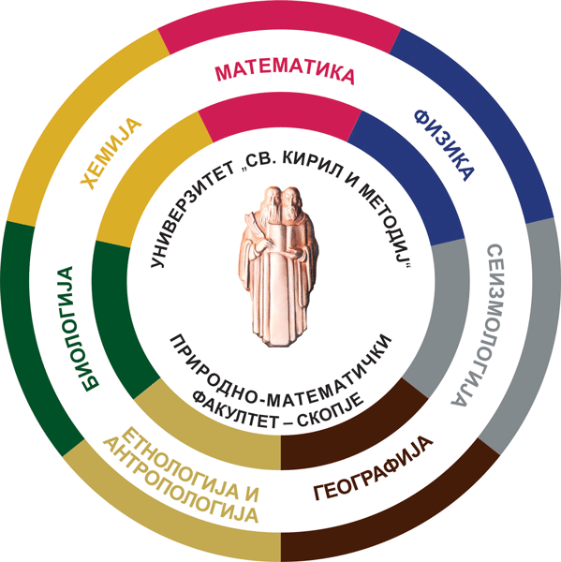



Part 5
Acknowledgment
Prof. Valentin Mirceski
Prof. Vladimir Ivanoski
Prof. Denis Music
Acknow
UNIC
objective
VIP
Contact

Slide 21

Part 5
UNIC
UNIC Alliance
The European University of Cities ​
in Post-Industrial Transition
Acknow
UNIC
Objective
Support
Contact

Slide 22
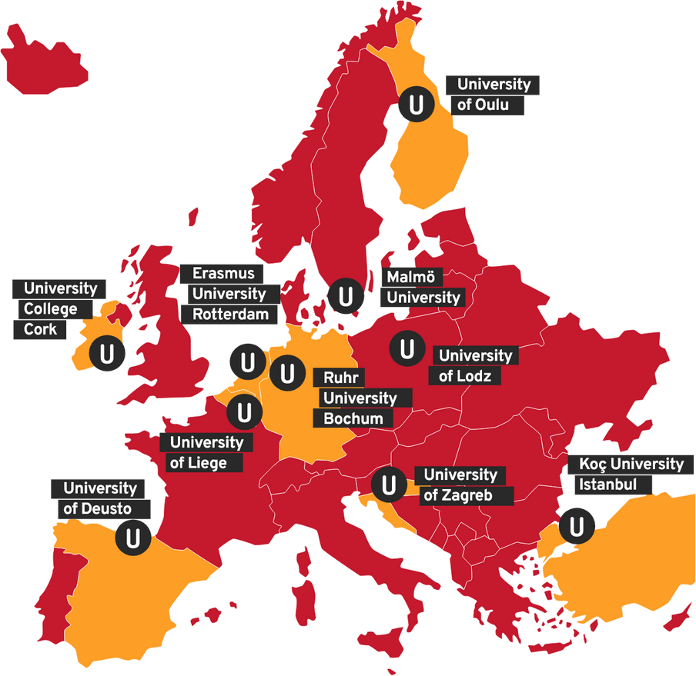
Part 5
UNIC Objective
What is UNIC?
UNIC is the European University of Cities in Post-Industrial Transition. It ’s one of over 65 European Universities Alliances, part of an ambitious and flagship EU initiative.
We are an alliance of ten universities based in post-industrial cities with a mission to boost mobility and inclusion for societal impact.
Together, we educate through teaching, research, innovation, and community engagement, towards inclusive societies.
Acknow
UNIC
Objective
Support
Contact

Slide 23
University of Lodz Support
Part 5
Student and staff mobility between partner universities.
Joint research projects involving researchers from different European countries.
Joint and innovative educational programmes.
Virtual mobility and online courses, allowing students to learn with colleagues from other UNIC universities.
Thematic conferences, workshops and international networking.
Collaboration with cities, communities and organisations to create practical solutions to urban and societal challenges.
Acknow
UNIC
objective
Support
Contact

Slide 24
Link & Contact
Part 5
www.unic.eu
www.uni.lodz.pl/unic
unic@uni.lodz.pl
Acknow
UNIC
Objective
Support
Contact

Slide 25
You are welcome to ask Questions

