Slide 1

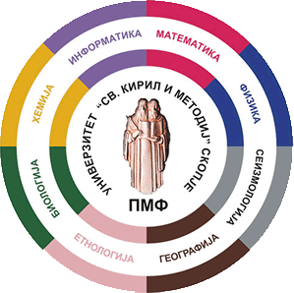

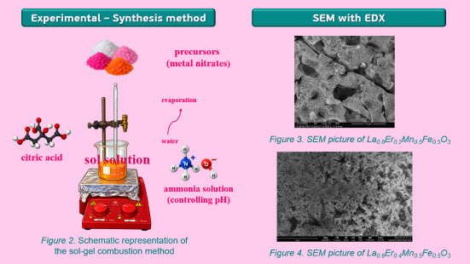
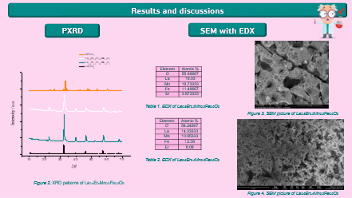
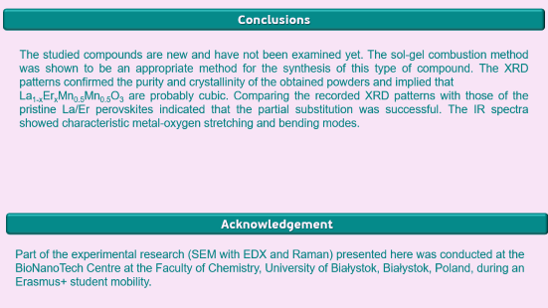
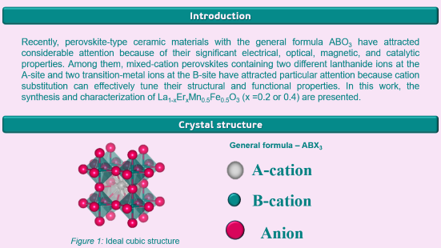
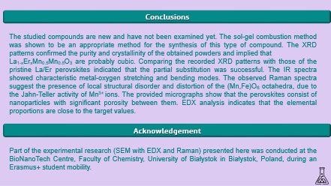
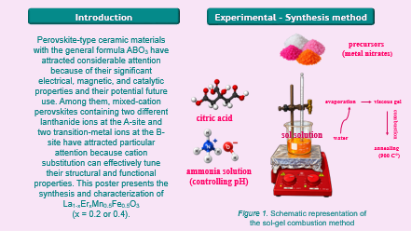
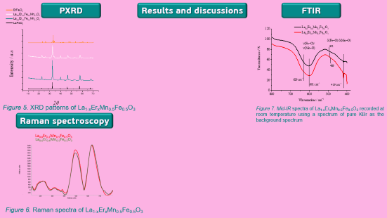
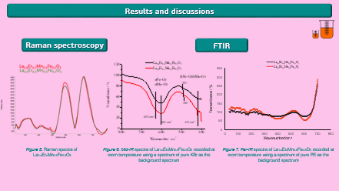
28th Congress of SCTM, 23-26 September, Ohrid, Macedonia
SYNTHESIS AND INVESTIGATION OF La_{1-x}ER_{x}Mn_{0.5}Fe_{0.5}O₃
(x = 0.2 and 0.4) COMPLEX PEROVSKITES
Cvetanka Trajkovska¹, Sofija Popovska Blazhevska¹, Miha Bukleski¹, Iwona Misztalewska-Turkowicz², Angieszka Z. Wilczewska², Slobotka Aleksovska¹
¹ Institute of Chemistry, Faculty of Natural Sciences and Mathematics, Ss. Cyril and Methodius University, Skopje, North Macedonia, cvetanka2000@hotmail.com ,
² Faculty of Chemistry, University of Bialystok, Bialystok, Poland

Slide 2
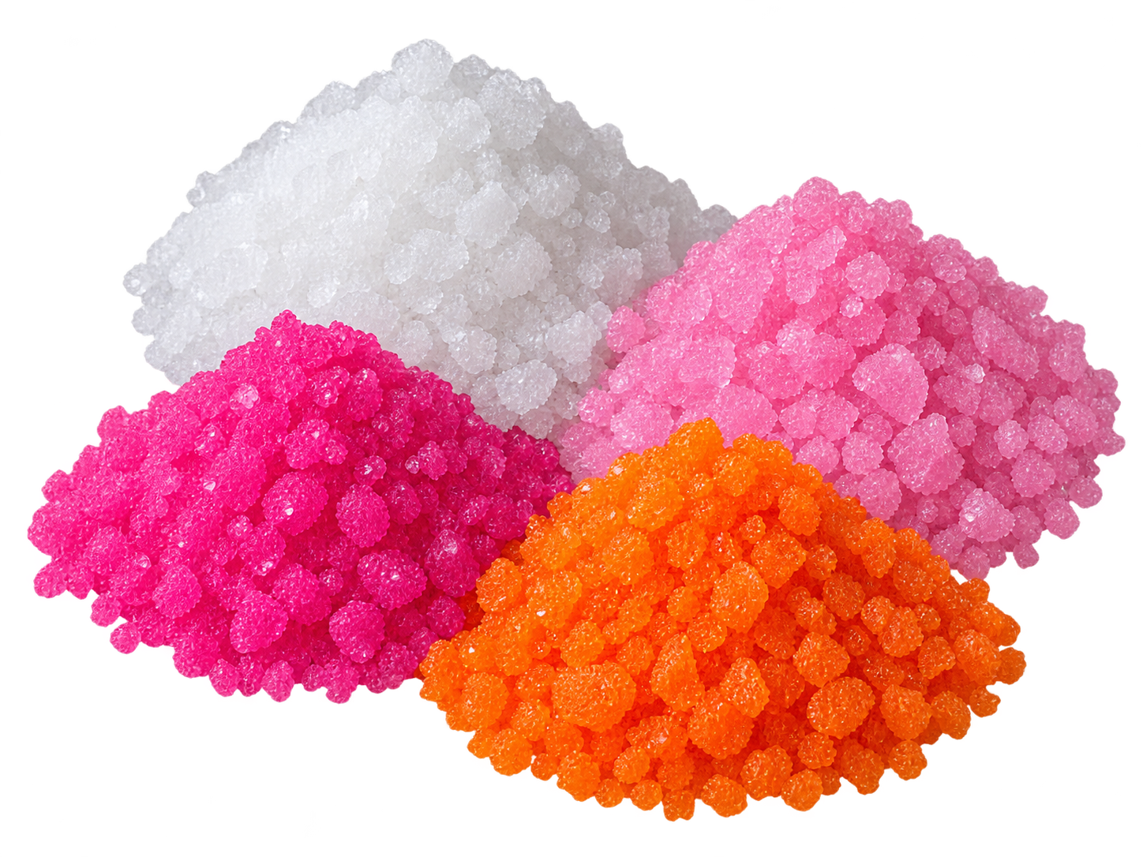
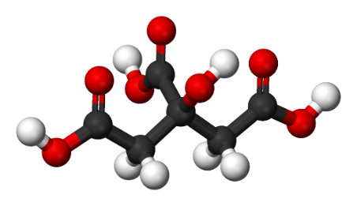
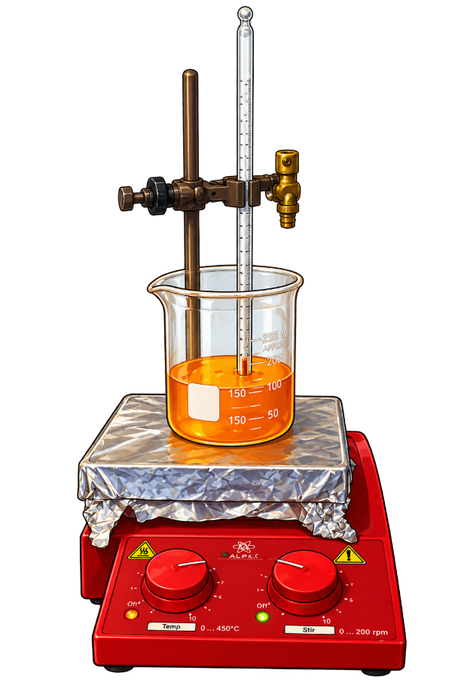
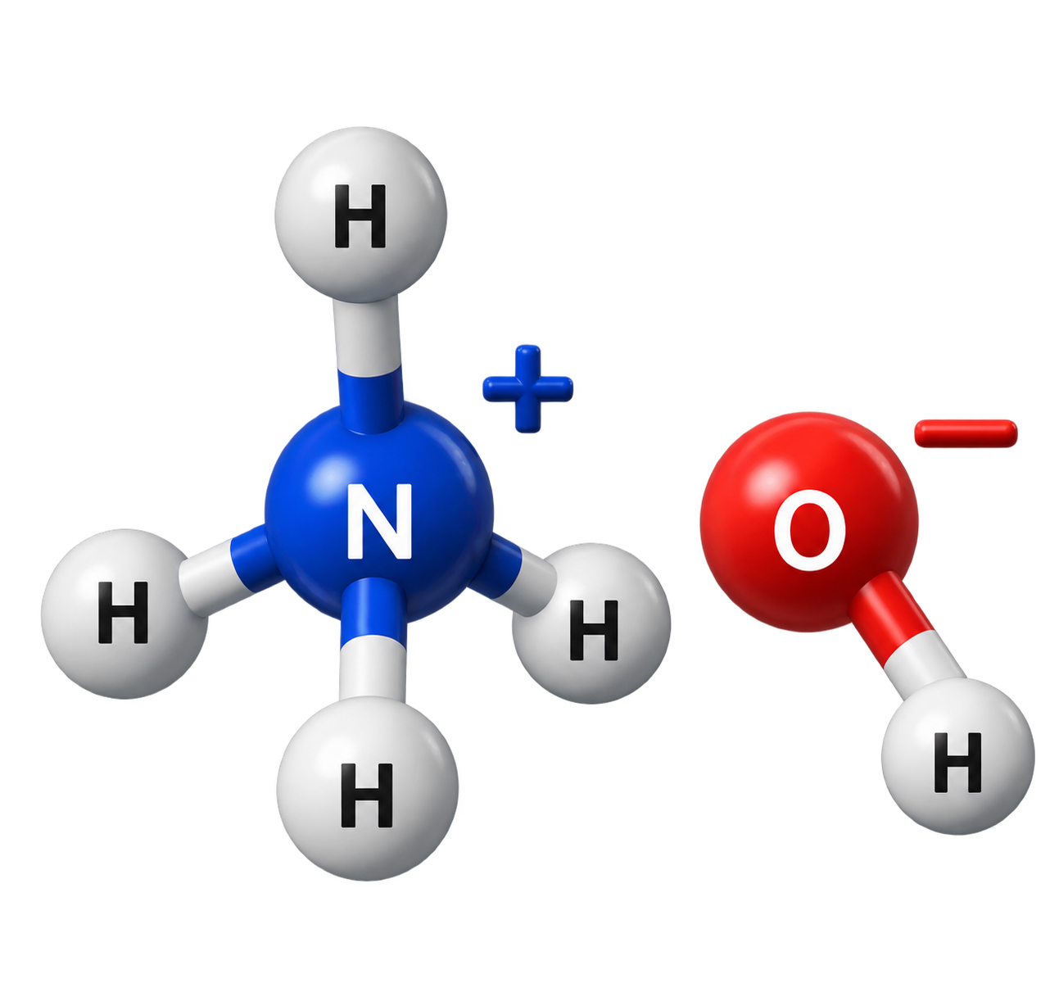
Introduction
Experimental - Synthesis method
Perovskite-type ceramic materials with the general formula ABO₃ have attracted considerable attention because of their significant electrical, magnetic, and catalytic properties and their potential future use. Among them, mixed-cation perovskites containing two different lanthanide ions at the A-site and two transition-metal ions at the B-site have attracted particular attention because cation substitution can effectively tune their structural and functional properties. This poster presents the synthesis and characterization of La_{1-x}Er_{x}Mn_{0.5}Fe_{0.5}O₃
(x = 0.2 or 0.4).
precursors
(metal nitrates)
evaporation
water
viscous gel
citric acid
combustion
sol solution
annealing
(900 C°)
ammonia solution
(controlling pH)
Figure 1. Schematic representation of the sol-gel combustion method

Slide 3

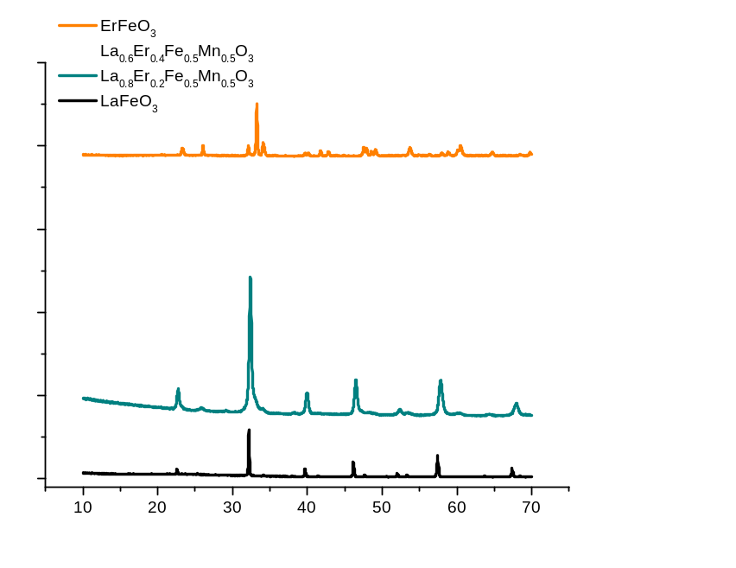
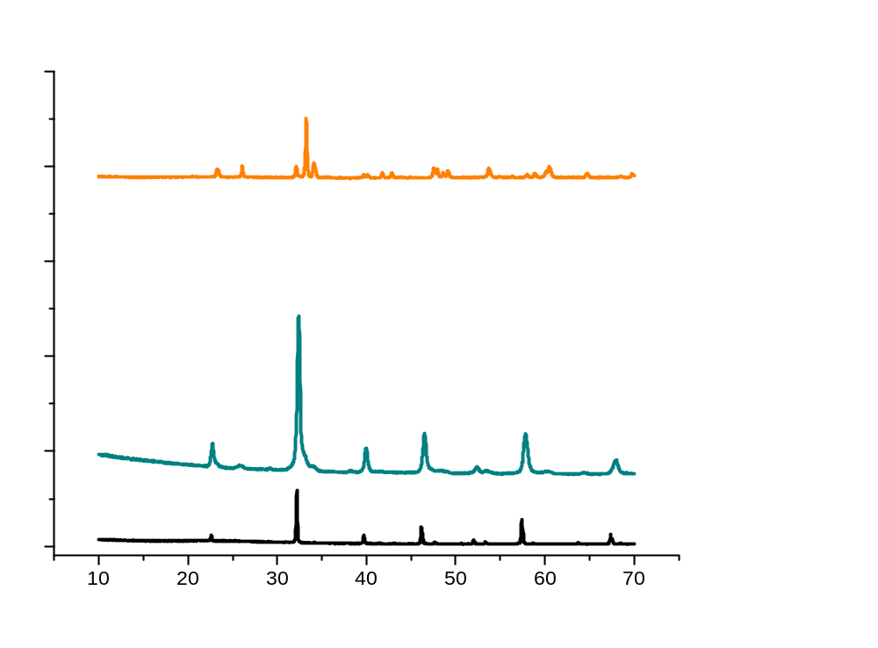

Results and discussions
PXRD
SEM with EDX
Element | Atomic %
O | 55.96667
La | 18.03
Mn | 10.73333
Fe | 11.40667
Er | 3.873333
Intensity / a.u
Table 1. EDX of La_{0.8}Er_{0.2}Mn_{0.5}Fe_{0.5}O₃
Figure 3. SEM picture of La_{0.8}Er_{0.2}Mn_{0.5}Fe_{0.5}O₃
Element | Atomic %
O | 54.24667
La | 14.33333
Mn | 10.95333
Fe | 12.38
Er | 8.09
Figure 2. XRD patterns of La_{1-x}Er_{x}Mn_{0.5}Fe_{0.5}O₃
Table 2. EDX of La_{0.6}Er_{0.4}Mn_{0.5}Fe_{0.5}O₃
Figure 4. SEM picture of La_{0.6}Er_{0.4}Mn_{0.5}Fe_{0.5}O₃

Slide 4

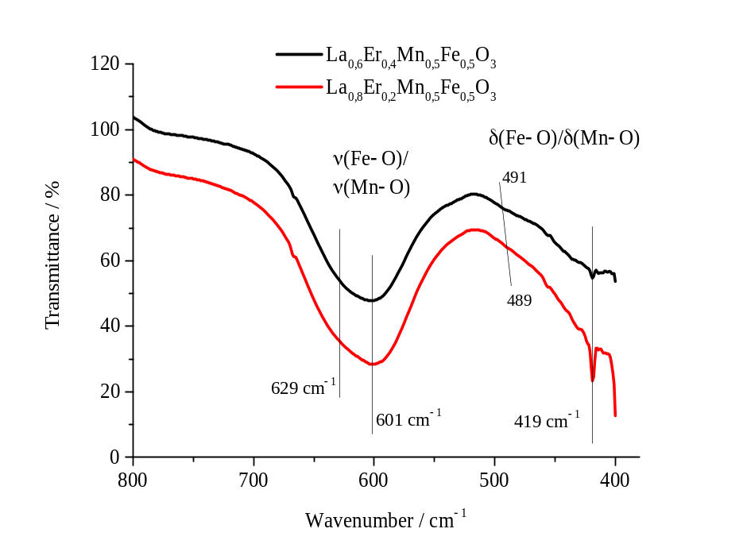
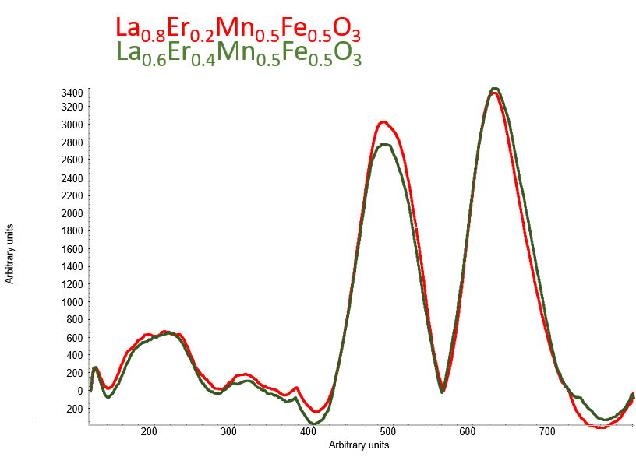

Results and discussions
Raman spectroscopy
FTIR
Figure 5. Raman spectra of
La_{1-x}Er_{x}Mn_{0.5}Fe_{0.5}O₃
Figure 6. Mid-IR spectra of La_{1-x}Er_{x}Mn_{0.5}Fe_{0.5}O₃ recorded at room temperature using a spectrum of pure KBr as the background spectrum
Figure 7. Far-IR spectra of La_{1-x}Er_{x}Mn_{0.5}Fe_{0.5}O₃ recorded at room temperature using a spectrum of pure PE as the background spectrum

Slide 5
Conclusions
The studied compounds are new and have not been examined yet. The sol-gel combustion method was shown to be an appropriate method for the synthesis of this type of compound. The XRD patterns confirmed the purity and crystallinity of the obtained powders and implied that
La_{1-x}Er_{x}Mn_{0.5}Mn_{0.5}O₃ are probably cubic. Comparing the recorded XRD patterns with those of the pristine La/Er perovskites indicated that the partial substitution was successful. The IR spectra showed characteristic metal-oxygen stretching and bending modes. The observed Raman spectra suggest the presence of local structural disorder and distortion of the (Mn,Fe)O₆ octahedra, due to the Jahn-Teller activity of Mn³⁺ ions. The provided SEM pictures show that the perovskites consist of nanoparticles with significant porosity between them. EDX analysis indicates that the elemental proportions are close to the target values.
Acknowledgement
Part of the experimental research (SEM with EDX and Raman) presented here was conducted at the BioNanoTech Centre, Faculty of Chemistry, University of Białystok in Białystok, Poland, during an Erasmus+ student mobility.

