Slide 1
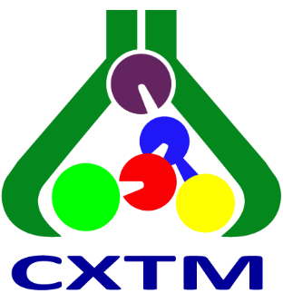
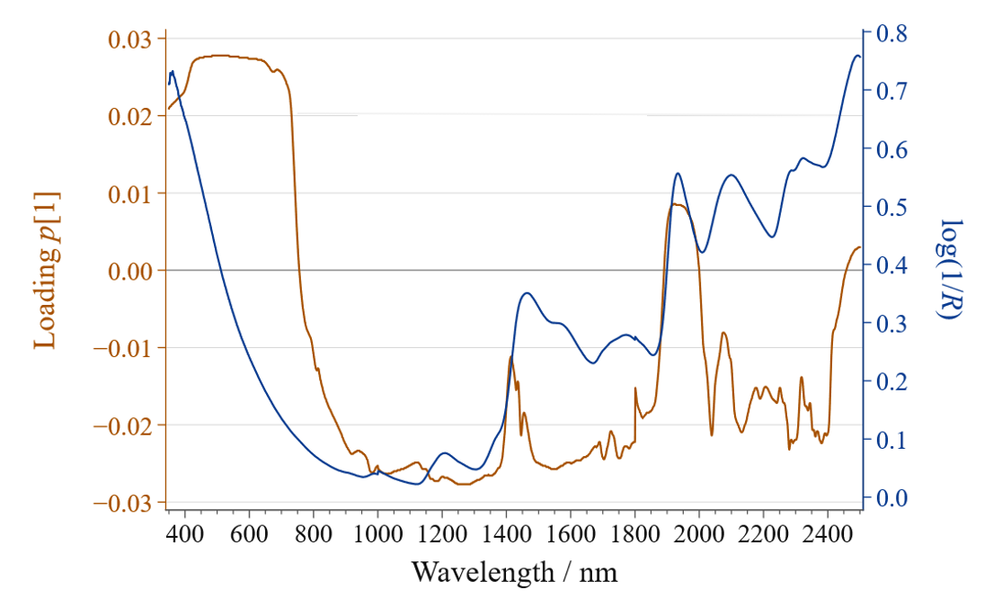
28th Congress of SCTM, 23-26 September, Ohrid, Macedonia
P18
Rapid authentication of salep in commercial products using
VIS-NIR spectroscopy coupled with statistical methods
Kosta Najkov¹*, Jovana Manikj¹, Veronika Gjorgjievska Stoilkovska², Gjoshe Stefkov², Olga Gigopulu², Nikola Geskovski², Petre Makreski¹*
¹Ss. Cyril and Methodius University in Skopje, Faculty of Natural Sciences and Mathematics, Institute of Chemistry, Skopje, N. Macedonia
²Ss. Cyril and Methodius University in Skopje, Faculty of Pharmacy, Skopje, N. Macedonia
Introduction & Aim
Salep powder is a high-value food ingredient that has been claimed to offer a number of health benefits. However, commercial salep mixtures are frequently adulterated with cheaper sugars and starches, yet methods for verifying their authenticity remain scarce. This work demonstrates that VIS–NIR spectroscopy with principal component analysis (PCA) following standard normal variate (SNV) correction can be utilized for this purpose.
Theoretical model built on a variety of different commercially available food–grade salep mixtures, each one spiked with pure salep powder from 0 % up to 50 % addition
Portable and rapid NIR spectrometer, ASD FieldSpec4 Hi-Res NG (Malvern Instruments, UK) using Muglight accessory
Experimental
Results and discussion
NIR band centered near 1850–1900 nm corresponding to the O–H stretching + bending combination band
Flagged three commercial products as containing low levels or no detectable genuine salep
Model provided successful discrimination of salep-specific spectral features rather than the features arising from starches and other components in real, ready-to-use, salep mixtures
Conclusions

