Slide 1

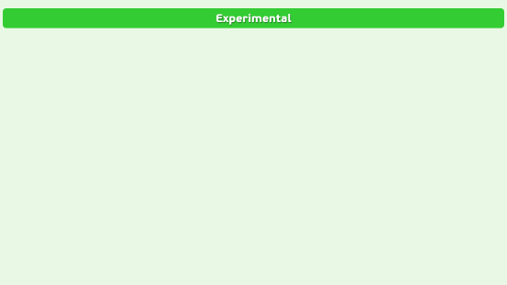
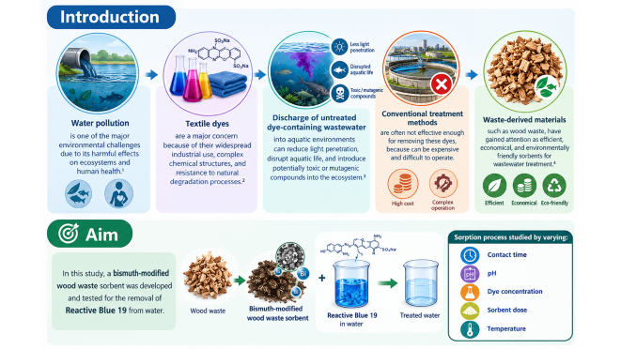
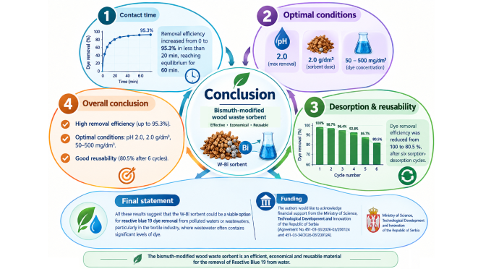
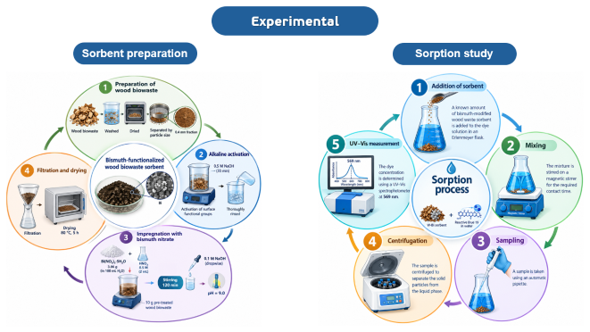
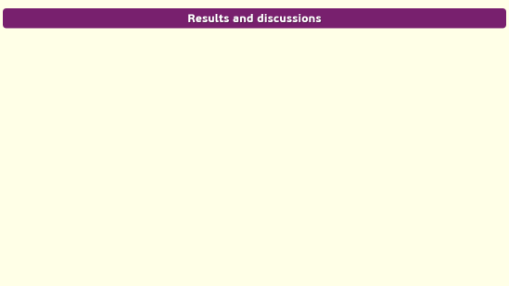
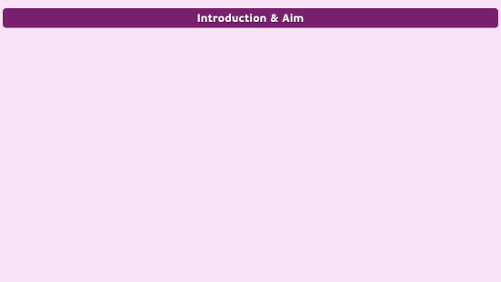
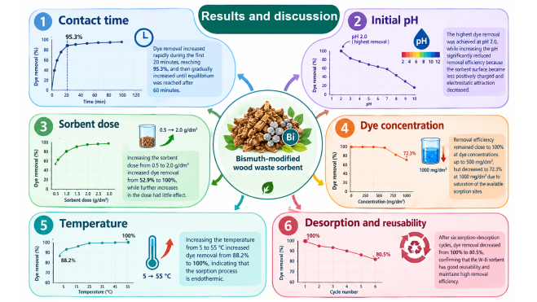
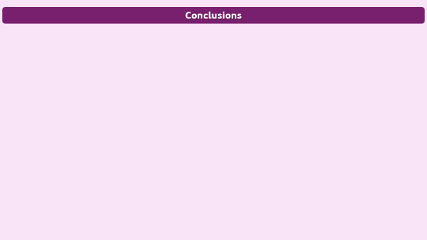
28th Congress of SCTM, 23-26 September, Ohrid, Macedonia
CE-P4
Bismuth-Modified Wood Waste as a Sustainable Sorbent for Reactive Blue 19 Removal
Nena Velinov Georgiev, Miloš Kostić, Miljana Radović Vučić, Slobodan Najdanović, Milan Momčilović, Jelena Mitrović, Aleksandar Bojić
University of Niš, Faculty of Sciences and Mathematics, Department of Chemistry, Višegradska 33, Niš, Republic of Serbia, e-mail: nena.velinov@yahoo.com, nena.velinov@pmf.edu.rs

Slide 2
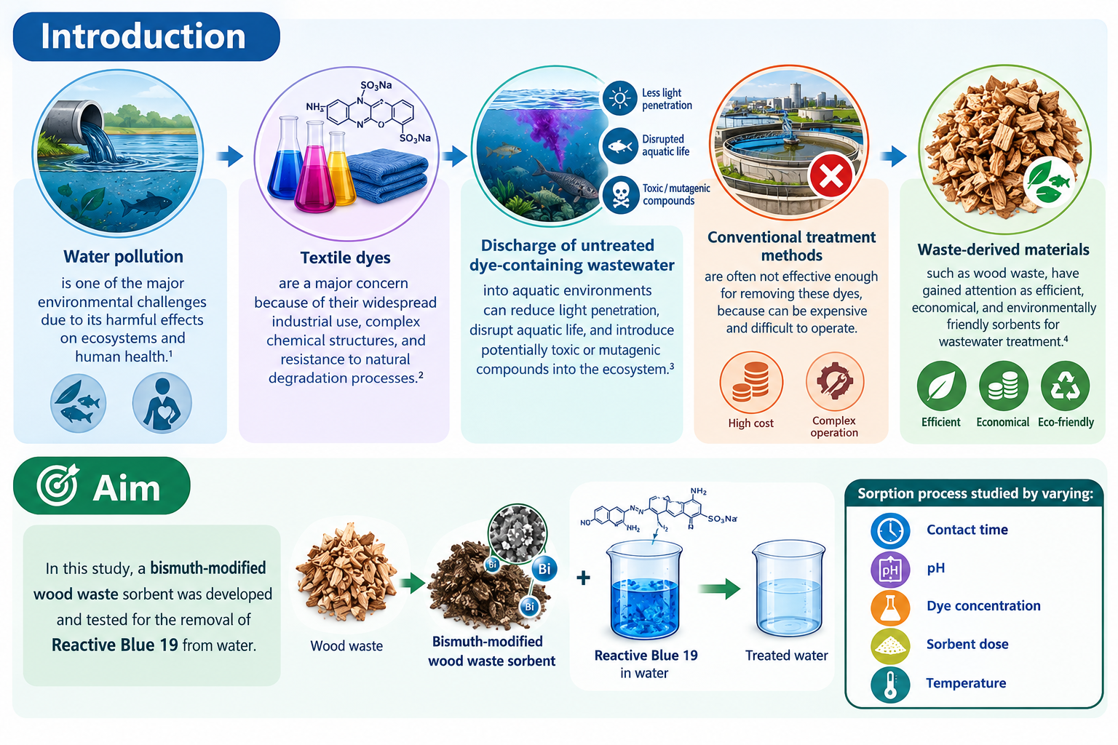

Slide 3
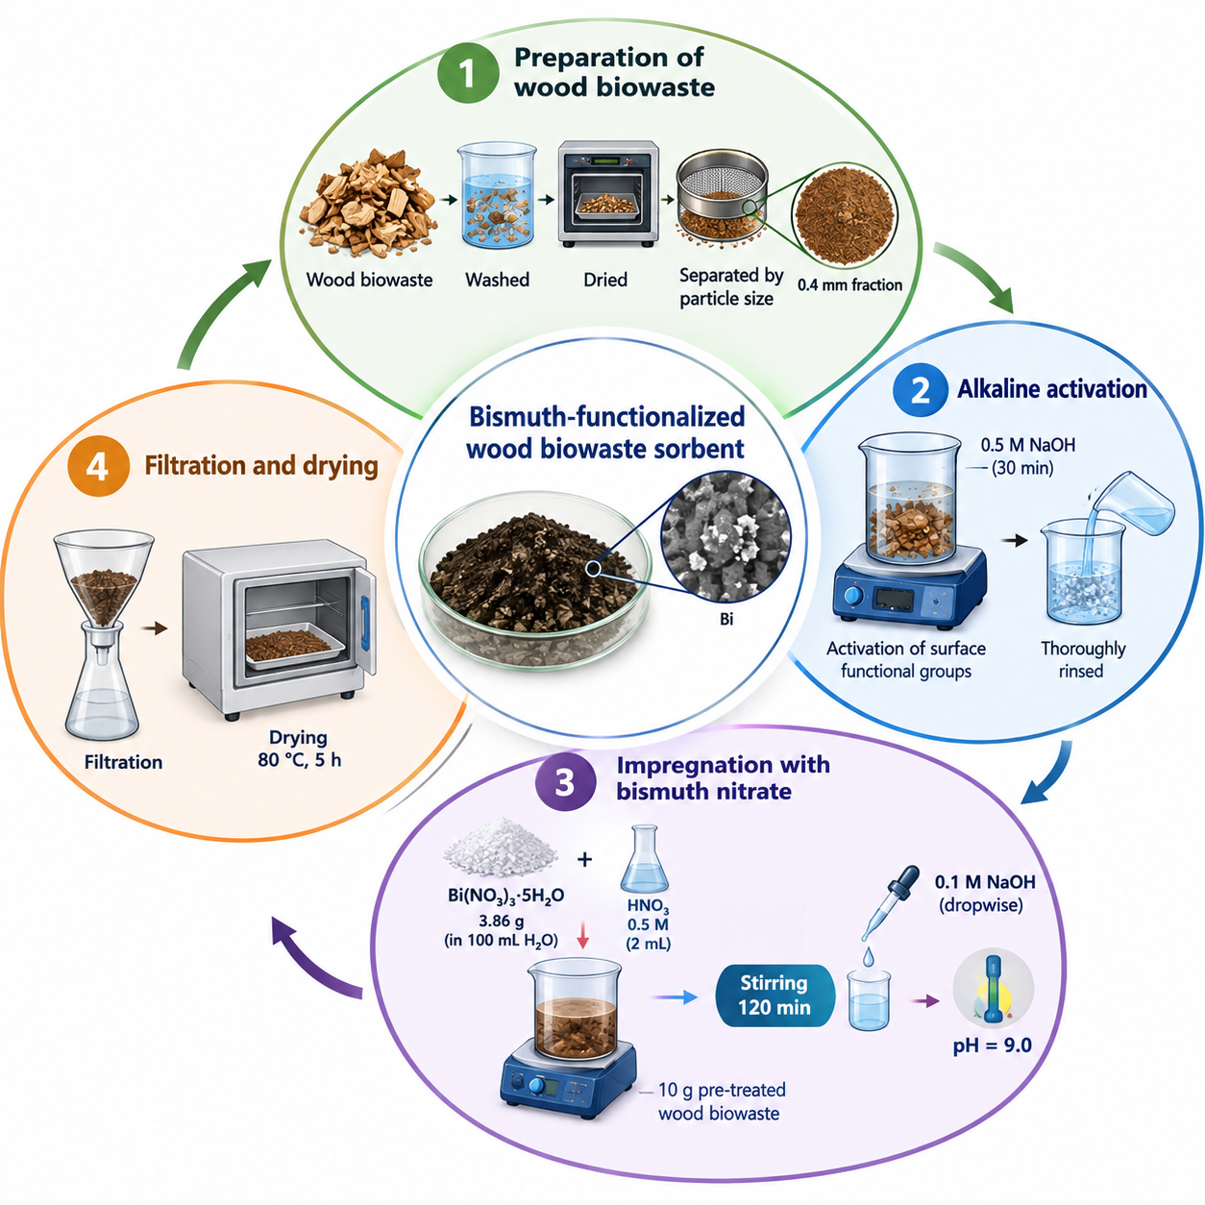
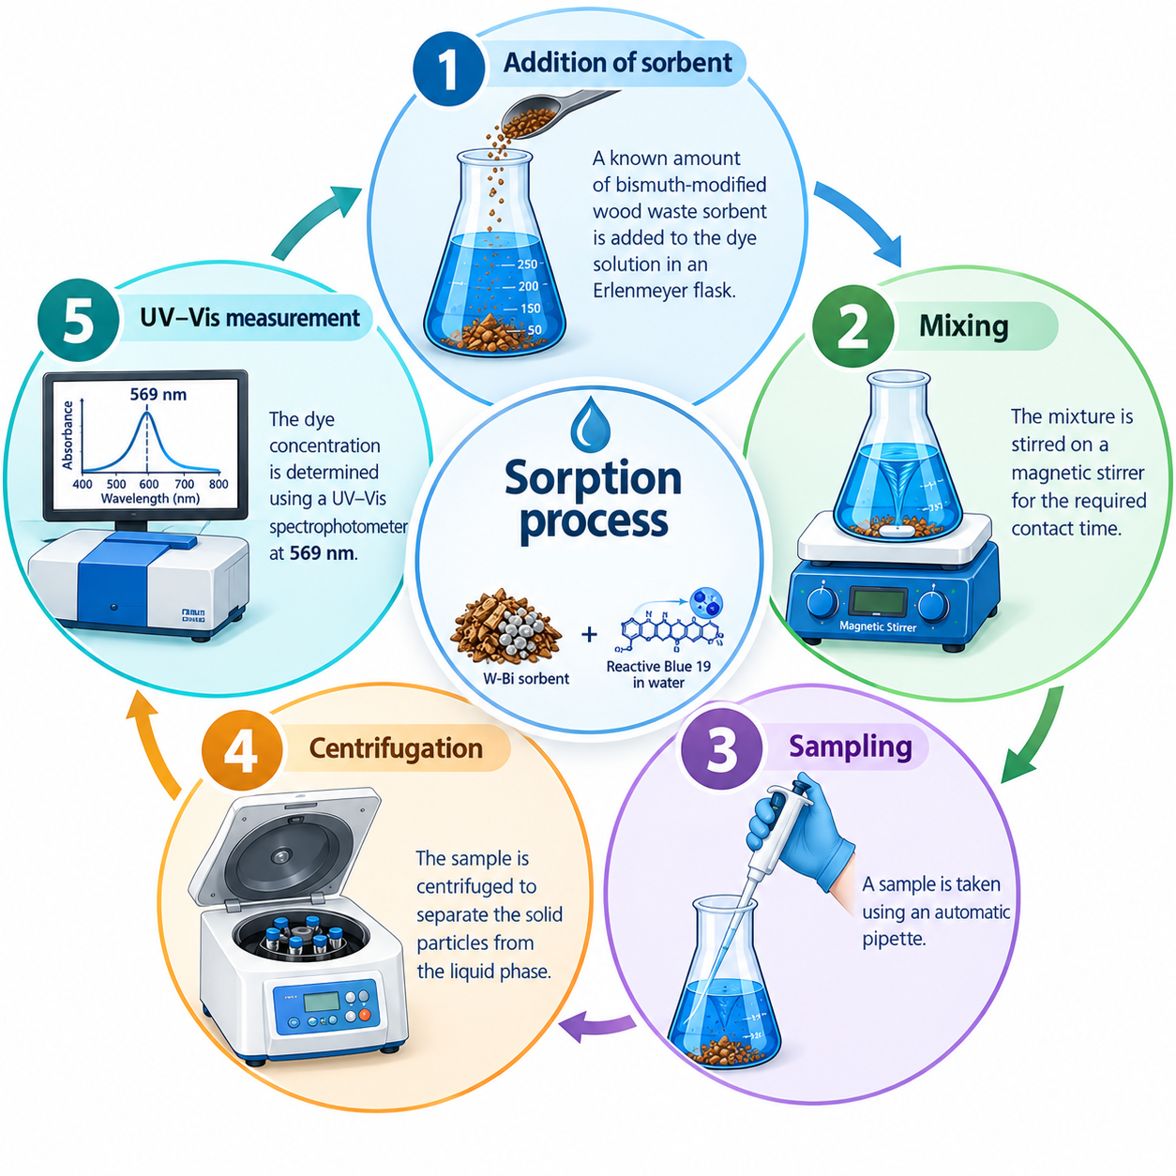
Experimental
Sorbent preparation
Sorption study

Slide 4
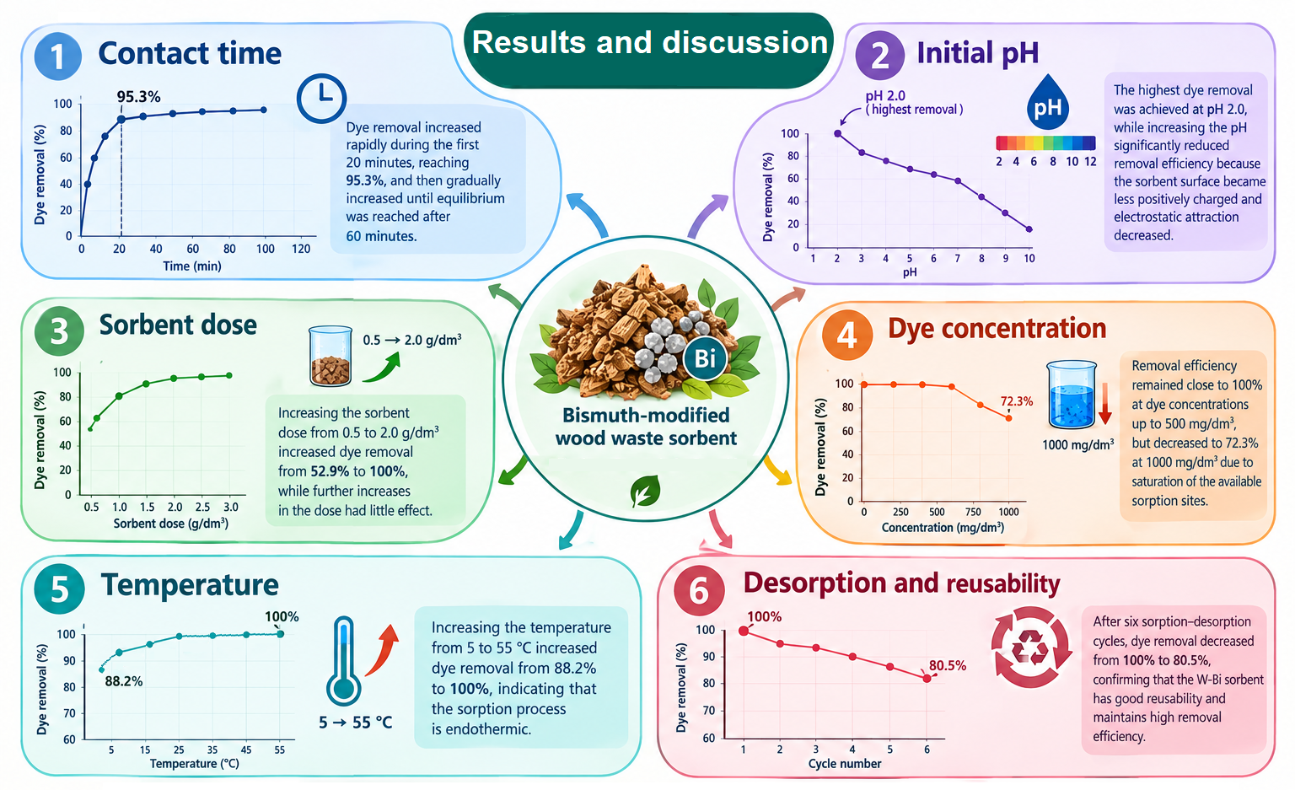

Slide 5
