Slide 1

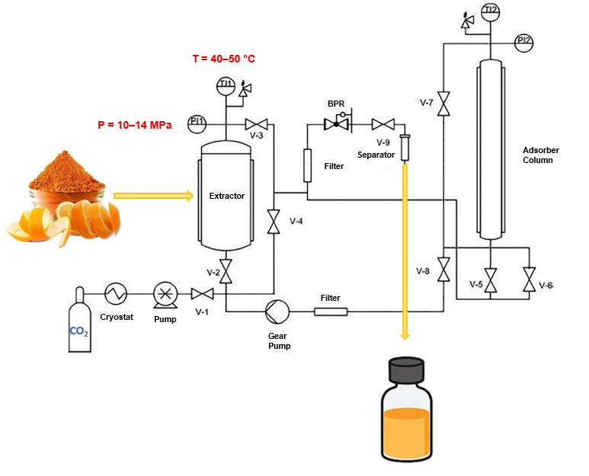



28th Congress of SCTM, 23-26 September, Ohrid, Macedonia
000
SUSTAINABLE VALORIZATION OF ORANGE PEEL WASTE BY SUPERCRITICAL CO₂ EXTRACTION: GC–MS AND RAMAN SPECTROSCOPIC CHARACTERIZATION
Mina Volić Ollier¹, Jovana Ilić Pajić², Nataša Obradović³
¹University of Belgrade, Innovation Centre of the Faculty of Technology and Metallurgy (e-mail: mvolic@tmf.bg.ac.rs), ²Institute of Chemistry, Technology and Metallurgy, National Institute of the Republic of Serbia, ³University of Belgrade, Faculty of Technology and Metallurgy
Introduction & Aim
Orange peel is an abundant agro-industrial by-product rich in valuable essential oil, particularly D-limonene, but its full chemical and biological potential is often underutilized. Supercritical CO₂ extraction offers a sustainable, solvent-free approach for selective recovery of thermolabile terpenes, while Raman spectroscopy provides a rapid and non-destructive tool for extract characterization and quality control.
Experimental
Results and discussion
Raw material
orange peel agro-industrial waste
drying: 40 °C, 24 h
moisture: 1.21%
particle size: ~0.20 mm
The CO₂-extracted orange peel oil was dominated by D-limonene (92.7–96.7%), followed by β-pinene (1.20–1.69%), α-pinene (0.11–0.35%), sabinene (0.07–0.16%), and valencene (0.18–0.57%).
10 MPa / 40 °C
10MPOa
12 MPa / 40 °C
SFE conditions
Pressure: 10 / 12 / 14 MPa
Temperature: 40 / 45 / 50 °C
Extraction time: 1 h
CO₂ consumption: ~700 g
Raman spectroscopy confirmed the dominance of D-limonene and revealed process-dependent variations in the terpene composition.
12 MPa / 50 °C
Conclusions
Acknowledgement
Supercritical CO₂ extraction enabled solvent-free recovery of essential oil from orange peel waste. Extraction conditions strongly affected both the yield and chemical profile of the obtained extracts. Raman spectroscopy demonstrated its potential for rapid, non-destructive quality control and process optimization.
This work was supported by the Ministry of Science, Technological Development and Innovation of the Republic of Serbia and Western Balkans Innovation Voucher Programme.

