Slide 1
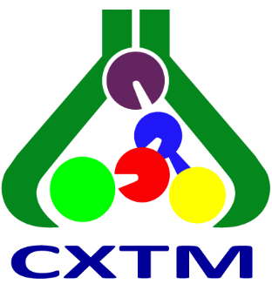
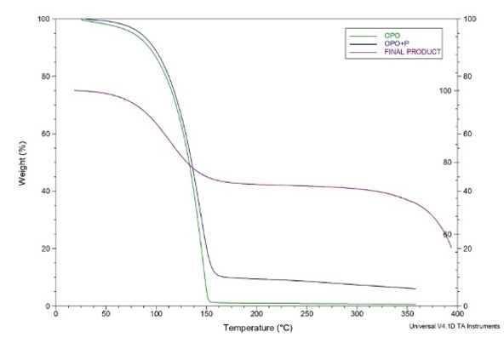
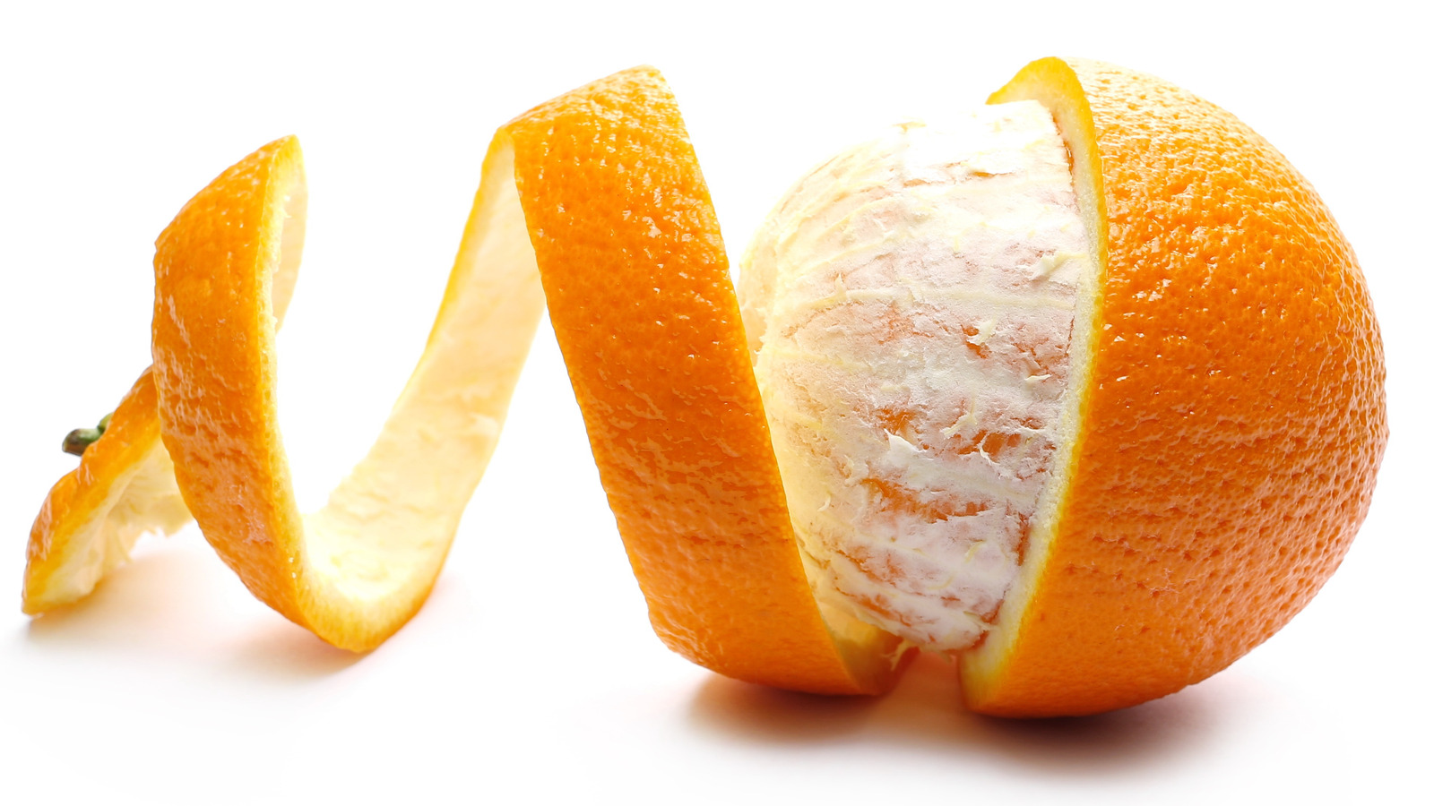
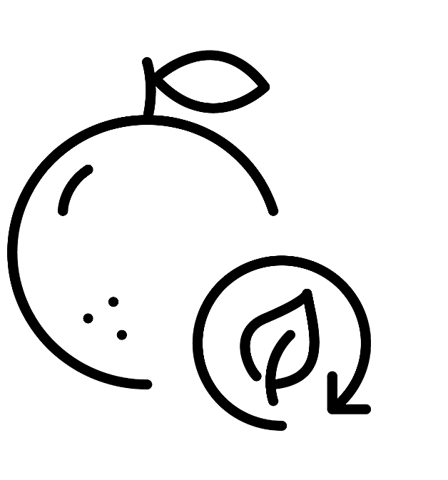
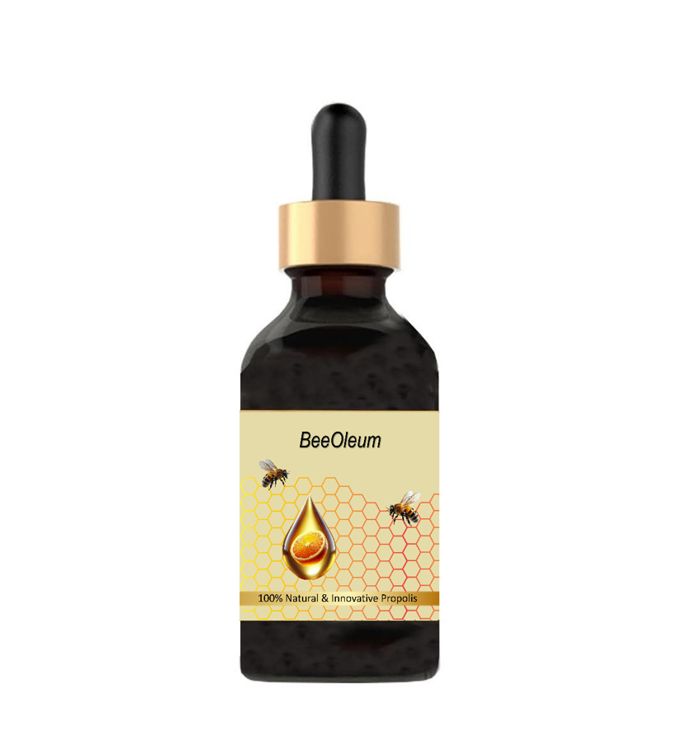



28th Congress of SCTM, 23-26 September, Ohrid, Macedonia
BFT-P3
ORANGE PEEL ESSENTIAL OIL AS A NATURAL SOLVENT FOR PROPOLIS: DEVELOPMENT AND CHARACTERIZATION OF AN OIL-BASED FORMULATION
Nataša Obradović¹, Jovana Ilić Pajić², Mina Volić Ollier³
¹University of Belgrade, Faculty of Technology and Metallurgy (e-mail: ntomovic@tmf.bg.ac.rs), ²Institute of Chemistry, Technology and Metallurgy, National Institute of the Republic of Serbia, ³University of Belgrade, Innovation Centre of the Faculty of Technology and Metallurgy
Introduction & Aim
Propolis is a natural source of bioactive compounds, but its conventional formulations are predominantly based on ethanol or other synthetic solvents, which limits their application in certain food and pharmaceutical products. This study aimed to develop and characterize a natural, alcohol-free oil formulation of propolis using orange peel essential oil as a functional terpene-rich solvent.
Experimental
Results and discussion
Orange peel, an agro-industrial by-product, was subjected to hydrodistillation to obtain essential oil, which was subsequently characterized.
The obtained orange peel oil was dominated by D-limonene (97.09%), accompanied by smaller amounts of β-pinene (1.69%), α-pinene (0.45%), sabinene (0.43%), and valencene (0.08%).
ORANGE PEEL
HYDRODISTILLATION
GC–MS, HPLC
PROPOLIS
Agro-industrial
by-product
Essential oil
Chemical
characterization
Dissolution in
orange peel oil
Selective antimicrobial activity of the formulations against Staphylococcus aureus and Candida albicans.
TGA analysis
Conclusions
Acknowledgement
The developed formulation offers a natural, alcohol-free way to incorporate propolis bioactive compounds into an oil-based system while valorising orange peel agro-industrial waste.
This work was supported by the Ministry of Science, Technological Development and Innovation of the Republic of Serbia and the Western Balkans Innovation Voucher Programme.

