Slide 1

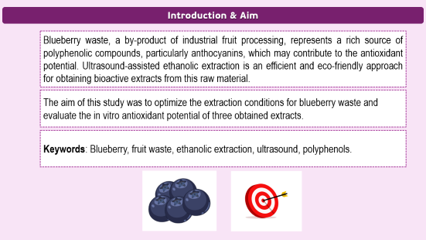
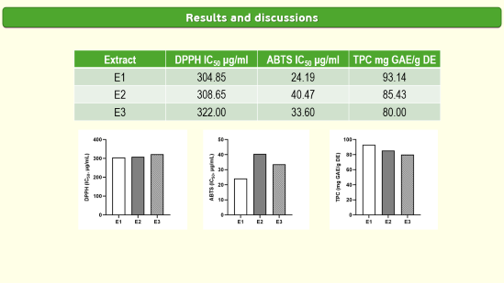
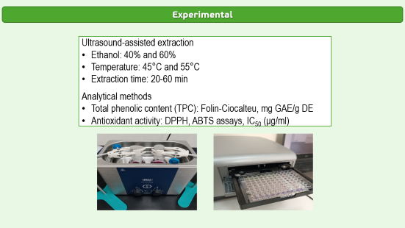
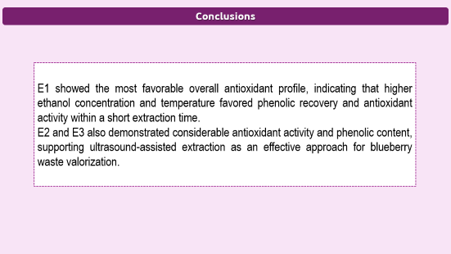
28th Congress of SCTM, 23-26 September, Ohrid, Macedonia
000
OPTIMIZATION OF ETHANOLIC EXTRACTION CONDITIONS FROM BLUEBERRY WASTE AND IN VITRO EVALUATION OF ANTIOXIDANT POTENTIAL
Djurdjina Petrovic¹, Aleksandar Kocovic^{1,2}, Jovana Bradic^{1,2}, Vladimir Jakovljevic^{1,3}, Aleksandra Stojanovic^{1,2}
¹ Center of Excellence for Redox Balance Research in Cardiovascular and Metabolic Disorders, Kragujevac, Serbia, djina.petrovic99@gmail.com, ² Department of Pharmacy, Faculty of Medical Sciences, University of Kragujevac, Kragujevac, Serbia, ³ Department of Physiology, Faculty of Medical Sciences, University of Kragujevac, Kragujevac, Serbia;

Slide 2
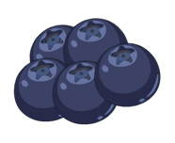

Introduction & Aim
Introduction & Aim
Blueberry waste, a by-product of industrial fruit processing, represents a rich source of polyphenolic compounds, particularly anthocyanins, which may contribute to the antioxidant potential. Ultrasound-assisted ethanolic extraction is an efficient and eco-friendly approach for obtaining bioactive extracts from this raw material.
The aim of this study was to optimize the extraction conditions for blueberry waste and evaluate the in vitro antioxidant potential of three obtained extracts.
Keywords: Blueberry, fruit waste, ethanolic extraction, ultrasound, polyphenols.

Slide 3
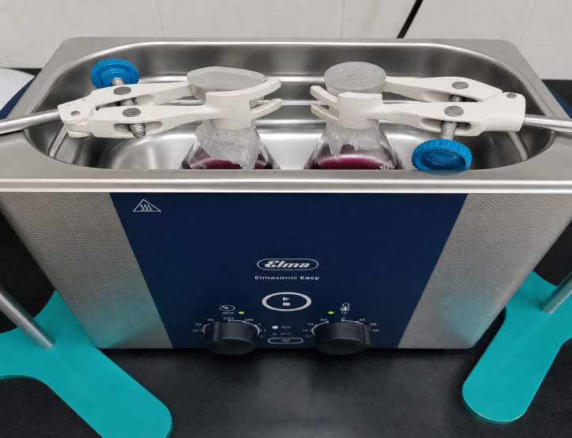
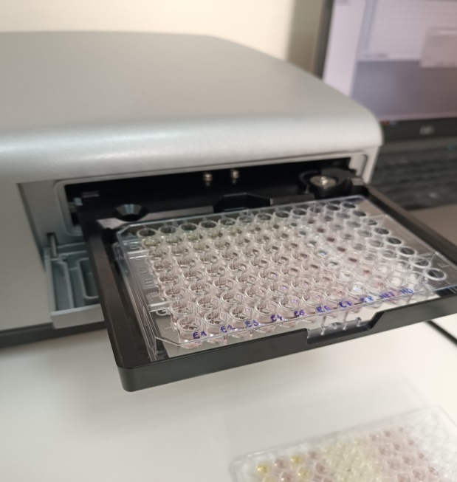
Experimental
Experimental
Ultrasound-assisted extraction
Ethanol: 40% and 60%
Temperature: 45°C and 55°C
Extraction time: 20-60 min
Analytical methods
Total phenolic content (TPC): Folin-Ciocalteu, mg GAE/g DE
Antioxidant activity: DPPH, ABTS assays, IC₅₀ (μg/ml)

Slide 4
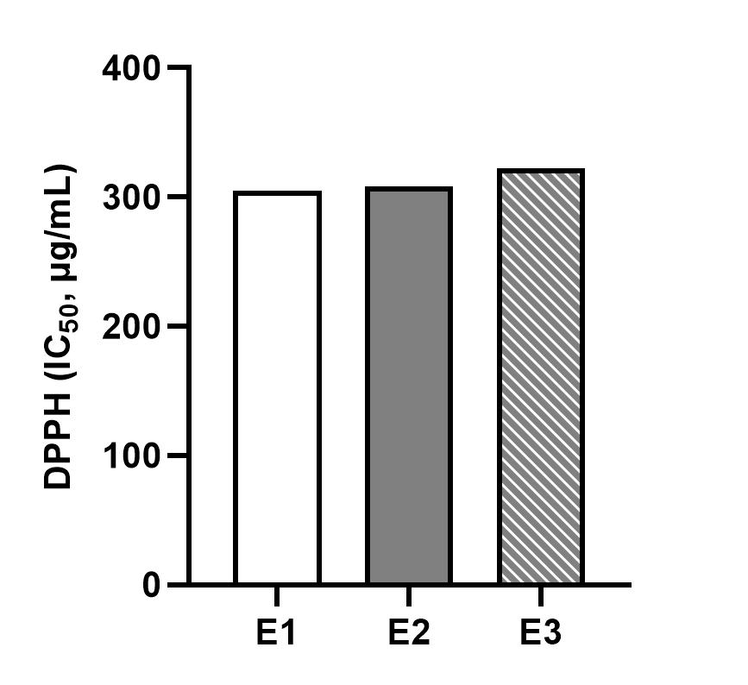
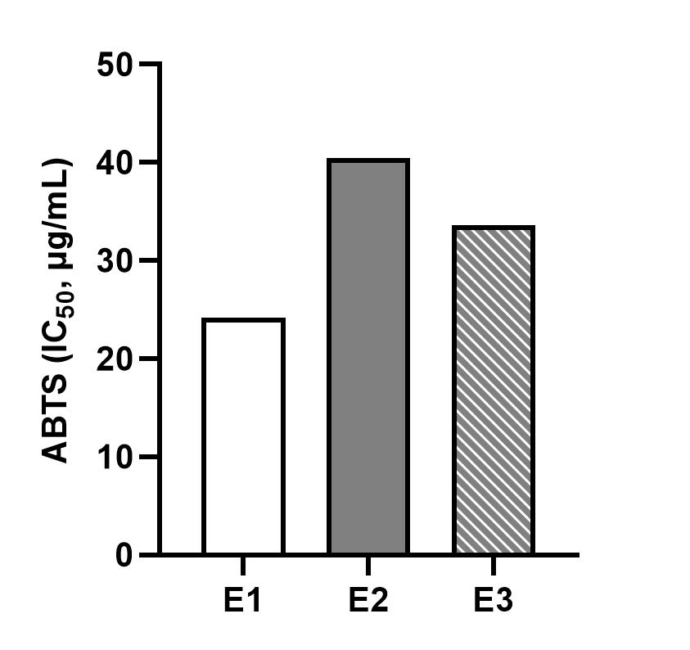
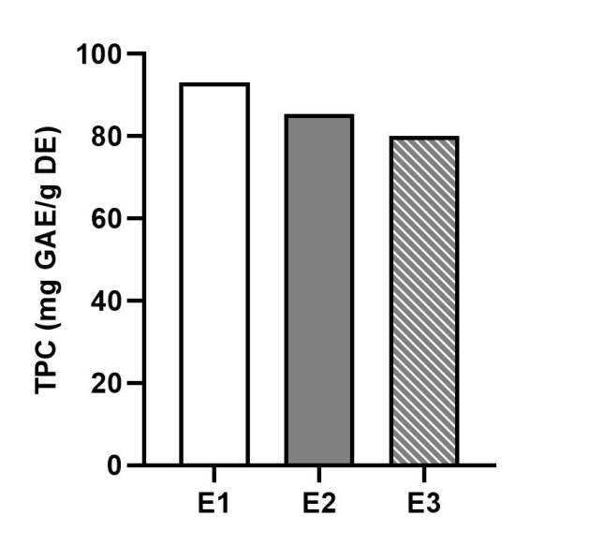
Results and discussions
Results and discussions
Extract | DPPH IC₅₀ μg/ml | ABTS IC₅₀ μg/ml | TPC mg GAE/g DE
E1 | 304.85 | 24.19 | 93.14
E2 | 308.65 | 40.47 | 85.43
E3 | 322.00 | 33.60 | 80.00

Slide 5
Conclusions
Conclusions
E1 showed the most favorable overall antioxidant profile, indicating that higher ethanol concentration and temperature favored phenolic recovery and antioxidant activity within a short extraction time.
E2 and E3 also demonstrated considerable antioxidant activity and phenolic content, supporting ultrasound-assisted extraction as an effective approach for blueberry waste valorization.

