Slide 1

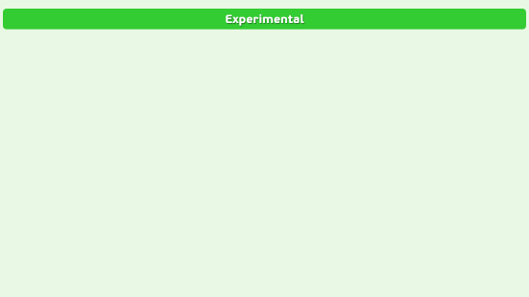
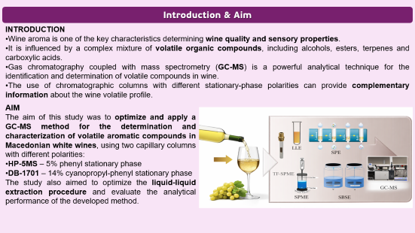
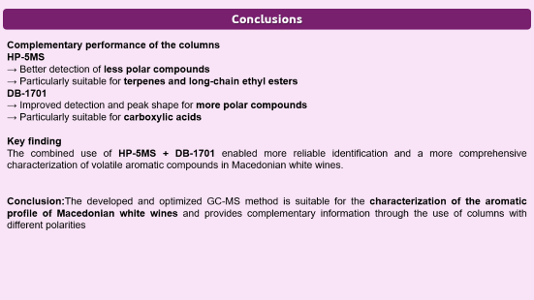
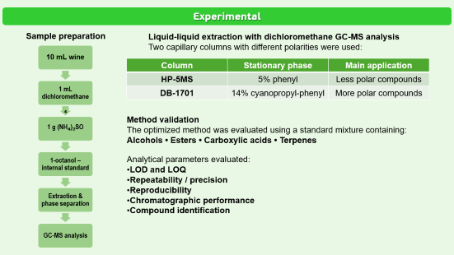

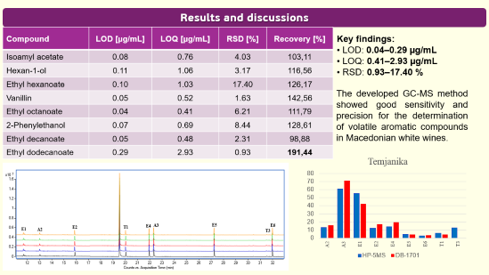
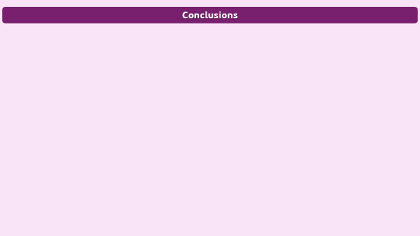
AEC-P3
28th Congress of SCTM, 23-26 September, Ohrid, Macedonia
Optimization and Application of a Method for Determining the Aromatic Profile of Macedonian White Wines Using Gas Chromatography Coupled with Mass Spectrometry
Hristina Trisheska^{1,2}, Marina Stefova²
¹Institute of Chemistry, Faculty of Natural Sciences and Mathematics, Ss. Cyril & Methodius, Skopje, Macedonia
²Farmahem, Skopje, Macedonia

Slide 2
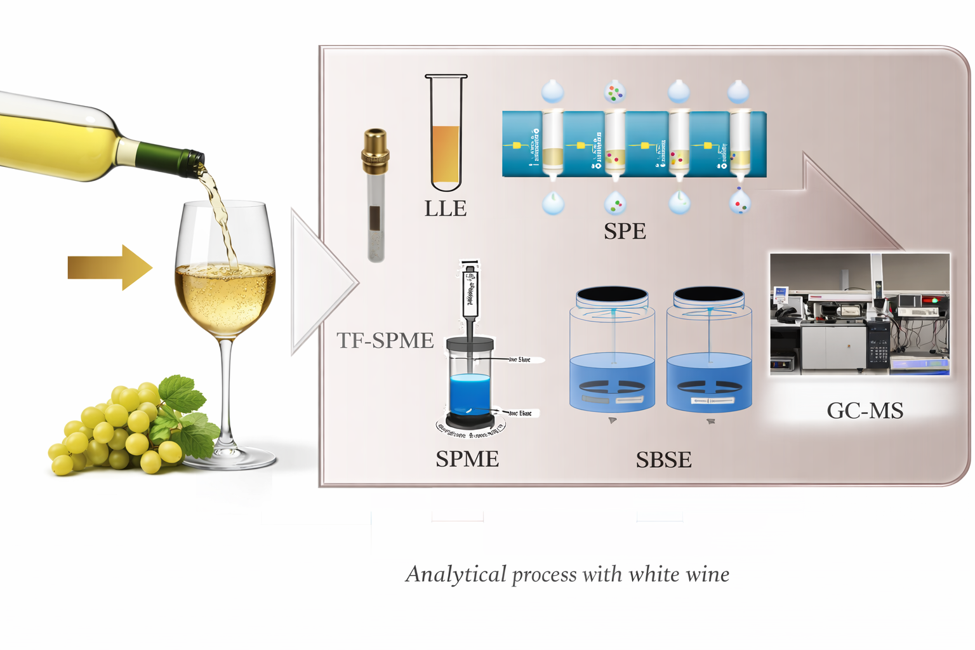
Introduction & Aim
INTRODUCTION
Wine aroma is one of the key characteristics determining wine quality and sensory properties.
It is influenced by a complex mixture of volatile organic compounds, including alcohols, esters, terpenes and carboxylic acids.
Gas chromatography coupled with mass spectrometry (GC-MS) is a powerful analytical technique for the identification and determination of volatile compounds in wine.
The use of chromatographic columns with different stationary-phase polarities can provide complementary information about the wine volatile profile.
AIM
The aim of this study was to optimize and apply a GC-MS method for the determination and characterization of volatile aromatic compounds in Macedonian white wines, using two capillary columns with different polarities:
HP-5MS – 5% phenyl stationary phase
DB-1701 – 14% cyanopropyl-phenyl stationary phase
The study also aimed to optimize the liquid-liquid extraction procedure and evaluate the analytical performance of the developed method.

Slide 3
Experimental
Sample preparation
Liquid-liquid extraction with dichloromethane GC-MS analysis
Two capillary columns with different polarities were used:
10 mL wine
1 mL dichloromethane
₄
1 g (NH₄)₂SO
1-octanol – internal standard
Extraction & phase separation
GC-MS analysis
Column | Stationary phase | Main application
HP-5MS | 5% phenyl | Less polar compounds
DB-1701 | 14% cyanopropyl-phenyl | More polar compounds
Method validation
The optimized method was evaluated using a standard mixture containing:
Alcohols • Esters • Carboxylic acids • Terpenes
Analytical parameters evaluated:
LOD and LOQ
Repeatability / precision
Reproducibility
Chromatographic performance
Compound identification

Slide 4
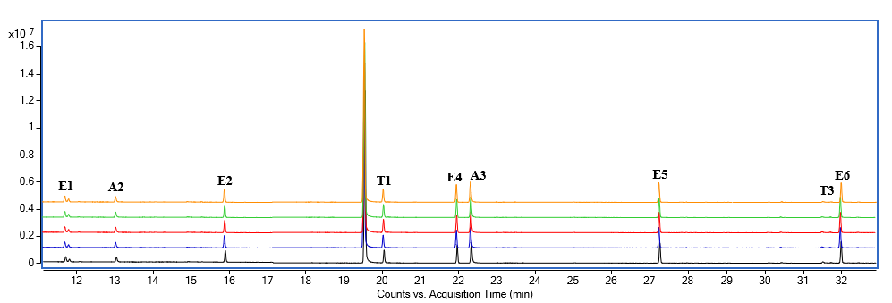
Results and discussions
Compound | LOD [µg/mL] | LOQ [µg/mL] | RSD [%] | Recovery [%]
Isoamyl acetate | 0.08 | 0.76 | 4.03 | 103,11
Hexan-1-ol | 0.11 | 1.06 | 3.17 | 116,56
Ethyl hexanoate | 0.10 | 1.03 | 17.40 | 126,17
Vanillin | 0.05 | 0.52 | 1.63 | 142,56
Ethyl octanoate | 0.04 | 0.41 | 6.21 | 111,79
2-Phenylethanol | 0.07 | 0.69 | 8.44 | 128,61
Ethyl decanoate | 0.05 | 0.48 | 2.31 | 98,88
Ethyl dodecanoate | 0.29 | 2.93 | 0.93 | 191,44
.
Key findings:
LOD: 0.04–0.29 µg/mL
LOQ: 0.41–2.93 µg/mL
RSD: 0.93–17.40 %
The developed GC-MS method showed good sensitivity and precision for the determination of volatile aromatic compounds in Macedonian white wines.

Slide 5
Conclusions
Complementary performance of the columns
Key finding
The combined use of HP-5MS and DB-1701 enabled more reliable identification and a more comprehensive characterization of volatile aromatic compounds in Macedonian white wines.
Conclusion:The developed and optimized GC-MS method is suitable for the characterization of the aromatic profile of Macedonian white wines and provides complementary information through the use of columns with different polarities
HP-5MS | DB-1701
Better detection of less polar compounds | Improved detection and peak shape for more polar compounds
Particularly suitable for terpenes and long-chain ethyl esters | Particularly suitable for carboxylic acids

