Slide 1

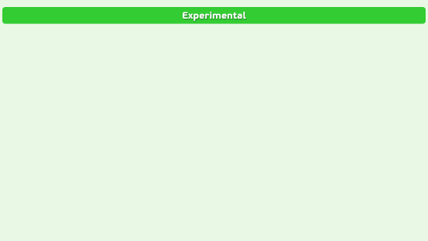
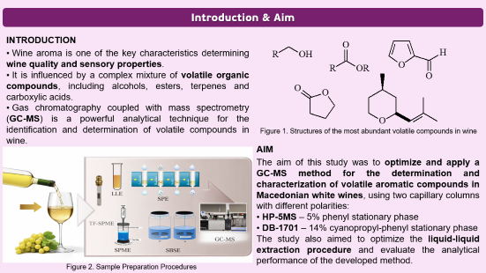
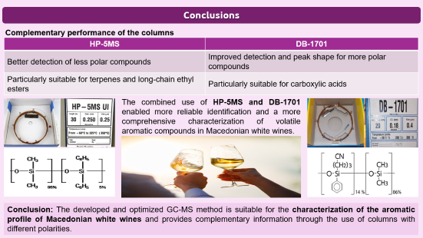
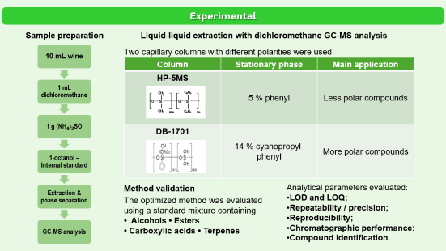
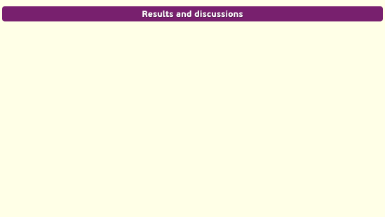
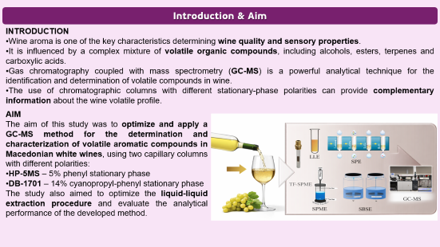
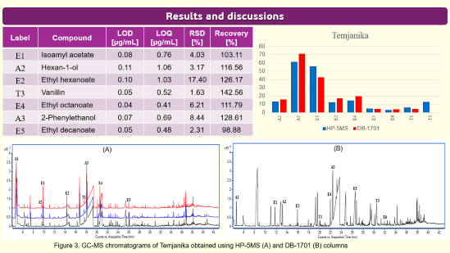
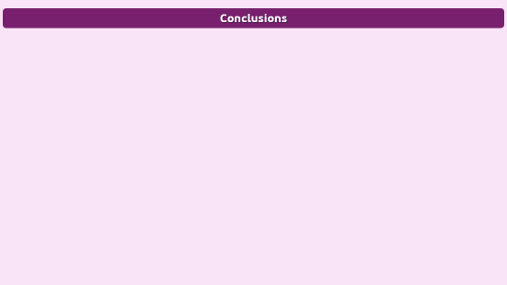
AEC-P3
28th Congress of SCTM, 23-26 September, Ohrid, Macedonia
Optimization and Application of a Method for Determining the Aromatic Profile of Macedonian White Wines Using Gas Chromatography Coupled with Mass Spectrometry
Hristina Trisheska^{1,2}, Marina Stefova²
¹Institute of Chemistry, Faculty of Natural Sciences and Mathematics, Ss. Cyril & Methodius, Skopje, Macedonia
²Farmahem, Skopje, Macedonia

Slide 2
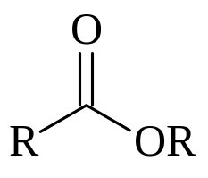
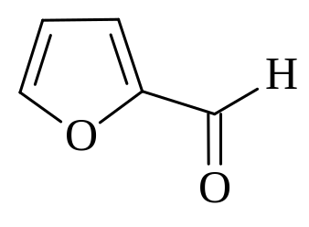

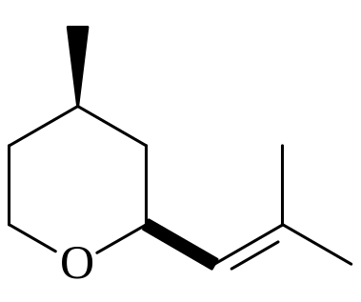
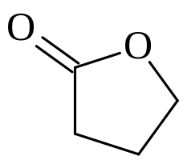
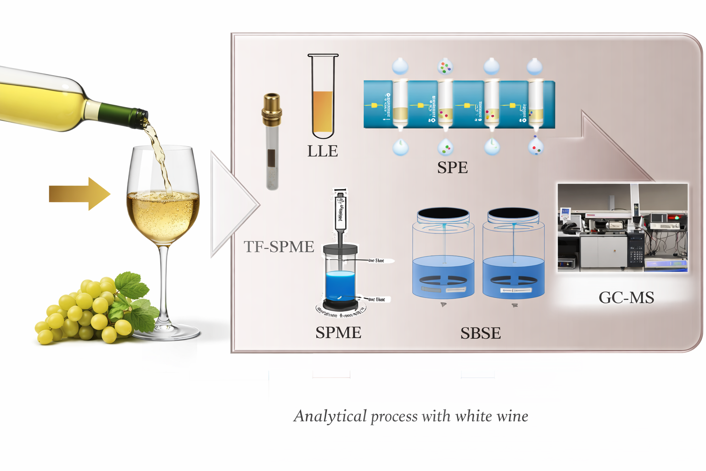
Introduction & Aim
INTRODUCTION
Wine aroma is one of the key characteristics determining wine quality and sensory properties.
It is influenced by a complex mixture of volatile organic compounds, including alcohols, esters, terpenes and carboxylic acids.
Gas chromatography coupled with mass spectrometry (GC-MS) is a powerful analytical technique for the identification and determination of volatile compounds in wine.
Figure 1. Structures of the most abundant volatile compounds in wine
AIM
The aim of this study was to optimize and apply a GC-MS method for the determination and characterization of volatile aromatic compounds in Macedonian white wines, using two capillary columns with different polarities:
HP-5MS – 5% phenyl stationary phase
DB-1701 – 14% cyanopropyl-phenyl stationary phase
The study also aimed to optimize the liquid-liquid extraction procedure and evaluate the analytical performance of the developed method.
Figure 2. Sample Preparation Procedures
Notes:
Wine aroma is very important for the quality and taste of wine, which contains many different volatile compounds, such as alcohols, esters, terpenes and acids.
To identify and measure these compounds, we used GC-MS, which is a useful technique for the analysis of volatile compounds in wine. The aim of this study was to develop and use a GC-MS method for the analysis of aroma compounds in Macedonian white wines.
We used and compared two different GC columns with different polarity HP-5MS and DB-1701.
We also worked on the extraction procedure and checked the performance of the method.

Slide 3
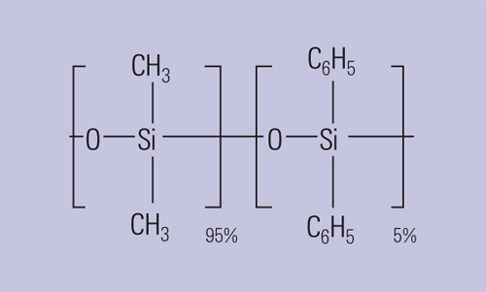
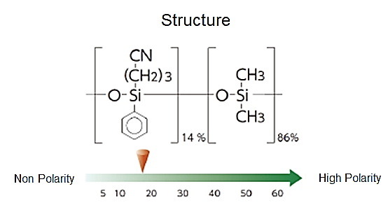
Experimental
Sample preparation
Liquid-liquid extraction with dichloromethane GC-MS analysis
10 mL wine
1 mL dichloromethane
1 g (NH₄)₂SO
1-octanol – internal standard
Extraction & phase separation
GC-MS analysis
Two capillary columns with different polarities were used:
Column | Stationary phase | Main application
HP-5MS | 5 % phenyl | Less polar compounds
DB-1701 | 14 % cyanopropyl-phenyl | More polar compounds
Method validation
The optimized method was evaluated using a standard mixture containing:
• Alcohols • Esters
• Carboxylic acids • Terpenes
Analytical parameters evaluated:
LOD and LOQ;
Repeatability / precision;
Reproducibility;
Chromatographic performance;
Compound identification.
Notes:
For the extraction, we used 10 milliliters of wine.
We added dichloromethane, ammonium sulfate, and 1-octanol as an internal standard.
After extraction and separation of the phases, the samples were analyzed by GC-MS using both columns.
We evaluated the method for sensitivity, precision, reproducibility, chromatographic performance, and compound identification.

Slide 4
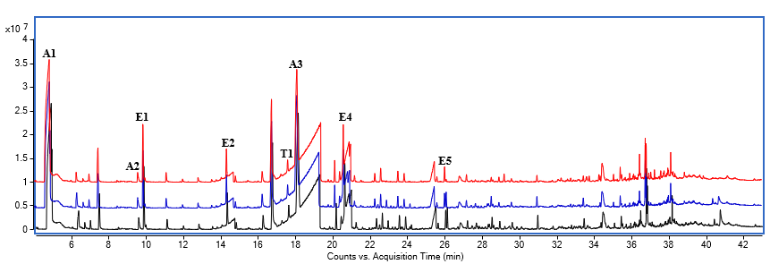
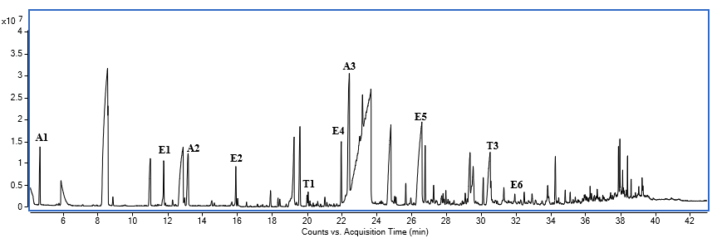
Results and discussions
Label | Compound | LOD [µg/mL] | LOQ [µg/mL] | RSD [%] | Recovery [%]
Е1 | Isoamyl acetate | 0.08 | 0.76 | 4.03 | 103.11
А2 | Hexan-1-ol | 0.11 | 1.06 | 3.17 | 116.56
Е2 | Ethyl hexanoate | 0.10 | 1.03 | 17.40 | 126.17
Т3 | Vanillin | 0.05 | 0.52 | 1.63 | 142.56
Е4 | Ethyl octanoate | 0.04 | 0.41 | 6.21 | 111.79
А3 | 2-Phenylethanol | 0.07 | 0.69 | 8.44 | 128.61
Е5 | Ethyl decanoate | 0.05 | 0.48 | 2.31 | 98.88
.
(A)
(B)
Figure 3. GC-MS chromatograms of Temjanika obtained using HP-5MS (A) and DB-1701 (B) columns
Notes:
We analyzed several important aroma compounds, including isoamyl acetate, hexan-1-ol, ethyl hexanoate, vanillin, ethyl octanoate and 2-phenylethanol.
An important result was the difference between the two columns.
The HP-5MS was more suitable for less polar compounds. It was especially useful for terpenes and long-chain ethyl esters.
The DB-1701 was more suitable for more polar compounds and gave better peak shape for some of these compounds, especially carboxylic acids.
So, the two columns gave different but complementary information about the wine aroma. Here, you can see the main validation parameters: LOD, LOQ, recovery, and RSD. The developed GC-MS method provided good sensitivity and precision.

Slide 5
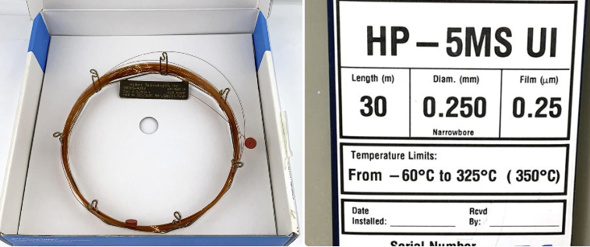
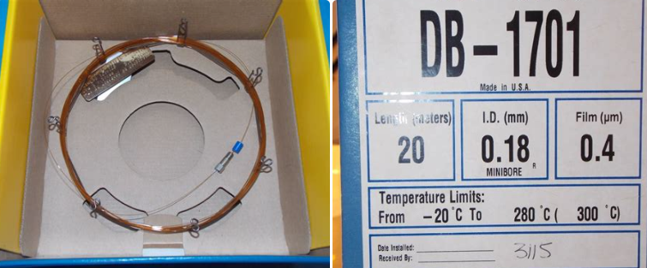

Conclusions
Complementary performance of the columns
HP-5MS | DB-1701
Better detection of less polar compounds | Improved detection and peak shape for more polar compounds
Particularly suitable for terpenes and long-chain ethyl esters | Particularly suitable for carboxylic acids
The combined use of HP-5MS and DB-1701 enabled more reliable identification and a more comprehensive characterization of volatile aromatic compounds in Macedonian white wines.
Conclusion: The developed and optimized GC-MS method is suitable for the characterization of the aromatic profile of Macedonian white wines and provides complementary information through the use of columns with different polarities.
Notes:
To conclude, the GC-MS method was successfully used for the analysis of volatile aroma compounds in Macedonian white wines.
The results provided that the choice of the column is very important. Using both columns therefore provides a more comprehensive characterization of the aroma compounds in wine.

