Slide 1


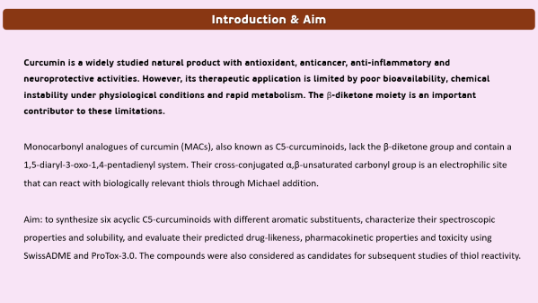
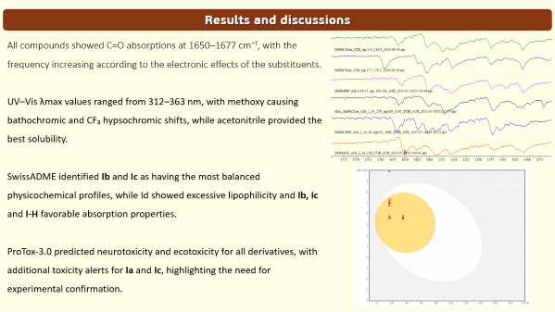
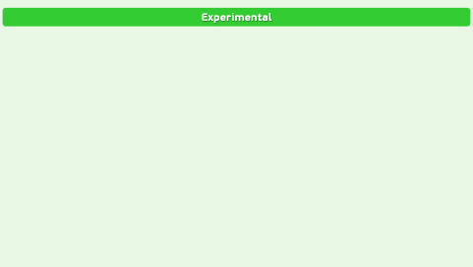
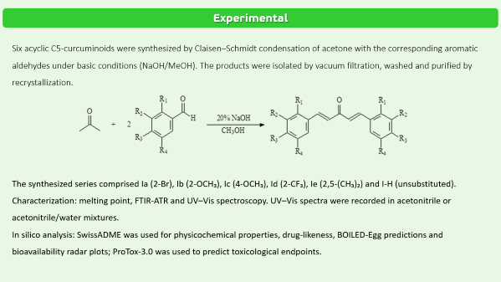


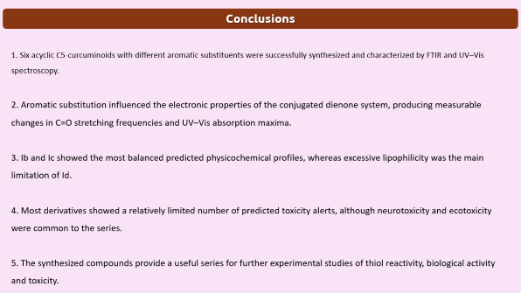
28th Congress of SCTM, 23-26 September, Ohrid, Macedonia
SYNTHESIS, COMPARISON OF SPECTROSCOPIC PROPERTIES AND IN SILICO ANALYSIS OF SOME ACYCLIC DERIVATIVES OF C5-CURCUMINOIDS
Arjan Ganiji, Milena Kolevska, Jane Bogdanov
Institute of Chemistry, Faculty of Natural Sciences and Mathematics, Ss. Cyril and Methodius University, Arhimedova 5, 1000 Skopje, R. N. Macedonia

Slide 2
Introduction & Aim
Curcumin is a widely studied natural product with antioxidant, anticancer, anti-inflammatory and neuroprotective activities. However, its therapeutic application is limited by poor bioavailability, chemical instability under physiological conditions and rapid metabolism. The β-diketone moiety is an important contributor to these limitations.
Monocarbonyl analogues of curcumin (MACs), also known as C5-curcuminoids, lack the β-diketone group and contain a 1,5-diaryl-3-oxo-1,4-pentadienyl system. Their cross-conjugated α,β-unsaturated carbonyl group is an electrophilic site that can react with biologically relevant thiols through Michael addition.
Aim: to synthesize six acyclic C5-curcuminoids with different aromatic substituents, characterize their spectroscopic properties and solubility, and evaluate their predicted drug-likeness, pharmacokinetic properties and toxicity using SwissADME and ProTox-3.0. The compounds were also considered as candidates for subsequent studies of thiol reactivity.

Slide 3
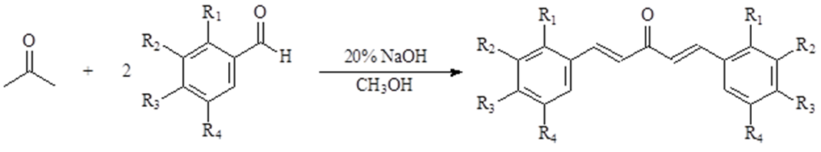
Experimental
Six acyclic C5-curcuminoids were synthesized by Claisen–Schmidt condensation of acetone with the corresponding aromatic aldehydes under basic conditions (NaOH/MeOH). The products were isolated by vacuum filtration, washed and purified by recrystallization.
The synthesized series comprised Ia (2-Br), Ib (2-OCH₃), Ic (4-OCH₃), Id (2-CF₃), Ie (2,5-(CH₃)₂) and I-H (unsubstituted).
Characterization: melting point, FTIR-ATR and UV–Vis spectroscopy. UV–Vis spectra were recorded in acetonitrile or acetonitrile/water mixtures.
In silico analysis: SwissADME was used for physicochemical properties, drug-likeness, BOILED-Egg predictions and bioavailability radar plots; ProTox-3.0 was used to predict toxicological endpoints.

Slide 4
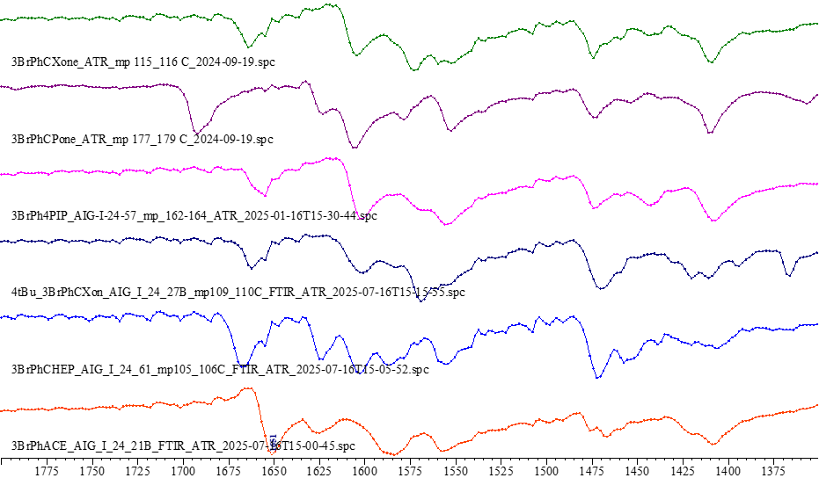
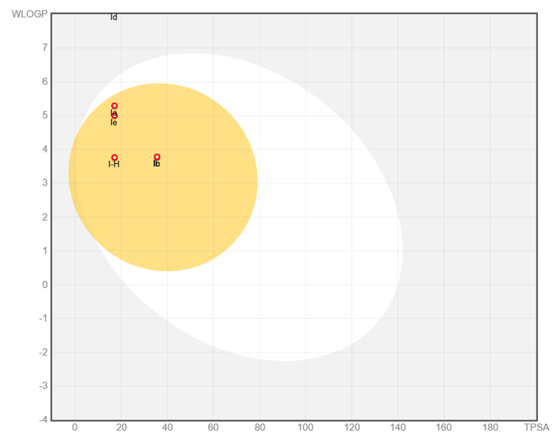
Results and discussions
All compounds showed C=O absorptions at 1650–1677 cm⁻¹, with the frequency increasing according to the electronic effects of the substituents.
UV–Vis λmax values ranged from 312–363 nm, with methoxy causing bathochromic and CF₃ hypsochromic shifts, while acetonitrile provided the best solubility.
SwissADME identified Ib and Ic as having the most balanced physicochemical profiles, while Id showed excessive lipophilicity and Ib, Ic and I-H favorable absorption properties.
ProTox-3.0 predicted neurotoxicity and ecotoxicity for all derivatives, with additional toxicity alerts for Ia and Ic, highlighting the need for experimental confirmation.

Slide 5
Conclusions
1. Six acyclic C5-curcuminoids with different aromatic substituents were successfully synthesized and characterized by FTIR and UV–Vis spectroscopy.
2. Aromatic substitution influenced the electronic properties of the conjugated dienone system, producing measurable changes in C=O stretching frequencies and UV–Vis absorption maxima.
3. Ib and Ic showed the most balanced predicted physicochemical profiles, whereas excessive lipophilicity was the main limitation of Id.
4. Most derivatives showed a relatively limited number of predicted toxicity alerts, although neurotoxicity and ecotoxicity were common to the series.
5. The synthesized compounds provide a useful series for further experimental studies of thiol reactivity, biological activity and toxicity.

