Slide 1











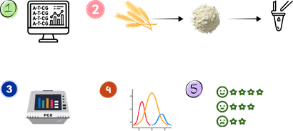



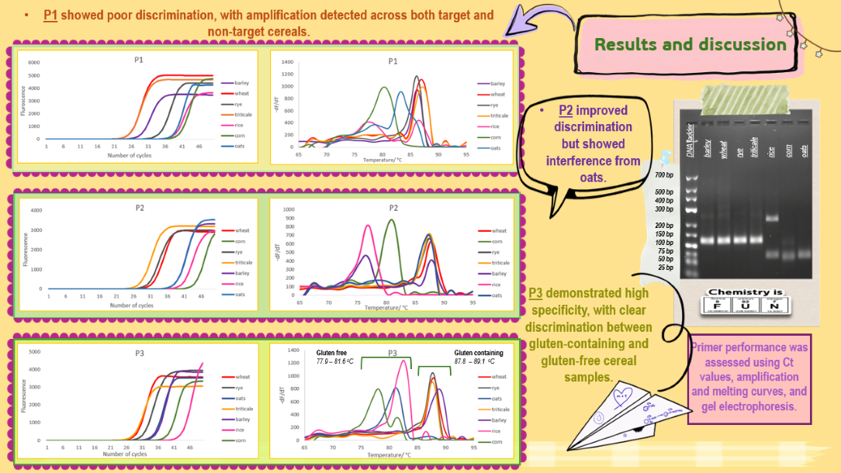
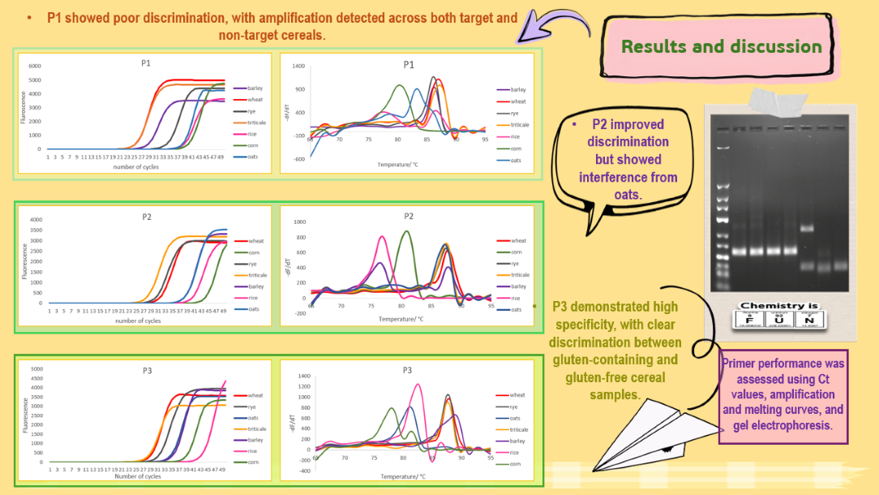
28th Congress of SCTM, 23-26 September, Ohrid, Macedonia
OBPC-P7
PCR-HRM Discrimination of Gluten-Containing and Gluten-Free Cereals
Mihaela Nedelkovska, Teona Spaseska, Marinela Cvetanoska, Pece Sherovski
Institute of Chemistry, Faculty of Natural Sciences and Mathematics, Ss. Cyril and Methodius University in Skopje,
Skopje, North Macedonia
Introduction & Aim
The growing demand for gluten-free foods highlights the need for reliable methods to ensure their safety and authenticity, as accidental cross-contamination with gluten-containing cereals can occur during food production and distribution. This study aimed to develop and evaluate PCR-HRM (Polymerase Chain Reaction-High Resolution Melting) primers targeting the internal transcribed spacer (ITS) region for the discrimination of gluten-containing and gluten-free cereals.
Experimental
Target selection and primer design
Sample preparation
PCR Amplification & High-Resolution Melting (HRM)
Data analysis
Primer evaluation
Conclusions
Careful primer selection in the ITS region enables specific PCR-HRM differentiation between gluten-containing and gluten-free cereals.
Future optimization will test broader reference materials and food matrices to establish sensitivity and detection limits.
Acknowledgement
This work was supported by the University Students' Assembly of the Ss. Cyril and Methodius University in Skopje through the project "Gluten detection using PCR methods: A new approach for monitoring commercial food products“.

Slide 2



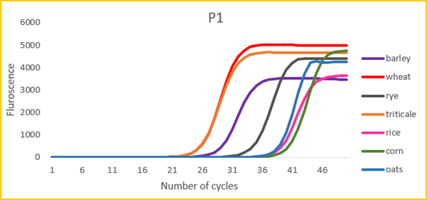
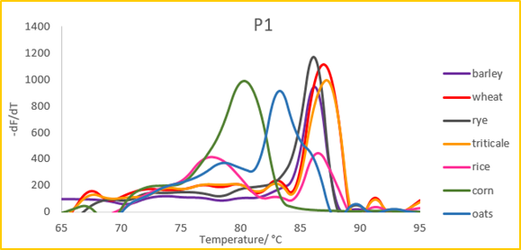



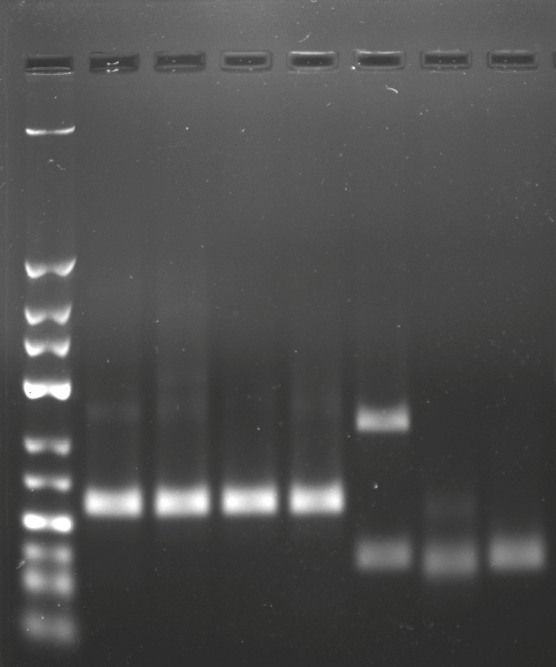

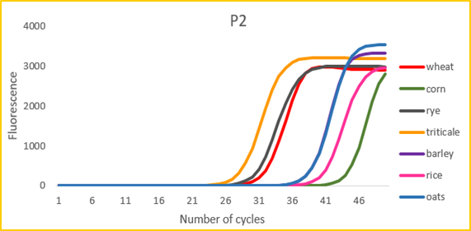
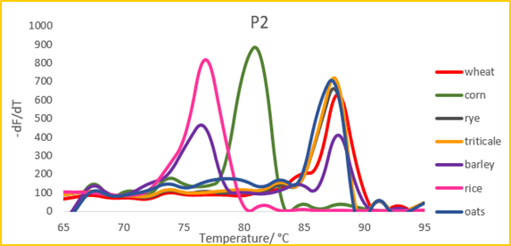



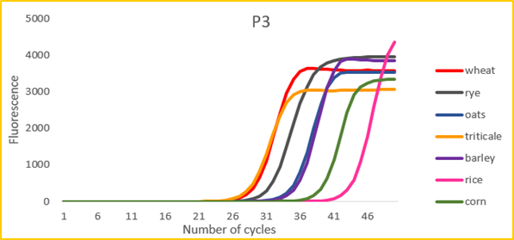
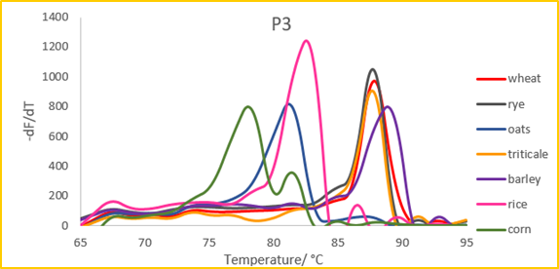

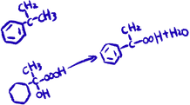



P1 showed poor discrimination, with amplification detected across both target and
non-target cereals.
Results and discussion
P2 improved discrimination but showed interference from oats.
barley
DNA ladder
triticale
oats
rye
rice
corn
wheat
700 bp
500 bp
400 bp
300 bp
200 bp
150 bp
100 bp
75 bp
50 bp
25 bp
P3 demonstrated high specificity, with clear discrimination between gluten-containing and gluten-free cereal samples.
Gluten free
77.9 – 81.6 ºC
Gluten containing
87.8 – 89.1 ºC
Primer performance was assessed using Ct values, amplification and melting curves, and gel electrophoresis.

