Slide 1


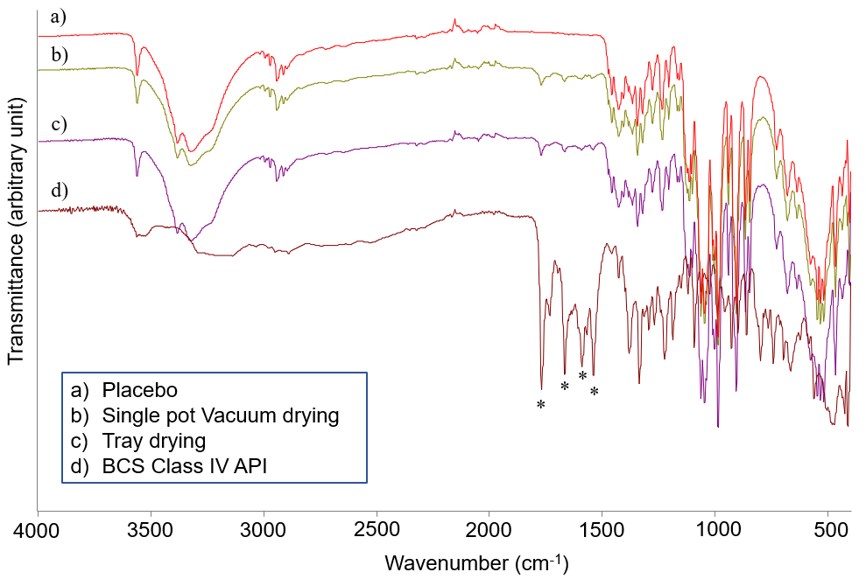
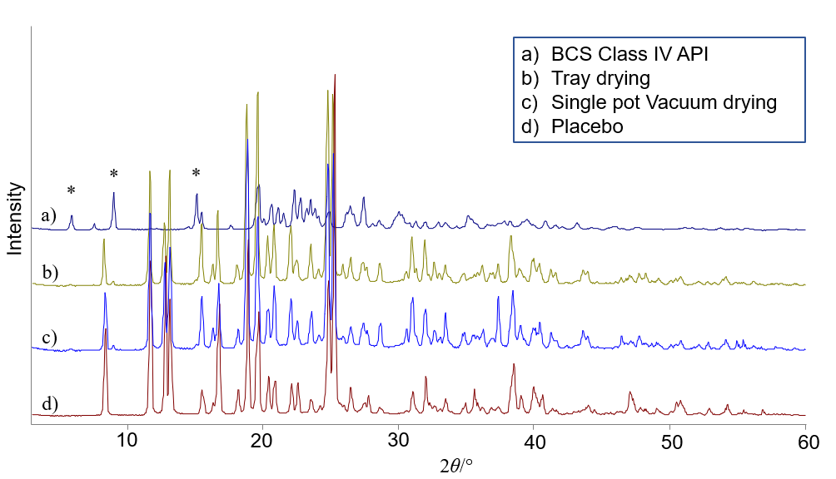
28th Congress of SCTM, 23-26 September, Ohrid, Macedonia
000
Comparative Evaluation of Drying Methods in the Manufacturing of Granules for Oral Suspension
Viktorija Bezhovska^{1*}, Krume Toshev¹, Natasa Anevska Stojanovska¹
¹Manufacturing Technical Operations, ALKALOID AD, Blvd. Aleksandar Makedonski 12, 1000 Skopje, N. Macedonia
*vbezhovska@alkaloid.com.mk
INTRODUCTION AND AIM
The critical quality attributes of the drug product and the efficiency of the manufacturing process for production of granules for oral suspension can be affected by the drying process. The aim of this study was to evaluate the impact of single-pot vacuum, fluid bed, and tray drying technologies, which differ in their heat and mass transfer mechanisms, on process efficiency, granule characteristics, and final product quality attributes.
EXPERIMANTAL
An immediate-release formulation containing a BCS Class IV active pharmaceutical ingredient was prepared by wet granulation. Drying was performed using a single-pot vacuum processor (DIOSNA P/VAC 10), a fluid bed dryer (Mycrolab system), and a tray dryer (Panasonic MOV 212S-2). Granules were characterized in terms of particle size distribution (PSD), loss on drying (LOD), porosity, and flowability. Product quality was evaluated through assay and related/degradation products testing, whereas XRPD and FT-IR analyses were performed to evaluate the solid-state properties of the active pharmaceutical ingredient.
RESULTS AND DISCUSION
Single-pot and fluid bed drying reduced drying time by approximately 78% and 69%, respectively, compared to tray drying, demonstrating higher process efficiency under dynamic drying conditions (Figure 1).
Vacuum drying also enabled the lowest product temperature (27 °C), compared to 31 °C and 50 °C for fluid bed and tray drying, respectively.
Drying technology primarily affected particle size distribution, with the highest proportion of fines being observed after single-pot vacuum drying (51.9% below 0.150 mm), compared to tray and fluid bed drying (26.6% and 27.0%, respectively). This behavior is attributed to continuous mixing under vacuum, promoting denser granules and granule breakage. The overall particle size distributions remained comparable across all systems.
The solid-state properties of the active pharmaceutical ingredient in the final product were evaluated using XRPD and FT-IR analyses (Figure 3 and Figure 4).
Figure 1. Reduction in Drying Time Relative to Tray Drying
All samples met the endpoint loss on drying specification, indicating comparable moisture content across the investigated drying technologies. Porosity and flowability of both granules and final blends also remained comparable (Table 1).
Figure 3. XRPD diffractograms of API, placebo, and granules for oral suspension
Figure 4. FT-IR spectra of API, placebo, and granules for oral suspension
Table 1. Quality Attributes of Granules and Final Blend
The analytical data obtained from XRPD and FT-IR analyses demonstrated that the crystalline form of the active pharmaceutical ingredient remained unchanged in the final product, indicating the absence of polymorphic transformation attributable to the drying conditions.
Parameters | Single - Pot Vacuum Drying | Tray Drying | Fluid Bed Drying
Granules
Loss on Drying (max 2 %) | 0.9 | 1.0 | 0.9
Porosity (%) | 56.5 | 56.2 | 53,7
Compressibility Index (%) | 17 | 12 | 12
Angle of Repose (°) | 34.9 | 32.7 | 33.3
Final Blend
Loss on Drying (max 2 %) | 0.8 | 0.7 | 0.9
Compressibility Index (%) | 12 | 9 | 8
Angle of Repose (°) | 31.7 | 30.7 | 30.8
Figure 1. Particle size distribution of screened granulate
Drying technology influenced granule characteristics, particularly particle size distribution, and affected process efficiency, with single-pot vacuum and fluid bed drying demonstrating advantages over tray drying. However, no significant differences were observed in the final product quality attributes. XRPD and FT-IR analyses confirmed preservation of the crystalline form of the active substance, indicating the absence of polymorphic transformation.
The authors would like to acknowledge ALKALOID AD Skopje for providing the resources and facilities necessary for the completion of this study.
The evaluated critical quality attributes (CQAs) of the final product are presented in Table 2.
CONCLUSION
ACKNOWLEDGEMENT
Table 2. Critical Quality Attributes of Granules for Oral Suspension
Parameter | Single - Pot Vacuum Drying | Tray Drying | Fluid Bed Drying
Assay (%) | 102.53 | 97.17 | 97.82
Related and degradation products | 0.3 | 0.3 | 0.3
All evaluated samples complied with the established specifications for assay and related and degradation products, confirming acceptable product quality across the investigated drying technologies.

