Slide 1

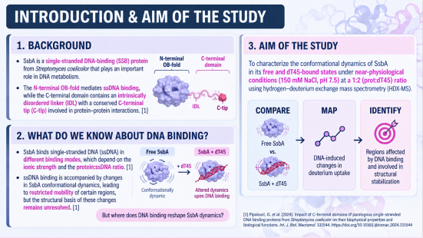
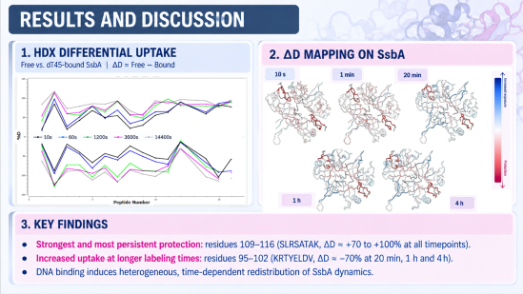
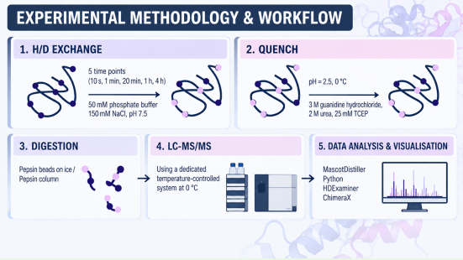
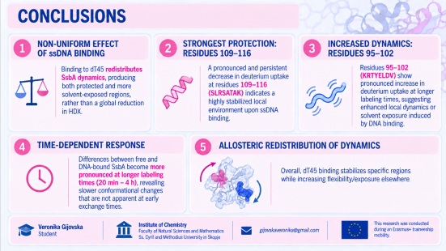
28th Congress of SCTM, 23-26 September, Ohrid, Macedonia
000
Structural Dynamics of SsbA from Streptomyces coelicolor by Hydrogen-Deuterium Exchange Mass Spectrometry
Veronika Gijovska^{1,2}, Goran Pipalović², Dušica Vujaklija², Saša Kazazić²
¹ Institute of Chemistry, Faculty of Natural Sciences and Mathematics, Ss. Cyril and Methodius University, Skopje, RN Macedonia
² Laboratory for mass spectrometry and functional proteomics, Ruđer Bošković Institute, Zagreb, Croatia

Slide 2

Introduction & Aim

Slide 3

Experimental

Slide 4
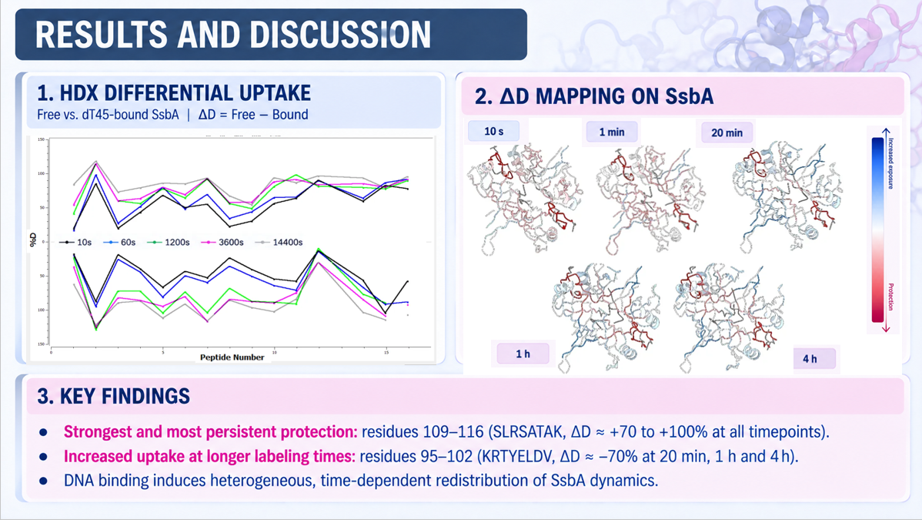
Results and discussions

Slide 5
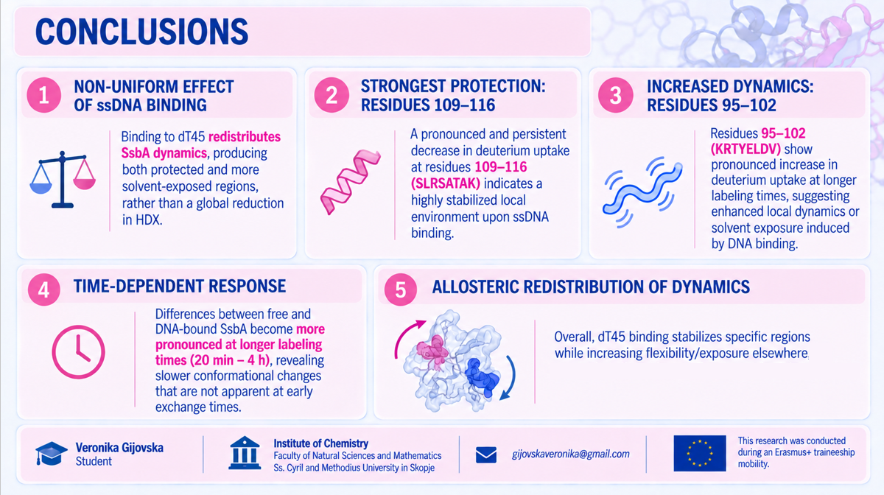
Conclusions

