Slide 1

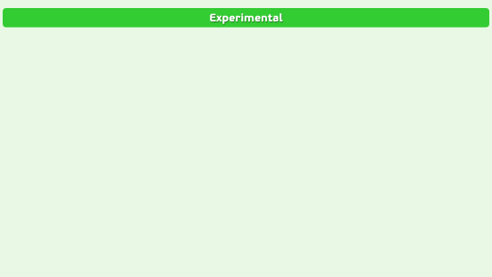
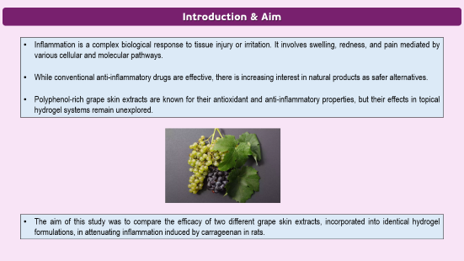
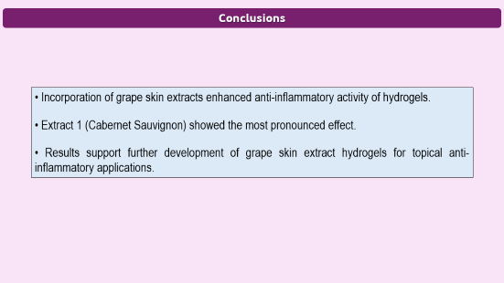
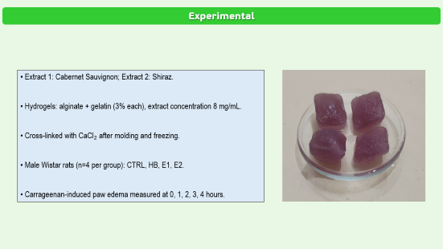
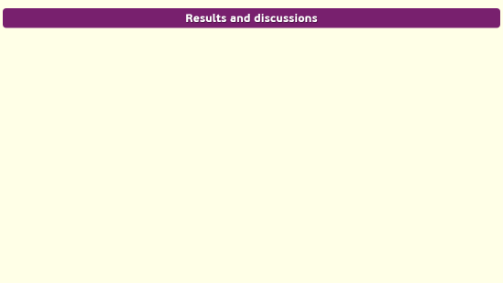

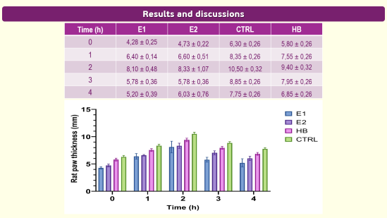
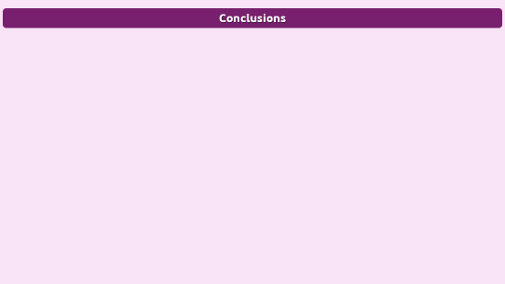
28th Congress of SCTM, 23-26 September, Ohrid, Macedonia
PPM-P4
ANTI-INFLAMMATORY EFFECTS OF GRAPE SKIN EXTRACT-LOADED HYDROGELS IN CARRAGEENAN-INDUCED PAW EDEMA IN RATS
Marko Simic¹, Aleksandar Kocovic^{1,2}, Edina Avdovic³, Vladimir Jakovljevic², Jovana Bradic^{1,2}
¹Department of Pharmacy, Faculty of Medical Sciences, University of Kragujevac, Kragujevac, Serbia, email: simic.marko.kg@gmail.com; ²Center of Excellence for Redox Balance Research in Cardiovascular and Metabolic Disorders, Kragujevac, Serbia; ³ Institute for Information Technologies, University of Kragujevac, Kragujevac, Serbia

Slide 2
Introduction & Aim
Inflammation is a complex biological response to tissue injury or irritation. It involves swelling, redness, and pain mediated by various cellular and molecular pathways.
While conventional anti-inflammatory drugs are effective, there is increasing interest in natural products as safer alternatives.
Polyphenol-rich grape skin extracts are known for their antioxidant and anti-inflammatory properties, but their effects in topical hydrogel systems remain unexplored.
The aim of this study was to compare the efficacy of two different grape skin extracts, incorporated into identical hydrogel formulations, in attenuating inflammation induced by carrageenan in rats.

Slide 3
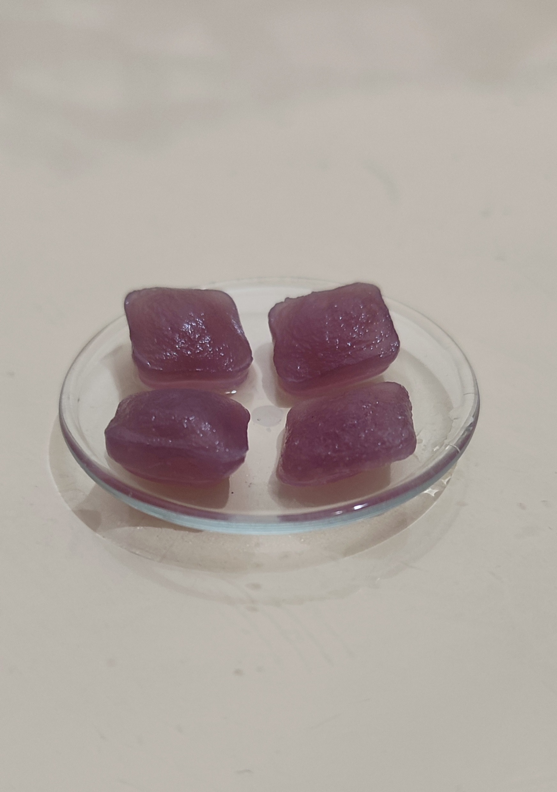
Experimental
• Extract 1: Cabernet Sauvignon; Extract 2: Shiraz.
• Hydrogels: alginate + gelatin (3% each), extract concentration 8 mg/mL.
• Cross-linked with CaCl₂ after molding and freezing.
• Male Wistar rats (n=4 per group): CTRL, HB, E1, E2.
• Carrageenan-induced paw edema measured at 0, 1, 2, 3, 4 hours.

Slide 4
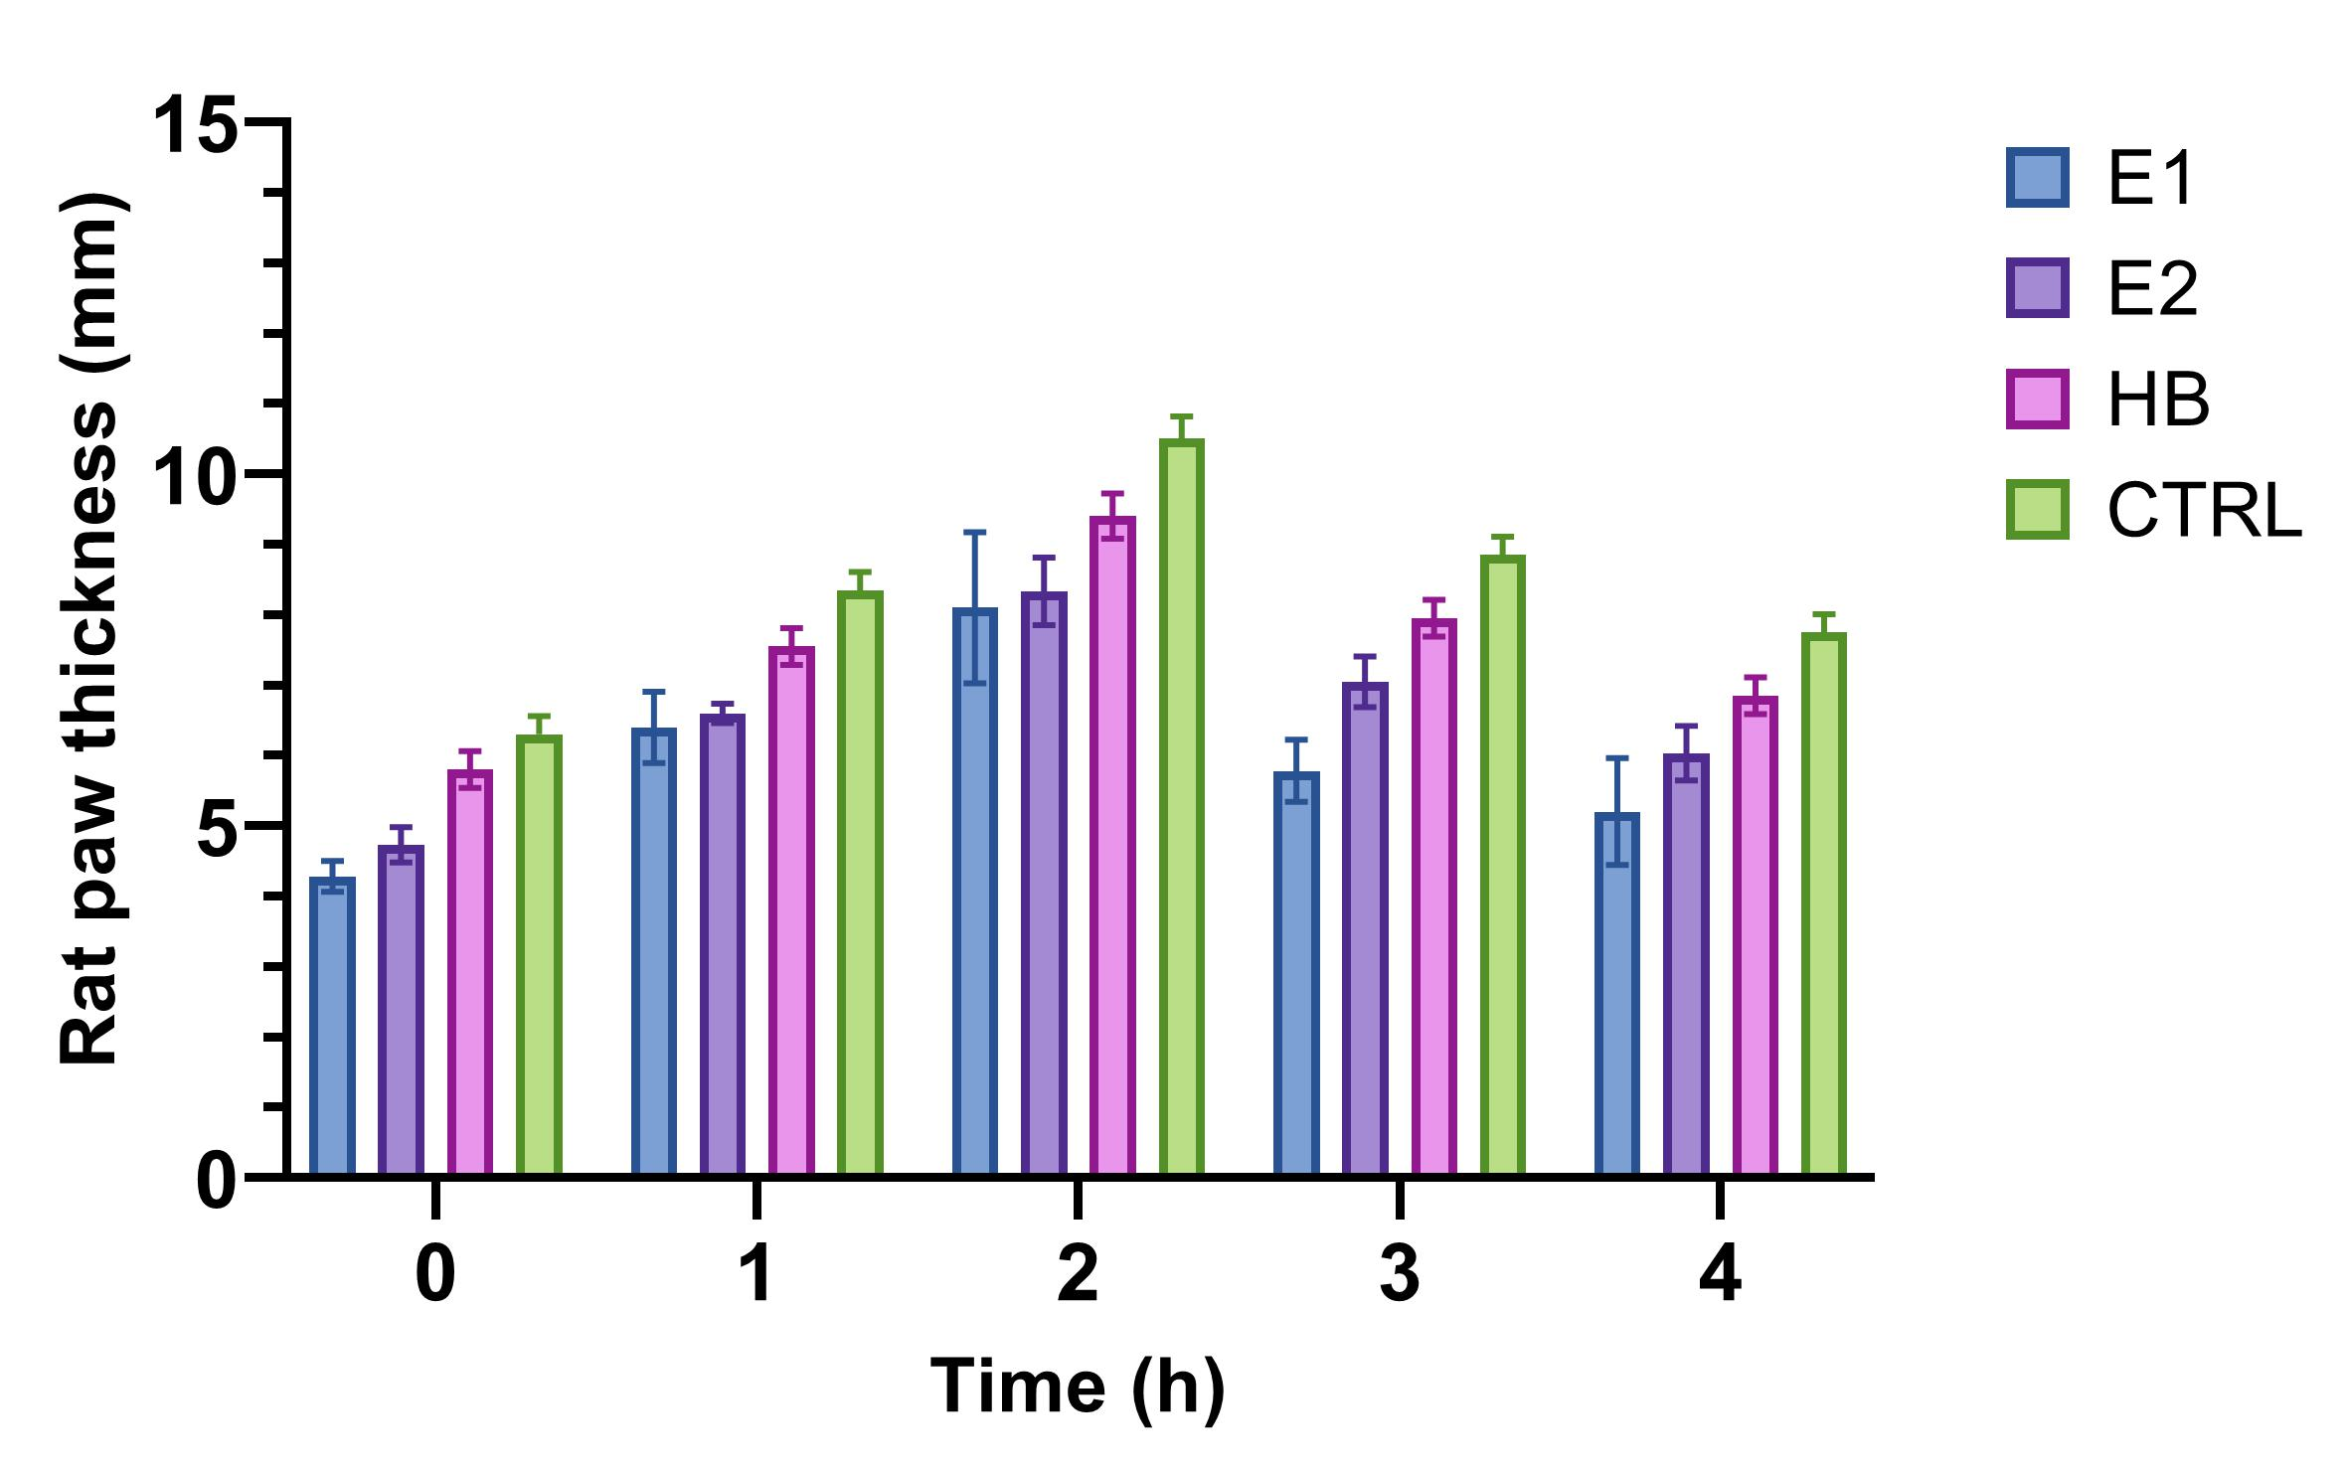
Results and discussions
Time (h) | E1 | E2 | CTRL | HB
0 | 4,28 ± 0,25 | 4,73 ± 0,22 | 6,30 ± 0,26 | 5,80 ± 0,26
1 | 6,40 ± 0,14 | 6,60 ± 0,51 | 8,35 ± 0,26 | 7,55 ± 0,26
2 | 8,10 ± 0,48 | 8,33 ± 1,07 | 10,50 ± 0,32 | 9,40 ± 0,32
3 | 5,78 ± 0,36 | 5,78 ± 0,36 | 8,85 ± 0,26 | 7,95 ± 0,26
4 | 5,20 ± 0,39 | 6,03 ± 0,76 | 7,75 ± 0,26 | 6,85 ± 0,26

Slide 5
Conclusions
• Incorporation of grape skin extracts enhanced anti-inflammatory activity of hydrogels.
• Extract 1 (Cabernet Sauvignon) showed the most pronounced effect.
• Results support further development of grape skin extract hydrogels for topical anti-inflammatory applications.

