Slide 1
Thermodynamic foundations of activity coefficients of electrolytes in electrostatic theories
Janez Cerar
Faculty of Chemistry and Chemical Technology, University of Ljubljana
Slovenia

Slide 2
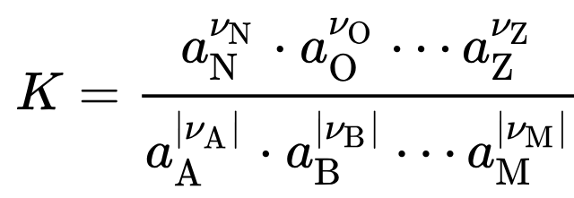
Electrochemical potential μ of species i : μ_{i} = μ_{i}º + R∙T∙ln a_{i}
where in solutions a_{i} = γ_{i}∙c_{i}/cº ; in ideal solutions γ_{i} = 1 i.e. a_{i} = c_{i}/cº
a_{i} – activity of species i; γ_{i} - activity coefficient of i ; c_{i} – molar concentration of i ; cº = 1 mol dm⁻³
Chemical equilibrium:
Chemical equation:
Equilibrium constant K:

Slide 3
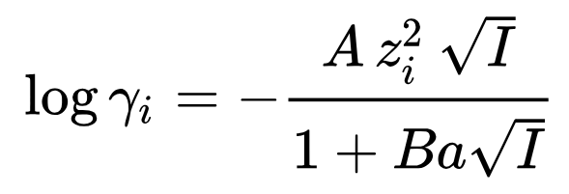
Ion activity coefficients in Debye-Hückel theory
Debye and Hückel derived their theory (in 1923) to explain chemical equlibria in aqueous electrolyte solutions. Namely, in such solution ions do not behave ideally.
I is the ionic strength of the solution, and a is a parameter describing the ion size.
A and B are parameters that depend on the solvent and the temperature.

Slide 4
Motivation
The thermodynamic and physical interpretation of the Debye-Hückel derivation remains a subject
of debate, with textbook presentations and scientific discussions often revealing ambiguities that
deserve closer examination
The extension of Debye-Hückel theory from electrolyte solutions to polyelectrolyte solutions for
calculating polyion activity coefficients, as presented in some classical publications, appears to yield
results that are difficult to reconcile with the assumptions underlying the original theory.
Can repulsive electrostatic interactions be adequately described within the Poisson-Boltzmann
framework?
Does the Debye-Hückel activity coefficient contain an entropic contribution?

Slide 5
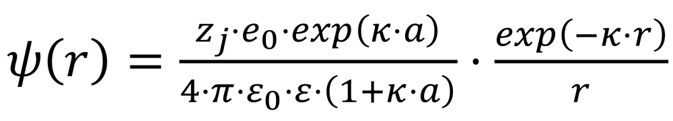
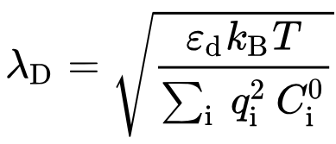
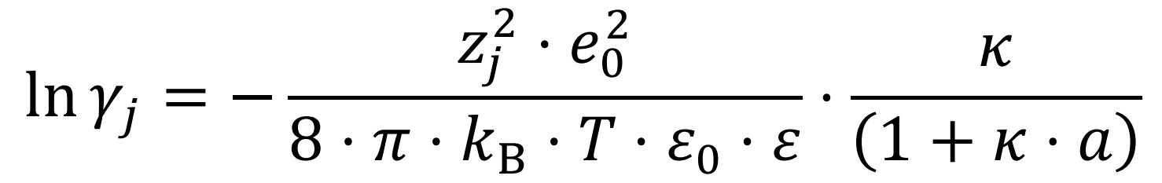
Problem
linearized Poisson-Boltzmann equation
        ?
individual activity coefficient γ_{j}
κ – the inverse value of Debye length λ_{D}

Slide 6
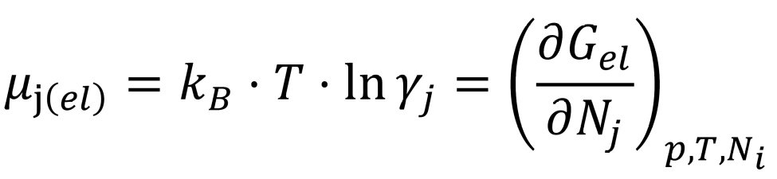
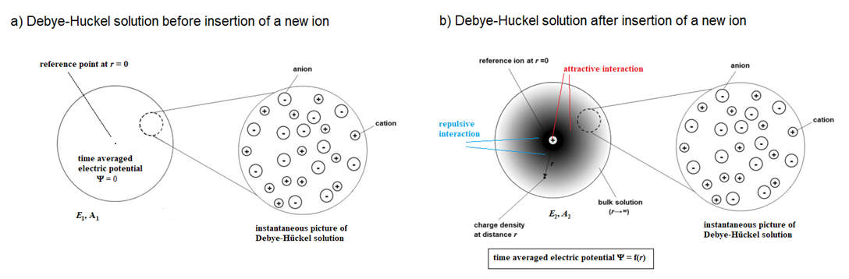
Solution: A new derivation using partial molar quantities

Slide 7
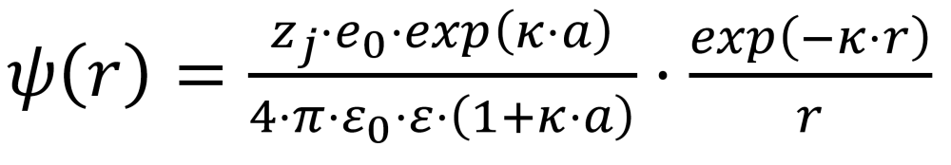
Starting point: linearized PB equation
The result is the equation that describes the electrostatic potential as a function of
the radial distance from the inserted ion j:
As with the Debye–Hückel theory, the electric potential is separated into two components:
one originating from the central ion, ψ_{j}(r),
and the other from the surrounding ionic atmosphere, ψ_{IA}(r).

Slide 8
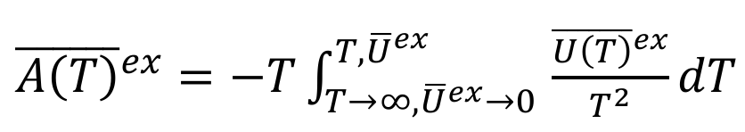
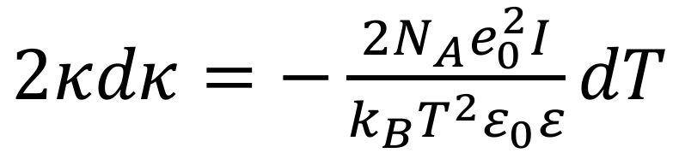
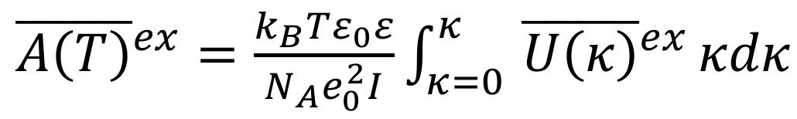
How to get the non-ideal contribution to the electrochemical potential of the central ion?
1.) Using ψ_{j}(r) one can calculate the excess partial molar internal energy of the central ion j due
to attractive electric interactions between the central ion and its ionic atmosphere
and indirect repulsive interactions within the ionic atmosphere
2.) Using Gibbs-Helmholtz equation one can calculate the excess partial molar Helmholtz free energy
of the central ion j from the excess partial molar internal energy of the central ion j
3.) The excess partial molar Helmholtz free energy of the central ion can be in liquid systems
approximated with the excess partial molar Gibbs free energy; this later one is in electrolyte solutions
essentially equal to the non-ideal contribution to the electrochemical potential of the central ion

Slide 9
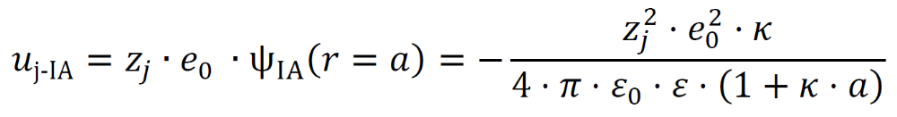
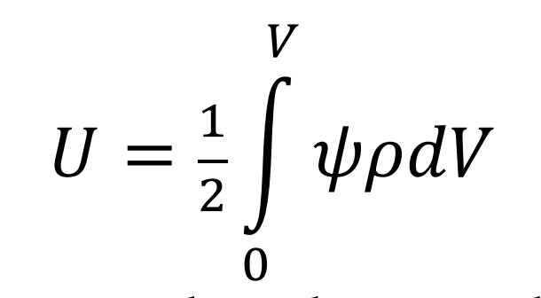
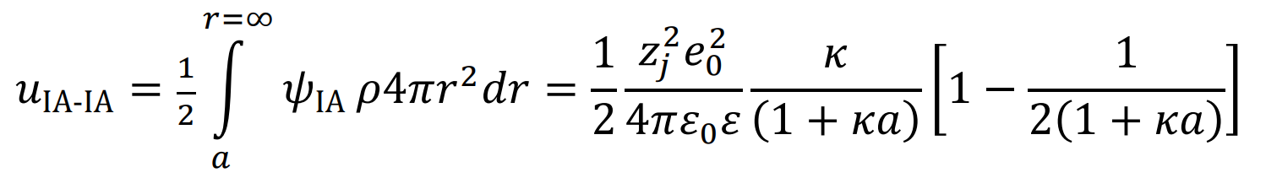
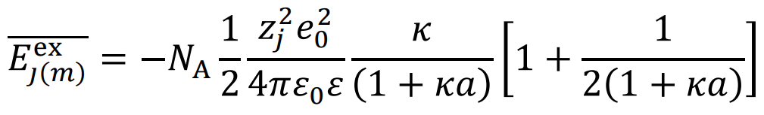
Calculations of excess partial molar internal energy of the central ion j
Excess partial internal energy (per one ion) of the central ion j due to attractive electric interactions
Excess partial internal energy (per one ion) of the central ion j due to indirect repulsive interactions
within the ionic atmosphere can be calculated using general relation
Excess partial molar internal energy of the central ion j

Slide 10
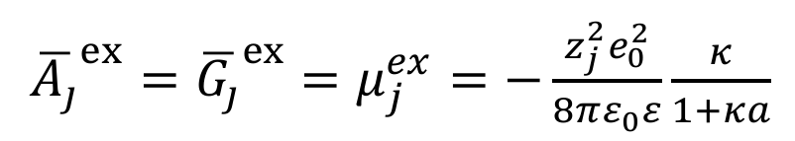
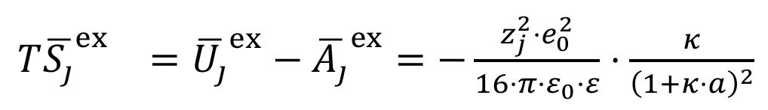
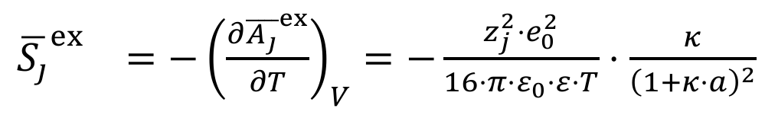
Calculations of excess partial molar Helmholtz free energy of the central ion j
Excess partial molar entropy of the central ion j

Slide 11
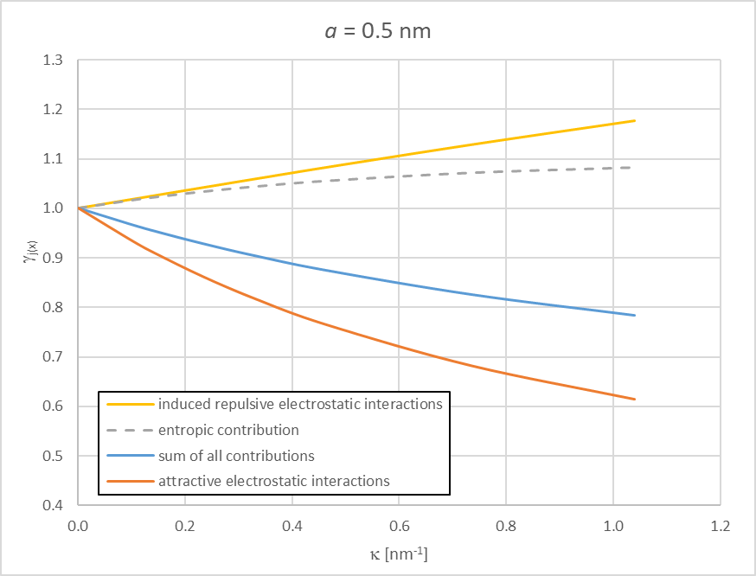
Contributions to the activity coefficient
(i), (iii)
(i)
(iii)
(iv)
(iv)
(ii)
(ii)
Individual contributions to the activity coefficient of the central ion at 25 °C in a 1:1 electrolyte:
induced repulsive electrostatic interactions,
(ii) direct attractive electrostatic interactions between the central ion and the ionic atmosphere,
(iii) entropic contribution due to charge relocation, and
(iv) the total sum of these three effects.

Slide 12
Conclusions
Analysis of the Debye-Hückel equation reveals that ionic activity coefficients reflect a
balance between
attractive ion-counterion electrostatic interactions,
repulsive electrostatic interactions among the accumulated counterions,
entropic penalties arising from the non-random redistribution of ions.
This interpretation provides a framework that may be extended beyond simple electrolyte
solutions to polyelectrolyte and ionic colloid systems.

