Slide 1



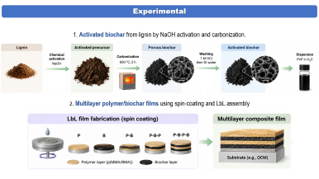
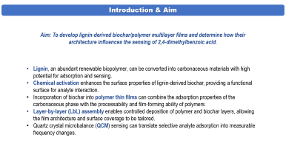
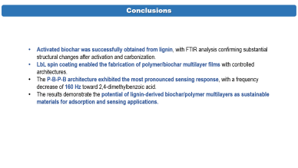
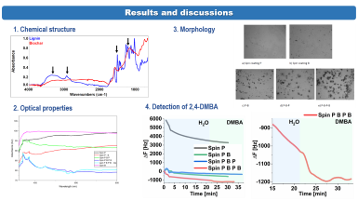
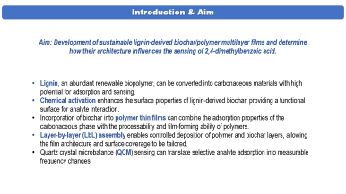
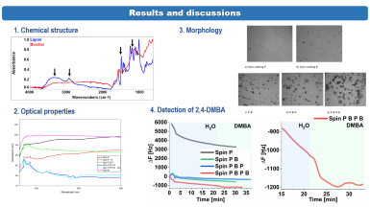
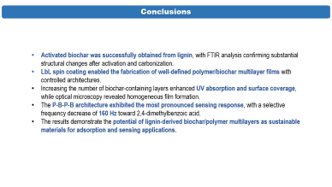
PPM
28th Congress of SCTM, 23-26 September, Ohrid, Macedonia
LAYER-BY-LAYER ASSEMBLY OF LIGNIN-DERIVED BIOCHAR/POLYMER COMPOSITE FILMS FOR SELECTIVE ADSORPTION OF 2,4-DIMETHYLBENZOIC ACID
Marija Prosheva¹, Daniyal Ashraf², Mihaela Girtan², Jadranka Blazhevska Gilev¹
e-mail: marija@tmf.ukim.edu.mk
¹Ss. Cyril and Methodius University in
Skopje, Faculty of Technology and Metallurgy, Skopje, North Macedonia
²LPHIA Laboratory, Faculty of Science, Angers University, 2BD. Lavoisier, 49045, Angers, France

Slide 2
Introduction & Aim
Aim: To develop lignin-derived biochar/polymer multilayer films and determine how their architecture influences the sensing of 2,4-dimethylbenzoic acid.
Lignin, an abundant renewable biopolymer, can be converted into carbonaceous materials with high potential for adsorption and sensing.
Chemical activation enhances the surface properties of lignin-derived biochar, providing a functional surface for analyte interaction.
Incorporation of biochar into polymer thin films can combine the adsorption properties of the carbonaceous phase with the processability and film-forming ability of polymers.
Layer-by-layer (LbL) assembly enables controlled deposition of polymer and biochar layers, allowing the film architecture and surface coverage to be tailored.
Quartz crystal microbalance (QCM) sensing can translate selective analyte adsorption into measurable frequency changes.

Slide 3
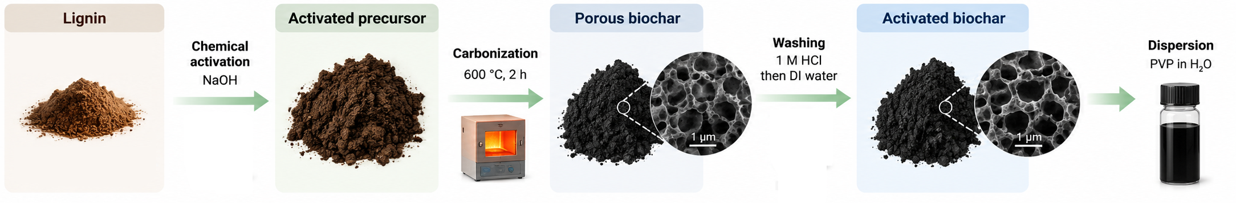
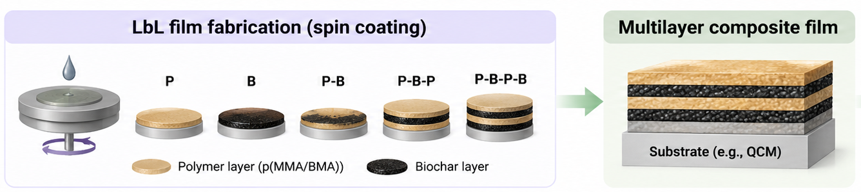
Experimental
1. Activated biochar from lignin by NaOH activation and carbonization.
2. Multilayer polymer/biochar films using spin-coating and LbL assembly

Slide 4
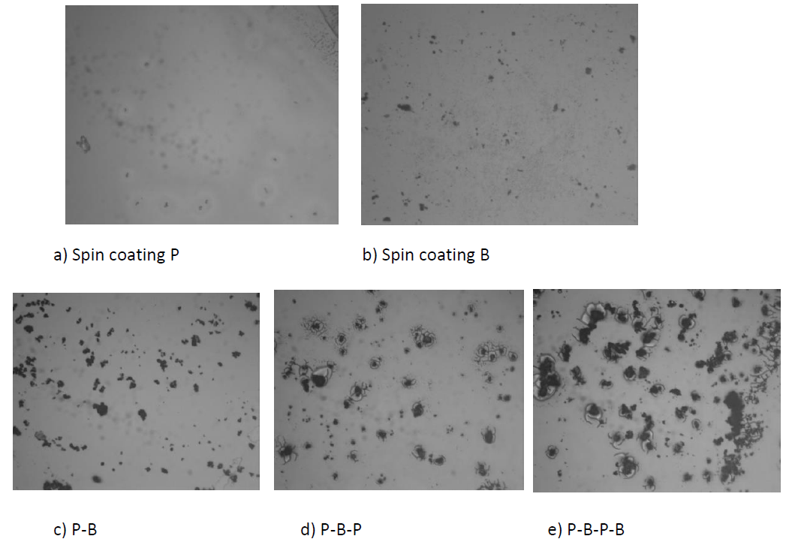
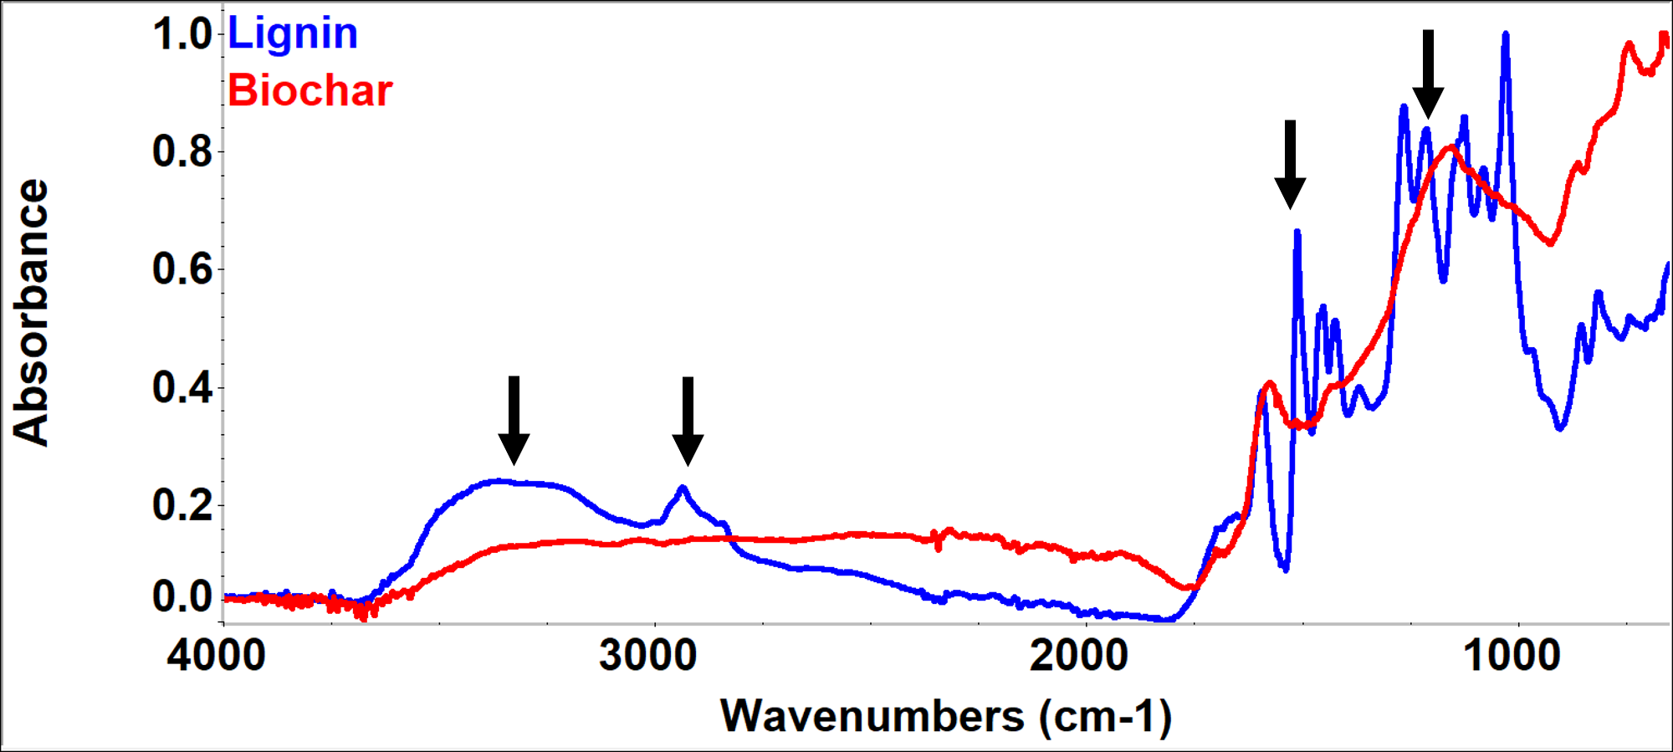
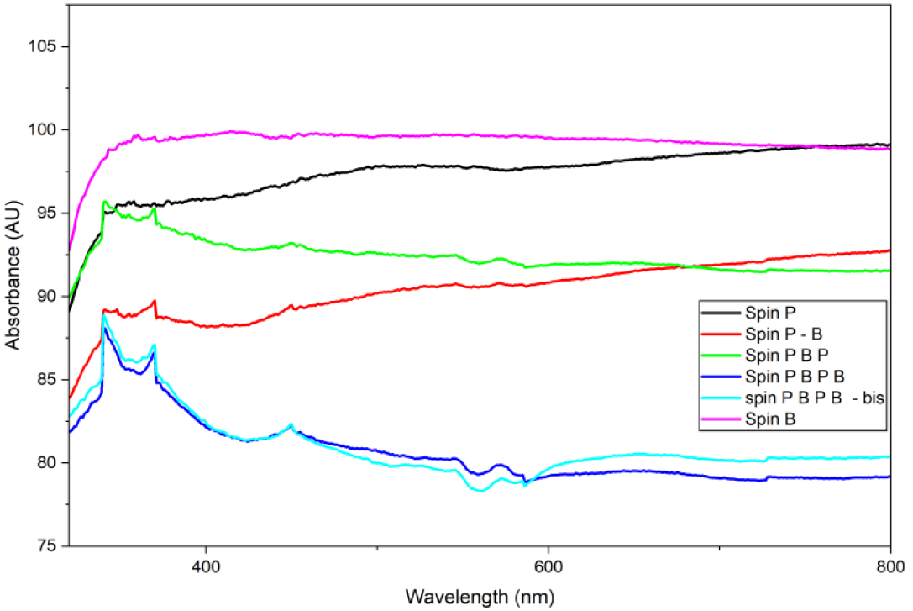
Results and discussions
1. Chemical structure
3. Morphology
2. Optical properties
4. Detection of 2,4-DMBA

Slide 5
Conclusions
Activated biochar was successfully obtained from lignin, with FTIR analysis confirming substantial structural changes after activation and carbonization.
LbL spin coating enabled the fabrication of polymer/biochar multilayer films with controlled architectures.
The P-B-P-B architecture exhibited the most pronounced sensing response, with a frequency decrease of 160 Hz toward 2,4-dimethylbenzoic acid.
The results demonstrate the potential of lignin-derived biochar/polymer multilayers as sustainable materials for adsorption and sensing applications.

