Slide 1

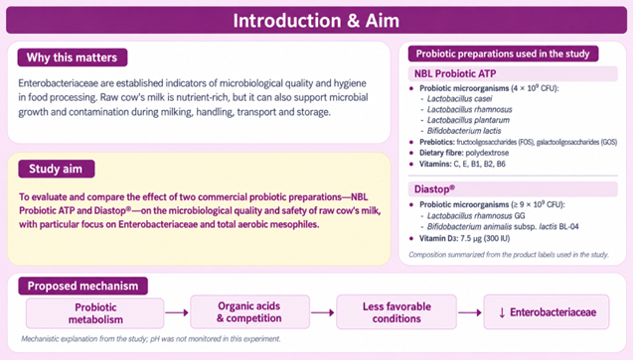
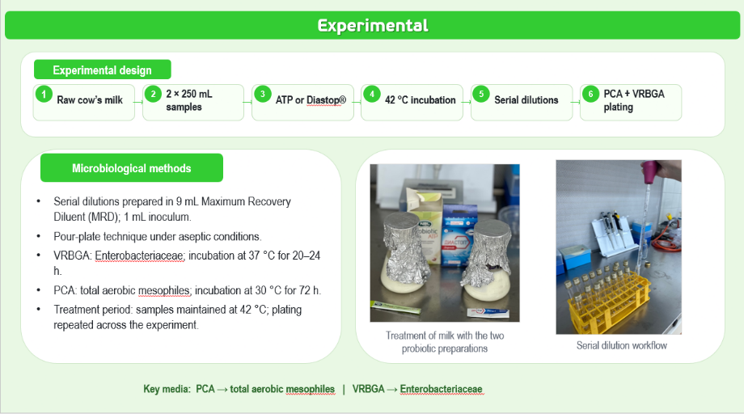
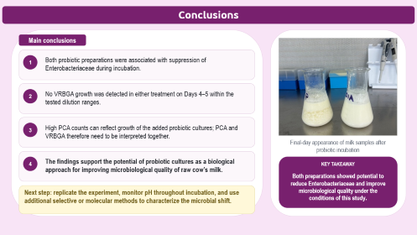
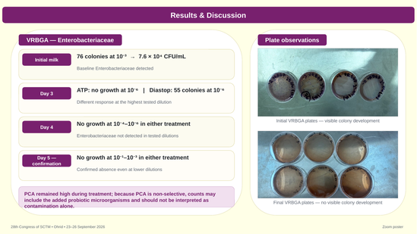
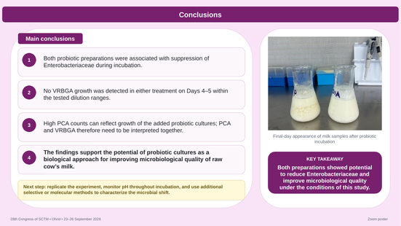
28th Congress of SCTM, 23–26 September, Ohrid, Macedonia
000
EFFECT OF PROBIOTIC PREPARATIONS ON ENTEROBACTERIACEAE
AND MICROBIOLOGICAL SAFETY OF RAW COW’S MILK
Ismail Ferati¹, Daniela Nikolovska Nedelkoska², Hava Miftari¹, Rejhana Luma¹, Yllza Hasani¹
¹University of Tetova, Faculty of Food Technology and Nutrition, Tetovo, North Macedonia
²University St. Kliment Ohridski-Bitola, Faculty of Technology and Technical Sciences Veles, Veles, North Macedonia
daniela.nedelkoska@uklo.edu.mk

Slide 2
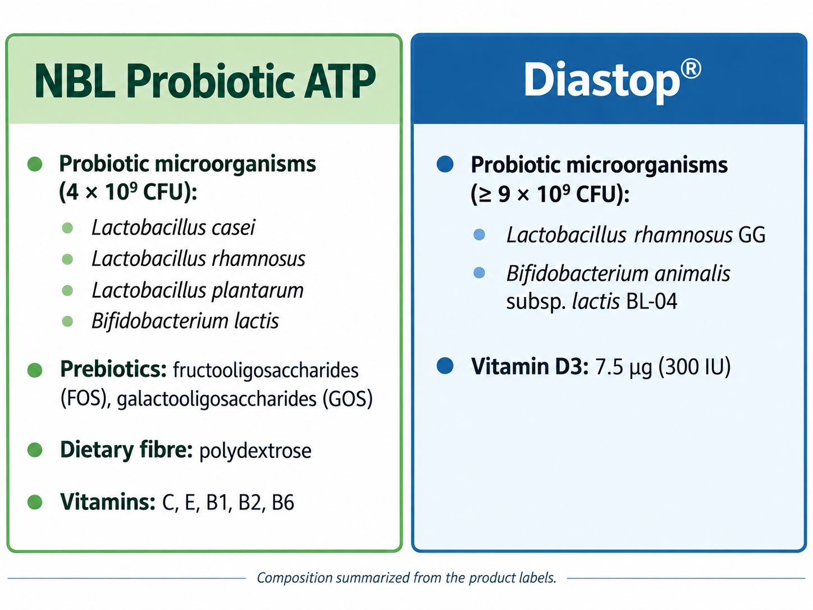
Introduction & Aim
Why this matters
Enterobacteriaceae are established indicators of microbiological quality and hygiene in food processing. Raw cow’s milk is nutrient-rich, but it can also support microbial growth and contamination during milking, handling, transport and storage.
Study aim
To evaluate and compare the effect of two commercial probiotic preparations—NBL Probiotic ATP and Diastop®—on the microbiological quality and safety of raw cow’s milk, with particular focus on Enterobacteriaceae and total aerobic mesophiles.
Commercial probiotic preparations used in the study
Proposed mechanism
Probiotic
metabolism
Organic acids
& competition
Less favorable
conditions
↓ Enterobacteriaceae
→
→
→
Mechanistic explanation from the study; pH was not monitored in this experiment.

Slide 3
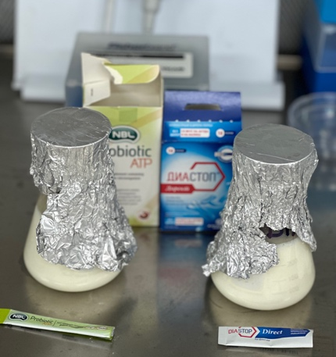
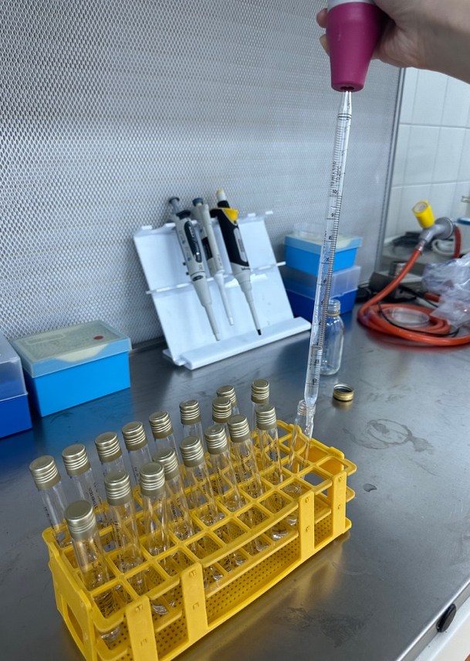
Experimental
Experimental design
1
2
2 × 250 mL samples
3
4
5
6
PCA + VRBGA
plating
1
Raw cow’s milk
→
2
→
3
ATP or Diastop®
→
4
42 °C incubation
→
5
Serial dilutions
→
6
Microbiological methods
Serial dilutions prepared in 9 mL Maximum Recovery Diluent (MRD); 1 mL inoculum.
Pour-plate technique under aseptic conditions.
VRBGA: Enterobacteriaceae; incubation at 37 °C for 20–24 h.
PCA: total aerobic mesophiles; incubation at 30 °C for 72 h.
Treatment period: samples maintained at 42 °C; plating repeated across the experiment.
Treatment of milk with the two probiotic preparations
Serial dilution workflow
Key media: PCA → total aerobic mesophiles | VRBGA → Enterobacteriaceae

Slide 4
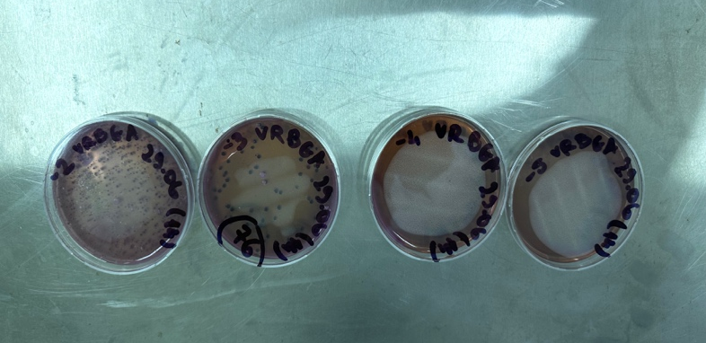
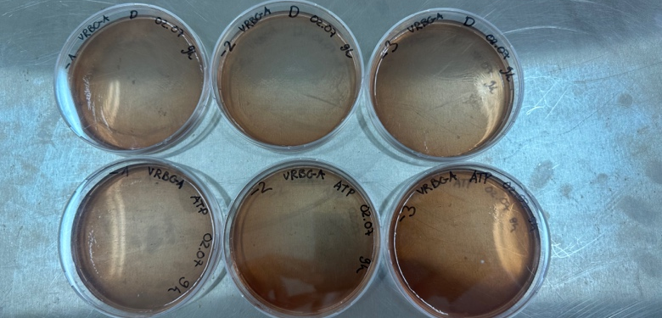
Results & Discussion
VRBGA — Enterobacteriaceae
Plate observations
Day 2
Initial status
VRBGA: 76 colonies at 10⁻³ → 7.6 × 0⁻⁴ CFU/mL
PCA: 60 colonies at 10⁻⁵ → 6.0 × 10⁶ CFU/mL
Day 3
VRBGA: ATP—no growth at 10⁻⁶ | Diastop—55 colonies at 10⁻⁶
Diastop: 5.5 × 10⁷ CFU/mL; PCA counts remained high
Initial VRBGA plates — visible colony development
Day 4
VRBGA: no growth, 10⁻⁴–10⁻⁶ (both samples)
Enterobacteriaceae not detected in tested dilutions
Day 5
Confirmation
VRBGA: no growth, 10⁻¹–10⁻³ (both samples)
Absence confirmed at the lower dilutions
PCA remained high; as a non-selective medium, it may also count the added probiotic microorganisms.
Final VRBGA plates — no visible colony development

Slide 5
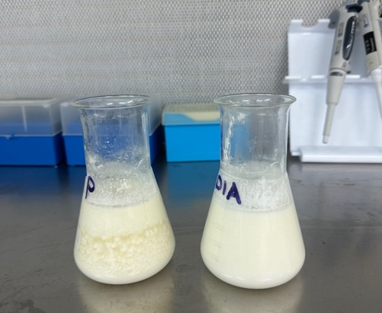
Conclusions
Main conclusions
1
Both probiotic preparations were associated with suppression of Enterobacteriaceae during incubation.
2
No VRBGA growth was detected in either treatment on Days 4–5 within the tested dilution ranges.
3
High PCA counts can reflect growth of the added probiotic cultures; PCA and VRBGA therefore need to be interpreted together.
Final-day appearance of milk samples after probiotic incubation
4
The findings support the potential of probiotic cultures as a biological approach for improving microbiological quality of raw cow’s milk.
KEY TAKEAWAY
Both preparations showed potential to reduce Enterobacteriaceae and improve microbiological quality under the conditions of this study.
Next step: replicate the experiment, monitor pH throughout incubation, and use additional selective or molecular methods to characterize the microbial shift.

