Slide 1

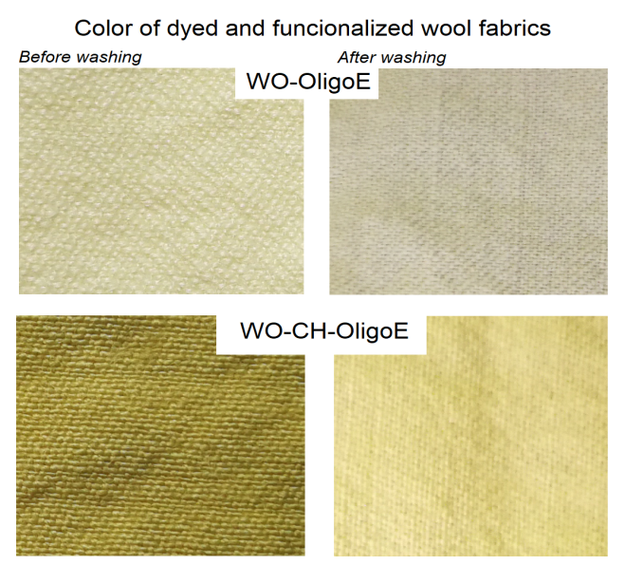
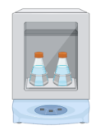
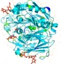
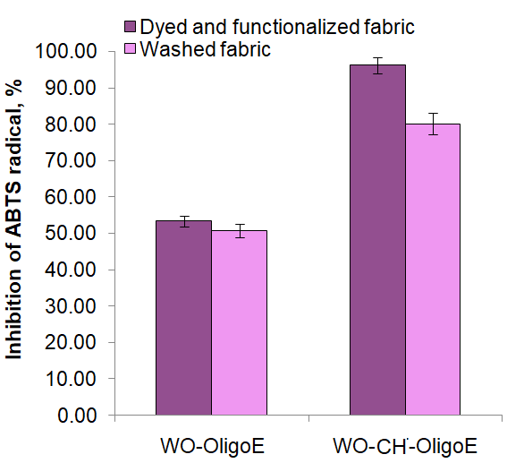



28th Congress of SCTM, 23-26 September, Ohrid, Macedonia
000
LACCASE-CATALYZED OLIGOMERIZATION OF ESCULIN FOR in situ DYEING AND FUNCTIONALIZATION OF WOOL FABRIC
Ana Vukoičić¹, Aleksandra Ivanovska¹, Marija Ćorović², Ana Milivojević², Dejan Bezbradica²
¹ Innovation Center of Faculty of Technology and Metallurgy in Belgrade Ltd., Belgrade, Serbia, avukoicic@tmf.bg.ac.rs
² University of Belgrade, Faculty of Technology and Metallurgy, Belgrade, Serbia
Introduction & Aim
The transition of textile dyeing and functionalization processes towards the utilization of natural dyes and naturally derived compounds has intensified the development of environmentally sustainable technologies. In this context, laccase-catalyzed oxidation of their substrates such as natural polyphenolic compounds can be applied. This reaction can yield colored oligomeric/polymeric compounds which in addition to color, have potential to add novel functionalities to textile materials. The aim of this study was to evaluate the in situ simultaneous dyeing and functionalization of wool (WO) and chitosan-modified wool (WO-CH) fabrics by oligomerization of coumarin glycoside esculin to its colored oligomers (OligoE) by laccase from Trametes versicolor.
Washing and drying of WO-CH
WO + 1% CH (35°, 1h)
ABTS radical scavenging activity
(35°, 24h, 130 rpm)
Washing and drying
In situ dyeing and functionalization of WO and WO-CH
Washing cycle
Removal of WO-OligoE and WO-CH-OligoE from reaction mixture
Data analysis
Antioxidant activity and K/S value of fabrics after washing cycle
K/S measurement
Experimental
Results and discussion
K/S | Before washing | After washing
WO-OligoE | 2.56 | 5.42
WO-CH-OligoE | 10.02 | 6.22
Wool fabrics were successfully dyed and functionalized by in situ oligomerization of esculin catalyzed by laccase from Trametes versicolor.
The washing cycle revealed high retention of antioxidant activity indicating to the strong interactions between oligoE compounds and WO or WO-CH fabrics.
Modification of wool fabrics with chitosan significantly improved fabrics’ color and antioxidant activity.
This dyeing and functionalization protocol shows potential of laccase and natural flavonoids to be used in textile industry for dyeing and imparting novel functionalities to textile materials.
Conclusions
Acknowledgement
This work was supported by the Ministry of Science, Technological Development and Innovations of the Republic of Serbia (Contract No.: 451-03-33/2026-03/200287 and 451-03-34/2026-03/200135).
Some photos were downloaded form www.biorender.com and www.flaticon.com.

