Slide 1
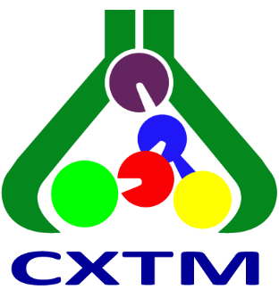
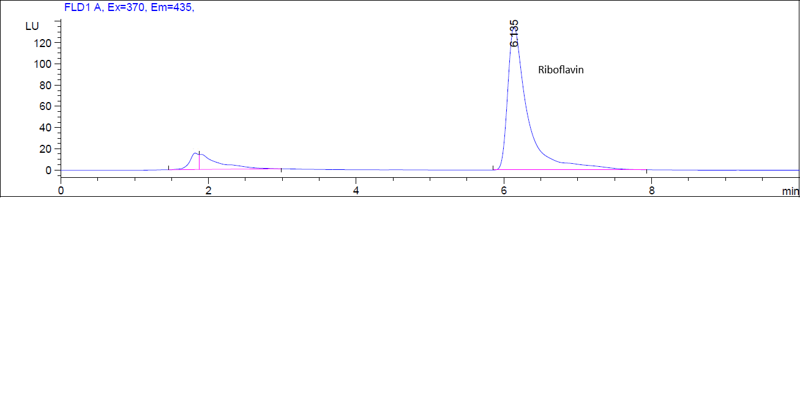
28th Congress of SCTM, 23-26 September 2026, Ohrid, Macedonia
AEC-P2
RIBOFLAVIN AND THIAMINE CONTENT IN COMMERCIAL ALMOND MILK
Slavica M. Sunarić ¹
¹Department of Chemistry, Faculty of Medicine, University of Niš, Serbia
Introduction & Aim
Long valued for its distinct taste, almond beverage has recently emerged as one of the leading plant-based milk alternatives. Vegans and people with lactose intolerance use almond milk as a healthy substitute for dairy products. Almond milk offers fewer calories than cow milk, mainly because it has less protein and fewer carbohydrates when unsweetened. Almond milk is produced by blending water with almond paste or powder. It generally contains water, almonds, salt, added vitamins and minerals, and stabilizers and preservatives. During commercial manufacturing, almond liquid undergoes high-pressure homogenization and pasteurization to enhance product stability and shelf life. However, recent studies indicate that these thermal and mechanical treatments can alter the physical properties of the beverage. The aim of this work was to determine the riboflavin and thiamine content in commercial almond milk.
Experimental
Results and discussion
Commercial almond milk with 1.1% fat and 2% of almonds was from the local market. HPLC analysis with fluorescence detection was conducted on the C18 column using the mobile phase consisting of 30.0% methanol and 70.0% 0.005M NH₄Ac (pH 5.0). The sample was prepared by protein precipitation using perchloric acid. After vortexing and centrifugation, a clear supernatant was obtained. Riboflavin was analyzed directly after filtration through a membrane filter. To analyze thiamine, the supernatant was derivatized with 1% potassium ferricyanide in 15% sodium hydroxide.
The concentration of riboflavin in commercial almond milk was found to be 1.884±0.124 µg/ml (RSD 6.6%), while thiamine content was 1.20±0.13 ng/ml (RSD 10.8%).
Conclusions
Riboflavin (vitamin B2) and thiamine (vitamin B1) are essential water-soluble B-vitamins which are coenzymes in cellular energy metabolism, support normal growth, and maintain a healthy nervous system. In the commercial almond milk sample, the concentration of riboflavin was significant, while thiamine was present in very low concentrations. The findings confirm that almond milk may be a good source of riboflavin in a vegan/plant-based diet.
Acknowledgement
This work was supported by The Ministry of Science, Technological Development and Innovation of the Republic of Serbia (Grant No: 451-03-34/2026-03/200113).

