Slide 1

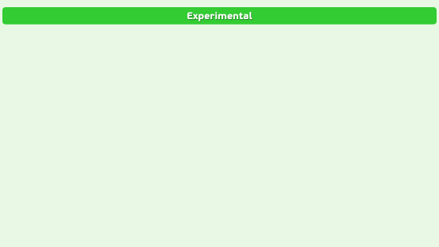
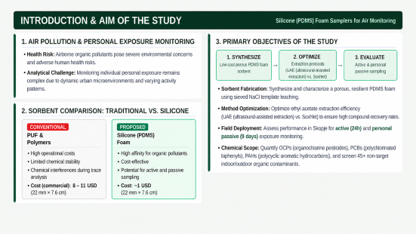
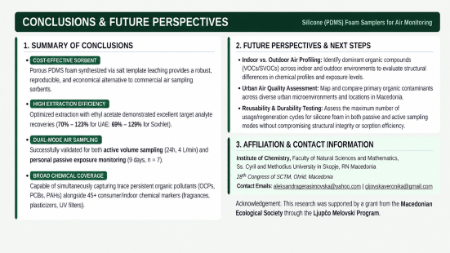
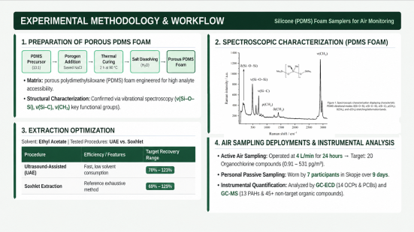


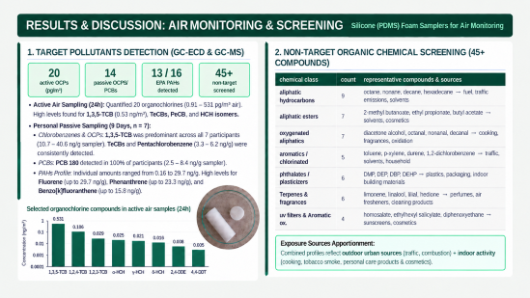
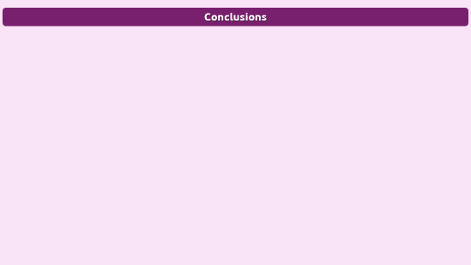
28th Congress of SCTM, 23-26 September, Ohrid, Macedonia
000
Cost-Effective Silicone Foam Samplers for Monitoring Organic Compounds in Air
Veronika Gijovska, Aleksandra Gjerasimovska, Mihail Trajkov, Ivona Sofronievska, Miha Bukleski, Marina Stefova
Institute of Chemistry, Faculty of Natural Sciences and Mathematics, Ss. Cyril and Methodius University in Skopje, 1000, Skopje, RN Macedonia

Slide 2
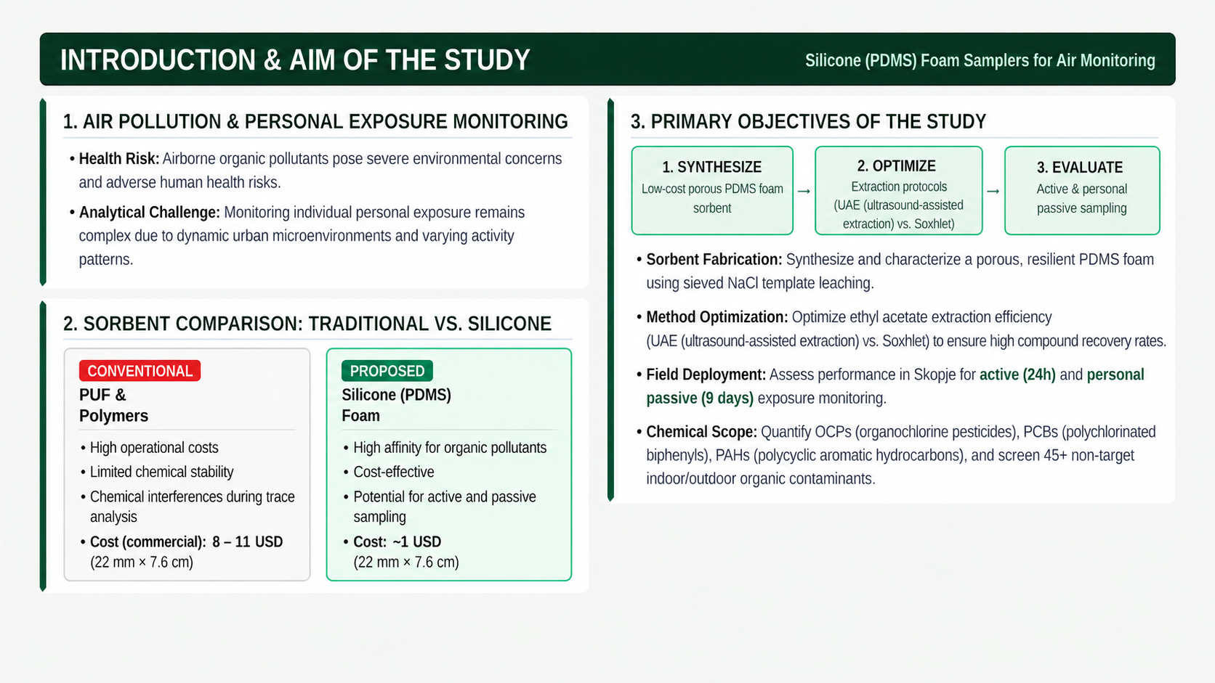
Introduction & Aim

Slide 3
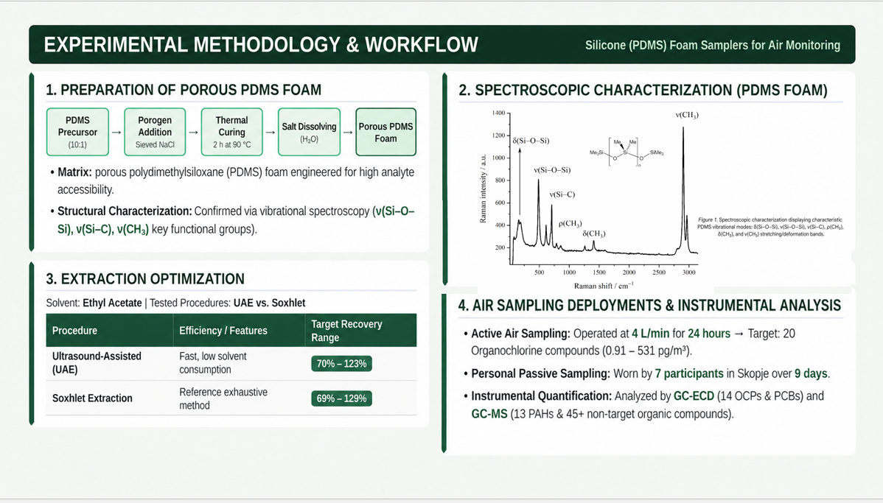
Experimental

Slide 4

Results and discussions

Slide 5
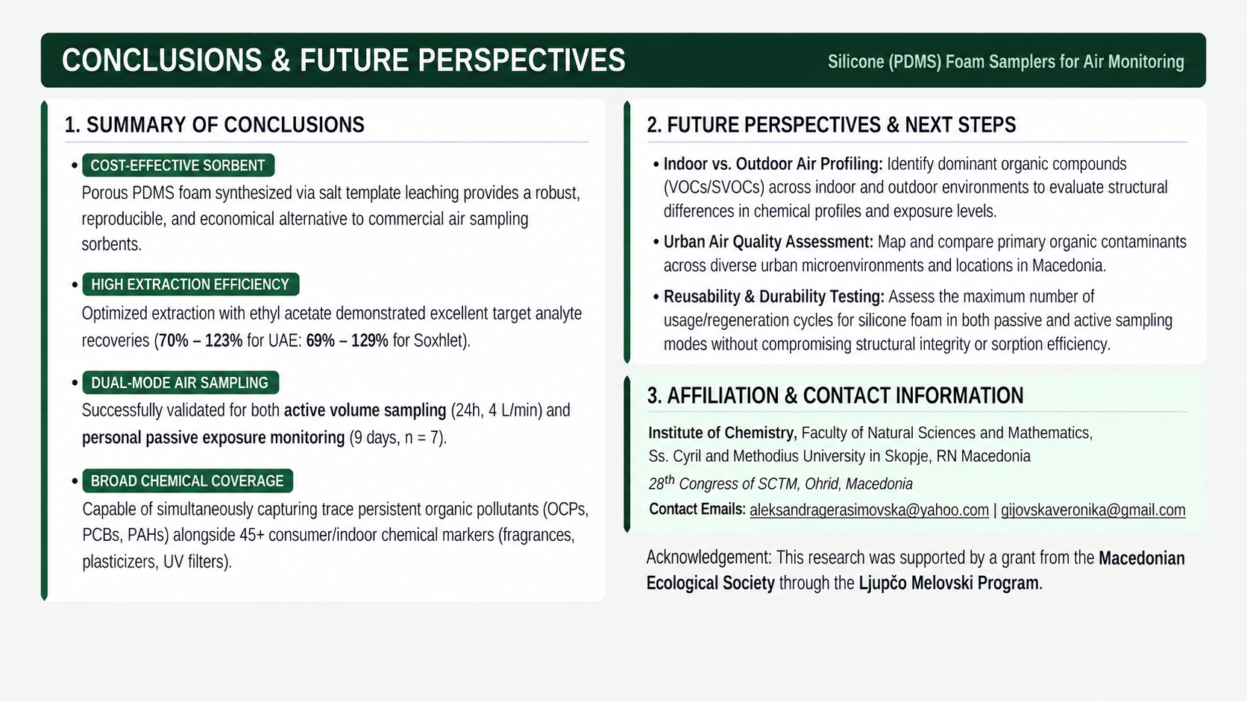
Conclusions

