Slide 1

VALIDATED ANALYTICAL APPROACH FOR SOIL CARBON MONITORING:
MULTI-CROP EVIDENCE FROM CARBON FARMING SYSTEMS
Biljana Balabanova*, Verica Ilieva, Sasa Mitrev, Aleksandar Piperevski
Faculty of Agriculture, Goce Delcev University, Krste Misirkov bb, 2000 Stip, Republic of North Macedonia
*biljana.balabanova@ugd.edu.mk
28th Congress of Chemists and Technologists of Macedonia
23-26 September, 2026, Metropol Lake Resort, Ohrid, Macedonia
Date: 24/09/2026

Slide 2
CARBONICA – Carbon Initiative for Climate-resilient Agriculture is a Horizon Europe project (Grant Agreement No.101087233) focused on accelerating the transition toward climate-resilient and low-carbon agricultural systems.
https://carbonica-hub.eu/
Date: 24/09/2026

Slide 3
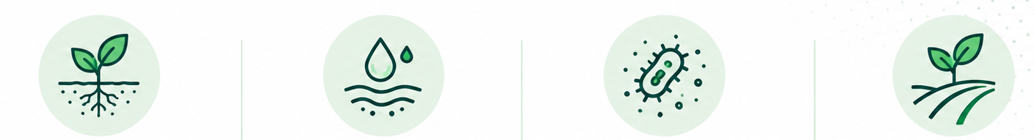
Carbon in soil
The importance of carbon in soil includes several key aspects, regarding:
1) Soil structure and water retention
2) Nutrient supply
3) Microbial activity
4) Soil fertility and productivity
5) Carbon sequestration
28th Congress of Chemists and Technologists of Macedonia
23-26 September, 2026, Metropol Lake Resort, Ohrid, Macedonia
Date: 24/09/2026

Slide 4


Carbon analysis
Accurate SOC measurements are essential for evaluating soil health, guiding fertilization strategies, and improving land productivity
Accurate data is necessary:
For quantifying carbon storage in soils
Informing climate policies
Participating in carbon credit markets
Accurate monitoring is essential for evaluating the effectiveness of sequestration practices and ensuring compliance with environmental policies and carbon credit systems.
28th Congress of Chemists and Technologists of Macedonia
23-26 September, 2026, Metropol Lake Resort, Ohrid, Macedonia
Date: 24/09/2026

Slide 5

Carbon aspects in agri-sector
Agriculture is an economic sector that requires large financial investments
Not every farmer is financially able to monitor the carbon content.
A general drawback is the availability of
cost-effective but precise analyses
Cost-effective methods enable widespread soil testing, especially for large-scale agricultural operations and research projects
Lowering the cost of analysis allows:
Better use of limited resources
Enhancing monitoring frequency
Geographic coverage
28th Congress of Chemists and Technologists of Macedonia
23-26 September, 2026, Metropol Lake Resort, Ohrid, Macedonia
Date: 24/09/2026

Slide 6



Carbon aspects in agri-sector
Soil carbon is highly variable across locations and depths, primarly depended from the lithogenic and pedogenic environment
Accurate measurement of SOC is essential for sustainable land management and climate mitigation strategies.
Reliable data is necessary for trading carbon credits and verifying offsets in voluntary and regulated carbon markets.
28th Congress of Chemists and Technologists of Macedonia
23-26 September, 2026, Metropol Lake Resort, Ohrid, Macedonia
Date: 24/09/2026

Slide 7

Carbon measurment
Accurate soil carbon determination traditionally relies on dry combustion methods which require expensive equipment and high operational costs
Cost-effective alternatives are needed to facilitate broader soil carbon monitoring, especially in resource-limited settings
Techniques like the Walkley-Black method and Total Organic Carbon (TOC) analyzers are frequently used to measure soil organic carbon (SOC)
28th Congress of Chemists and Technologists of Macedonia
23-26 September, 2026, Metropol Lake Resort, Ohrid, Macedonia
Date: 24/09/2026

Slide 8

Accurate measurement of SOC is essential for sustainable land management and climate mitigation strategies
Walkley-Black method is a traditional chemical approach
TOC analyzer represents a modern, automated solution
Both methods have distinct cost structures influenced by equipment, consumables, labor, and maintenance
Comparative analysis for both soil carbon analysis methods:
evaluate the accuracy
analyze cost and time efficiency
recommend best practices for implementation
28th Congress of Chemists and Technologists of Macedonia
23-26 September, 2026, Metropol Lake Resort, Ohrid, Macedonia
Date: 24/09/2026

Slide 9
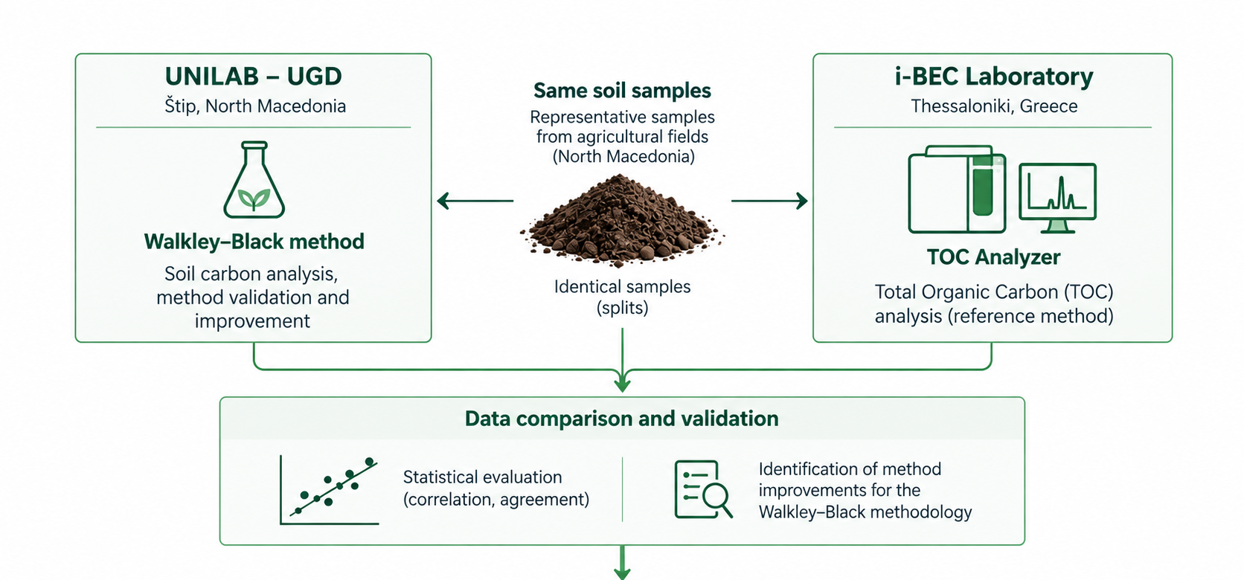

Main approach for validation
28th Congress of Chemists and Technologists of Macedonia
23-26 September, 2026, Metropol Lake Resort, Ohrid, Macedonia
Date: 24/09/2026

Slide 10

Walkley-Black method
Wet combustion method involving the oxidation of organic matter using potassium dichromate (K₂Cr₂O₇) in a sulfuric acid (H₂SO₄) medium.
Cost components included in the methodology are given as follow:
Chemicals: Potassium dichromate (K₂Cr₂O₇), sulfuric acid (H₂SO₄) and ferrous sulfate (FeSO₄) for titration;
Labor: Time required for sample preparation, titration, and calculations;
Equipment and consumables: Glassware (burettes, pipettes, flasks), balances and fume hoods;
Waste disposal: Costs associated with disposing of hazardous chromium-containing waste.
The analytical procedure includes: a known weight of soil (usually 0.5 to 1 g) is mixed with 1 N potassium dichromate solution. Than concentrated sulfuric acid is added, and the mixture is gently swirled to ensure complete reaction. The solution is left to cool. Excess dichromate is titrated with 0.5 N ferrous sulfate solution using an appropriate indicator (usually diphenylamine or orthophenanthroline). The organic carbon content is calculated based on the amount of dichromate reduced.
28th Congress of Chemists and Technologists of Macedonia
23-26 September, 2026, Metropol Lake Resort, Ohrid, Macedonia
Date: 24/09/2026

Slide 11

Extracted dominant cost
Cost variables are defined for each method based on actual data from equipment manufacturers, chemical suppliers, and laboratory operations
Table 1. Cost breakdown per sample (average costs values are given as Euro per sample)
Component | TOC analyser | Walkley-Black method
Capital equipment | 5.00 | 0.50
Consumables | 6.50 | 2.00
Labor | 2.00 | 4.00
Maintenance | 1.00 | 0.30
Waste disposal | 0.10 | 0.70
Total | 14.6 | 7.50
Balabanova et al. (2024). Journal of Agriculture and Plant Sciences, 22(2), 15–24. DOI: 10.46763/JAPS2422215b.
28th Congress of Chemists and Technologists of Macedonia
23-26 September, 2026, Metropol Lake Resort, Ohrid, Macedonia
Date: 24/09/2026

Slide 12
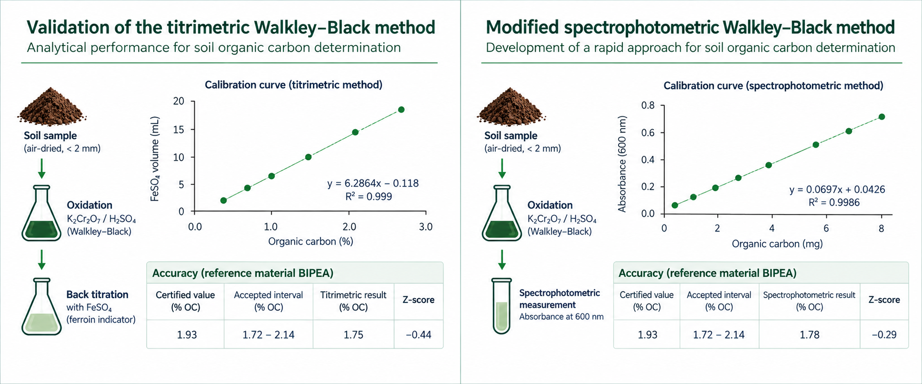
28th Congress of Chemists and Technologists of Macedonia
23-26 September, 2026, Metropol Lake Resort, Ohrid, Macedonia
Date: 24/09/2026

Slide 13
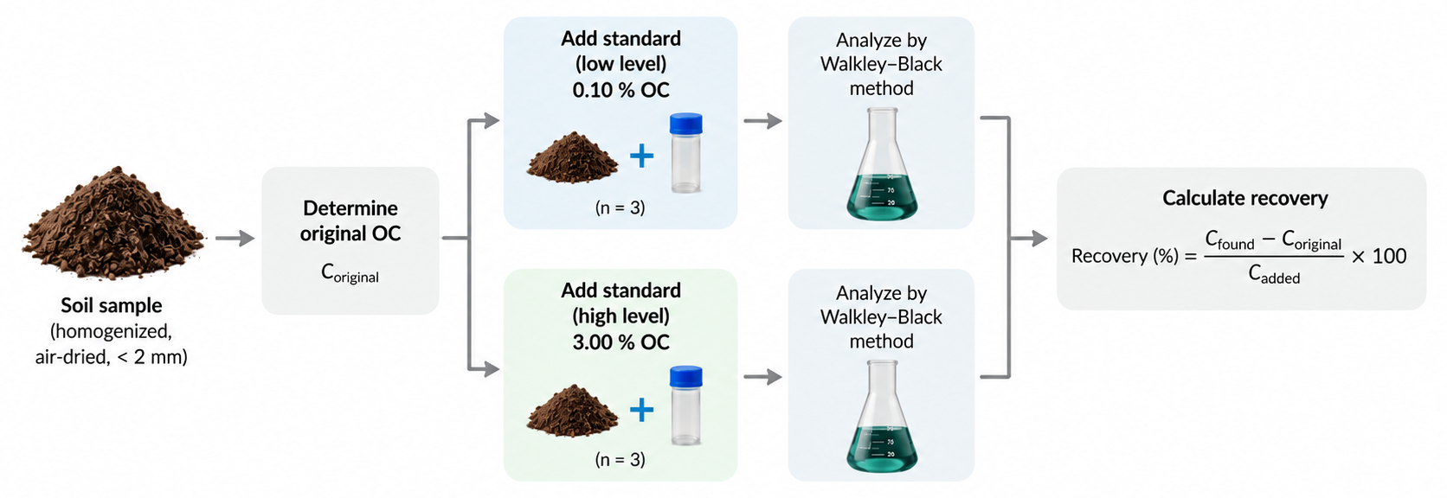
Accuracy – standard addition (spike-recovery) approach
 | Low level | High level
Original OC (%) | 0.85 | 0.85
Added OC (%) | 0.10 | 3.00
Found OC (%) | 0.957 | 3.81
Recovery (%) | 107.2 | 98.7
The somewhat higher recovery observed at the low concentration level indicates a greater relative contribution of analytical variability near the lower end of the working range, while the high-level recovery was close to the theoretical value.
28th Congress of Chemists and Technologists of Macedonia
23-26 September, 2026, Metropol Lake Resort, Ohrid, Macedonia
Date: 24/09/2026

Slide 14
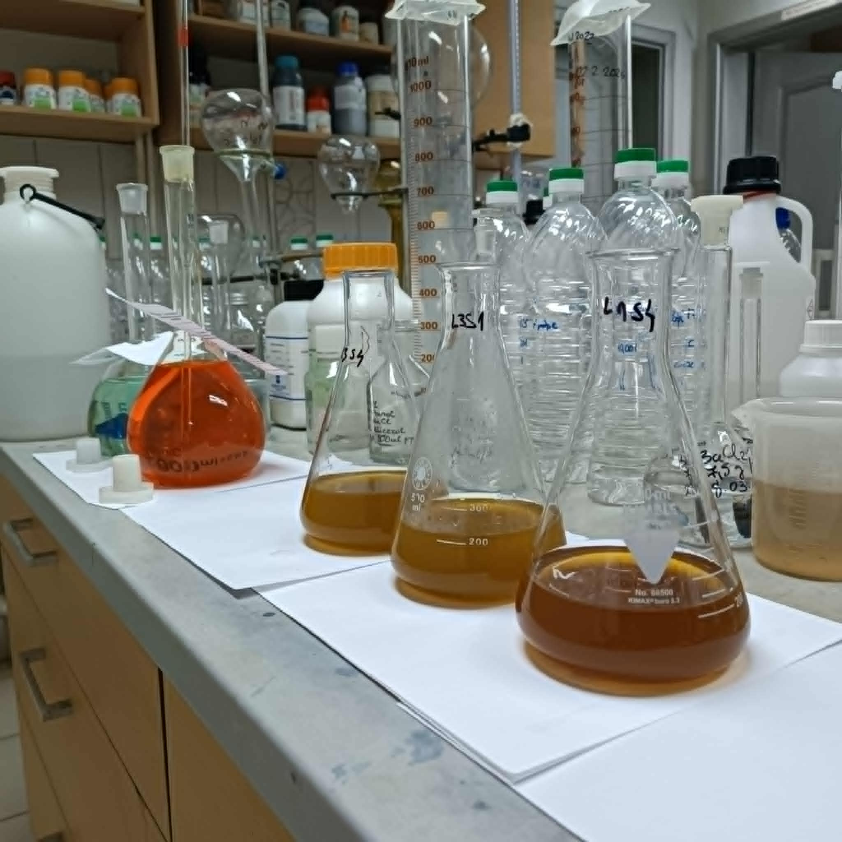
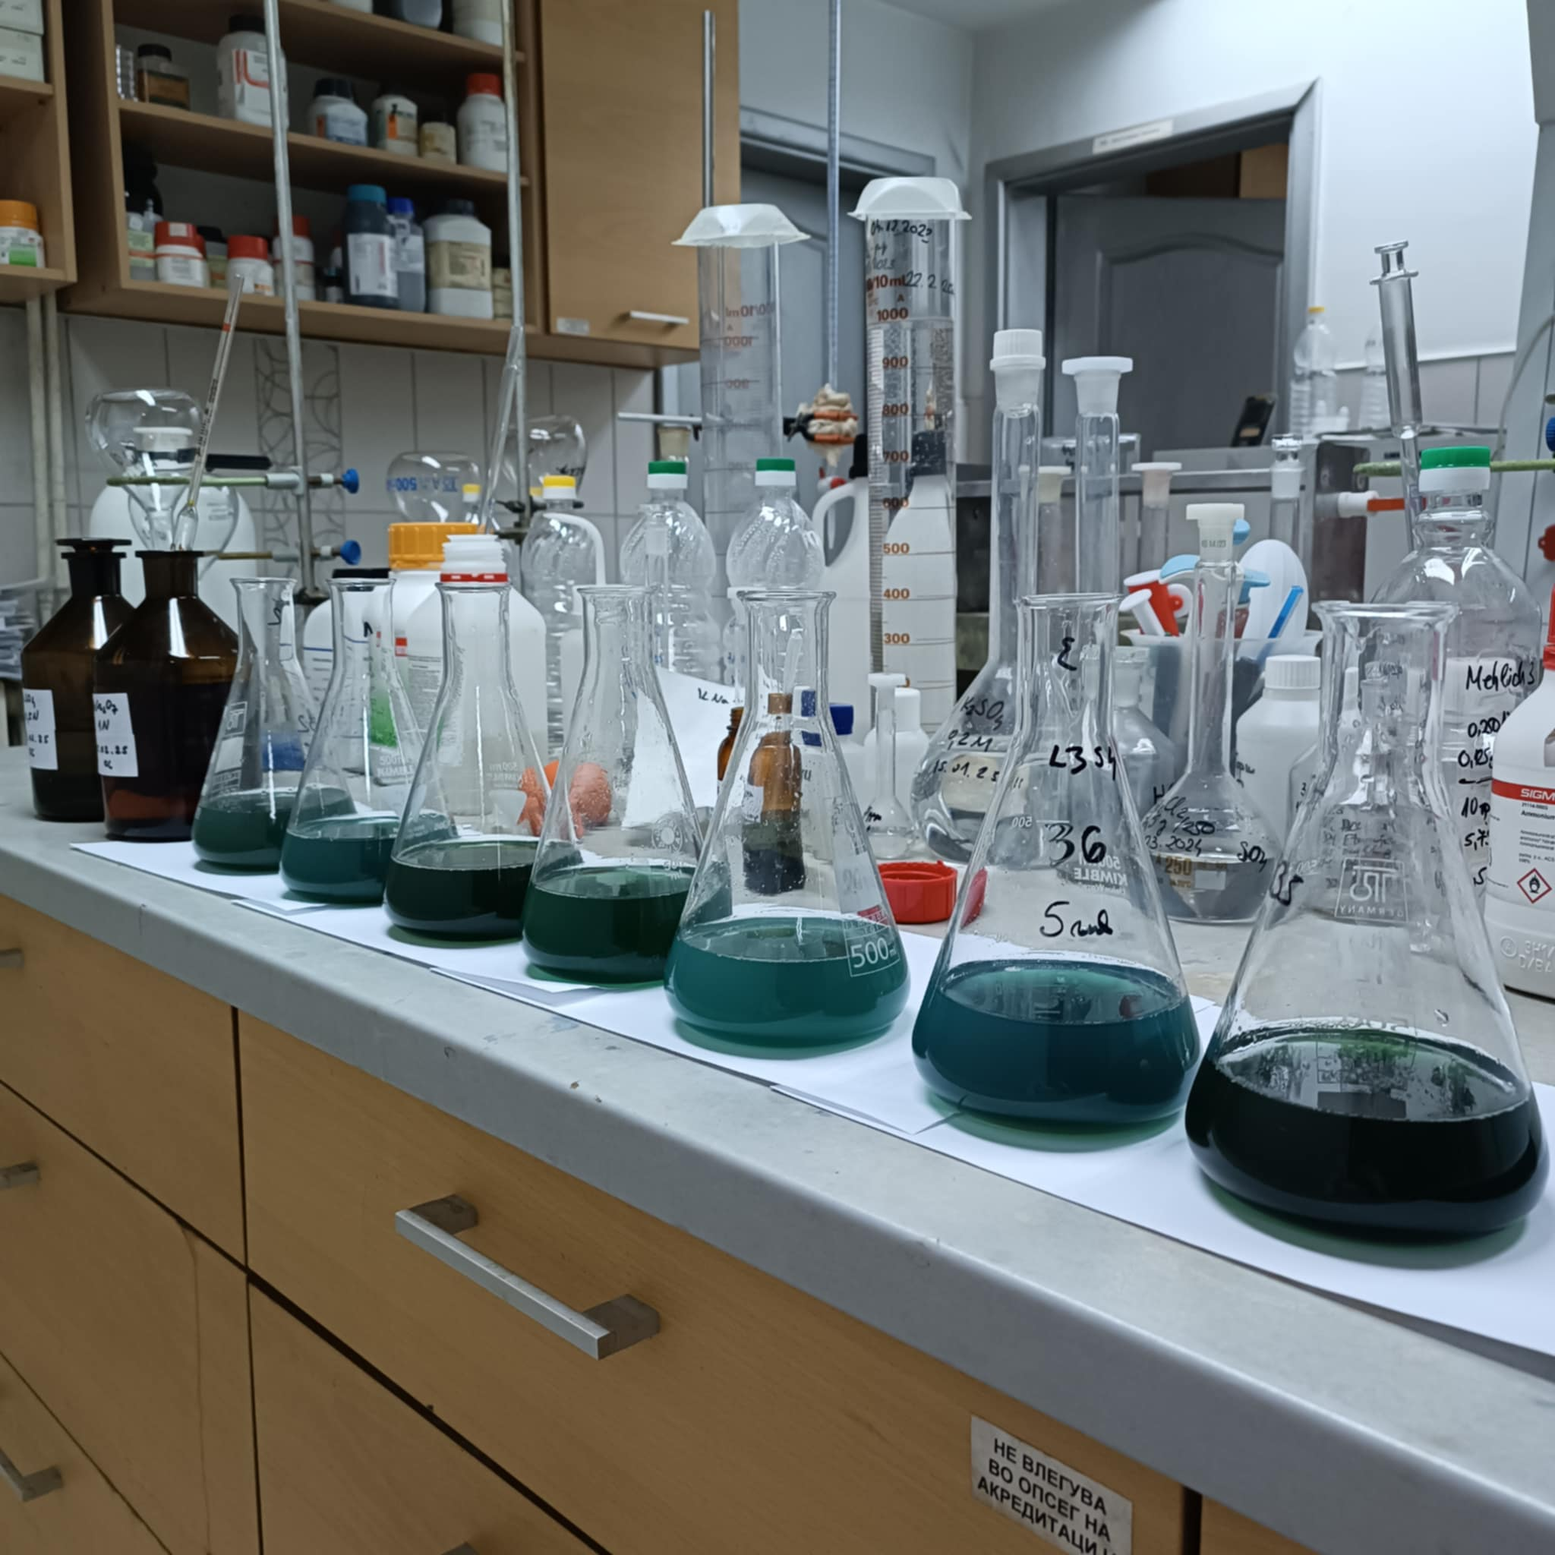
Reagent/Material | Specification | Purpose
K₂Cr₂O₇ | Analytical grade | Oxidizing agent
H₂SO₄ | 95-98% | Oxidation medium
FeSO₄·7H₂O | 0.5 N | Back titration
H₃PO₄ | Analytical grade | Reaction stabilization
Diphenylamine | 0.5% | Endpoint indicator
Glucose | Analytical standard | Calibration and validation
BIPEA CRM | Certified reference soil, code 212-0115-0069 | Accuracy verification
Repeatability / precision
Series | n | Mean FeSO₄ (mL) | SD (mL) | RSD (%)
Blank | 10 | 19.84 | 0.052 | 0.26
Real soil sample | 10 | 17.05 | 0.071 | 0.41
BIPEA reference soil | 10 | 14.11 | 0.160 | 1.13
Ten replicate determinations under repeatability conditions (n = 10)
28th Congress of Chemists and Technologists of Macedonia
23-26 September, 2026, Metropol Lake Resort, Ohrid, Macedonia
Date: 24/09/2026

Slide 15
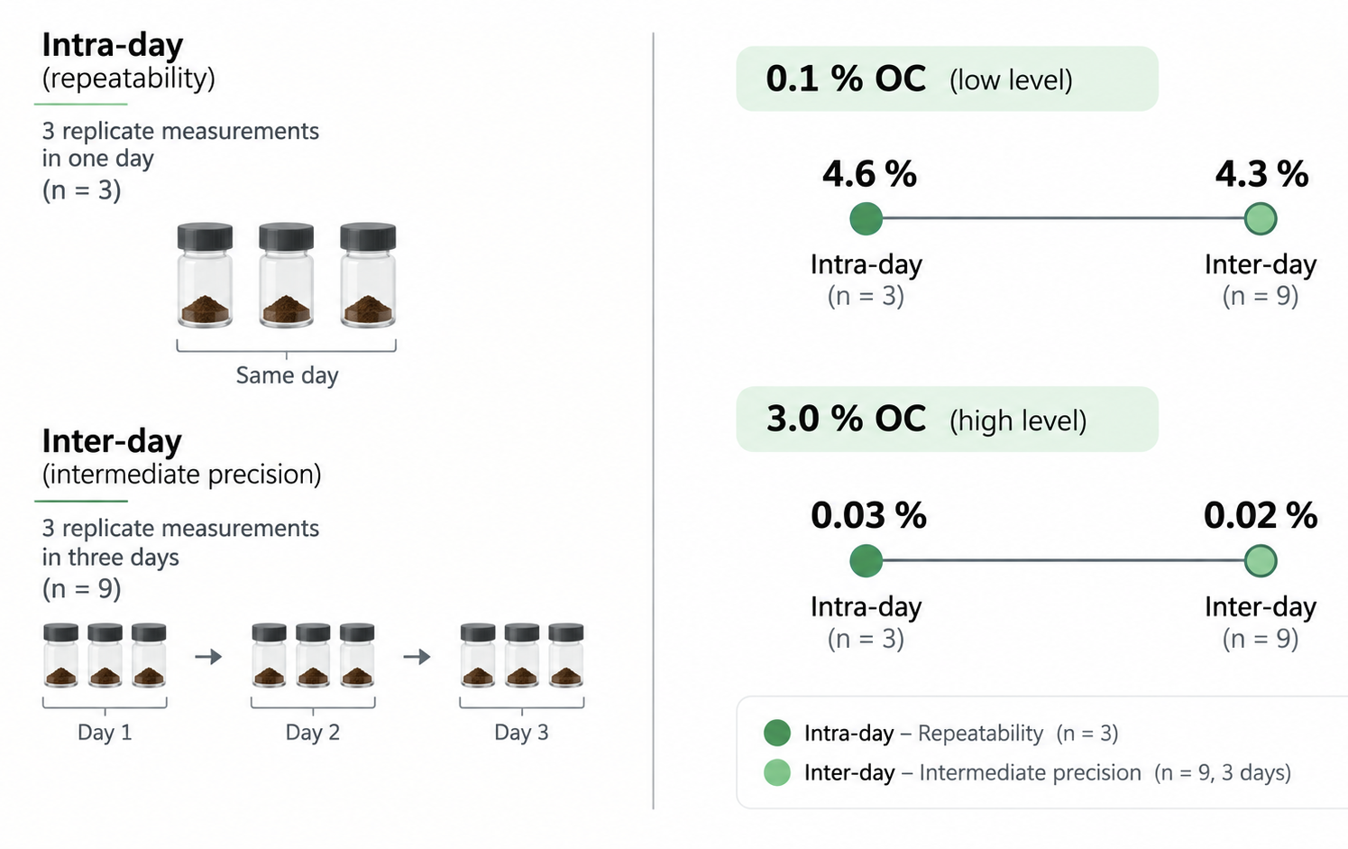
28th Congress of Chemists and Technologists of Macedonia
23-26 September, 2026, Metropol Lake Resort, Ohrid, Macedonia
Date: 24/09/2026

Slide 16
Comparative analysis based on quality assurance (QA) of the methods
TOC analyzer provides high accuracy, referred with values of analytical recovery in the range from 86 to 112 % (validation submitted from i-BEC laboratory)
Walkley-Black method: Historically reliable but tends to underestimate TOC by 10-30% since it does not oxidize all organic carbon. Accuracy depends on the assumption of a fixed efficiency factor (higher than 77%).
Data summary of comparative analysis of published improvements in QA for TOC analyzer and WB method
Sensitivity check | Improvement | TOC analyser | WB method
Precision | MAE (%) | 1.70 | 1.65
Accuracy | SD (%) | 0.45 | 0.52
Uncertanity | CV (%) | 2.65 | 4.28
*MAE - Mean Apsolute Error, SD - Standard Deviations, CV – Coefficient of Variation
28th Congress of Chemists and Technologists of Macedonia
23-26 September, 2026, Metropol Lake Resort, Ohrid, Macedonia
Date: 24/09/2026

Slide 17
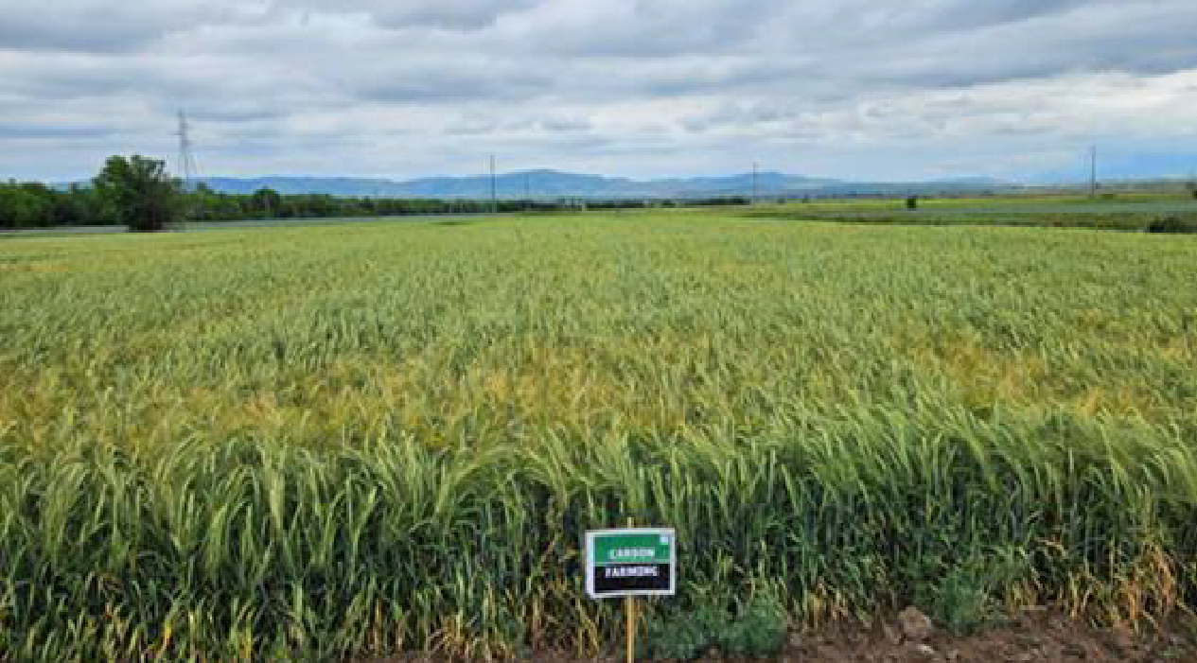
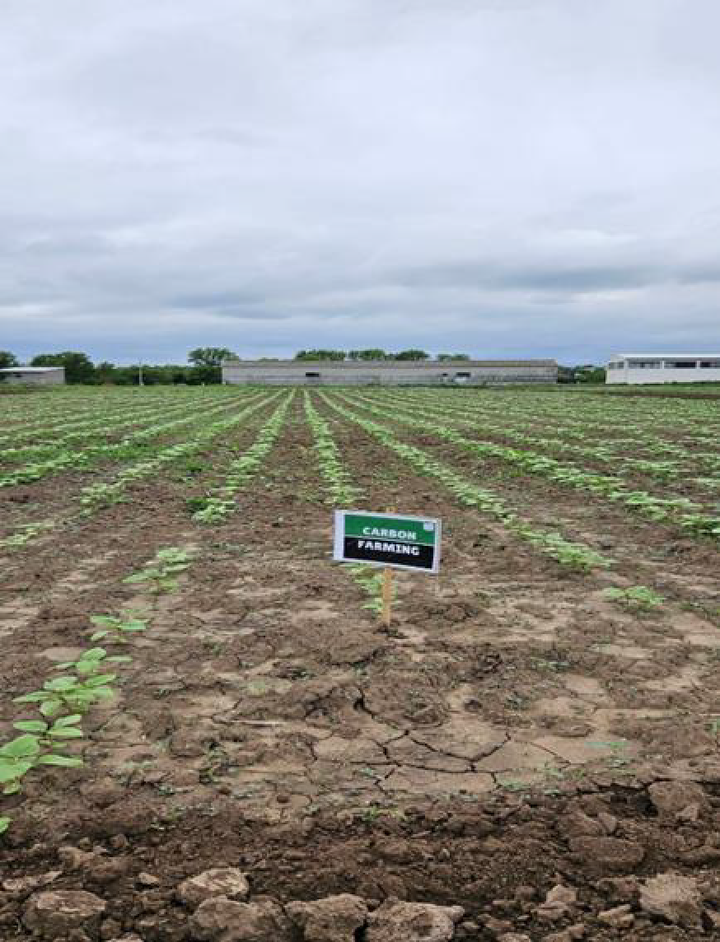
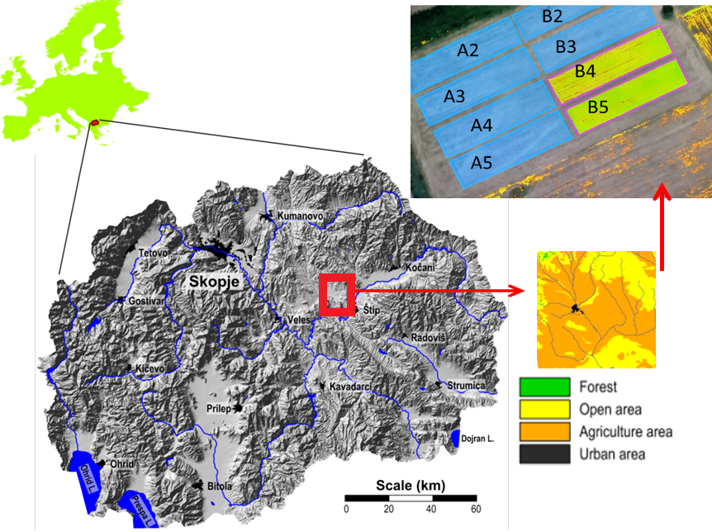
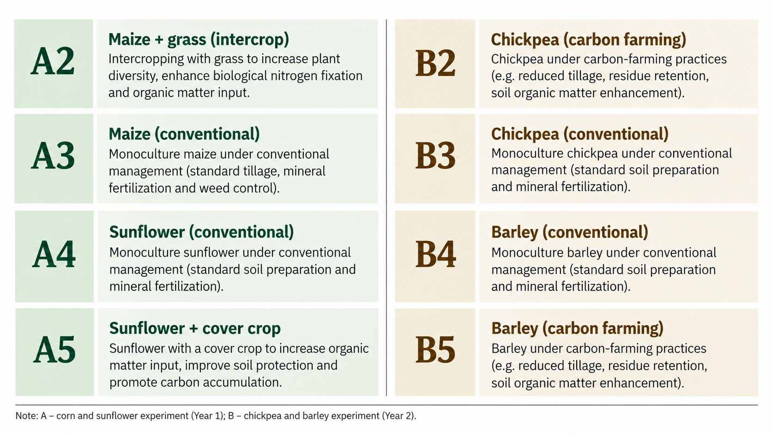
In situ piloting
28th Congress of Chemists and Technologists of Macedonia
23-26 September, 2026, Metropol Lake Resort, Ohrid, Macedonia
Date: 24/09/2026

Slide 18
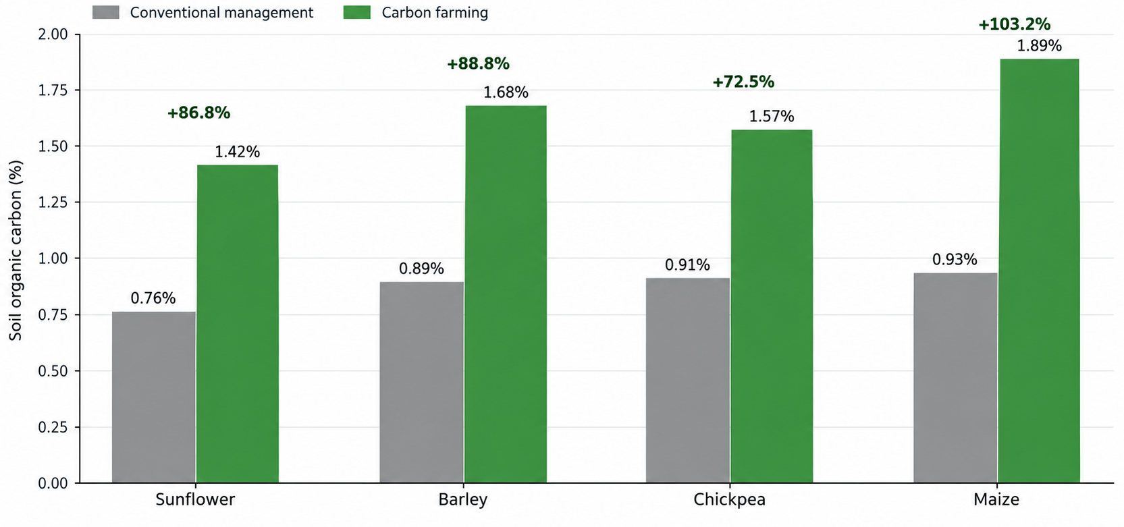
Carbon dynamics by crop
Balabanova et al., 2025, J. Agric. Plant Sci., 23(1), 19–32. DOI: 10.46763/JAPS2523119b
Balabanova et al., 2026, J. Agric. Plant Sci., 24(1), 9–22. DOI: 10.46763/JAPS2624109b
28th Congress of Chemists and Technologists of Macedonia
23-26 September, 2026, Metropol Lake Resort, Ohrid, Macedonia
Date: 24/09/2026

Slide 19
Concluding remarks
Effective carbon sequestration monitoring is vital for climate action, sustainable agriculture, and economic incentives through carbon trading.
Investing in reliable, cost-effective, and scalable monitoring systems will enhance global efforts to manage carbon and mitigate climate change.
Selection should be based on project scale, precision requirements, and available resources
The predictive cost model enables better financial planning for laboratories and research institutions
Cost per sample can be minimized by optimizing reagent use, training staff for efficiency, and investing in durable equipment.
28th Congress of Chemists and Technologists of Macedonia
23-26 September, 2026, Metropol Lake Resort, Ohrid, Macedonia
Date: 24/09/2026

Slide 20

Concluding remarks
The TOC Analyzer is superior in both accuracy and precision, making it the preferred method for critical applications, while the Walkley-Black method remains valuable for cost-effective, routine SOC analysis with acceptable precision
The TOC Analyzer leads in precision and accuracy but is limited by cost and complexity, while the Walkley-Black Method is cost-effective but less reliable, offering unique advantages for field application.
Soils act as major carbon sinks, storing carbon and mitigating climate change by reducing atmospheric carbon dioxide levels
28th Congress of Chemists and Technologists of Macedonia
23-26 September, 2026, Metropol Lake Resort, Ohrid, Macedonia
Date: 24/09/2026

Slide 21


Discover more insights and interact with our project data, visit our website today!
https://carbonica-hub.eu/
28th Congress of Chemists and Technologists of Macedonia
23-26 September, 2026, Metropol Lake Resort, Ohrid, Macedonia
Date: 24/09/2026

Slide 22


Slide 23

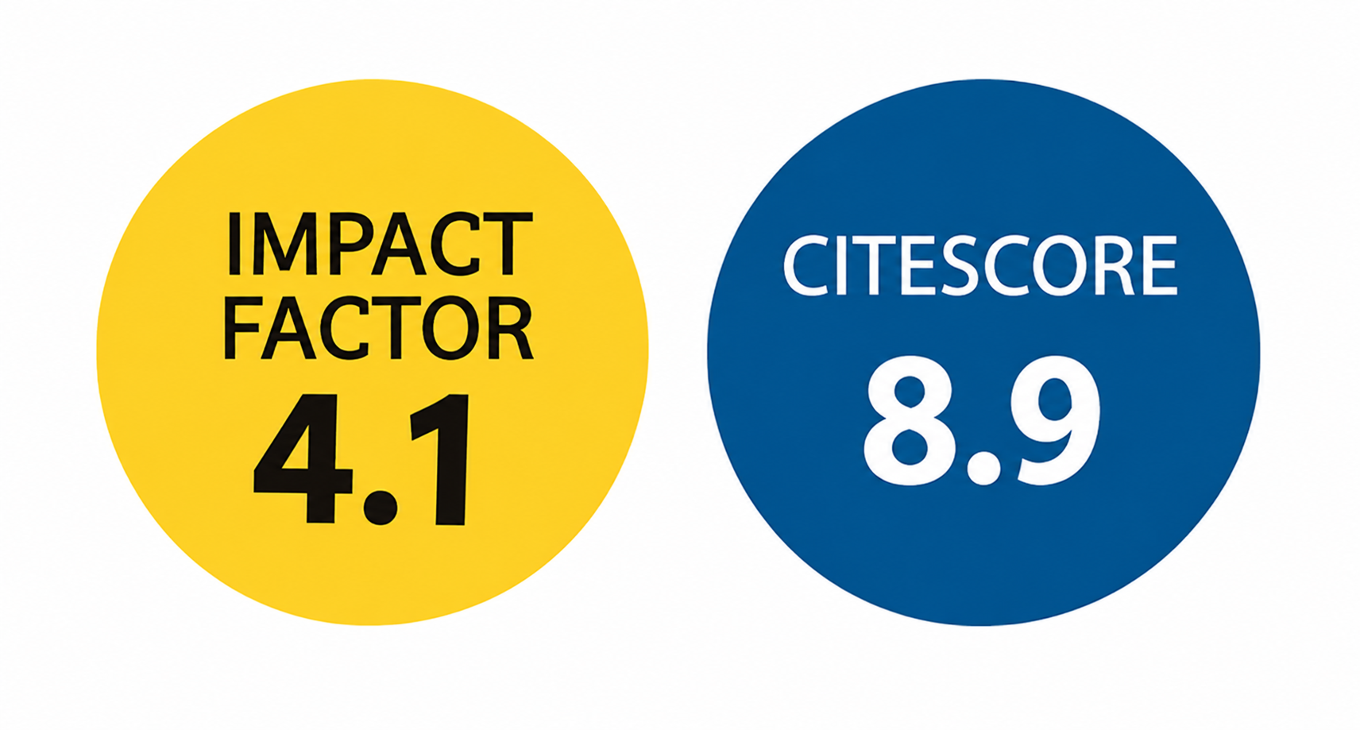

Translational Research in Sustainable Agriculture: Integrating Data Science, Technology and Field Practice
(https://www.mdpi.com/journal/sustainability/special_issues/P4I3NH1QSH)
Keywords
translational research
sustainable agriculture
agroecology
agroecosystem management
precision agriculture
digital agriculture
data science in agriculture
Deadline for manuscript submissions: 31 March 2027

