Slide 1

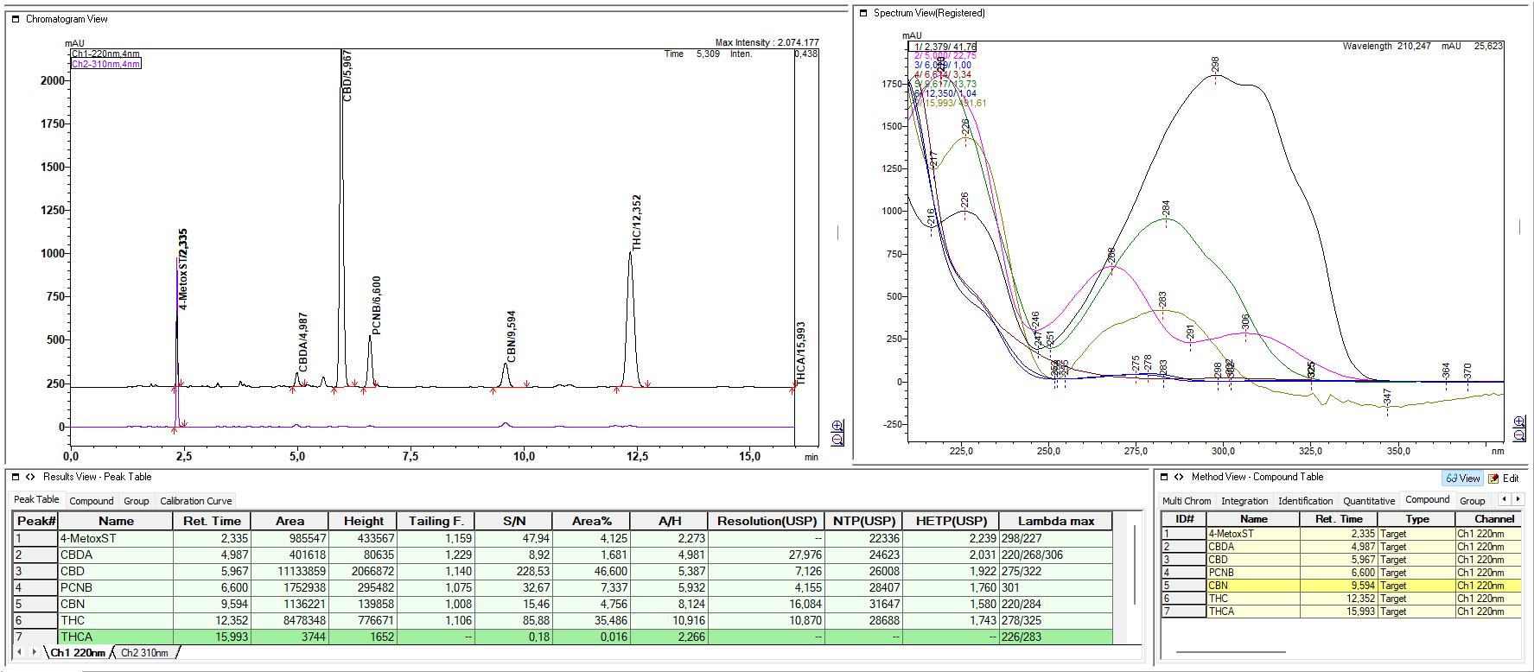

28th Congress of SCTM, 23-26 September, Ohrid, Macedonia
AEC-P16
INTERNAL STANDARDS USE IN ANALYSES OF CANNABINOIDS
Marjan Piponski¹, Antonija Beneta²,
¹ Quality Control Galafarm , piponski99@gmail.com, , Skopje,. North Macedoima; Managing Dir and Chief Analyst in LabSense d.o.o., Borongajska Cesta 83H, Zagreb, Croatia ²,
Introduction & Aim
According to regulations in HPLC analytics of cannabinoids, the re-injections counted or repeated analyses are considered as obligation, for example after Solvent (Blank) , Mobile Phase, the Calibration Set of Standards are ultimately injected 6x-times as first Precision confirmations, and after that every herbal or extract samples are prepared indouble and injectd each twice. We are expanding the idea for use of Internal Standard Molecules in Samples and Standard , in aim to elimninate the need for reinjections, thus halving the Cost-effficiency, shortening times till results acquiring, and signficantly increasing the Green-es of overall analyses
Experimental :
Results and
discussion
For our research performing, U/HPLC-PDA systems Shimadzu Nexera 2060c-3D controlled with Lab Solutions and Agilent with PDA 1260 II controled by Open Lab-(Chem Station). Standards of cannabinoids, sets of 12 and 11 and 5 (CBDA,CBD, CBN, d9-THC and d9-THCA) were purchased from Lipomed. The standards trans-4-Stilbene Methanol and pentachloronitrobenzene, were purchased from Supelco-MERCK. The solid-core , or porous-shell columns were used 50-100 x 4,6mm 2,7um particles, in mobile phase combined with iscratic elution with acetonitrile and trifluoroaceti or ortho-Phosphoric acid, under PDA multi-Channnel at 220nm-280nm, at 30`C and F=1ml/min. The Response factors were calculated and compared
.
Our preliminary research showed very interesting and promising results, which would need further improvement and checks. When we compared the External Standard Mode with Internal Standard Mode determinations, quantitative results for levels 5 most important cannabinoids , CBDA,CBD,CBN,d9-THC and d9-THCA, the results in Contents, Precision, Accuracy were very similar, RSD in % differing in range 0,9 -1,87%. Higher variations as expected showed results with acidic type of cannabinoids, CBDA and THCA. Other factor which could effect accuracy of Internal Standard Mode of determination, were levels of near by eluting components, as inherent feature to samples. There after we tested two very different molecules for Internal Standards, trans-4-methoxysilbene as very polar and early eluting, and more hydophobic pentachlotonitrobenzene
Conclusions
T
Text: recommended, The U/HPLC analyses for determination of cannabinoids, especially the 5 important to pharmacy, can be simplified Cost-effectively and Environmentally, by aimin of use Internal Standard Quantification methods, by searching, testing and estimating the best choice of most adequate candidates, the best imitating behaviour to canabinoides in testing solutions and interactions during analyses processes This research we hope will prompt further research projects and activities in this way
Acknowledgement :
T
his poster presentation was made possible by the
generous support of the Management Team of
LabSense company from Zagreb, Croatia

