Slide 1

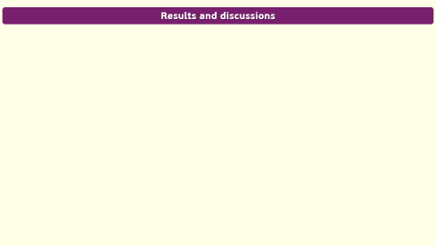
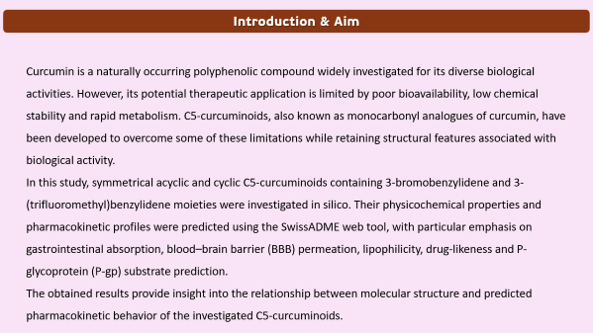
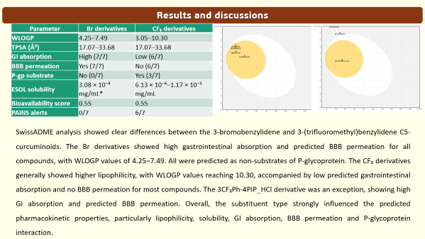
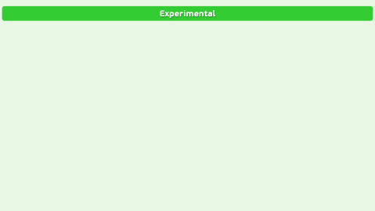
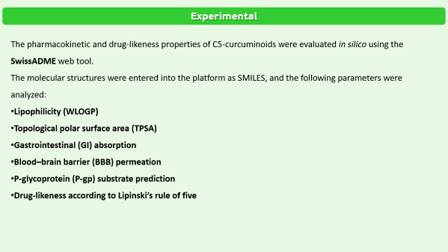
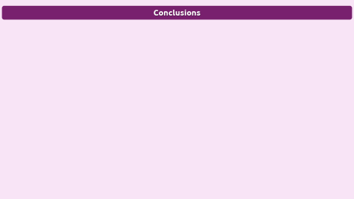
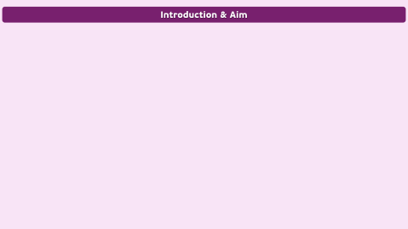
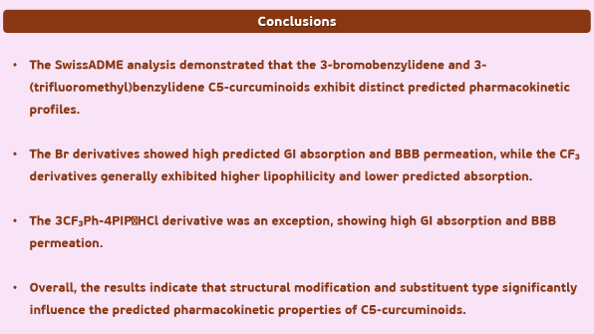
28th Congress of SCTM, 23-26 September, Ohrid, Macedonia
In Silico Pharmacokinetic Studies of Symmetrical Acyclic and Cyclic of C5-Curcuminoids Containing 3-bromobenzylidene and 3-(trifluoromethyl)benzylidene Moiety
Arjan Ganiji, Milena Kolevska, Jane Bogdanov
Institute of Chemistry, Faculty of Natural Sciences and Mathematics, Ss. Cyril and Methodius University, Arhimedova 5, 1000 Skopje, R. N. Macedonia

Slide 2
Introduction & Aim
Curcumin is a naturally occurring polyphenolic compound widely investigated for its diverse biological activities. However, its potential therapeutic application is limited by poor bioavailability, low chemical stability and rapid metabolism. C5-curcuminoids, also known as monocarbonyl analogues of curcumin, have been developed to overcome some of these limitations while retaining structural features associated with biological activity.
In this study, symmetrical acyclic and cyclic C5-curcuminoids containing 3-bromobenzylidene and 3-(trifluoromethyl)benzylidene moieties were investigated in silico. Their physicochemical properties and pharmacokinetic profiles were predicted using the SwissADME web tool, with particular emphasis on gastrointestinal absorption, blood–brain barrier (BBB) permeation, lipophilicity, drug-likeness and P-glycoprotein (P-gp) substrate prediction.
The obtained results provide insight into the relationship between molecular structure and predicted pharmacokinetic behavior of the investigated C5-curcuminoids.

Slide 3
Experimental
The pharmacokinetic and drug-likeness properties of C5-curcuminoids were evaluated in silico using the SwissADME web tool.
The molecular structures were entered into the platform as SMILES, and the following parameters were analyzed:
Lipophilicity (WLOGP)
Topological polar surface area (TPSA)
Gastrointestinal (GI) absorption
Blood–brain barrier (BBB) permeation
P-glycoprotein (P-gp) substrate prediction
Drug-likeness according to Lipinski’s rule of five

Slide 4
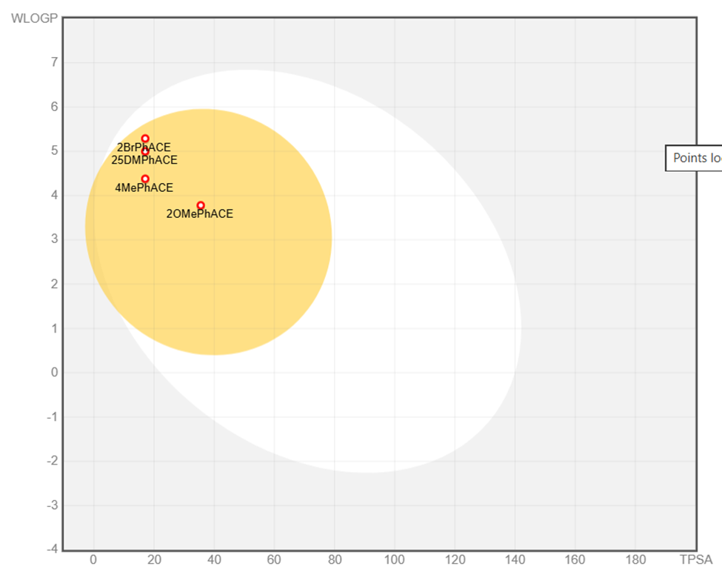
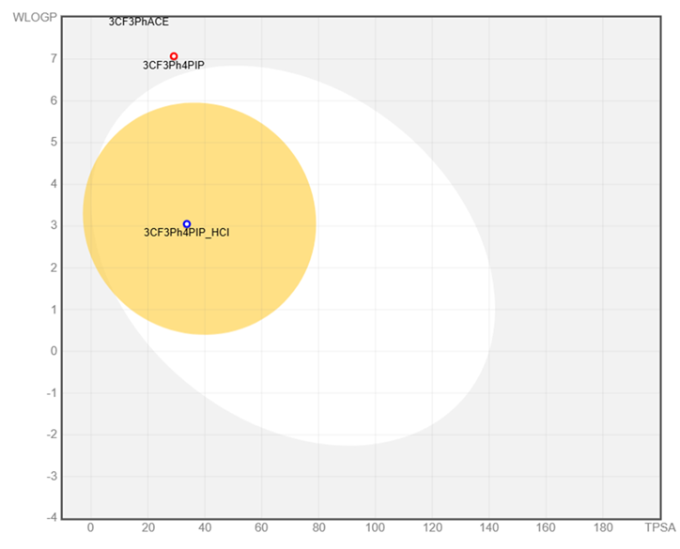
Results and discussions
Parameter | Br derivatives | CF₃ derivatives
WLOGP | 4.25–7.49 | 3.05–10.30
TPSA (Å²) | 17.07–33.68 | 17.07–33.68
GI absorption | High (7/7) | Low (6/7)
BBB permeation | Yes (7/7) | No (6/7)
P-gp substrate | No (0/7) | Yes (3/7)
ESOL solubility | 3.08 × 10⁻⁴ mg/mL* | 6.13 × 10⁻⁶–1.17 × 10⁻³ mg/mL
Bioavailability score | 0.55 | 0.55
PAINS alerts | 0/7 | 6/7
SwissADME analysis showed clear differences between the 3-bromobenzylidene and 3-(trifluoromethyl)benzylidene C5-curcuminoids. The Br derivatives showed high gastrointestinal absorption and predicted BBB permeation for all compounds, with WLOGP values of 4.25–7.49. All were predicted as non-substrates of P-glycoprotein. The CF₃ derivatives generally showed higher lipophilicity, with WLOGP values reaching 10.30, accompanied by low predicted gastrointestinal absorption and no BBB permeation for most compounds. The 3CF₃Ph-4PIP_HCl derivative was an exception, showing high GI absorption and predicted BBB permeation. Overall, the substituent type strongly influenced the predicted pharmacokinetic properties, particularly lipophilicity, solubility, GI absorption, BBB permeation and P-glycoprotein interaction.

Slide 5
Conclusions
The SwissADME analysis demonstrated that the 3-bromobenzylidene and 3-(trifluoromethyl)benzylidene C5-curcuminoids exhibit distinct predicted pharmacokinetic profiles.
The Br derivatives showed high predicted GI absorption and BBB permeation, while the CF₃ derivatives generally exhibited higher lipophilicity and lower predicted absorption.
The 3CF₃Ph-4PIP_HCl derivative was an exception, showing high GI absorption and BBB permeation.
Overall, the results indicate that structural modification and substituent type significantly influence the predicted pharmacokinetic properties of C5-curcuminoids.

