Slide 1



16th Students’ Congress of SCTM
Oct. 27-28, 2025, Faculty of Technology and Metallurgy, Skopje, N. Macedonia
Tribocatalytic degradation of Cephalexin by sol-gel ZnO powders: effect of the solvent
Trajce Trajkov, Nina Kaneva
Laboratory of Nanoparticle Science and Technology, Department of General and Inorganic Chemistry, Faculty of Chemistry and Pharmacy, University of Sofia, 1 James Bourchier Blvd., 1164 Sofia, Bulgaria
*Corresponding author’s e-mail: trajce_trajkov11@hotmail.com

Slide 2
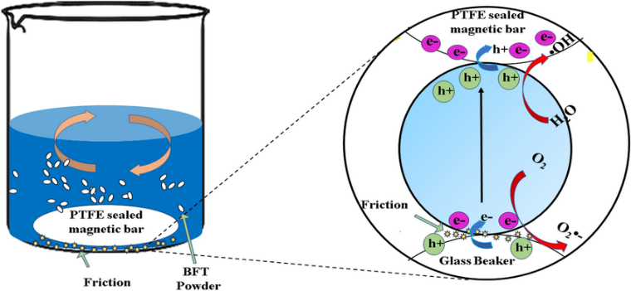
Tribocatalysis
Most effective, environmentally friendly method;
Self-powered;
Does not require light nor heat.
Glass beaker material
Isolator;
Low electron affinity;
Electron donor;
Positively charged.
PTFE beaker material
Higher affinity towards electrons-acceptor;
Negatively charged;
Capable of generating triboelectric charges under low-frequency mechanical forces.

Slide 3
Aims
Preparation of sol-gel ZnO powders with different solvent.
Characterization of the surface morphology and crystallite size of the ZnO powders by Scanning Electron Miscrosopy (SEM), Energy-Dispersive X-ray Spectroscopy (EDS), X-ray diffraction(XRD).
Investigation of the degradation of Cephalexin (persistent antibiotic pollutant), using tribocatalysis - low-cost, energy-saving, and sustainable method. By adjusting the stirring speed and the types of beaker materials, the degradation efficiency can be improved
Evaluation of the influence of solvents (methanol, ethanol) in minimizing electron–hole recombination.

Slide 4
Reagents and Materials
Precursors:
Zn(CH₃COO)₂.2H₂O, Sigma-Aldrich (≥ 99.5 %)
NaOH, Sigma-Aldrich (≥ 99.5 %)
CH₃OH, Sigma-Aldrich (≥ 99.5 %)
C₂H₅OH, Sigma-Aldrich (≥ 99.5 %)
Pollutants:
Cephalexin (C₁₆H₁₇N₃O₄S, λmax = 262 nm), Teva (≥ 99.0 %)
Distilled water is used in the preparation of pharmaceutical drug solutions

Slide 5
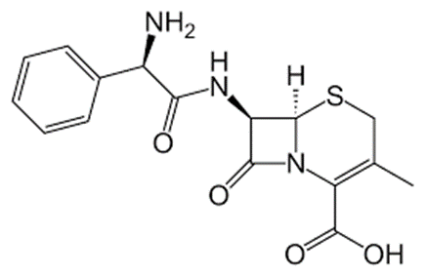
Pollutant
Structure | Indications | High dosage effects
Cephalexin | Cephalexin is indicated for the treatment of certain infections caused by susceptible bacteria. These infections include respiratory tract infections, otitis media, skin and skin structure infections, bone infections, and genitourinary tract infections. | nausea, vomiting, stomach pain neurotoxicity(agitation,confusion,seizures, kidney failures)

Slide 6
SOlvents
Methanol | Ethanol
smaller and reactive molecule not recombinating but reacting with positive charges CH₃OH+q⁺→.CH₂OH+ H⁺ CH₂OH-attacks pollutants-contributing to degradation good dispersion with ZnO-more active sites for electron transfer. | Same method,slower rate C-C bond-less favorable oxidation forms radical C₂H₄OH-reacts with positive charges-less reactive C₂​H_{5​}OH+q⁺→⋅CH₂​CH_{2​}OH + H⁺

Slide 7
Scanning electron microscopy
a)
b)
SEM images of sol-gel ZnO samples with (a) ethanol and (b) methanol.

Slide 8
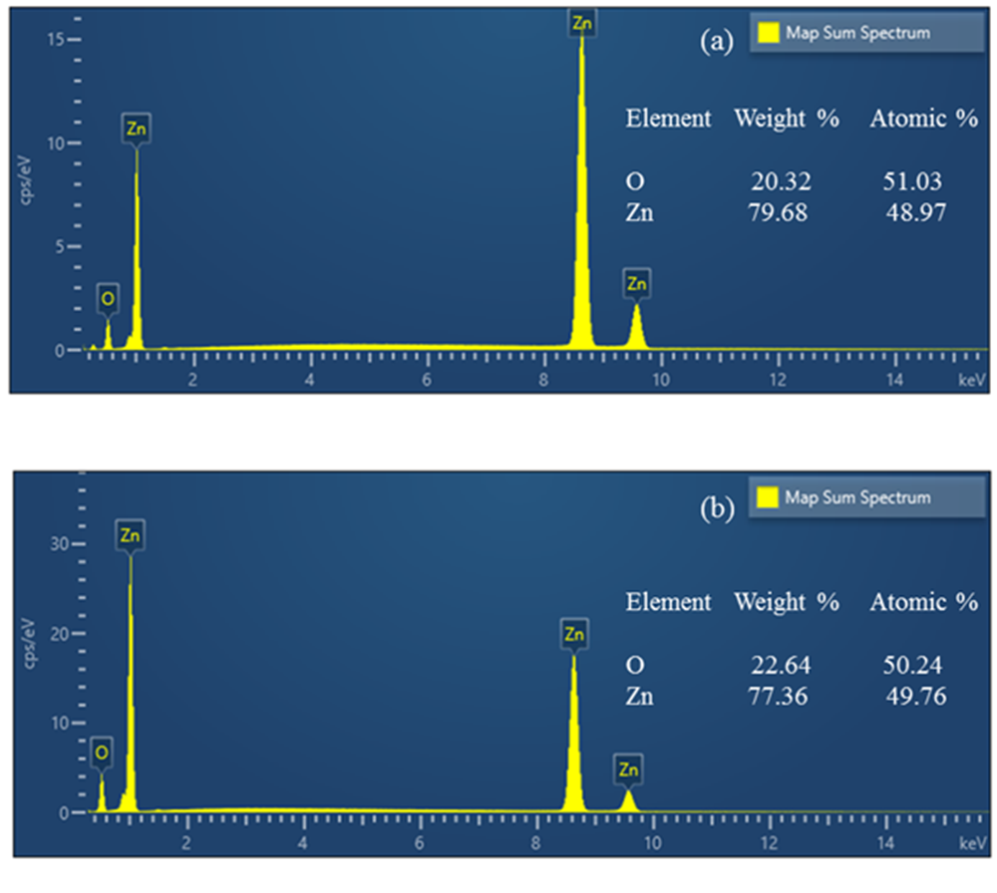
Energy-Dispersive spectroscopy
a)
EDS spectra of ZnO powders with (a) ethanol and (b) methanol.
b)

Slide 9
X-ray Diffraction
XRD pattern of sol–gel ZnO powders.
ZnO Tribocatalysts with | Crystallite Size, nm | Parameters, Å
Ethanol | 40.6 | a, b : 3.250
 |  | c: 5.207
Methanol | 33.1 | a, b: 3.2407
 |  | c: 5.2017
The XRD patterns of the sol–gel samples were used to calculate the structural parameters.

Slide 10
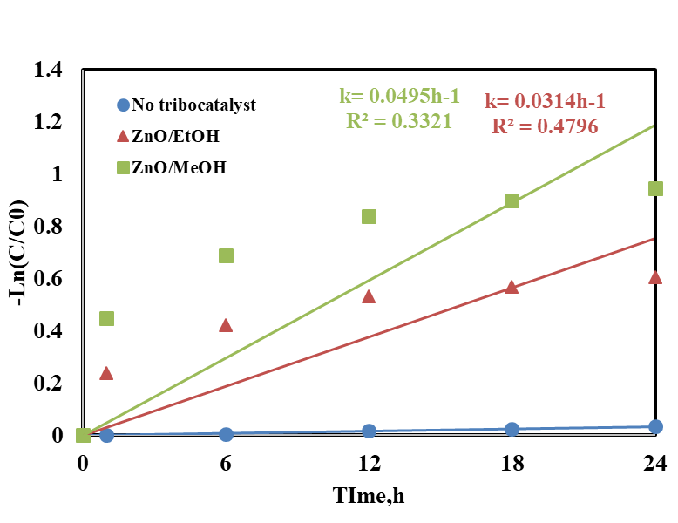
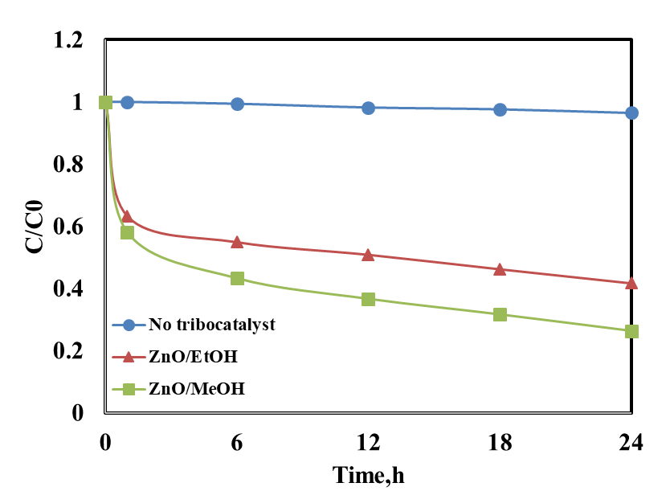
Tribocatalysis of Cephalexin—Effect of solvent (ethanol and methanol)
Tribocatalysis of Cephalexin using ZnO powders with methanol and ethanol as solvents

Slide 11
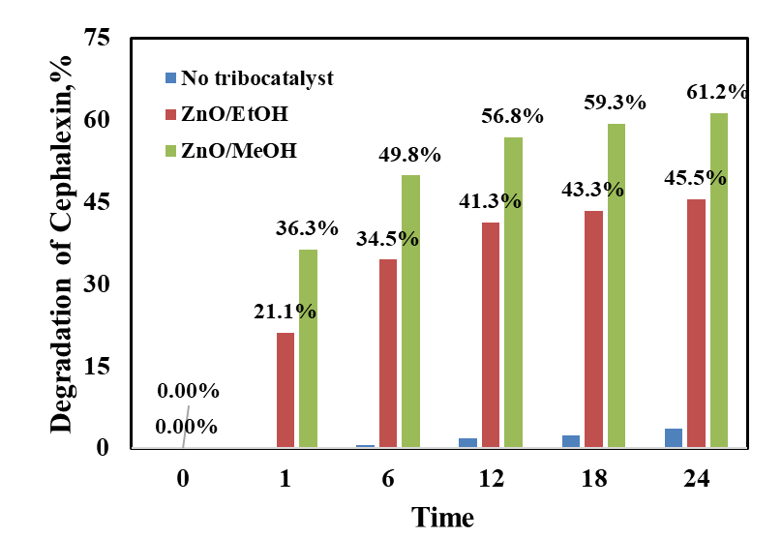
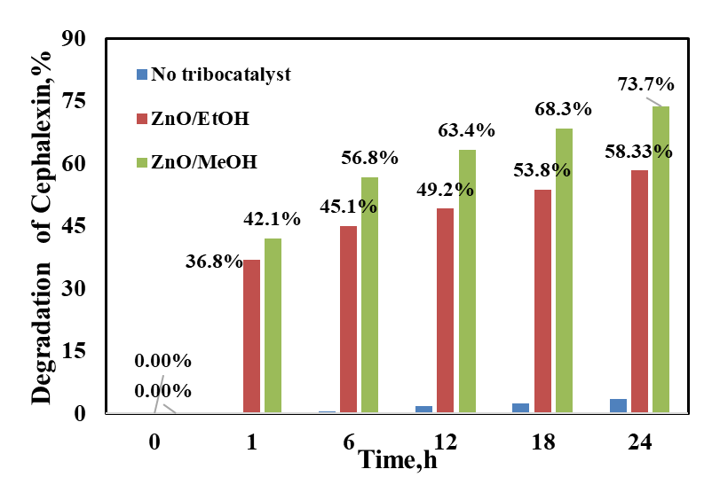
Tribocatalysis of Cephalexin—Effect of the type beaker material (glass and PTFE)
a)
b)
Tribocatalysis of Cephalexin in a) Glass beaker, b)PTFE beaker

Slide 12
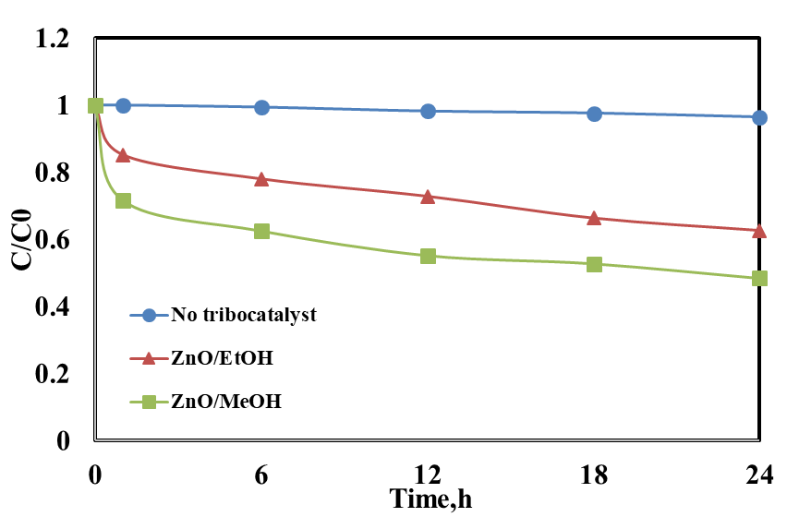
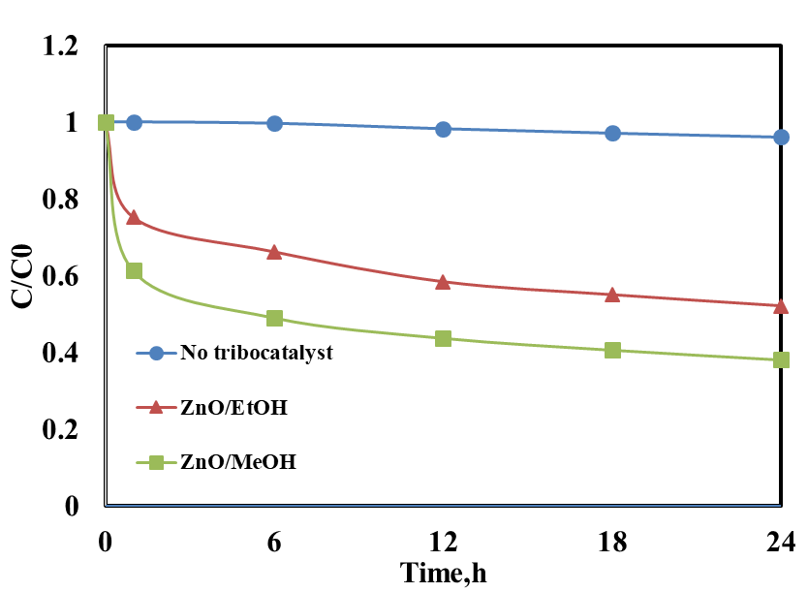
Effect of Stirring Speed (100, 300 and 500 rpm)
a)
b)
c)
500 rpm > 300 rpm > 100 rpm
Tribocatalysis of Cephalexin using various steering speeds a)100rpm, b)300rpm, c)500rpm

Slide 13
Conclusions
In summary, by utilizing the friction energy from stirring, two distinct types of zinc oxide with different solvents are used to produce strong tribocatalysis for the breakdown of Cephalexin. The ZnO with methanol has a more developed surface with particles of different sizes and shapes, and more effective degradation. The tribocatalytic drug decomposition ratio reaches approximately 61% (in a glass beaker) and 73% (in a PTFE beaker) after the drug is agitated for 24 h at 500 rpm. According to the data, mechanical energy absorbed during friction effectively excites the electrons and holes in zinc oxide particles, leading to efficient drug breakdown. The tribocatalytic effect is a promising and eco-friendly way to use environmental mechanical energy to fight pollution. By promoting drug degradation, tribocatalysis opens up new avenues for reducing environmental contamination.

Slide 14
Acknowledgments
This project is financially supported by the Bulgarian NSF project KP-06-N89/07 (КП-06-Н89/07)

Slide 15
Thank you for your attention!

Slide 16
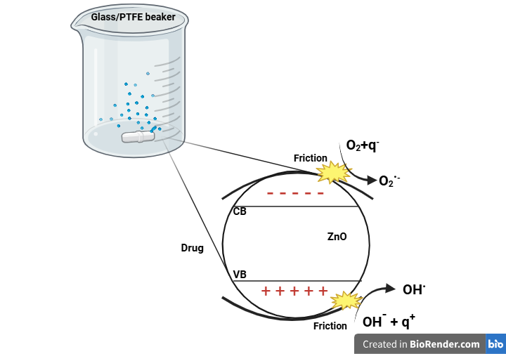
Diagram of a potential reaction mechanism for the tribocatalytic effect
+
Cephalexin
-
+
-
-
-
+
+
+
+
+
-
+
Products
q⁻, negative charge
q⁺, positive charge

Slide 17
